Slide 1
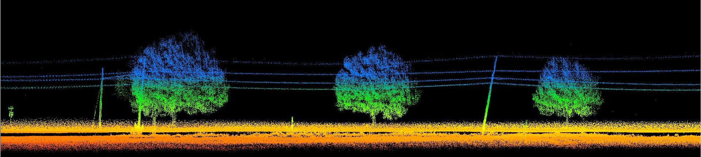
HYPACK Unmanned

Slide 2
Objectives of this session
1
2
Survey Planning for UMS
Planning a route in HYPACK
Finding your place in the world
Downloading Web Maps
Survey Acquisition for UMS
How to conduct and support unmanned surveys in HYPACK
Notes:
Stressed Water Supply
Issue
Maintain the health of traditional water sources and execute a water source diversification strategy
Solution
Xylem’s leading-edge technologies monitor, pump and treat water from all sources and enable water reuse
Aging Infrastructure
Issue
Utilities have to effectively assess and identify high-risk areas for repair/replacement before problems occur
Solution
Xylem’s intelligent pipeline and critical infrastructure services perform condition assessment, identify defective assets, provide bypass services and replacement technologies, reduce or eliminate combined sewer overflows and leaks/non-revenue water
Stormwater & Flooding
Issue
Significant increase in severe weather patterns is causing flooding and related damages to communities
Solution
Xylem’s flood management solutions include sensors for early warnings, dewatering for disaster response, communications for recovery and submersible pumping for resilient infrastructure
Regulatory Compliance
Issue
Utilities must successfully comply with a growing body of compliance regulations
Solution
Xylem’s analytics and sensors evaluate a broad range of water quality parameters, and our technologies treat water and wastewater to meet regulatory standards
Non-Revenue Water
Issue
Utilities have an important opportunity to reduce persistent and costly water losses from leaks and faulty meter readings
Solution
Xylem’s broad portfolio of solutions monitors for, and identifies, water leaks, as well as faulty meters. Our communications network enables point-to-multipoint communications throughout the system
Operating Strategy Reducing Costs
Issue
Utilities want to lower operating and energy costs, and leverage new revenue opportunities
Solution
Xylem offers industry-leading pumping and treatment solutions for energy efficiency, and software-enabled solutions to optimize operations and identify revenue opportunities

Slide 3
Survey planning for autonomous vehicles

Slide 4
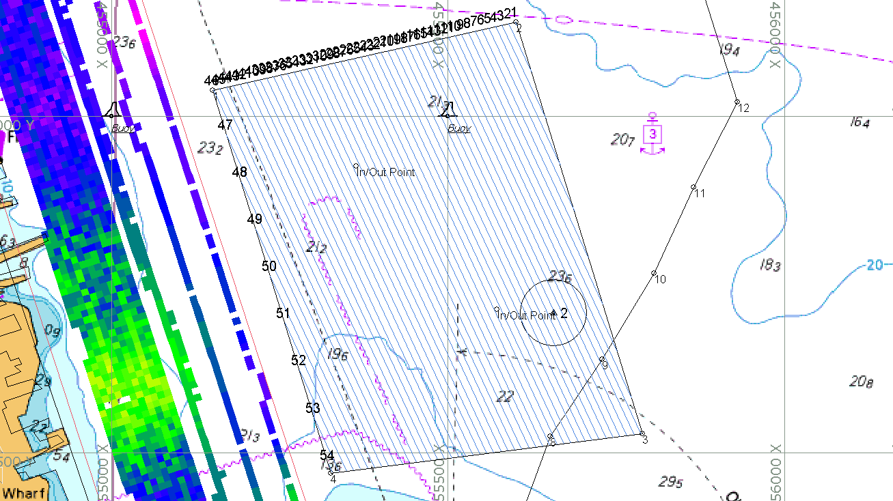
Mission Planning
Plan autonomous mission in HYPACK shell using
Line Editor
Border Editor
Outputs are available for common Autopilot formats
MAVLink
GPX
MOOS-IvP BHV
Teledyne ZRP

Slide 5
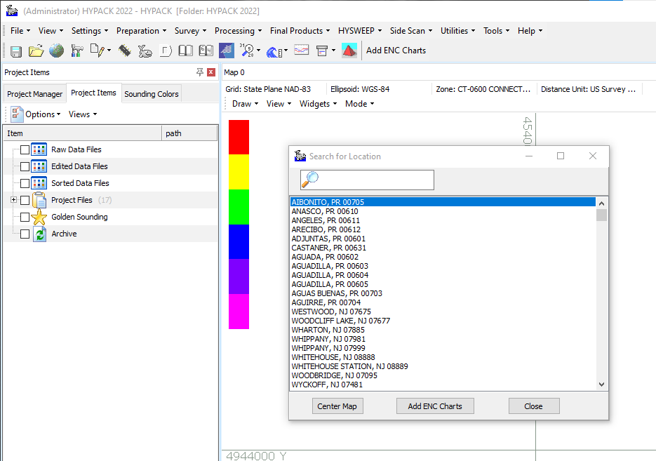
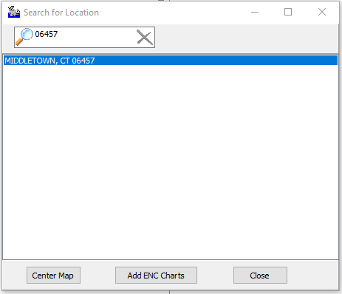
Finding your location by Zip Code
HYPACK allows the user to search a location based upon a zip code or city name.
In this example we will find the pond at HYPACK and survey it.
Enter the Zip code and select the location, then select Center Map.

Slide 6
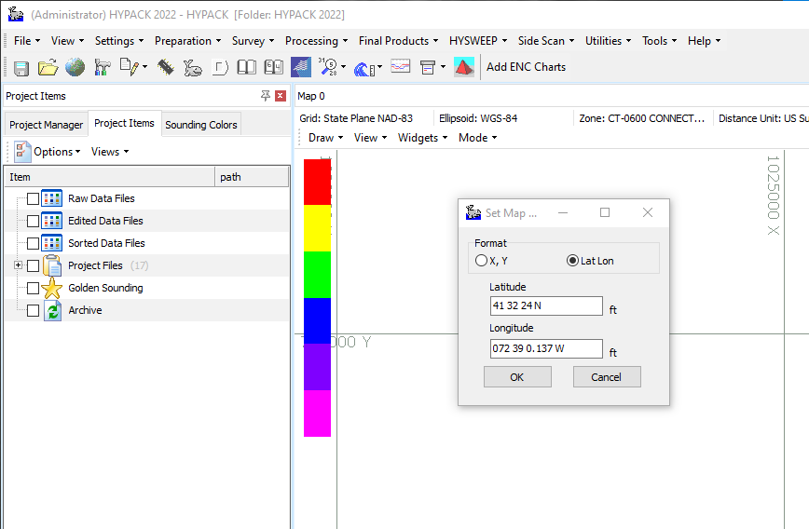
Center the Map on a known location
Using the View Menu on the map, select GoToPosition and enter the coordinate in either XY or Lat/Lon.
This will center the map on the location.

Slide 7
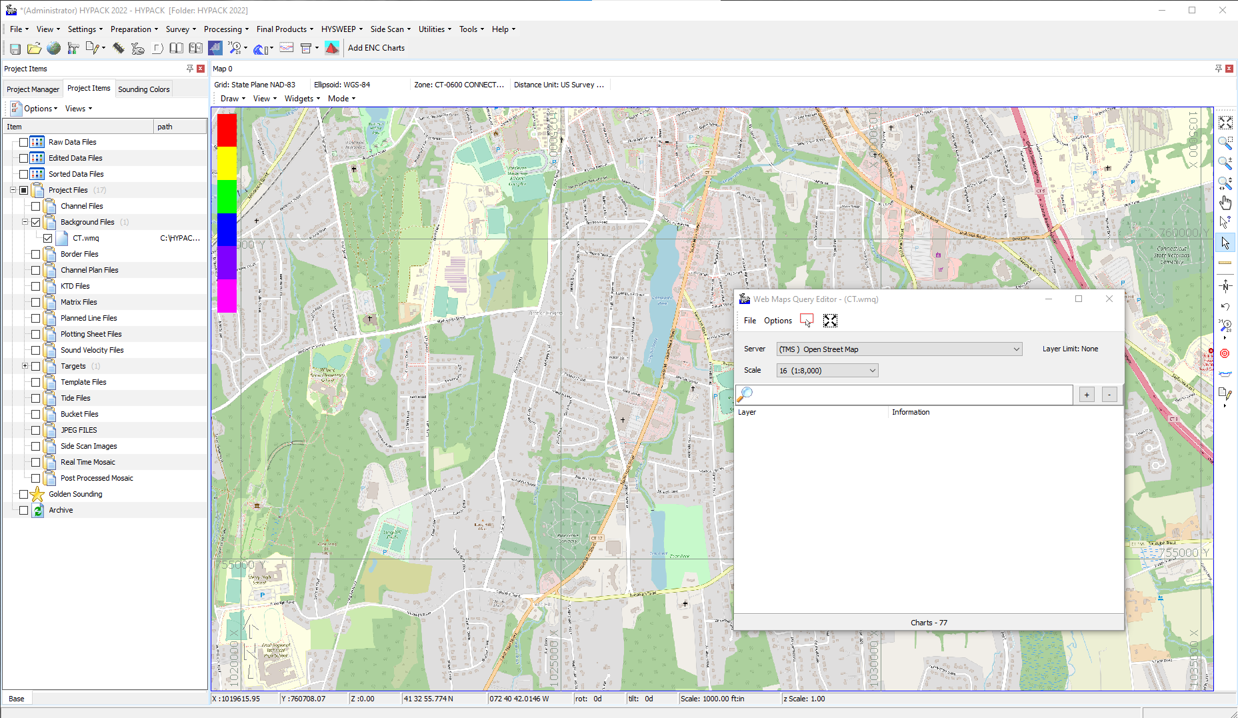
Download the Charts
Here the WMS Server for Open Street Maps was used to download the area around Middletown.
In the Preparation – Editor menu item is the Web Maps Editor. This dialog allows the user the ability to
At the bottom there is a number of charts that this resolution will download.

Slide 8
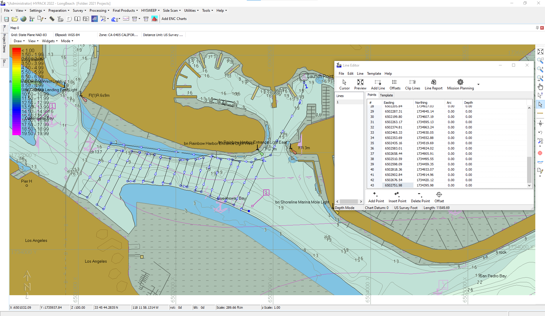
Manual Waypoint Creation
The Line Editor allows the user to pick each waypoint and draw the route that the vehicle will follow.
In the Line Editor the length of lines is shown so that the user can monitor the length of the mission.
Using the Cursor does not snap a line parallel to a prior lane.

Slide 9
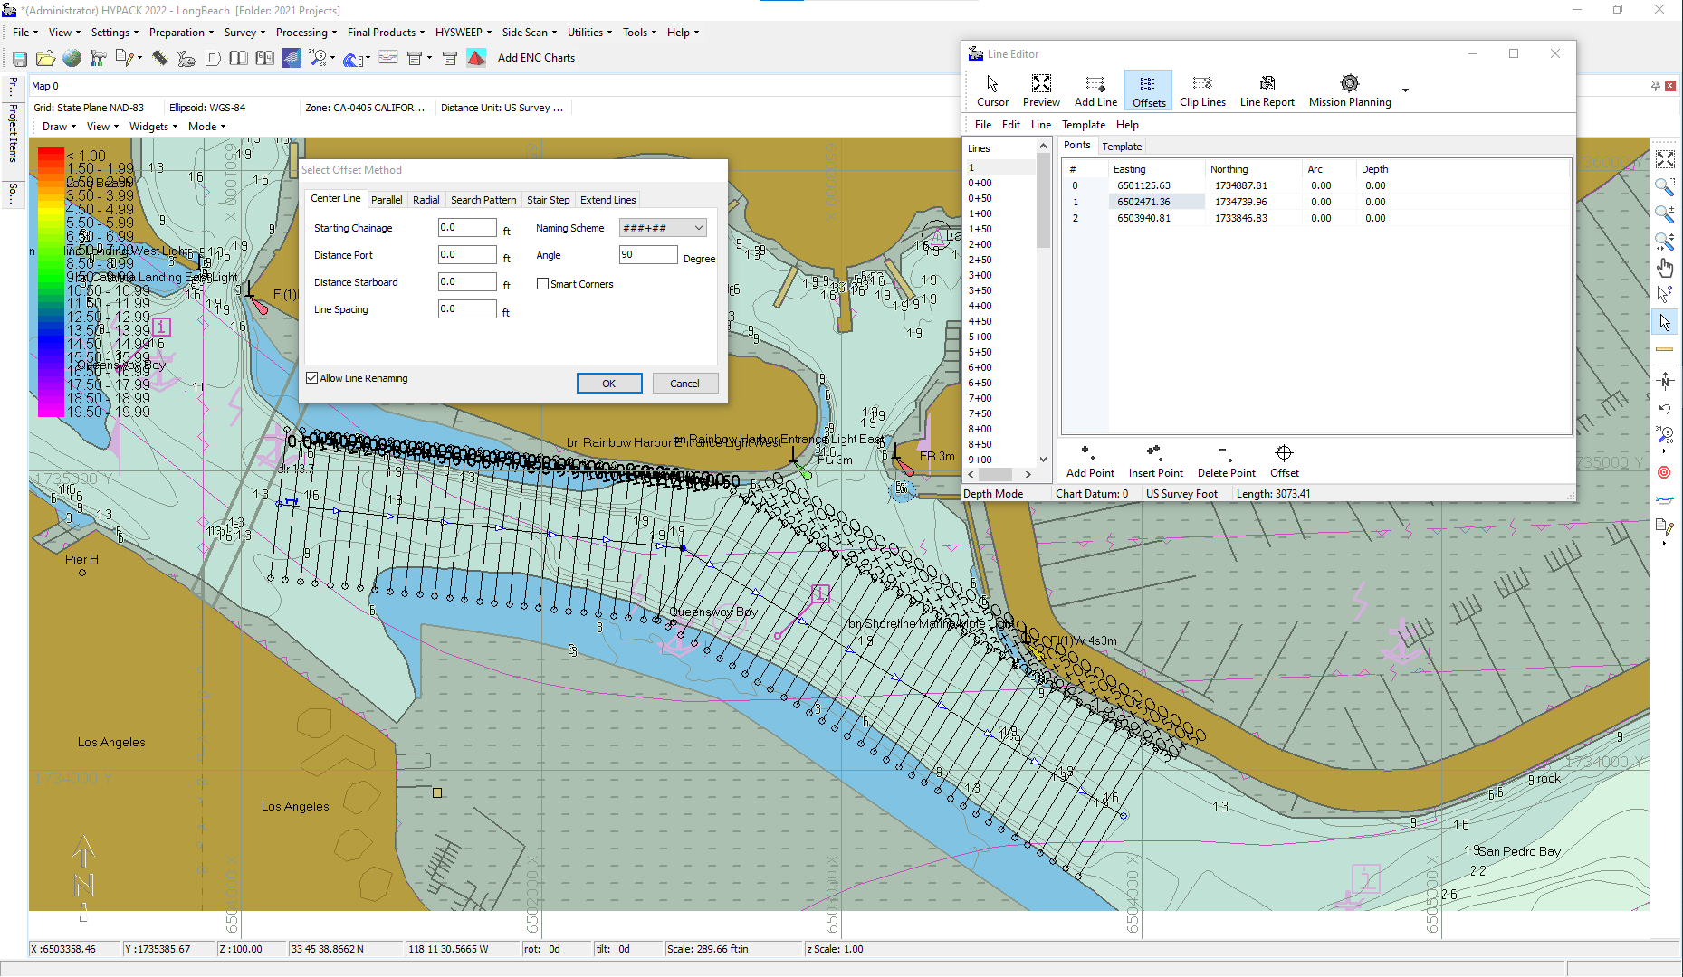
Mission Planning with Centerline Offsets
The Centerline offsets will create very good parallel lines.
The planned lines can extend into areas that are not safe to survey.
The cursor can be used to move end points to safe water.

Slide 10
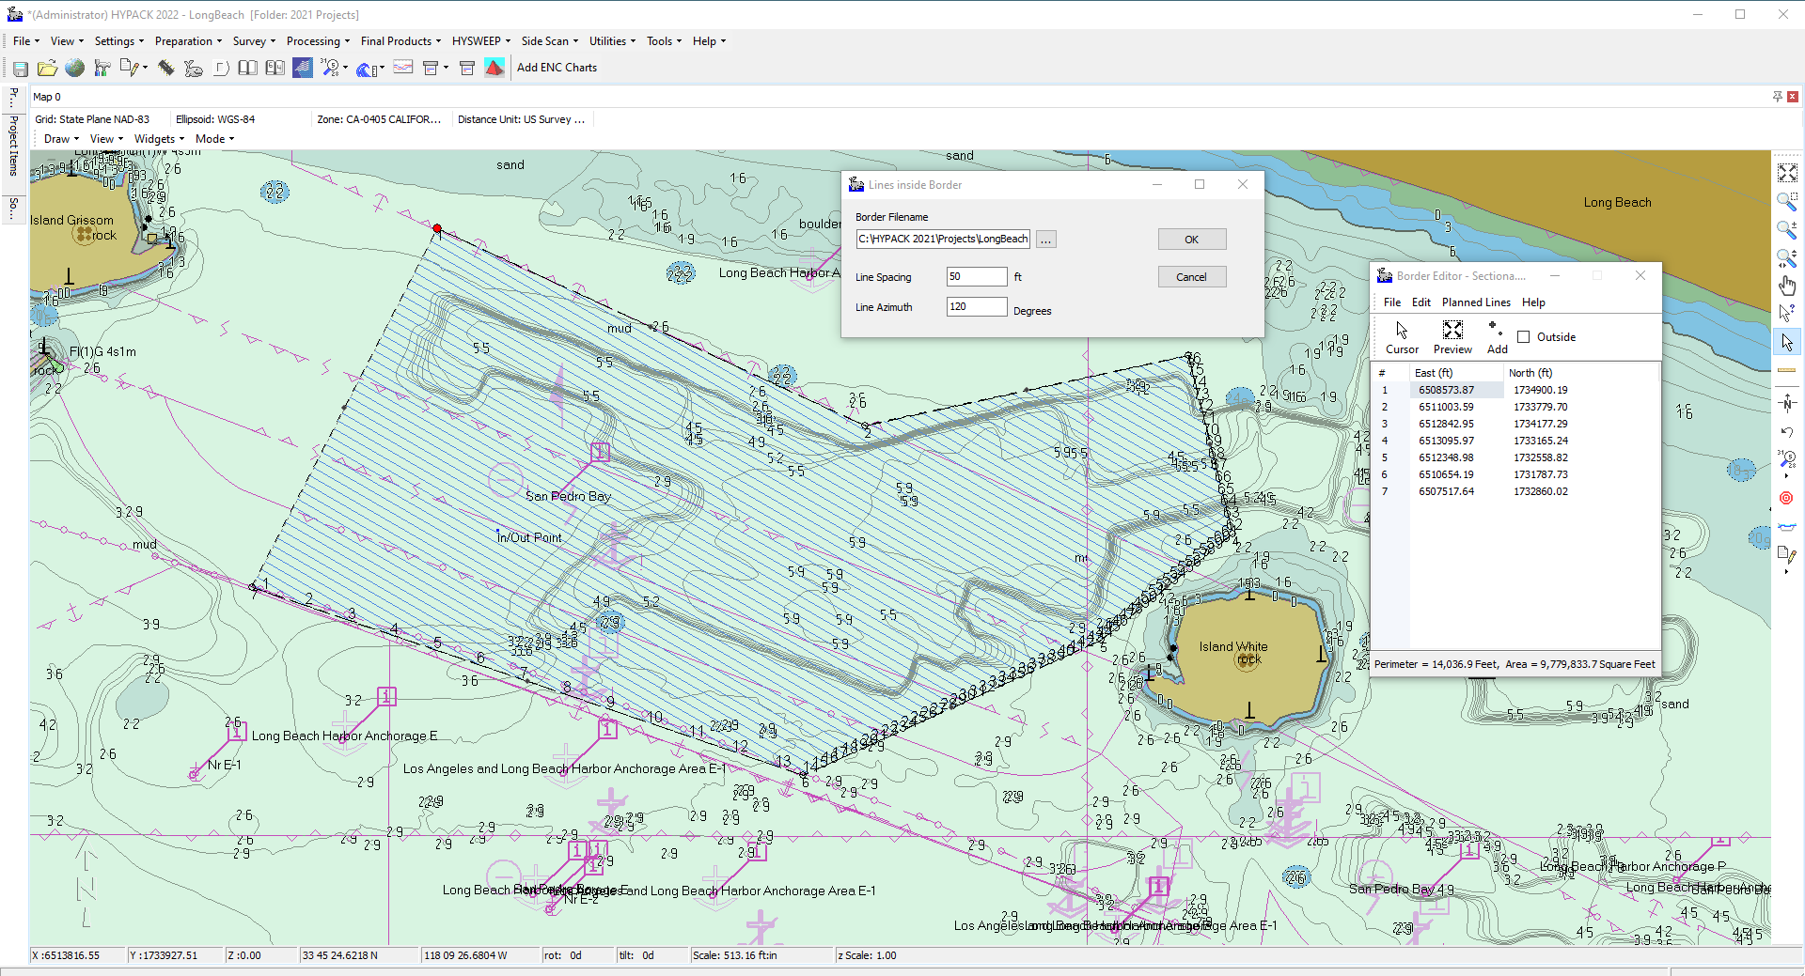
Planning a Mission with the Border
Using the Border Editor a series of lanes can be generated within a boundary.
The user controls the spacing and direction of the lanes.
Once the plan is in place the Line File is opened in the Planned Line Editor and exported to the Autonomous format required.

Slide 11
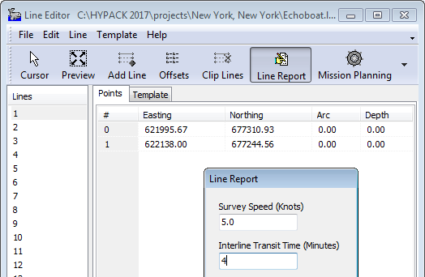
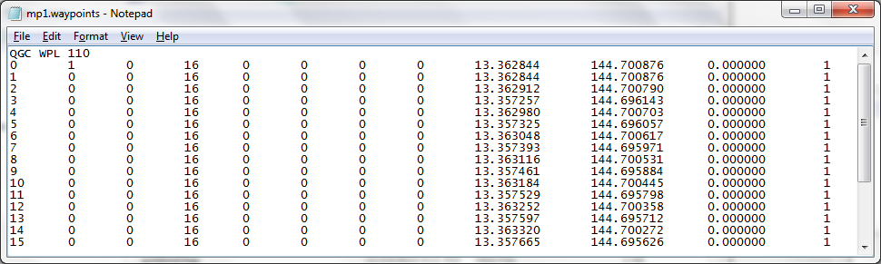
Mission Planning
Upload mission directly or export mission plan in 3rd party/proprietary format.
Can import GPX and Mavlink formats in Mission Planning, can export GPX, MAVlink, MOOS-IvP BHV, Teledyne ZRP
Line report gives you a time estimate based on line distance and input survey speed

Slide 12
Survey acquisition for autonomous vehicles

Slide 13
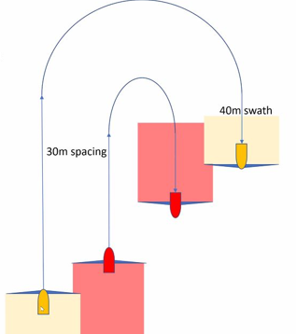
Using Coverage Driver to Track Multiple Vehicles
This example shows two vessels surveying together.
Using the device interfaces available in HYPACK it is possible to share the location between versions of the software running on a network.
Logging status can be synchronized using a device interface Remote Log Line.

Slide 14
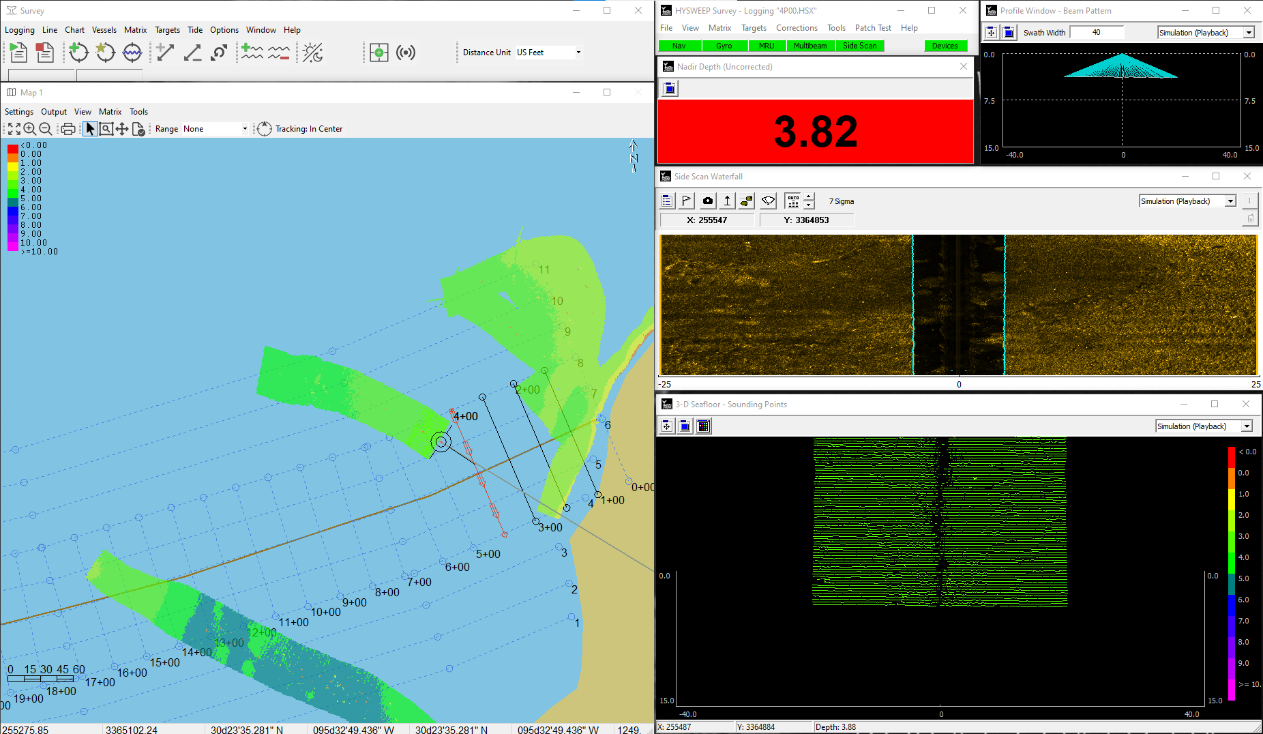
Use of a Matrix to Show Data Coverage
Matrix files are a good way to show the coverage based upon depth values.
The real-time display allows the user the ability to efficiently survey the area allowing full coverage.

Slide 15
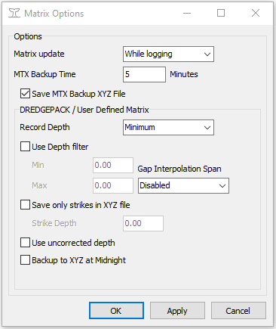
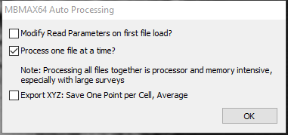
New Near Real-Time Export for Data
Additions were made recently to support the saving of XYZ data in near real-time for Machine Learning.
If the MBMAX64 Editor is open in Auto Processing mode, the ability to save an XYZ for each lane exists.
In the SURVEY program, under the Matrix Options an XYZ of the matrix can be saved at the time of the Matrix Backup. This works with a defined matrix and not the auto matrix option.

