Slide 1
DREDGEPACK Operation

Slide 2
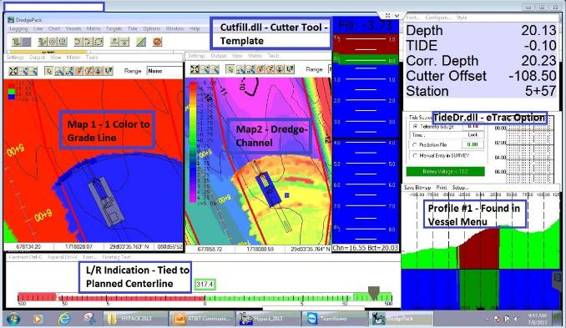
Cutter Dredge Example
In this example
The maps have different colors associated with the matrix
A Planned Line is used as a guide
The Cut/Fill tool is being used to assist the operator in making grade

Slide 3
Using Channel – Dredge to show where to dig
This is a 3D representation of a dredge cut. In this image the Channel and Stations are in Grey.
The Template depth is 20 feet and the area in Black is everything below 20 feet.
If the channel is not displayed, the operator may dredge outside of the limits of the project

Slide 4
Matrix Options
This matrix is filled with the pre-dredge survey data. Using Stop Light Colors, Green indicates dredge here, Yellow indicates near grade and Red indicates at grade. Black in this display indicates below grade so the operator knows grade has been met.
The darker the green, the more material there is to remove to reach the desired depth of 20 feet.
The top image shows depth versus color.
The second image shows Channel – Dredge, everything BLACK is already below grade.

Slide 5
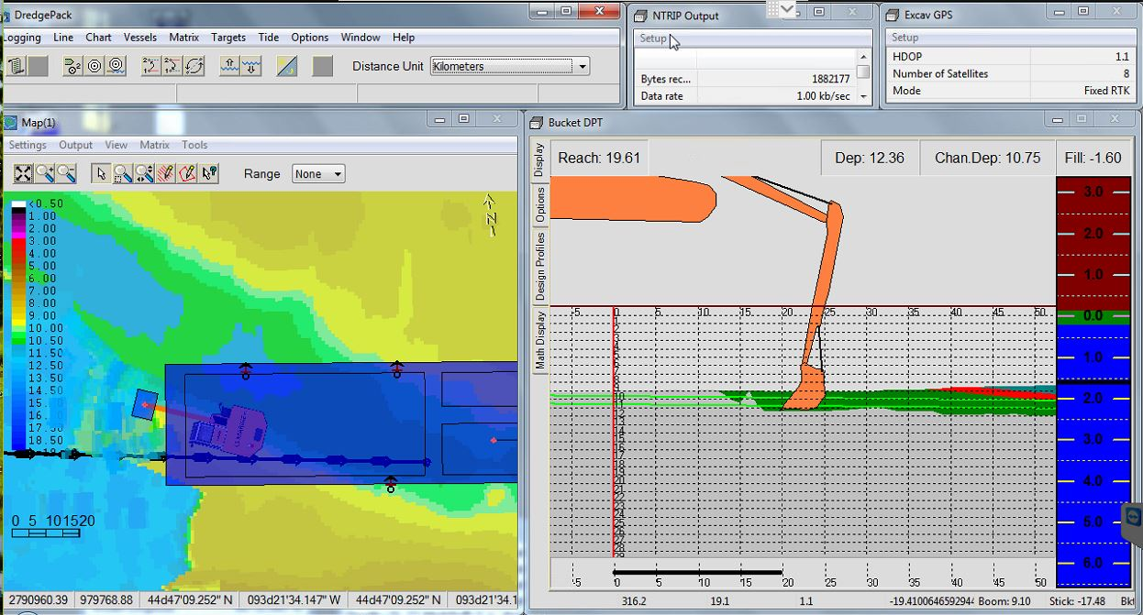
Excavators
Cut/Fill bar is integrated to the Excavator Interface

Slide 6
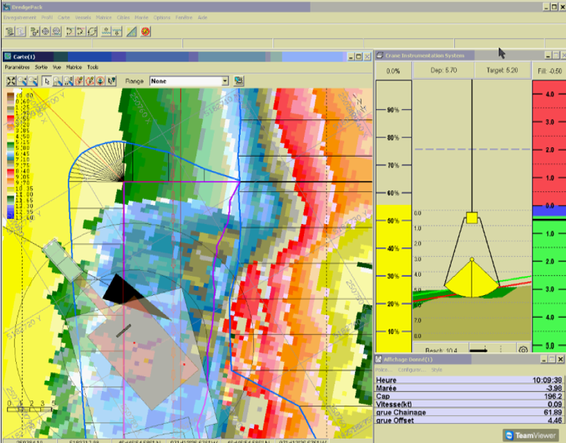
Mechanical Cranes
In this example
The Cut/Fill bar is integrated not the Mechanical DQM driver
There is an additional Percent Volume bar that can be enabled and will use Matrix update to calculate the estimated amount of material in the bucket
A channel is enabled with over depth limits displayed in the profile as a red line

Slide 7
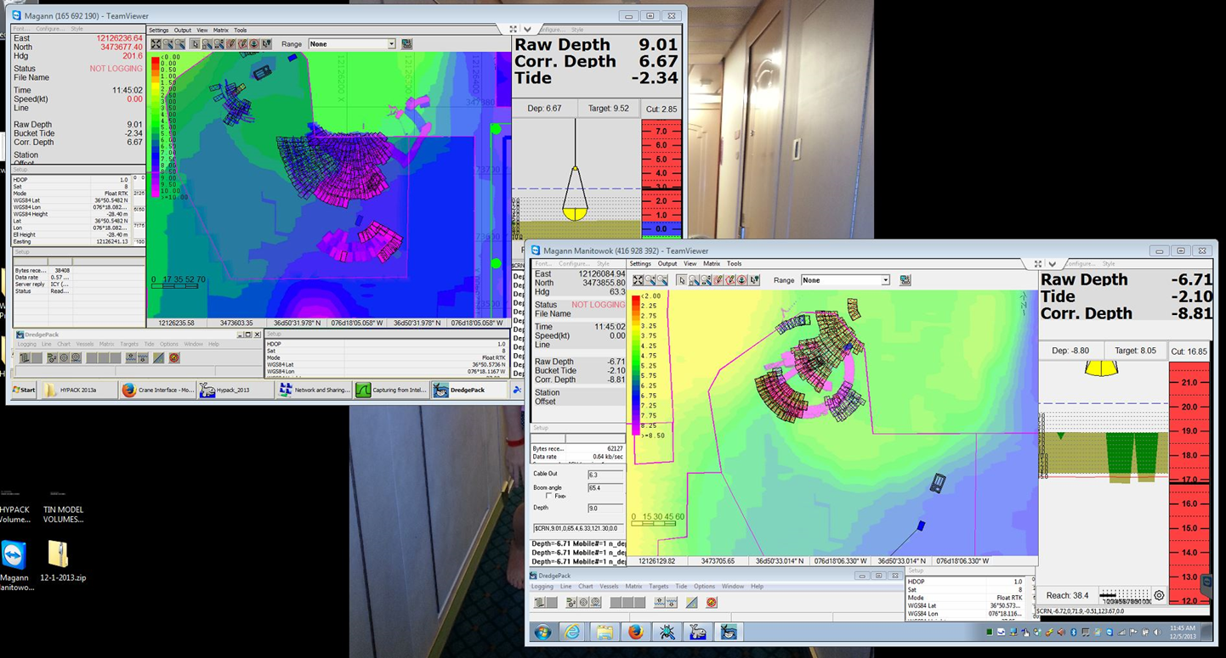
Wireless System Connecting Two Dredges
Using the Wireless system, it is possible to connect two dredges on a project and have them both update the matrix.
Each HYPACK / DREDGEPACK system on the network can receive the others
This works with Survey vessels on the network as well

Slide 8
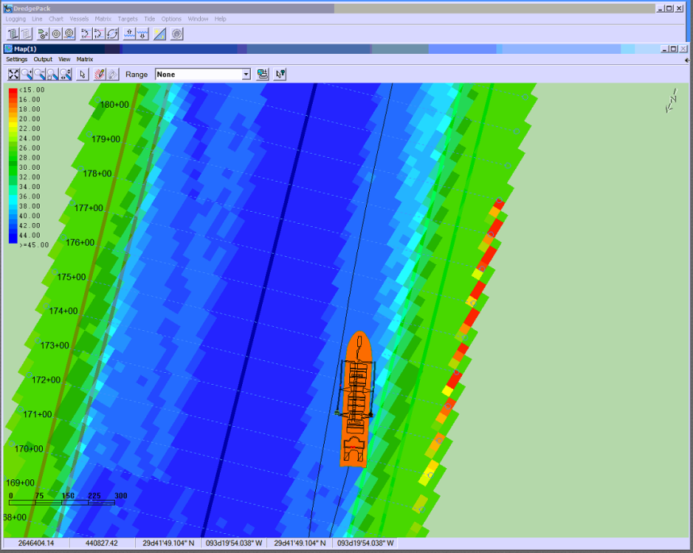
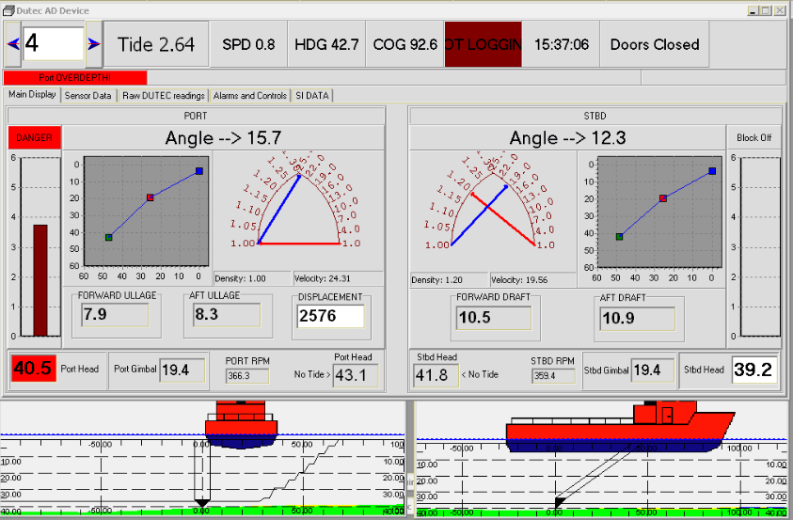
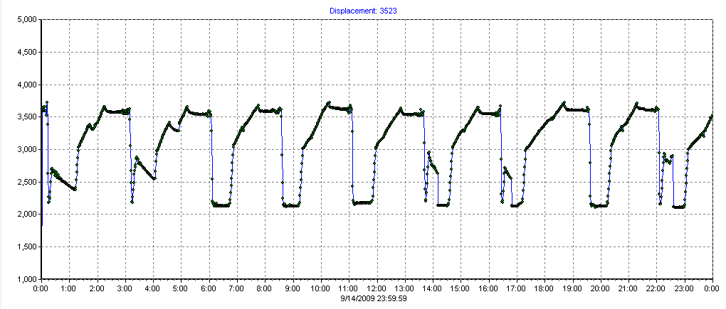
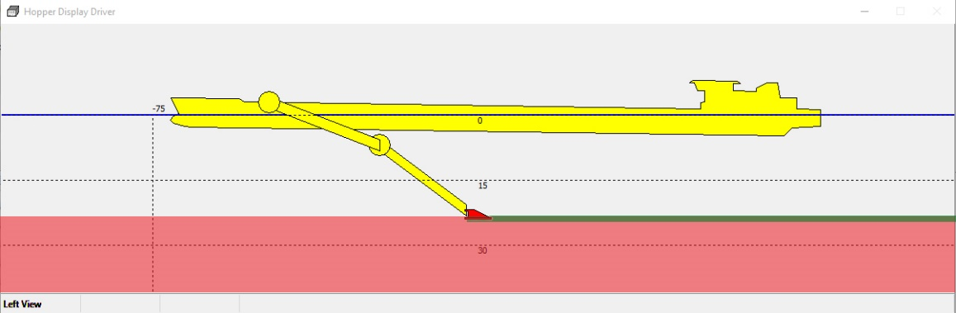
Hopper Dredges
Typical Hopper Display Windows
Custom Interfacing in most cases to the hardware.
Standard set of displays once the system is integrated.
Custom device displays

Slide 9
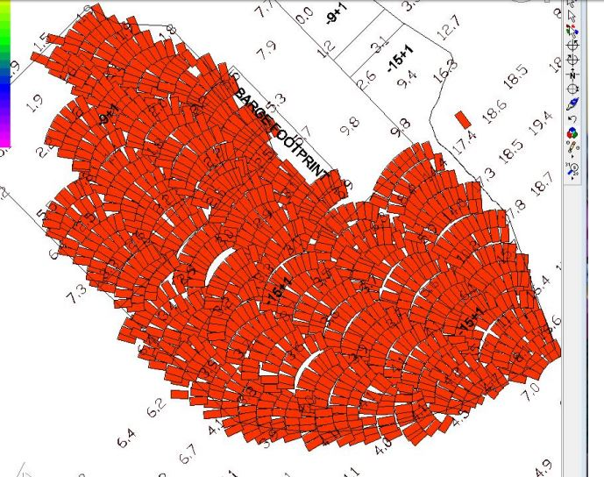
BUCKET DIGGING & CAPPING
In DREDGEPACK® the operator can track the location of bucket ‘digs’ or ‘placements’.
Each day DREDGEPACK® creates a file to store the day’s buckets. This allows:
  Easy determination of the area dredged in any period of time.
  The ability to disable unnecessary data to clear the screen.

Slide 10
Marking a Bucket Position
Currently the F3 key on the Keyboard or a special switch is used to mark the bucket position.
  Pressing F3 on the Keyboard places a bucket at the location defined in the Bucket Parameters window.
  Crane controller can be connected to a bucket switch and sends the marks directly to DREDGEPACK.
  Bucket File (*.BKT) Format
    Dredge T
    454306.51 4945419.34 57.80 121.48 10.00 30.00 51495
    454334.50 4945397.89 58.30 124.85 10.00 30.00 51500
    454406.94 4945350.17 59.80 124.21 10.00 30.00 51508
The header will be either "Dredge T" or "Capping T", depending on mode selected in DREDGEPACK ( under Options - Bucket Parameters).
Bucket Info contains values that are space delimited. The format is as follows:
[Easting] [Northing] [Depth] [Heading] [Length] [Width] [Time in Seconds]

Slide 11
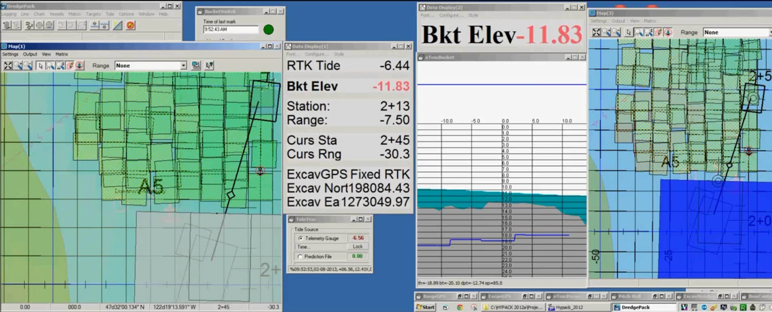
Bucket Pitch and Roll

Slide 12
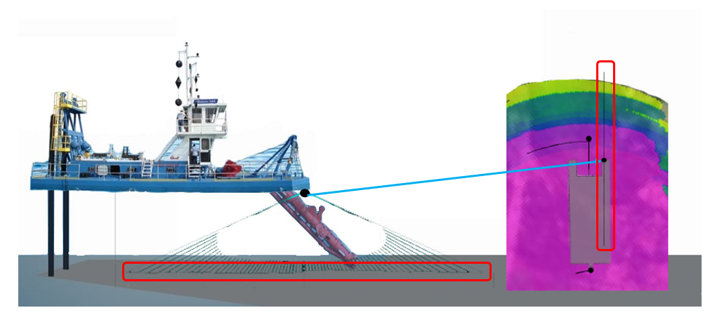
Using a MBES sensor on a dredge
Requires a HYSWEEP License
Any integrated MBES sensor HYPACK Supports can be used
Dredge Sensor will update the deepest point and the MBES the last reading

Slide 13
Creating an Exclusion ( Danger ) Area
Occasionally you want to know when a vessel is approaching an exclusion area. To handle this, there is a driver named Borderchk.dll.
If your vessel is on the wrong side of the boundary
(based on the Border In/Out point) the Border Check driver will alarm when you are within a preset distance of a border.
Dredge nearing border
Dredge violating border

Slide 14
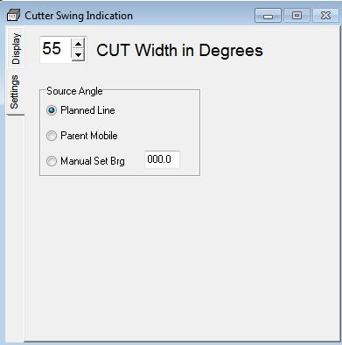
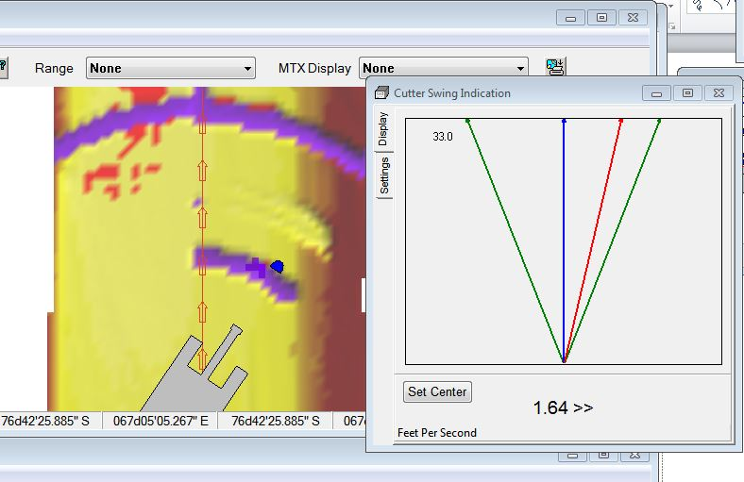

Using the SwingInd.dll
Measures angle of cutter tool relative to
  Planned Survey Line (*.LNW)
  Parent Mobile – Another Vessel
  Manually set bearing
Cut width is a set of predefined angled lines to keep operator within the confines of the digging plan
Speed can be expressed in:
  Feet per Second
  Feet per Minute
Gives the operator a sense on how fast the cutter is moving through the material
  Typically good dredge managers will have calculated a optimal swing speed given the type of material and the amount of material to be dredged to grade and # of passes.

