Slide 1
DREDGEPACK – Preparation

Slide 2
Objectives of this session
1
2
3
DREDGEPACK Background
Types of Dredges supported
Playback
3d Dredging
Geodesy and RTK
Datum, what is it
RTK Versus Tide Gauge
RTK Measurements
Typical HARDWARE Configuration
Dual Antenna GPS
RTK GPS
Angle Sensors
Tide Gauges
4
5
6
Design Profiles
Digging Plans
Boat Profile Window
Channel Design
Advanced Channel Design
Matrix Files
What is a Matrix File
Use of Matrix files in DREDGEPACK
Planned Lines
Planned Line Basics
Line Editor
Notes:
Stressed Water Supply
Issue
Maintain the health of traditional water sources and execute a water source diversification strategy
Solution
Xylem’s leading-edge technologies monitor, pump and treat water from all sources and enable water reuse
Aging Infrastructure
Issue
Utilities have to effectively assess and identify high-risk areas for repair/replacement before problems occur
Solution
Xylem’s intelligent pipeline and critical infrastructure services perform condition assessment, identify defective assets, provide bypass services and replacement technologies, reduce or eliminate combined sewer overflows and leaks/non-revenue water
Stormwater & Flooding
Issue
Significant increase in severe weather patterns is causing flooding and related damages to communities
Solution
Xylem’s flood management solutions include sensors for early warnings, dewatering for disaster response, communications for recovery and submersible pumping for resilient infrastructure
Regulatory Compliance
Issue
Utilities must successfully comply with a growing body of compliance regulations
Solution
Xylem’s analytics and sensors evaluate a broad range of water quality parameters, and our technologies treat water and wastewater to meet regulatory standards
Non-Revenue Water
Issue
Utilities have an important opportunity to reduce persistent and costly water losses from leaks and faulty meter readings
Solution
Xylem’s broad portfolio of solutions monitors for, and identifies, water leaks, as well as faulty meters. Our communications network enables point-to-multipoint communications throughout the system
Operating Strategy Reducing Costs
Issue
Utilities want to lower operating and energy costs, and leverage new revenue opportunities
Solution
Xylem offers industry-leading pumping and treatment solutions for energy efficiency, and software-enabled solutions to optimize operations and identify revenue opportunities

Slide 3
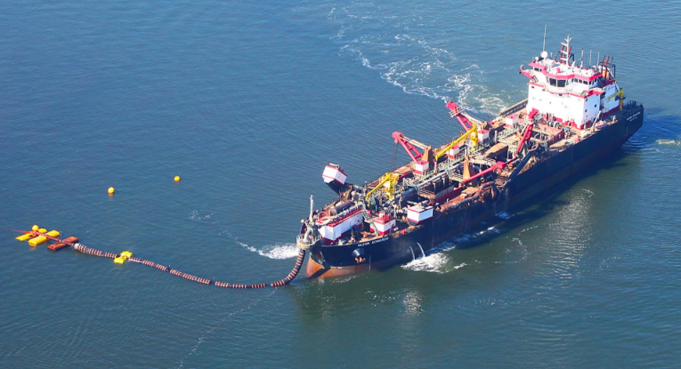
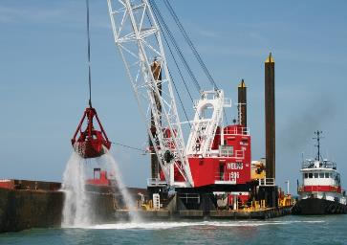
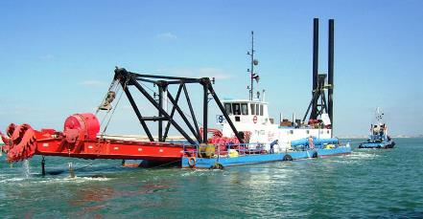
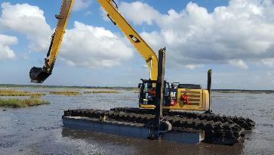
Discussion – Type of Dredges
DREDGEPACK works with all types of dredges and supports the USACE DQM program
Notes:
DREDGEPACK has been designed to show the operator the information required to dredge efficiently. DREDGEPACK can be used on all types of dredges, including the ones you see here. Top left is a hopper dredge, top right is a crane, bottom left is a cutter suction dredge and the last one is an excavator

Slide 4
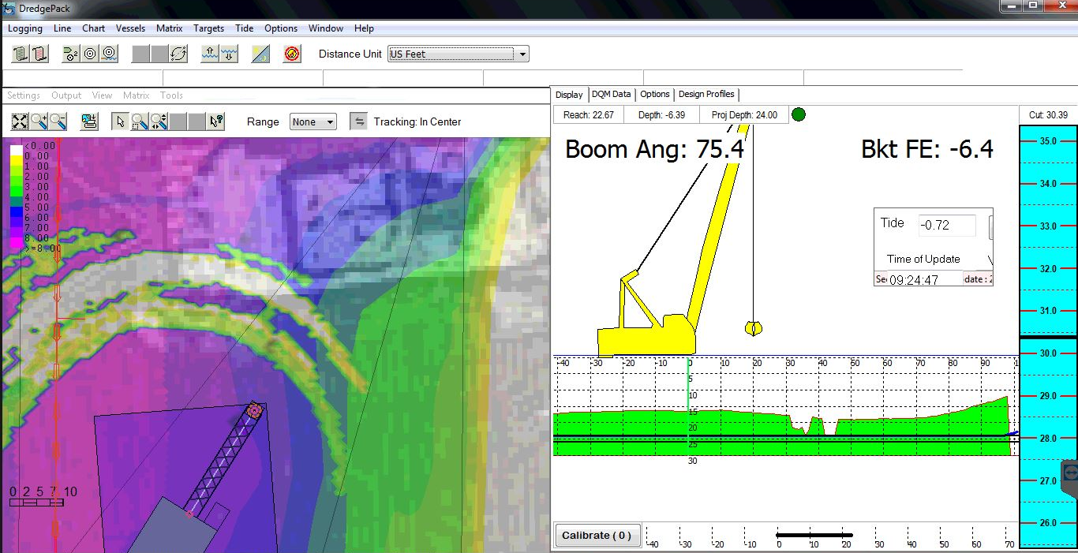
DREDGEPACK
Notes:
On this screen you can see the crane system displayed. There is a cut/fill bar on the right to show the operator when the bucket has reached the required depth. In the profile window you can see the template and allowable over depth. On the map the color filled matrix is displayed showing the depth of the material remaining.

Slide 5
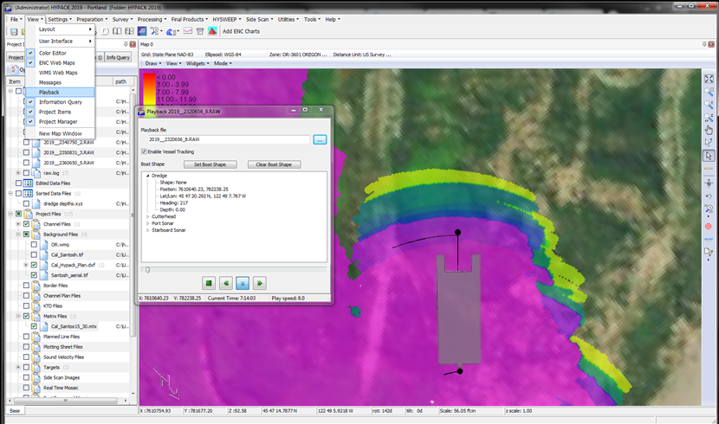
DREDGEPACK PLAYBACK
Requires that the RAW files are recorded during dredging.
All mobiles are played back in the shell.
If the RAW files are recorded it is possible to replay the dredge location in Fast forward and show where dredging took place.
Notes:
Last year a new feature was added to the software, the playback option in the shell. Using this option the tracks of the dredge can be replayed in the shell as long as the dredge was recording while operating. The Playback feature allows for fast playback similar to a video that can be sped up.

Slide 6
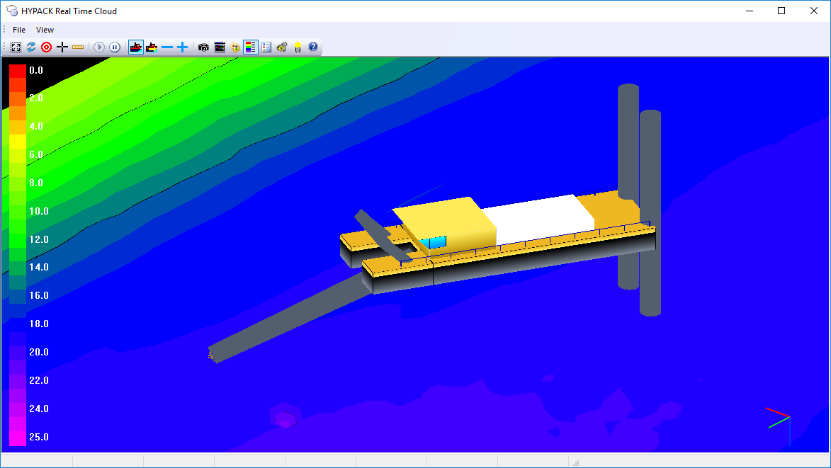
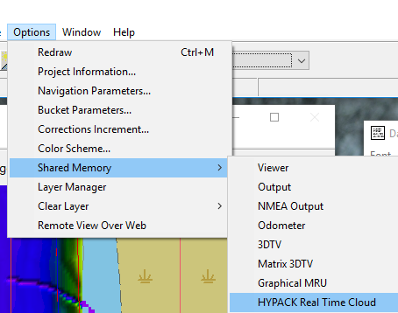
DREDGEPACK in 3D
Supports 3DS and OBJ shape files
View dredge and update matrix in real time.
Launches out of DREDGEPACK.
Notes:
In HYPACK 2021 the 3d dredging operation in the HYPACK Real Time Cloud software has been improved. In this display a Cutter Suction dredge is visible. The 3d Display allows the user to show the template allowing the operator a visual indication when the dredge as reached grade.

Slide 7
Geodesy and RTK

Slide 8
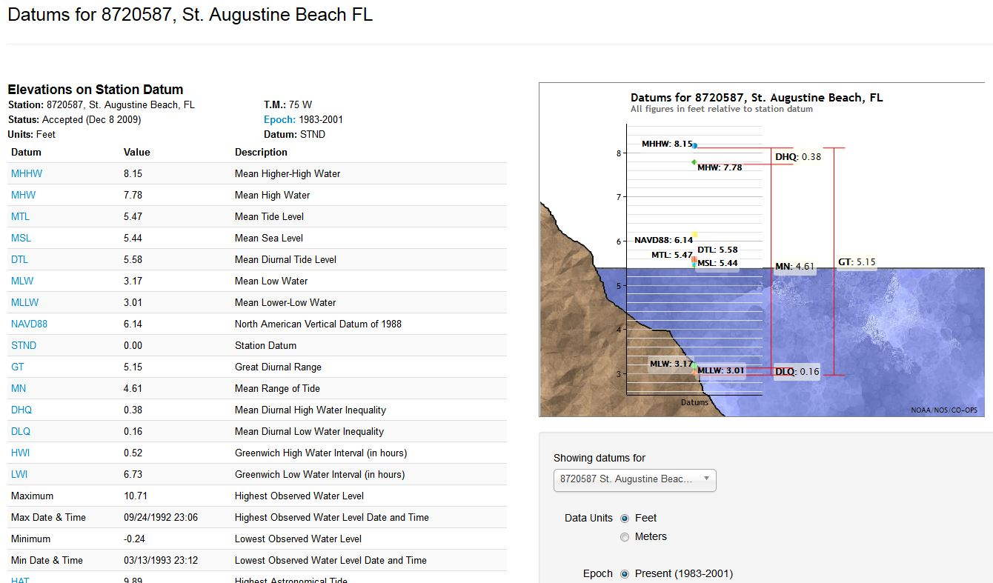
Know the Datum – Vertical Reference
The vertical reference is critical to correctly dredging a project, this is usually noted in the project specs.
DREDGEPACK does not know your vertical reference, the software understands water level or tide as referencing a 0 benchmark associated with your Datum

Slide 9
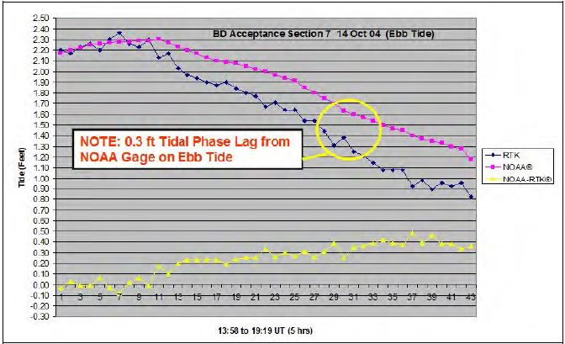
RTK versus Traditional Tide Gauge
RTK methods are especially applicable to any navigation project where tidal phase differences between the reference tide gauge and the project site are significant.
Phase difference is created when the tide gauge is not local to the project.
Five hours of water surface elevation differences between a NOAA tide gauge at Key West, FL, and RTK surface measurements, 3 miles south in the main ship channel.
This Pre-Dredge survey shows significant tidal phase differences that would be unaccounted for had only the gauge been used.
These constant phase differences (e.g., 0.3 ft) would adversely impact dredge clearance assessments and pay quantities if the NOAA gauge were used rather than the on-site RTK surface elevations.
NOTE: 0.3ft Tidal Phase Lag from NOAA Gauge on Ebb Tide

Slide 10
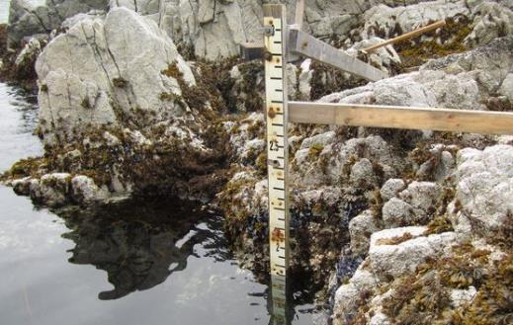
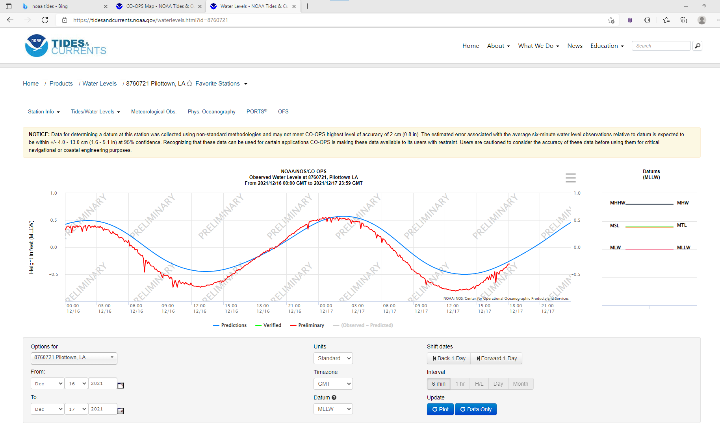
Manual Tide Gauges
Great QC check but who set them and what datum?
Enter the tide/water level in DREDGEPACK by typing in the value
Typically tide above gauge reads as + but is entered into DREDGEPACK as a -
NOAA has a website for tides:
NOAA Tides and Currents

Slide 11
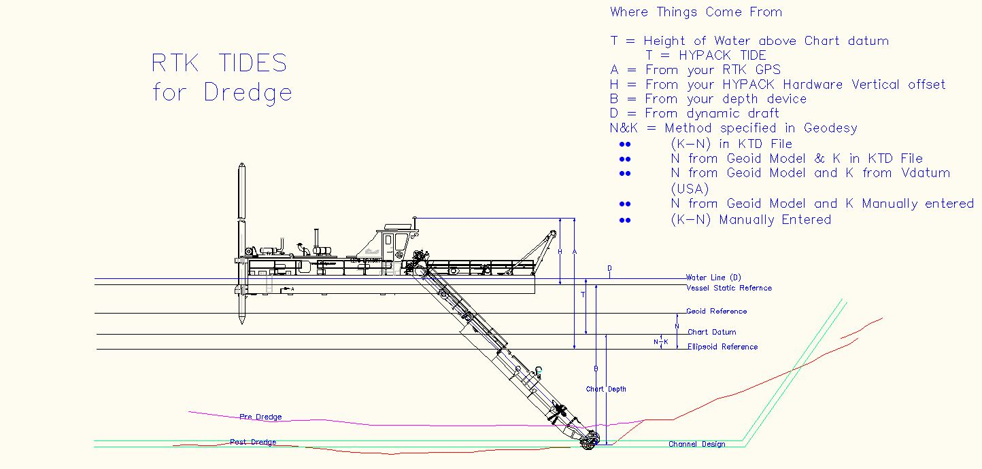
Where RTK Measurements Come From

Slide 12
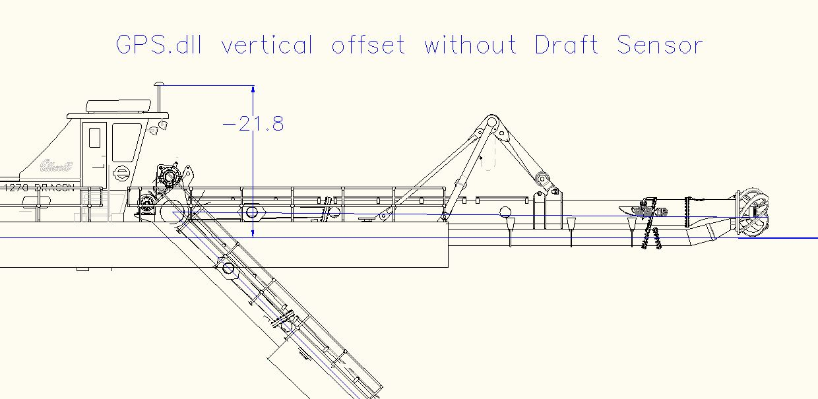
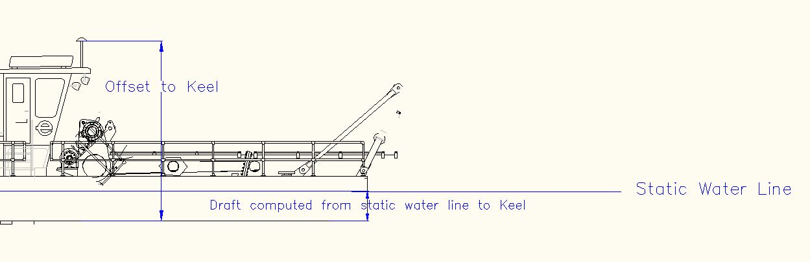
GPS Vertical Offset
Without a draft sensor the GPS Vertical reference is to the static water line.
With a draft sensor the GPS Vertical reference is to the keel.

Slide 13
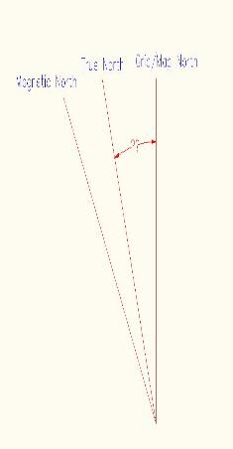
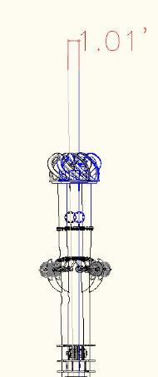
Map North vs. True North
Meridian Convergence
Map north and true heading from a compass source differ, we must compute the meridian convergence as a heading offset (Yaw for heading device).
Formula (Long Island, N.Y) :
Sin(Ref. Lat)*(Long-Central Meridian)
Sin(40.10)*(73.10-74)
0.674*-0.90
Yaw = 0.607 degrees
Assuming arm is 100’ long. Compute error of lever arm
  100*Tan(0.58)
  =1.01’
Lines of parallel at equator are more evenly spaced, the more you are to the north the more pronounced
True North
Grid North
Magnetic North

Slide 14
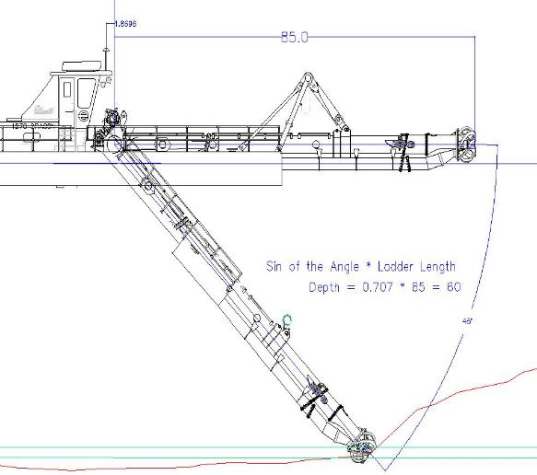
Always confirm your depth !!!
You dredge based upon calculated depth, make sure it's correct!
The best way to verify depth is to take a direct measurement at the cutter head
Lower to head to known depth and match up with what HYPACK shows in Data Display
Formula
Sin( Ladder angle in Radians) * Ladder Length

Slide 15
DREDGE HARDWARE

Slide 16
Minimum Equipment Needed
Equipment
Function
Position
  RTK GPS or DGPS
  Stand alone GPS : Forget about it! Not accurate enough
  Total Station
Depth Sensor
  Pressure Sensor – 4-20 mA Analog to Digital Converter
  Inclinometer(s)
  Cable Counter
  Bubblers
Pitch and Roll
  MRU
  Inclinometers on dual axis
Draft
  Pressure sensor / Bubbler
  Transducer
Tide
  RTK
  Tide gage
Position, Heading, Tide, Speed
RTK used on Excavators and Clamshells primarily
Depth
Pitch and Roll to correct for lever arms for RTK GPS
Dynamic draft of vessel
Water surface elevation
Notes:
Here are some of the sensors that can be used in DREDGEPACK. As a minimum the positioning source must be included. There have been cranes that used a boom tip GPS to position a bucket with no depth component for years.

Slide 17
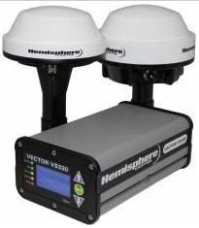
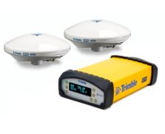

Dual Antenna GPS Systems
Trimble
Hemisphere
Leica, Topcon
There maybe others but these are the ones that we have experience with
Align GPS fore and aft or port and starboard along keel Y Frame. Perpendicular to keel.
Notes:
Dual antenna GPS units provide heading information that the dredge can use to help position the digging tool. The examples here are common GPS units that DREDGEPACK can interface with.

Slide 18
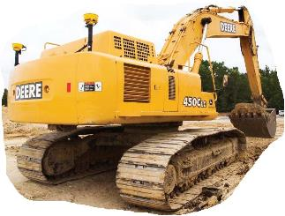
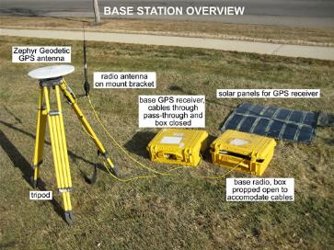
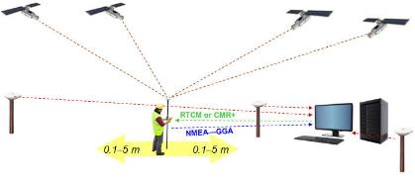
RTK GPS
Rover – gps.dll
Base station - Must know benchmark height and datum
VRS network with rover – Ntrip.dll
Notes:
RTK GPS can be used in DREDGEPACK to improve the positional accuracy of the operation. The RTK GPS is extremely useful when

Slide 19
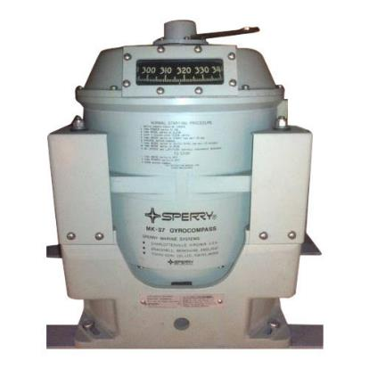
Gyro Compass
- Very accurate
- High cost
- You can use existing gyro if it has NMEA or ASCII output
- Being replaced by GPS heading
- Will take a while to acquire heading upon boot
- Has to be serviced from time to time

Slide 20
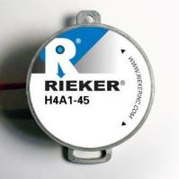
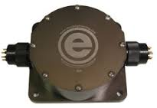
Angle Sensors
ETRAC
Gravity-based inclinometers – 360 degree range
Daisy chain or single sensor
Rieker +/- 45 degrees

Slide 21
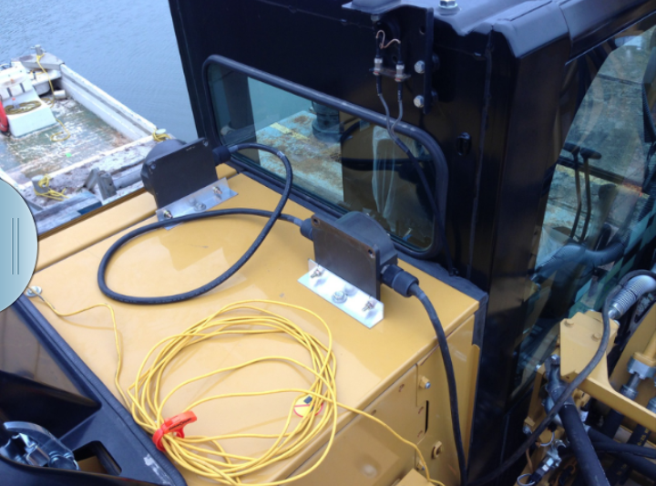
Angle Sensors for Pitch and Roll
Can use angle sensors for measuring pitch and roll to correct for water surface elevations as lever arms change.
Example here are two A2TS sensors.
A2Tsatt.dll

Slide 22
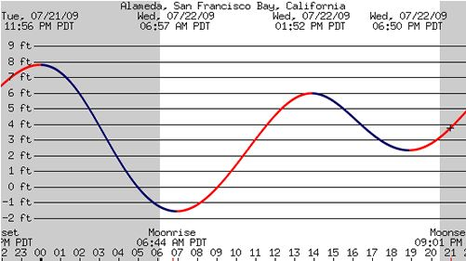
Manual Tide Gauges
Great QC check
Who set them and what datum?

Slide 23
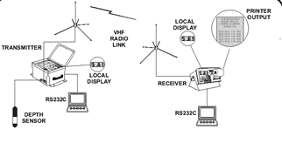
VHF Radio Tide Gauges
Herrin Design
eTrac
Valeport
Easily deployable
Can deviate if too far from job site
Needs serial connection to PC

Slide 24
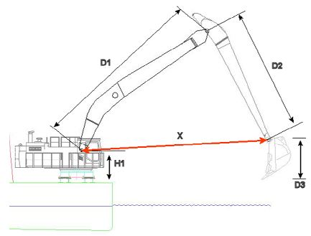
Excavator Calibration – RVG Example
When using an eTrac Sensor chain the calibration position is with the bucket teeth on the deck with bucket pin plumb with the teeth.

Slide 25
CS Dredge Hardware

Slide 26
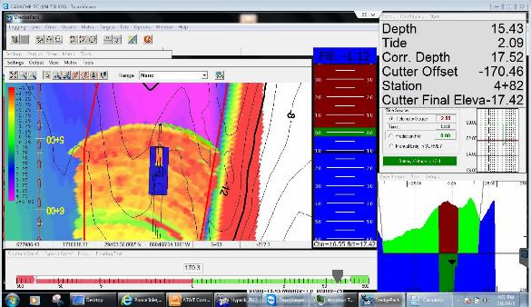
Cutter Suction Dredges
Boat
  GPS.dll
    Position, Heading, Tide
  Ais.dll
    Generates output messages.
    Receives the information from vessels that transmit position
Cutter Tool
  Inclinometer.dll
    Position, Depth, Heading
  HD25a.dll
    If it is a swinging ladder dredge then heading will differ from pontoon
  SwingInd.dll
    Gives information about swing speed of cutter and angle of swing in degrees
  Cutfill.dll
    Shows graphical information about cut/fill relative to a channel template
Spud
  Genoffset.dll
    Generate a spud position based on offset from Trunnion X,Y

Slide 27
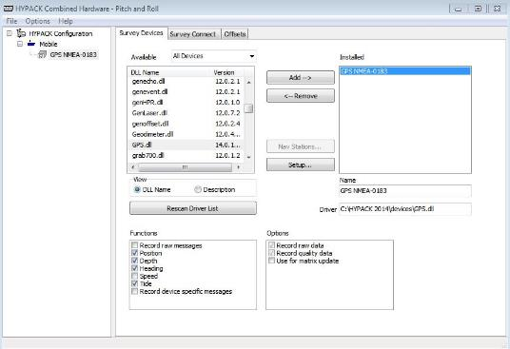
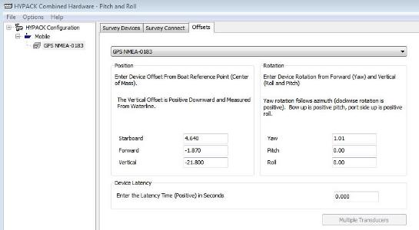
GPS.dll
Position
  Offset from Trunnion Pin for Starboard and Forward Offsets
  Vertical Offset set to Water surface or Keel if you have draft sensor
Heading
  Derived from Dual GPS system?
Tide
  Is this an RTK GPS
If there is any deviation from dual GPS antenna mounts verses the centerline of the machine, place Yaw value offset in Rotation.

Slide 28
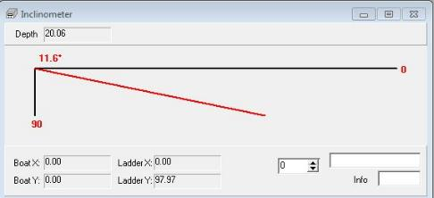
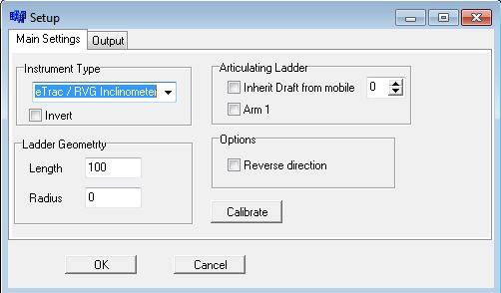
Inclinometer.dll
Inclinometer Type
Test Window
Inverts the mounting angle
Ladder Geometry
Length is cutter trunnion to end of cutter head
Radius of Cutter Tool

Slide 29
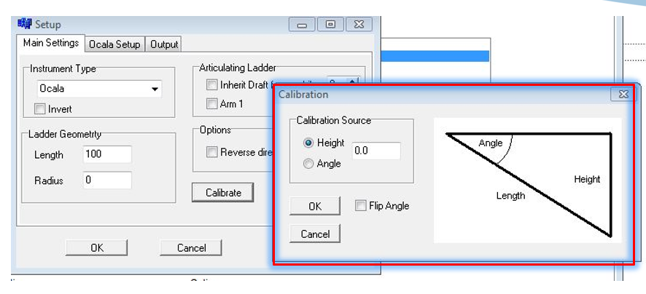
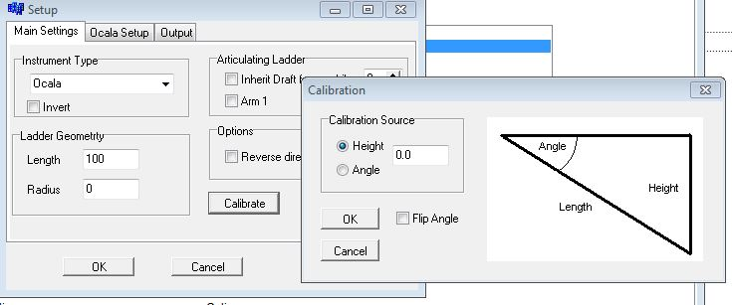
Calibration of Inclinometer
Set cutter tool to water surface and zero out the height of the cutter tool. If the tool and its calibration point cannot touch water, you can put a known offset in for the height
Angle calibration is seldom used as it takes an instrument to know angle of ladder relative to the water surface

Slide 30
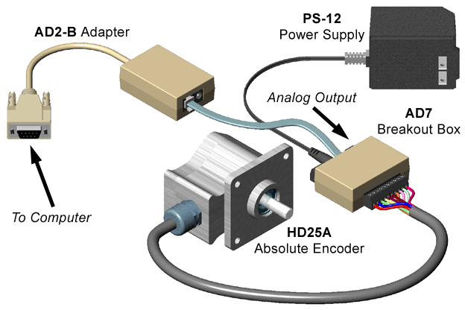
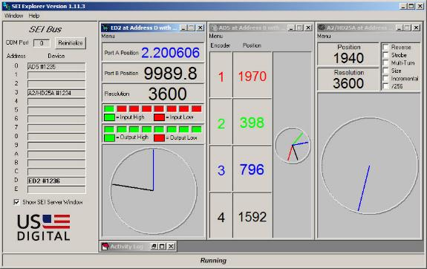
HD25a.dll - Swing Heading device
Measures swing angle of the ladder (Heading)
  Pontoon heading and arm heading are different
Calibration is done in HYPACK Hardware
  Set ladder straight and zero angle in the driver setup by typing in (0)
Heading is the only function of this device. Disable heading from other devices under the cutter mobile
Serial and USB adapters are available

Slide 31
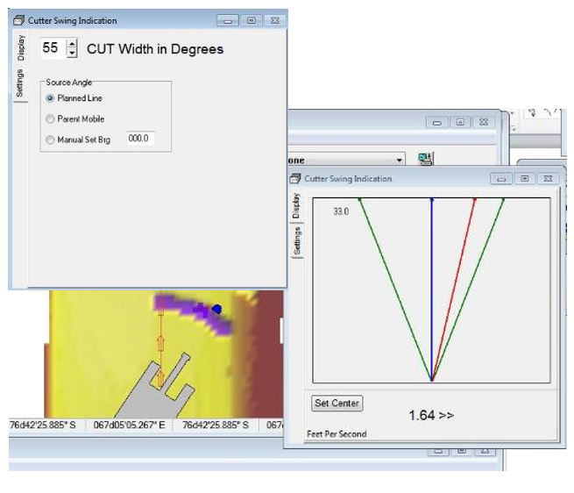
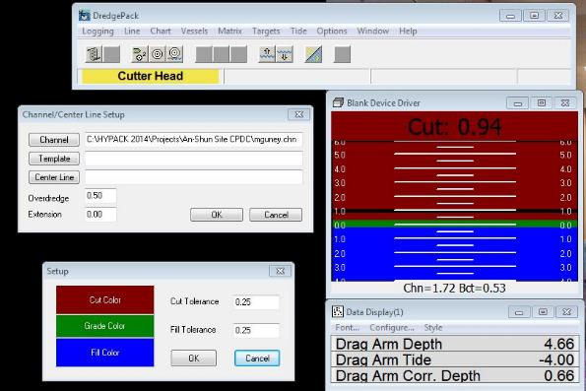
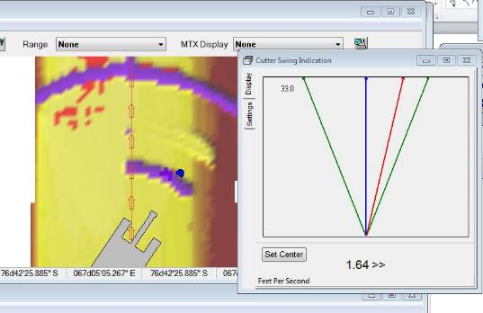
CutFill.dll
Tells the operator how much material is above or below the template in the Matrix cell that the cutter tool is over
The template that cutfill.dll references is found in Chart/Channel and can be either a .MTX or a .CHN file
A right click in the driver GUI in DREDGEPACK will give options about tolerances you are willing to give the operator and display colors

Slide 32
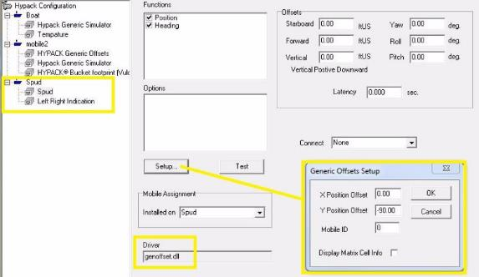
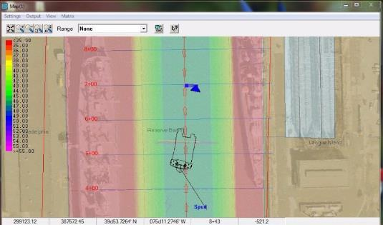
Genoffset.dll
Can be used to track just about anything on your dredge
Offsets get placed in the setup form for this driver
Left right Indicators and Station and Range in the Data display can be derived for this positions
Best way to avoid a pipeline!

Slide 33
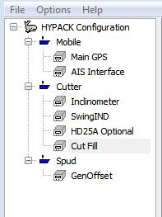
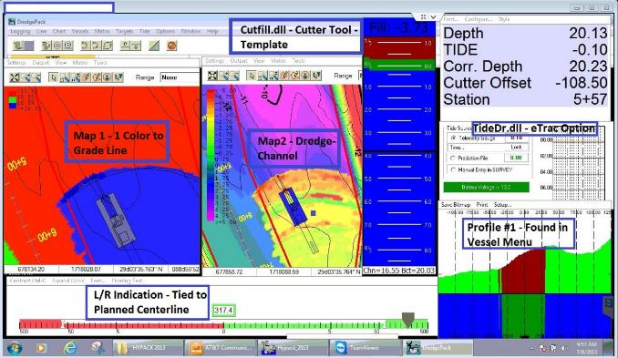
Cutter Dredge Hardware Sample

Slide 34
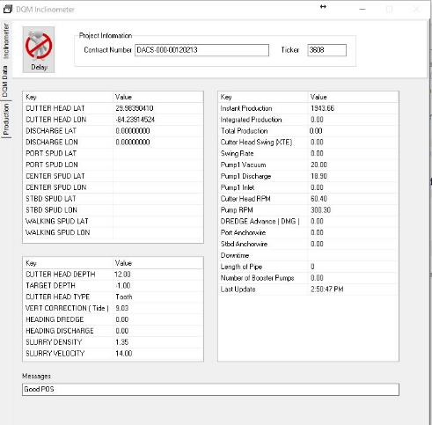
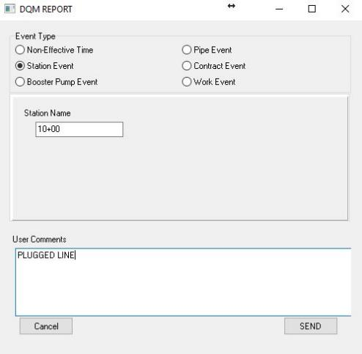
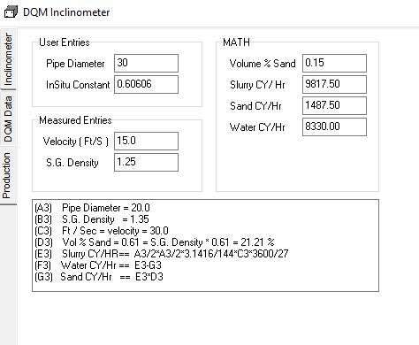
DQM Cutter Suction
SECTION 35 20 23.33
NATIONAL DREDGING QUALITY MANAGEMENT PROGRAM
PIPELINE HYDRAULIC DREDGE SPECIFICATION

Slide 35
Design Profiles

Slide 36
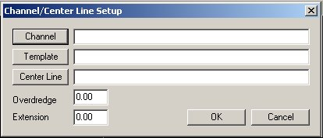


Digging Plan Options
CHN File from ADVANCED CHANNEL DESIGN
PLN File from CHANNEL DESIGN
Template (TPL)
Centerline (LNW)
Entering CHN, PLN, or TPL/LNW in DREDGEPACK®
Complex dredge plan in CHN format
Dredge plan in PLN format

Slide 37




Entering Your Digging Plan
PLN File Made in: CHANNEL DESIGN
3 Options
CHN File Made in: ACD
TPL File Made in:
CROSS SECTIONS & VOLUMES
LNW File: Centerline Only

Slide 38

Boat Profile Window
Perpendicular
  ┴ to vessel
  ┴ to line
  Arc
Parallel
  || to vessel
  || to line
Water level changes based on tide input.
Vessel rises and sinks based on draft input.
Planned Line

Slide 39


Profile Window
Activate the Profile windows from the “Vessels” window.
Inside the Profile window, click on “Setup…” to gain access to the Profile Setup window.

Slide 40

Profile Window – Direction and Orientation
Profiles:
  Perpendicular: For hopper and cutter suction dredge (most common)
  Parallel: Normally used for a hopper dredge
  Arc: For cutter suction dredges
Profile Orientation:
  Relative to vessel
  Relative to planned line
  Relative to channel centerline

Slide 41

Profile Window – Limits and Labels
Labeling - Horizontal and Vertical:
  Profile limits: Min/Max Depth or Profile Width
  Label Interval
  Tic Interval: Major tics are lines across the window
  Marks (Mark 1 & Mark 2): Lines drawn with a different color.

Slide 42


Profile Window - Colors
Choose the color for the item with the drop down
Press the “Colors” button…

Slide 43
CHANNEL DESIGN
CHANNEL DESIGN can only handle simple channels. For more complex geometry, go to ADVANCED CHANNEL DESIGN.
Left Top of Bank
Left Toe
Right Toe
Right Top of Bank
Centerline
By entering the location of the lines that define your channel:
  Left Toe Line
  Centerline
  Right Toe Line
  Side Slope Info
  Turning Basins
CHANNEL DESIGN computes where each planned line intersects these channel lines and creates a 3-D planned line file.
1
2
3
4
5
Planned Line
Plan View
1
5
2
3
4
Resulting Profile

Slide 44
The Advantages of CHANNEL DESIGN
CHANNEL DESIGN (CD) automatically makes planned lines with cross section templates.
These templates are used in:
    SURVEY: In the profile window.
    DREDGEPACK®: To display real time sections.
    SBMAX and MBMAX: To view the data against the channel design template.
    CROSS SECTIONS & VOLUMES: To compute material above or below the section.
    TIN MODEL: To compute material above or below the section (Philadelphia Method).

Slide 45
CHANNEL DESIGN: Turning Basins
TB4
The Toe List and Turning Basin list must contain the same points from where the Turning Basin departs from the Toe Line.
In the Left Toe List:
  LT1, LT2, LT3, LT4, LT5, LT6
In the Turning Basin List:
  TB1, TB2, TB3, TB4, TB5
Where:
  LT2 = TB1
  LT5 = TB5
TB3
Left Turning Basin
TB5
LT4
LT5
LT6
LT3
TB2
TB1
LT2
LT1

Slide 46

CHN Example
CHN files are used to create real time cross sections of complex areas in DREDGEPACK®.
They are also used to compute volumes over complex areas in the TIN MODEL.

Slide 47

CHN Example
CHN allows you to compute volume quantities for complex areas in the TIN MODEL.

Slide 48

CHN Example
This dredging plan had a dual side slope on the west side.
It also had a one meter trench running along the right and north toe lines.
The only way to handle it in DREDGEPACK® is to make a CHN file in ADVANCED CHANNEL DESIGN.
CHN courtesy Surveying Systems, Alexandria, Egypt

Slide 49




Creating a CHN file
1. Enter your Nodes (X,Y,Z,id).
3. Check for Illegal Faces
2. Combine Nodes into Planar Faces
4. Examine the 3D View

Slide 50
Making a Face in ACD
No concave faces. A face is concave if you can construct a line that passes through more than two points on the perimeter of the face.
Proceed in a counter-clockwise direction.
10.0
10.0
10.0
10.0
Legal!
Illegal!
Legal!
10.0
12.0
10.0
15.0
No warped faces.
Triangles are always legal!

Slide 51

Matrix Files

Slide 52
DREDGEPACK® Matrix
DREDGEPACK® uses a filled MTX
  TIN MODEL can fill a blank matrix
  XYZ TO MTX can fill a blank matrix
For each matrix cell, DREDGEPACK® tracks:
  The ‘As Surveyed’ depth
    Doesn’t change z-value
    Populated in TIN MODEL
  The ‘As Dredged’ depth
    Initially set to ‘As Dredged’ z-value
    Updated with the depth at which the cutting tool has passed through the cell
As Surveyed
As Dredged

Slide 53


Matrix Display Selection
Both DREDGEPACK® and the HYPACK® shell can display either:
  As Surveyed Matrix values.
  As Dredged Matrix values.
In HYPACK®:
  Right click on Matrix Files (under Project Files listing).
In DREDGEPACK®:
  Right click in the Matrix
Display Survey Depths or Dredge Depths
DREDGEPACK®
HYPACK® Shell

Slide 54

Matrix Options
Record Depth:
  Depth Project = Maximum
  Elevation Project = Minimum
Matrix Update
  While Logging
    User must remember to start-line and end-line.
  Always
    It is recommended to always update the matrix
Use uncorrected depth:
  Leave ‘un-checked’.
  Only use if depth provided by an external system (ie: OPC) includes all corrections.
Matrix Menu

Slide 55

Volume in DREDGEPACK
In the Data Display in DREDGEPACK you can display the computed volume up and down
Volume Down – Amount of material dredged to the design template – Cubic Yards
Volume Up – Amount of material dredge beneath the design template – Cubic Yards
Area Down and Up
  Formula = Length x Width x # of cells changed – Expressed in Geodesy Units – Square Feet

Slide 56

Vulcan.dll
Bucket Height
Without VULCAN driver, digging tool is a ‘point’. Only one cell is adjusted.
With VULCAN tool, all cells that fall within the VULCAN dimensions are adjusted.
VULCAN.DLL Setup from HARDWARE
Setup:
Bucket Height and Width

Slide 57
Planned Lines

Slide 58




Planned Lines Basics
A planned line needs a minimum of two waypoints.
A planned line can have over 100 segments.
Internal segments can be made as arcs by entering the radius for the arc.
Lines can be:
  2D: Only X-Y at waypoints
  3D: X-Y at waypoints and design depth at Distance Along Line

Slide 59
Programs for Making Planned Lines
Program ↓ | Location | 2D vs. 3D | Arcs | Multiple Segments | Input
LINE EDITOR | Preparation-Editors | 2D & 3D |  |  | X-Y or Lat-Long
CHANNEL DESIGN | Preparation-CHANNEL DESIGN | 3D Only |  |  | X-Y
DXF/DGN TO LNW | Right click on DXF or DGN file | 2D & 3D (3D – DXF Only) |  |  | XY
BRD to LNW (shown in BORDER EDITOR presentation) | Line Editor | 2D Only |  |  | BRD File
ADVANCED CHANNEL DESIGN | Utilities Menu | 3D |  |  | X-Y

Slide 60


LINE EDITOR: Other Options
Right-click on a line name and you can “Rename”, “Reverse the Order”, “Delete Lines”, or “Add Lines Between Two Selections”.
In the Offsets, you can also extend your lines, or reduce your lines. Go to the “Extend Lines” tab.
Extend Lines now adjusts any channel template information by the adjustment distances.

