Slide 1
Rig / Barge Moves

Slide 2
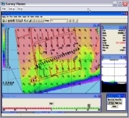

Sending SURVEY Windows Across the Network to Non-HYPACK Computers.
LAN or Wireless Network
Non-HYPACK Computer
Running SURVEY VIEWER
Non-HYPACK Computer
Running SURVEY VIEWER
Non-HYPACK Computer
Running SURVEY VIEWER
Non-HYPACK Computer
Running SURVEY VIEWER
HYPACK Computer
Windows 10 and Windows 7 limit the number of broadcast clients to 8.

Slide 3
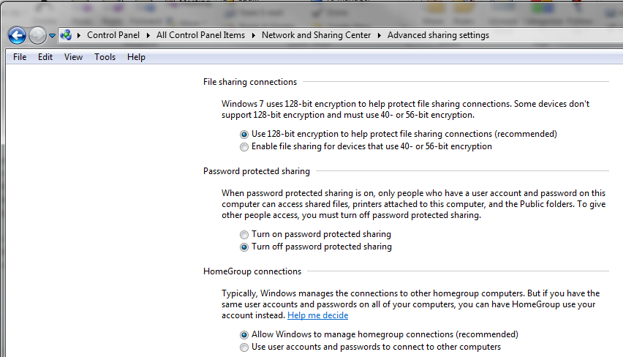
Password Protected Sharing = Off
For SURVEY VIEWER to function properly on Windows 7 computers, you will need to go into the Advanced Sharing Settings and ‘Turn off password protected sharing’ on the computer running HYPACK SURVEY.

Slide 4
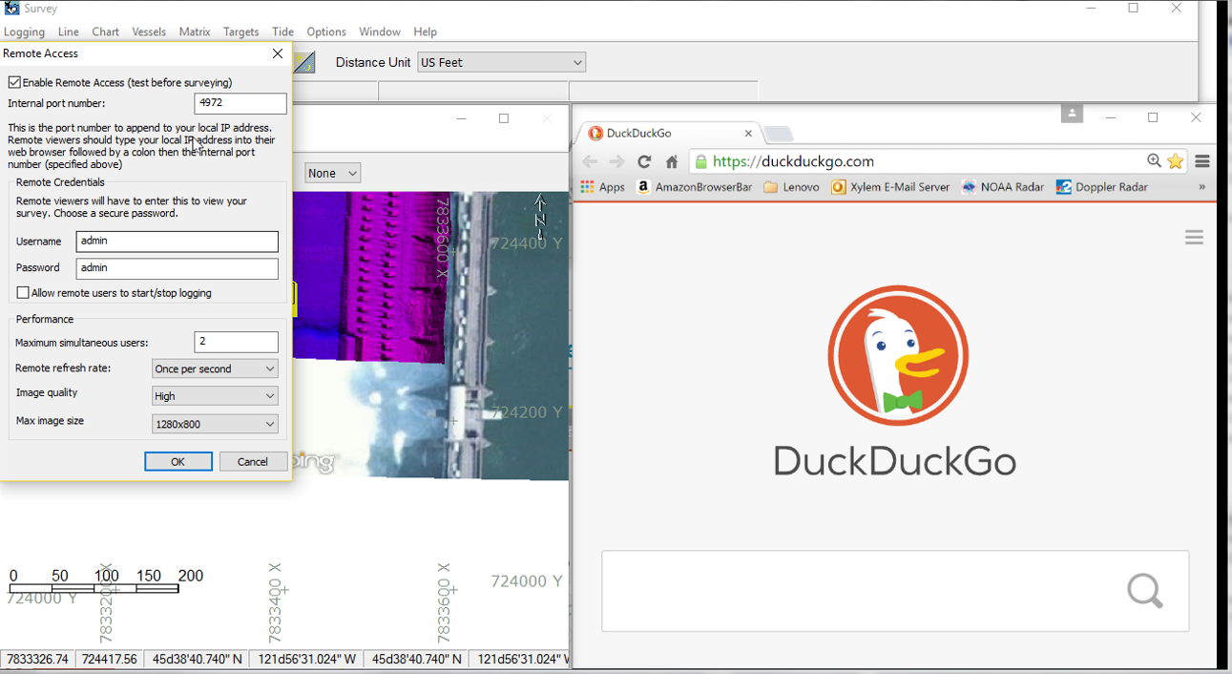
Remote Viewer Over Web

Slide 5
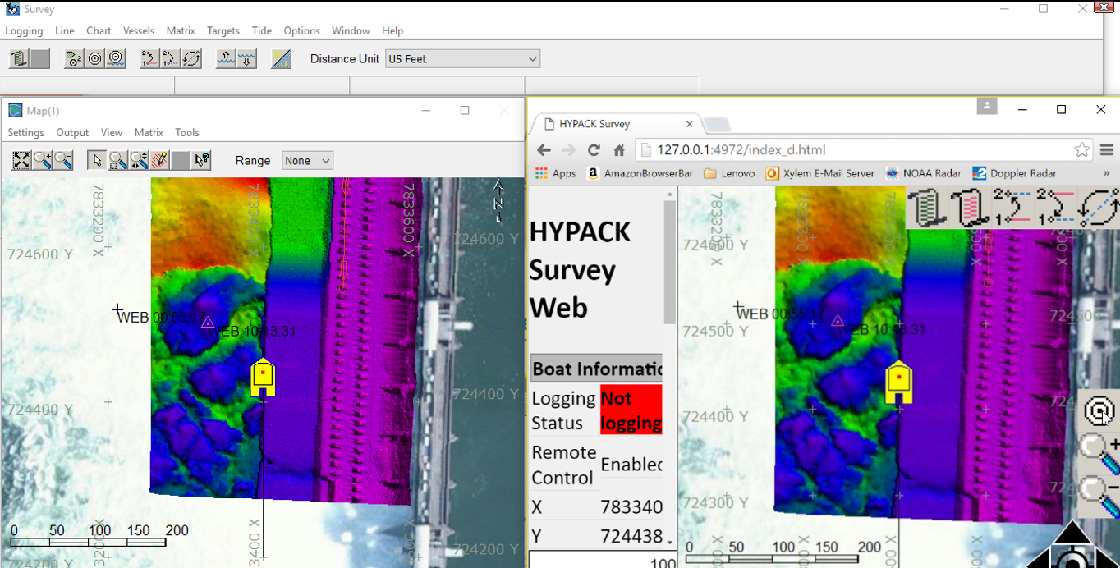
Remote Viewer Control
Control Survey remotely from PC without HYPACK Key
Basic commands sent. Logging, Targeting etc.

Slide 6
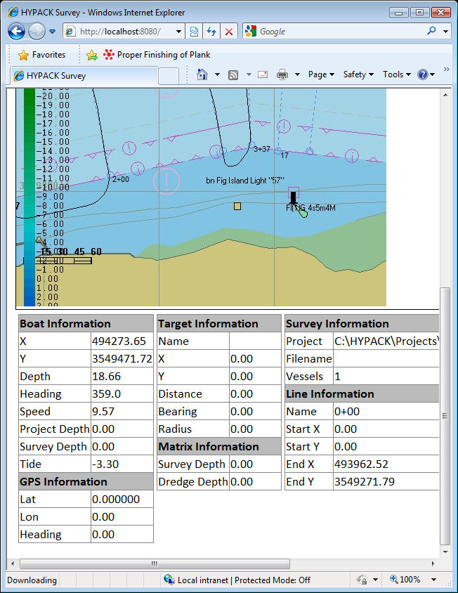
WebIF.DLL: Another Option…
View the SURVEY program (Area Map and Data) from an Intranet connection.
Check out the WEBIF presentation on this DVD under the ‘Survey’ group.

Slide 7
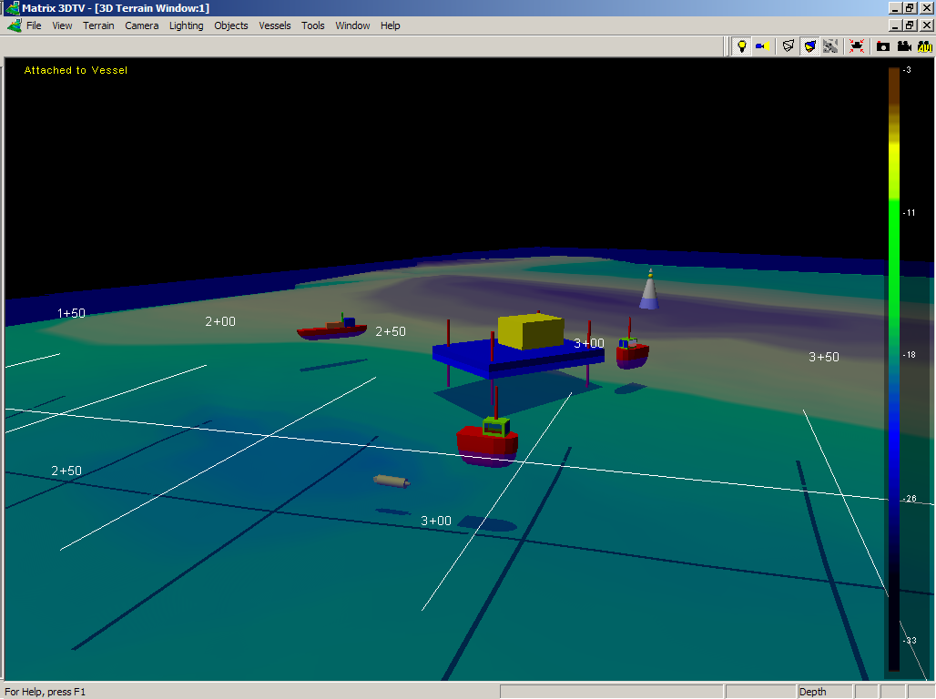
3D Vessel Monitoring
Barge in a work site that is going to be serviced by multiple vessels including a supply boat and a crew boat.
The requirement is that all vessels are able to share the position, heading and tide corrected depth with each other.
In this image there is a crew boat approaching the barge with a supply boat in the background. A survey vessel is running lines in the foreground with a magnetometer. Each vessel is controlled from a separate computer on our internal wireless network and collected on the main observation computer. The 3DTV program was used in its new multiple vehicle tracking capacity. The depth of the magnetometer was controlled by changing the draft of that mobile.

Slide 8
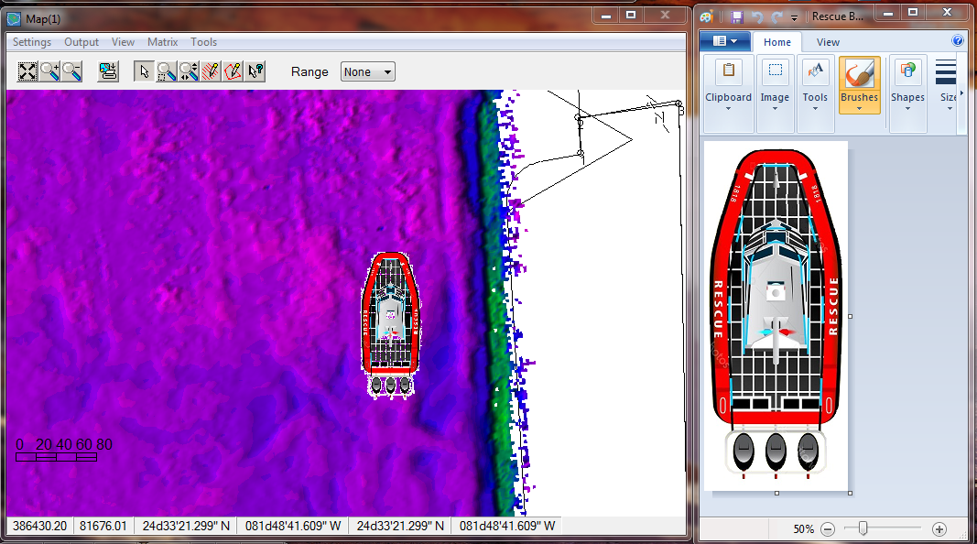
CUSTOM Shape Displays in SURVEY
Images can be saved as BMP and displayed in SURVEY Map Windows
Scalable Shape
Easily identifiable vessel tracking

Slide 9
RIG MOVES

Slide 10
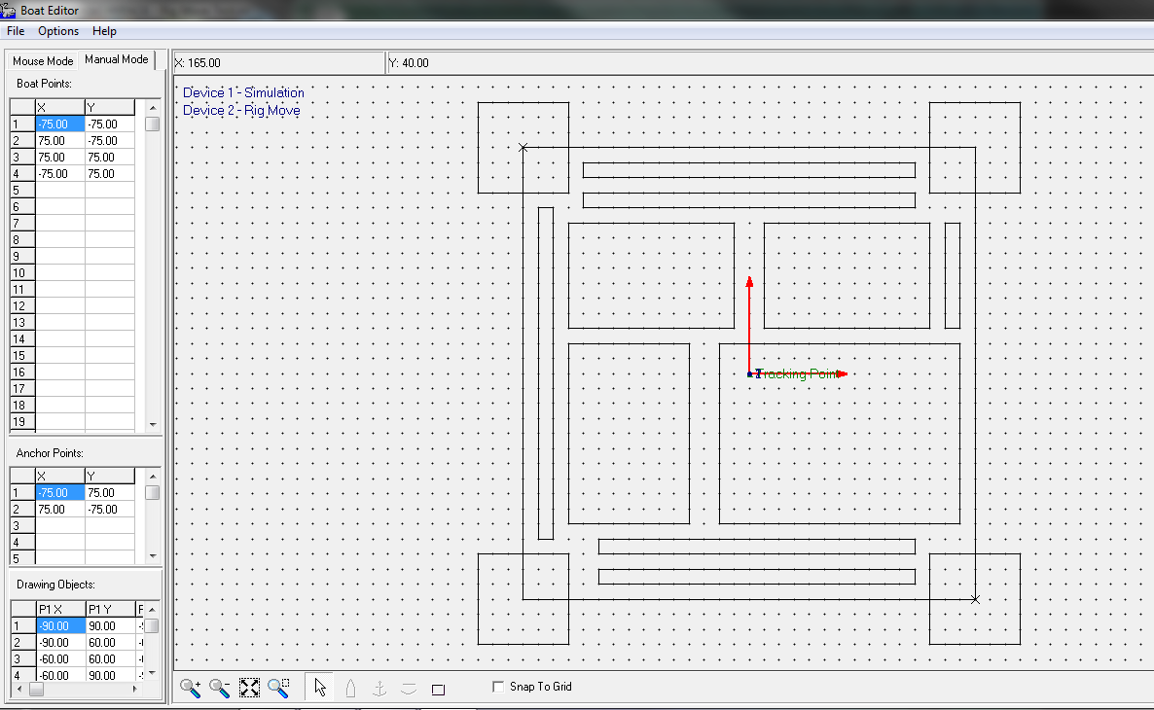
Step 1: Boat Shape Editor
Create your boat shape.
The Boat Origin Reference Point is at the X=0, Y=0 point.
Set 1 or 2 anchor points.
  One Anchor Point: SURVEY will determine the final rig position using the Anchor Point and the heading.
  Two Anchor Points: SURVEY will determine the final rig position using the two Anchor Points.

Slide 11
Step 1: Boat Shape Editor
Anchor #1
Anchor #2

Slide 12
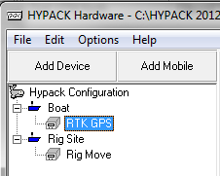
Step 2: HYPACK HARDWARE
The actual position of the Rig is the ‘Boat’ mobile.
  In this case, we are positioning the rig with an RTK GPS with directional antenna, using the GPS.DLL.
The final target position of the Rig is the ‘Rig Site’ mobile.
  We will use the BARGE.DLL to set the final target position for the rig.

Slide 13
Ghost Shapes vs. Barge Interface

Slide 14
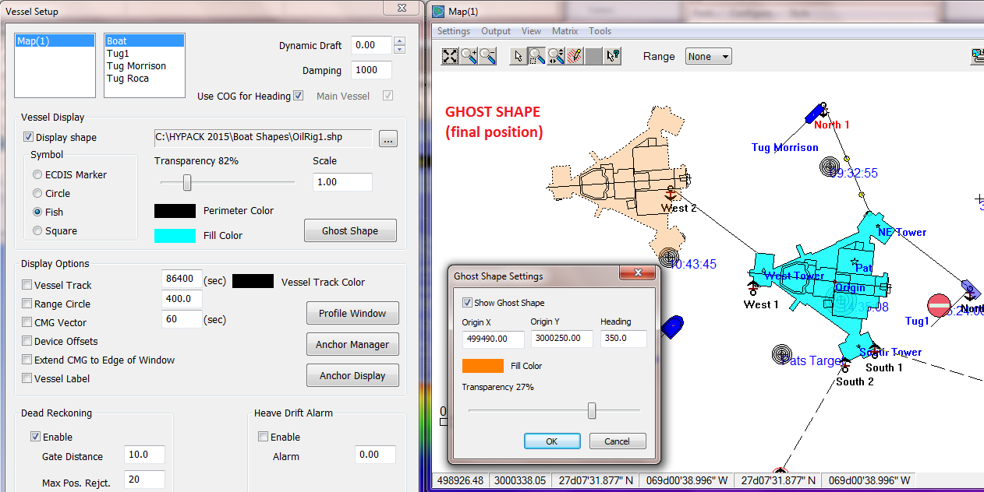
HYPACK SURVEY: GHOST SHAPES
Enter the final position for a rig or barge move and draw a ghost shape (orange).

Slide 15
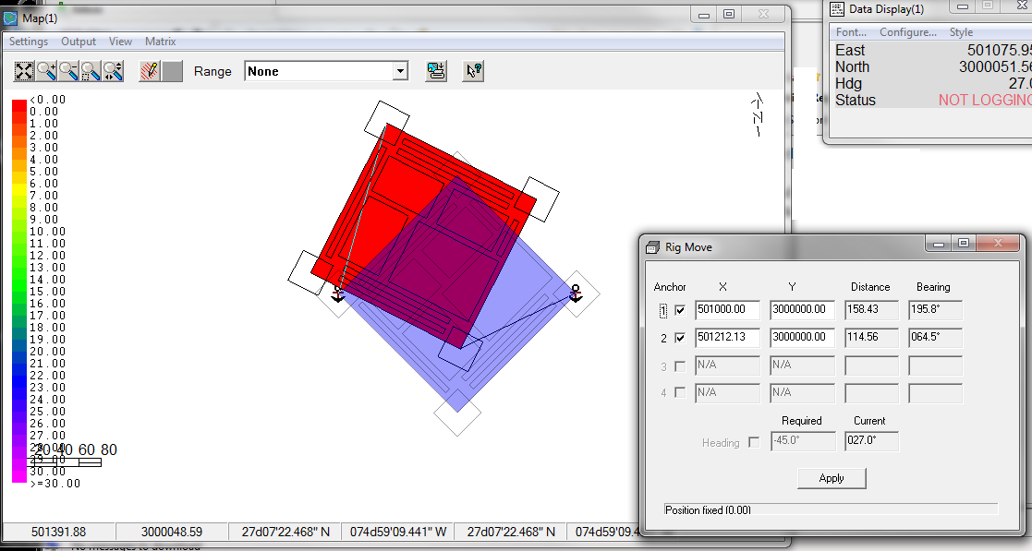
Barge Interface
The Barge Interface allows the anchors to be used to inform the team where the barge needs to be moved.
The Ghost shape only shows the operator the position on the map.

Slide 16
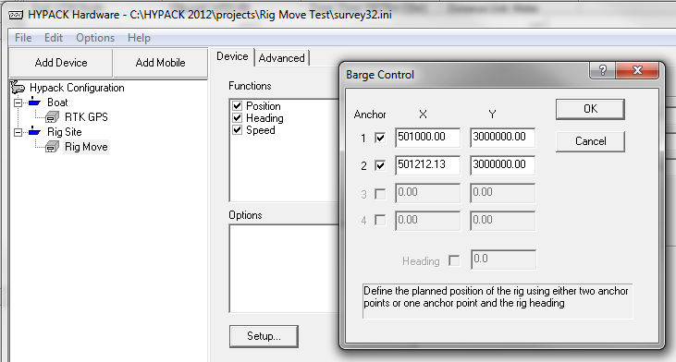
BARGE.DLL
In the ‘SETUP’ for the BARGE.DLL:
  To position the rig using one Anchor Point and a heading, click just the ‘Anchor 1’ box and enter final position and heading (below).
  To position the rig using two Anchor Points, click both the Anchor 1 and Anchor 2 boxes and enter the final positions.

Slide 17
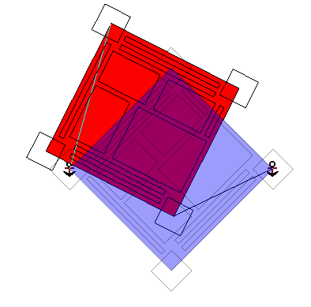
Step 3: SURVEY
The final position of the rig will be drawn in Blue.
  This is determined based on the information in the BARGE.DLL.
The current position of the rig is currently shown in Red.
  We have set the Fill Color for the main ‘Boat’ mobile to red. Your color may be different.
  We have also set the transparency for the boat shape so that we can see the final target position (blue) beneath the current position (red). (Done in the Vessels menu.)

Slide 18
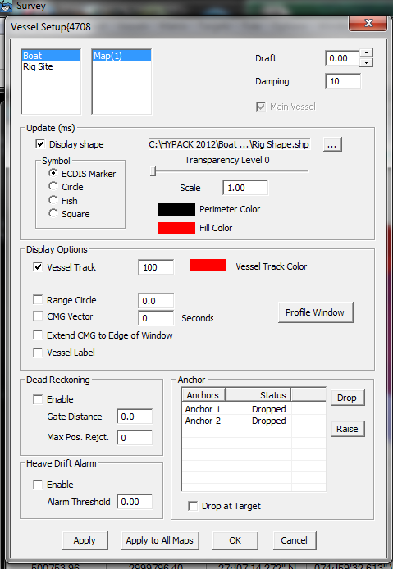
Vessel Settings: Current Position
Step 3: SURVEY
Select Primary Vessel:
Make Opaque
Set Color:

Slide 19
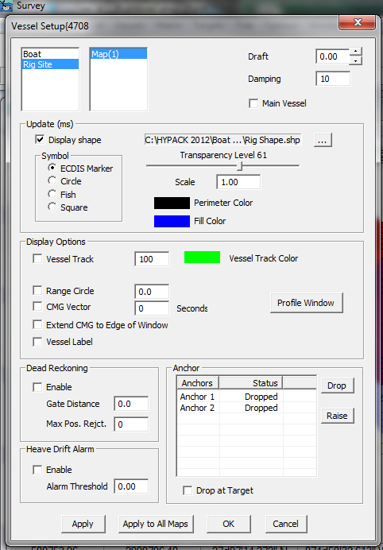
Vessel Settings: Final Position
Step 3: SURVEY
Select Rig Vessel:
Set Transparency
Set Color:

Slide 20
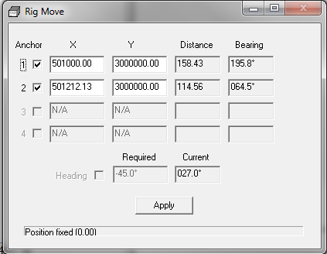
SURVEY: Barge Info Window
Displays the distance and bearing each Anchor Point needs to move.
Displays the current heading and the required heading.

Slide 21
BARGE MANAGEMENT

Slide 22
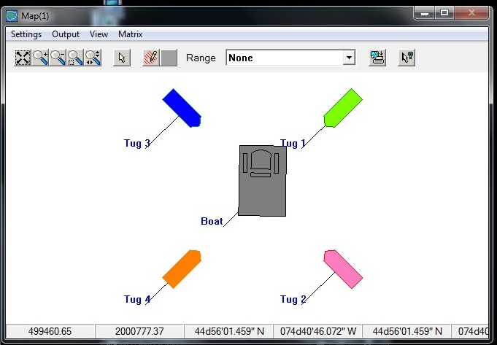
Barge Management in HYPACK
The main Barge wants to see Tug1, Tug2, Tug3 and Tug4.
Tug1 wants to see the Barge, Tug2, Tug3 and Tug4.
Etc., etc., etc.

Slide 23
Hardware Requirements:
Main Barge:
  GPS with Directional Antenna.
  Wireless router with Omni-Directional antenna
  Computer with HYPACK SURVEY capability.
Tugs
  GPS with Directional Antenna.
  Notebook Computer with HYPACK SURVEY and Wifi capability.
Network Setup:
  Each computer needs a Static IP address on a common sub-net.
  See the example below for sample settings.
Vessel IP Address Subnet
Main Barge (Boat): 192.168.5.101 255.255.255.0
Tug 1: 192.168.5.102 255.255.255.0
Tug 2: 192.168.5.103 255.255.255.0
Tug 3: 192.168.5.104 255.255.255.0
Tug4: 192.168.5.105 255.255.255.0

Slide 24
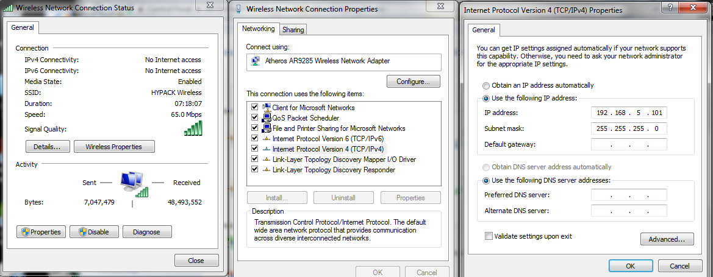
Setting a Static IP Address
Open the Network and Sharing Center and click on your Wireless Network Connection. The window on the left will appear.
Click the ‘Properties’ button. The window in the center will appear.
Click on ‘Internet Protocol Version 4 (TCP/Pv4) and then ‘Properties’. The window on the right will appear.
Enter the appropriate IP address and subnet address for the computer.

Slide 25
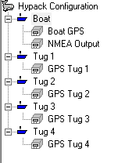
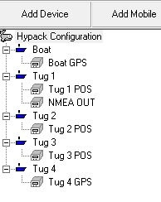
HYPACK HARDWARE
Create a separate mobile for each vessel. The vessel set-up on the Barge is shown to the right.
On each vessel:
    Use the GPS.DLL to determine your position and heading.
    Use the NMEAOUTPUT.DLL to output your position and heading to the other vessels.
To see the other vessels:
    Use the GPS.DLL to read their position and heading.
Vessel Setup on Barge
Vessel Setup on Tug 1

Slide 26
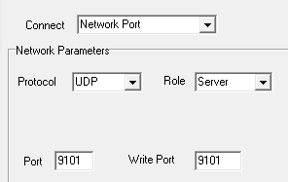
Configuring the NMEAOUTPUT.DLL
NMEAOUTPUT.DLL Type Client/Server Read/Write Port
Barge (Boat) UDP Server 9101
Tug2 UDP Server 9102
Tug3 UDP Server 9103
Tug4 UDP Server 9104
Tug5 UDP Server 9105
On each vessel, we will configure the NMEAOUTPUT.DLL to broadcast its position and heading data using a UDP connection.
Each vessel will use a separate Read/Write Port value.

Slide 27
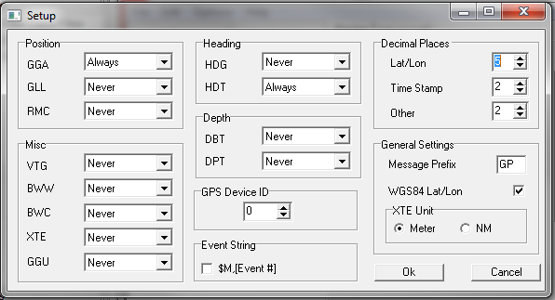
Configure the NMEAOUTPUT.DLL
Settings Window: Output GGA & HDT.

Slide 28
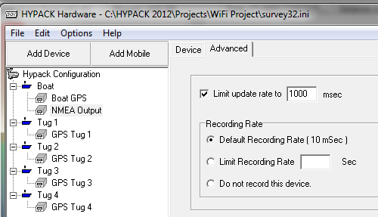
Configure the NMEAOUTPUT.DLL
Set the update rate at 1Hz.

Slide 29
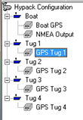

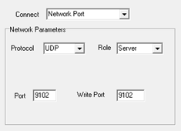
Reading the Broadcast from Each Vessel
We are just reading the Position and Heading data from each vessel’s broadcast.
On the Barge, we will use the GPS.DLL to read the position data from Tug 1.
We’ll specify a Network connect, using UDP protocol and acting as a Server. Set the Read Port and Write port to the proper value for the vessel.

Slide 30
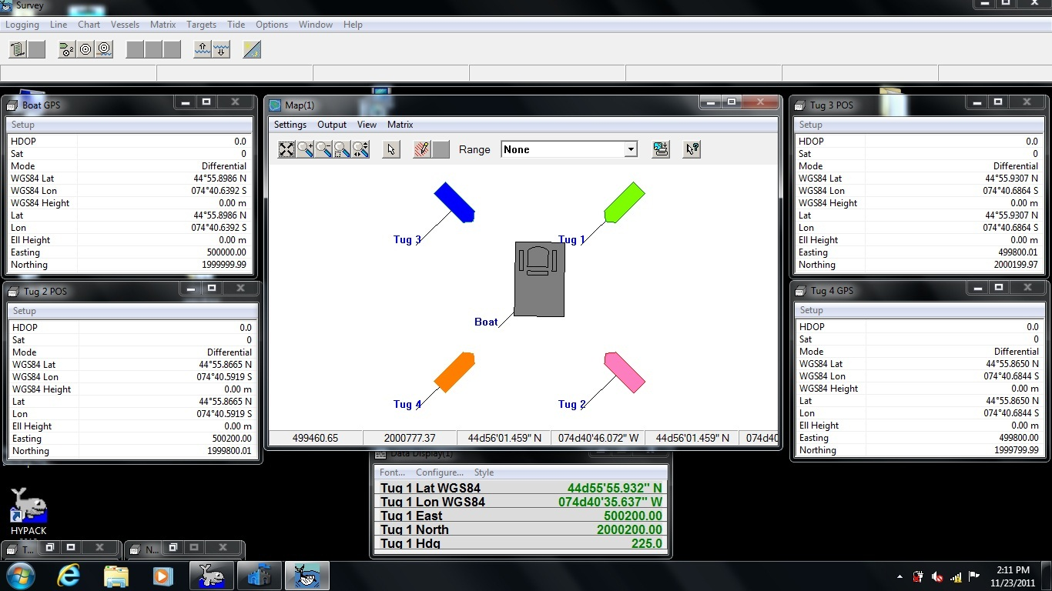
HYPACK SURVEY

Slide 31
Thank You !
Contact Us:
Sales@HYPACK.com
Help@HYPACK.com
(860) 635 - 1500
Links to more information:
HYPACK on Youtube.com ( Historical Sessions ) HYPACK Live Chat
HYPACK on Youtube.com ( Newer Sessions ) HYPACK Ustream
HYPACK SUPPORT Site HYPACK Website

