Slide 1
HYPLOT MAX

Slide 2
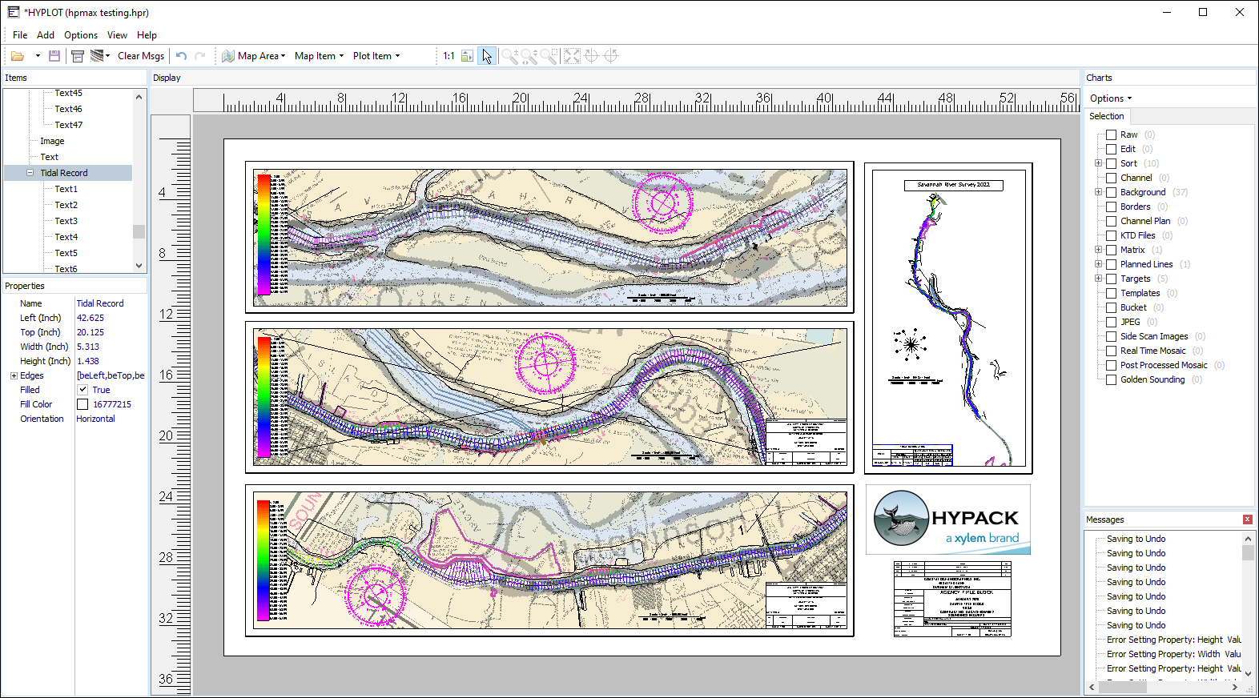
HYPLOT MAX
New for 2022!
Uses paper space.
Plot multiple maps to one sheet!
Create plot area without PLT file.
Plots all background files.
Lock items to prevent editing.
Multiple undo’s.
Define settings in main window.
Open and Save layouts to HPR file.

Slide 3
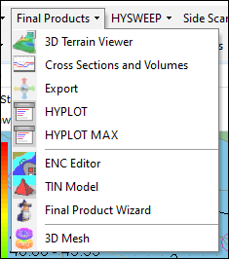
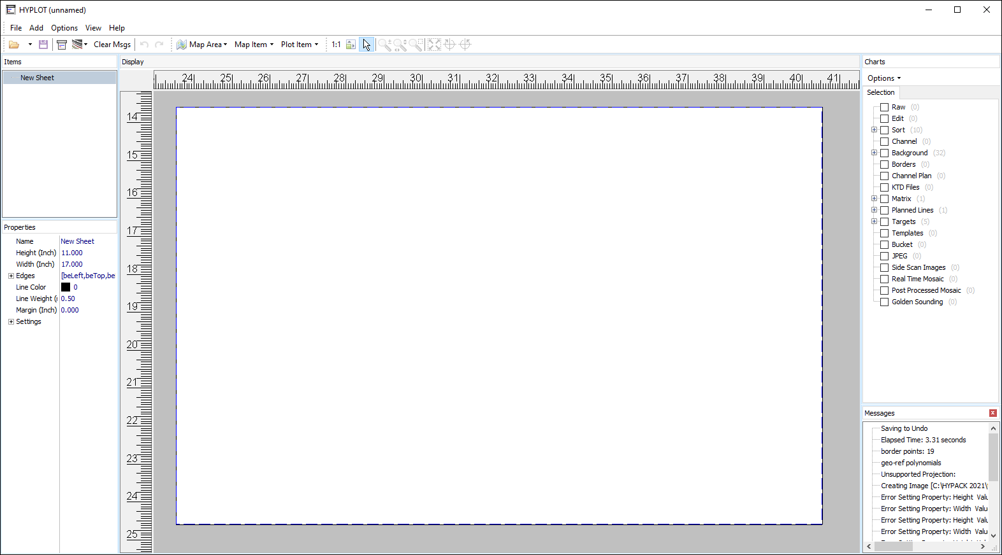
Running HYPLOT MAX
Run from FINAL PRODUCTS menu.
Plotting Sheet File (*.plt) file not required. (optional)
HYPLOT MAX will open with a blank paper space.

Slide 4
HYPLOT MAX - LAYOUT
View Tools:
Select, zoom, pan, etc.
Items:
Lists loaded plot files, text boxes, title blocks, arrows, etc.
Charts:
Enable/disable project files to be plotted.
Properties:
Define attributes of selected items.
Display:
Sheet view.
Messages:
Tracks all activity.

Slide 5

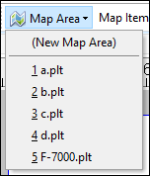
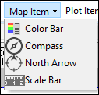
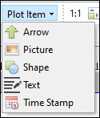
HYPLOT MAX – LAYOUT continued
Open/Save
HPR file
Print
Export Image File
Clear Messages
Map Area: create new map area or select plot sheet file.
Map Item: Add to any map area.
Plot Item: Add anywhere on sheet.

Slide 6
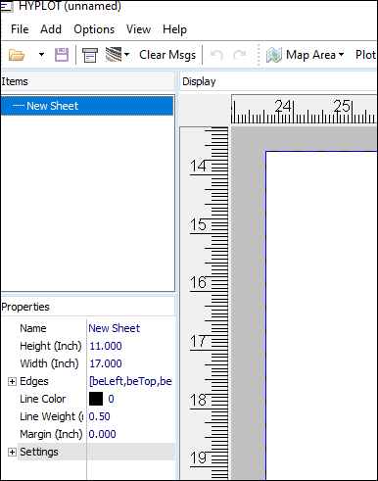
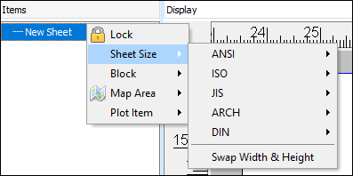
NEW SHEET
Change paper size under properties.
Right-click on sheet item to select predefined sheet sizes.
Swap height and width.
Paper size will automatically change to fit first map area.

Slide 7
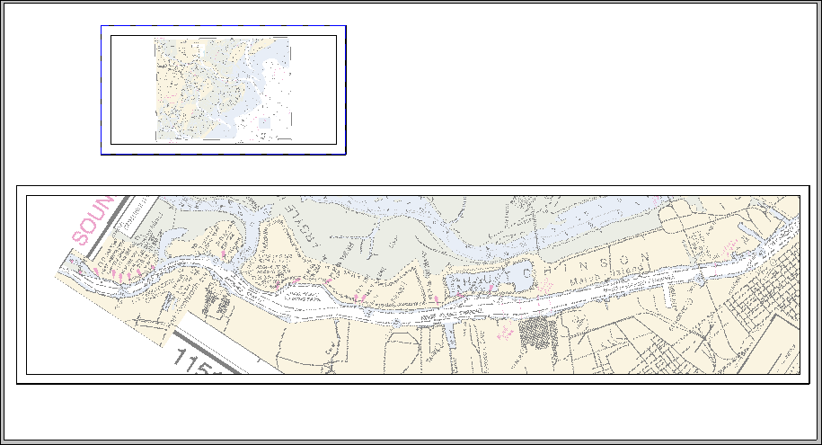
ADD MAP AREAS
Create New Map Area will create plot border.
  Drag edges to size.
  Use view tools to define plot area.
Select PLT files previously created from list.
Drag anywhere on sheet.

Slide 8

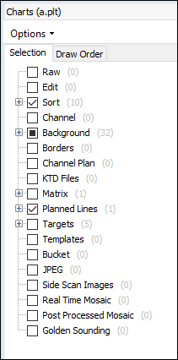
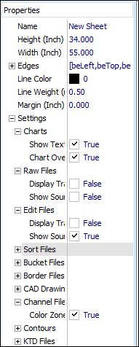
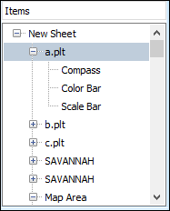
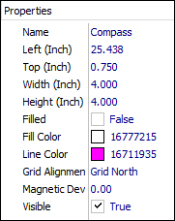
ADDING ITEMS TO MAPS
Select Map Area from ITEMS list.
Use MAP AREA dropdown to add Color Bar, Scale Bar, Compass, North Arrow.
  Drag anywhere on map.
  Modify items under Properties.
Enable/Disable project files under CHARTS.
Change project file properties under NEW SHEET – PROPERTIES – SETTINGS.
  Similar options as Shell Settings.

Slide 9
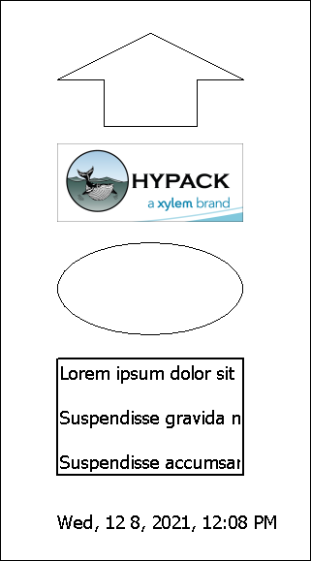
PLOT ITEMS
Properties:
Change name, size, color, fill, direction.
Load any image format.
Ellipse or triangle. More to come! Change name, size, color, fill, type.
Change font size, color, alignment, etc.
Change font size, etc.

Slide 10
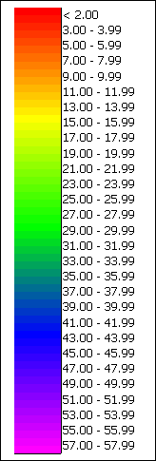
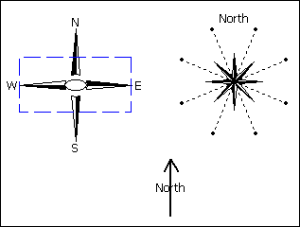
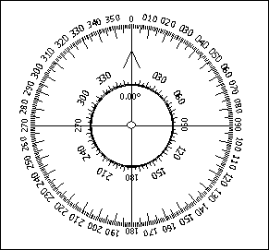

MAP ITEMS
North Arrows
Compass
Scale Bar
Color Bar

Slide 11
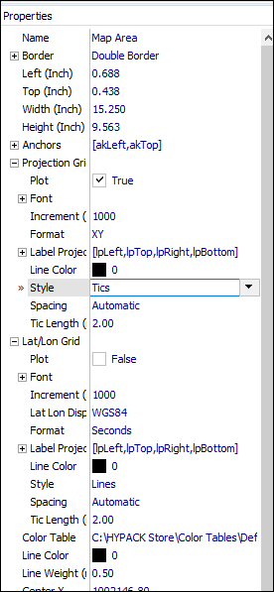

MORE PROPERTIES
Change Map Area properties:
Borders – Single, double, title area, IHO Chinese, Russian.
Projection Grid – lines, tics, spacing, color, format, labels.
Lat/Lon Grid – lines, tics, spacing, color, format, labels.

Slide 12
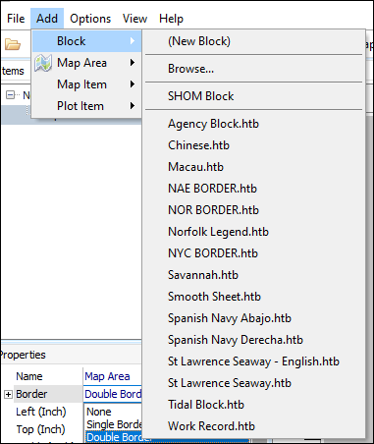
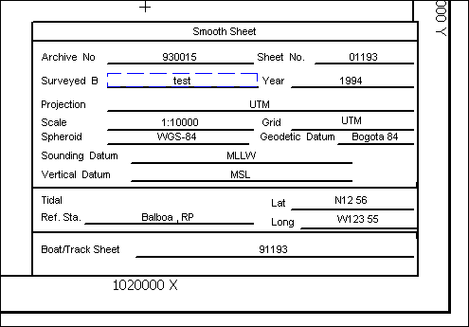
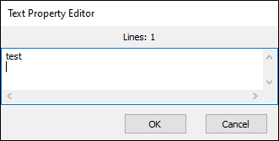
TITLE BLOCKS
Predefined Title Blocks listed under ADD – BLOCK.
Modify predefined title blocks right on sheet!
Craft your own title block in the Block Editor.
Hold Shift key and drag title block to new location.
Right-click on the text you would like to edit.

Slide 13
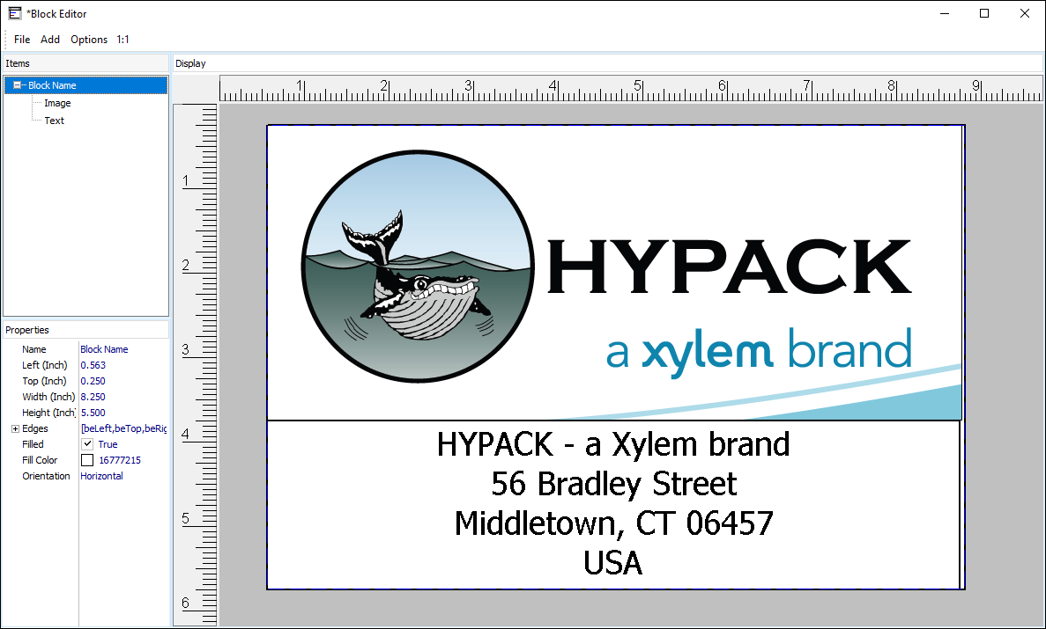
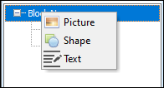
BLOCK EDITOR
Create your own title blocks in the Block Editor!
Right-click on Block item and add Text, Images or Shapes.
Text can be multiple lines!
Modify block items under Properties.
Save as *.htb file.

Slide 14
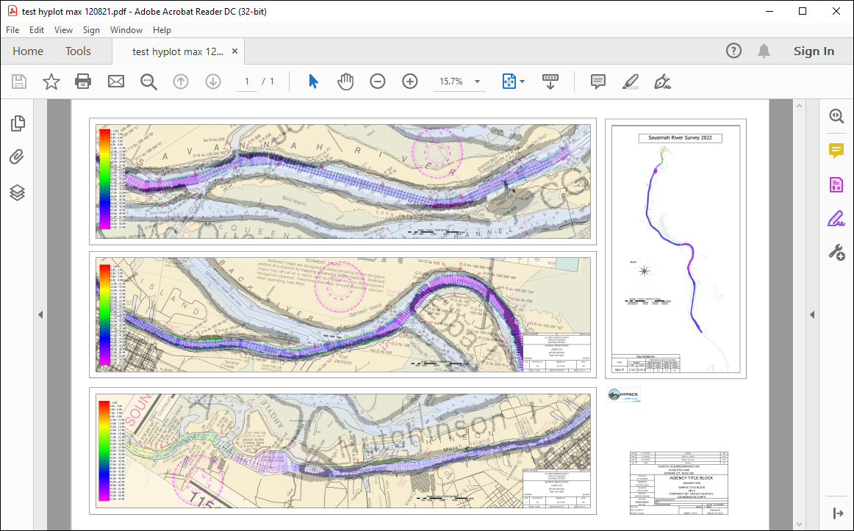

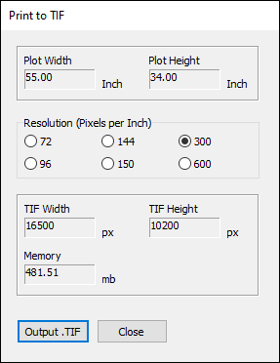
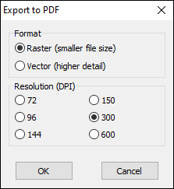
Print and Export
Print to any Windows – based printer.
Export to PDF and TIFF.
  Raster or Vector (PDF).
  Select resolution.

Slide 15
Thank You !
Contact Us:
Sales@HYPACK.com
Help@HYPACK.com
(860) 635 - 1500
Links to more information:
HYPACK on Youtube.com ( Historical Sessions ) HYPACK Live Chat
HYPACK on Youtube.com ( Newer Sessions ) HYPACK Ustream
HYPACK SUPPORT Site HYPACK Website

