Slide 1
Side Scan Survey Acquisition and Processing

Slide 2
Objectives of this session
1
2
3
Side Scan Theory
Basics of sonar imagery, range, etc.
Surveying Principles
Towed vs. hull-mounted side scan sonars
Surveying speed
Sonar range vs. resolution
Configuring Devices
Connecting a side scan device
Configuring as towed or mounted
4
5
Post Processing
Adjusting your image
Marking targets
Creating mosaics
6
Running a Survey
Adjusting your side scan imagery
Marking targets
File Work
Saving post-processed files
Mosaicking batch files
Notes:
Stressed Water Supply
Issue
Maintain the health of traditional water sources and execute a water source diversification strategy
Solution
Xylem’s leading-edge technologies monitor, pump and treat water from all sources and enable water reuse
Aging Infrastructure
Issue
Utilities have to effectively assess and identify high-risk areas for repair/replacement before problems occur
Solution
Xylem’s intelligent pipeline and critical infrastructure services perform condition assessment, identify defective assets, provide bypass services and replacement technologies, reduce or eliminate combined sewer overflows and leaks/non-revenue water
Stormwater & Flooding
Issue
Significant increase in severe weather patterns is causing flooding and related damages to communities
Solution
Xylem’s flood management solutions include sensors for early warnings, dewatering for disaster response, communications for recovery and submersible pumping for resilient infrastructure
Regulatory Compliance
Issue
Utilities must successfully comply with a growing body of compliance regulations
Solution
Xylem’s analytics and sensors evaluate a broad range of water quality parameters, and our technologies treat water and wastewater to meet regulatory standards
Non-Revenue Water
Issue
Utilities have an important opportunity to reduce persistent and costly water losses from leaks and faulty meter readings
Solution
Xylem’s broad portfolio of solutions monitors for, and identifies, water leaks, as well as faulty meters. Our communications network enables point-to-multipoint communications throughout the system
Operating Strategy Reducing Costs
Issue
Utilities want to lower operating and energy costs, and leverage new revenue opportunities
Solution
Xylem offers industry-leading pumping and treatment solutions for energy efficiency, and software-enabled solutions to optimize operations and identify revenue opportunities

Slide 3
Side Scan Theory

Slide 4
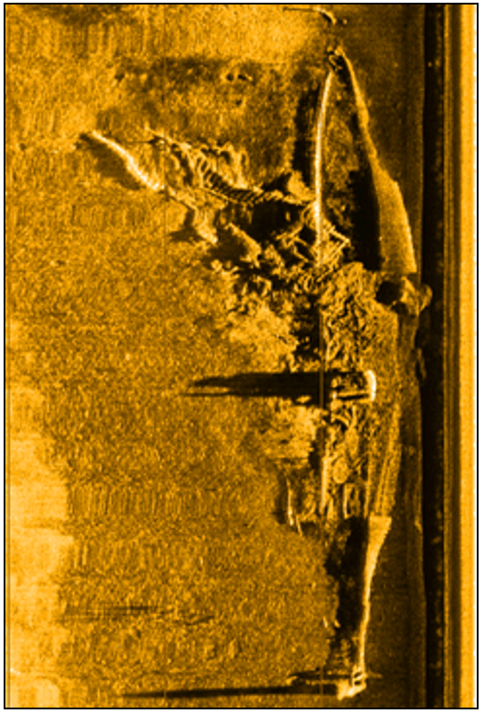
Side Scan Survey Overview
Uses:
Object detection
  Obstructions
  Search and recovery
  Historical sites
Visual analysis
  Pipelines
  Underwater structures
Geological identification
Notes:
More subjective, less objective
Imagery

Slide 5
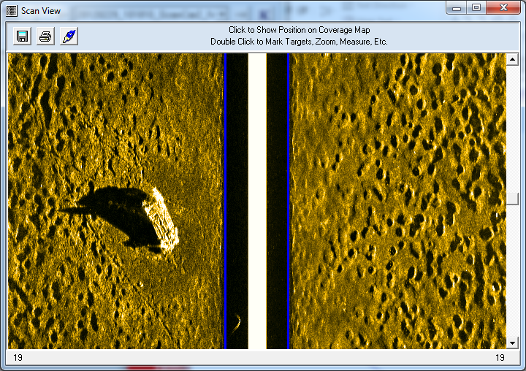
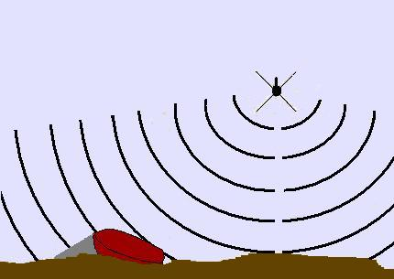
What Is Found In A Side Scan Record?
Shadow
Water Column
Features on the seafloor create shadows
Water column: sonar (fish) height
Target: some feature or object (generally produce a shadow)
Bottom sediment: will affect return
Notes:
Fish is along center
Like dragging a paintbrush

Slide 6


The Importance Of The Shadow
Lower towfish, longer shadow
Closer
Farther

Slide 7
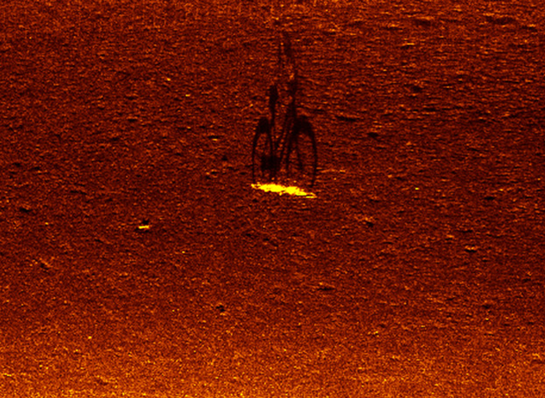
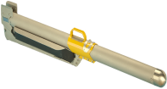
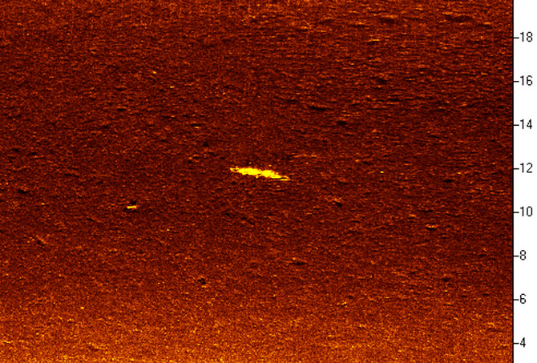

The Importance of the Shadow
The shadow can be more helpful than the shape

Slide 8
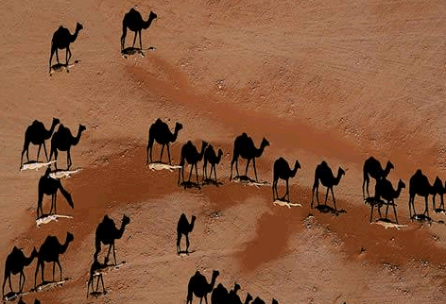
The Shadow Effect
Often the shadow is more recognizable than the object.

Slide 9
What You Find With A Side Scan Record
Received signal
T₀ (Ping)
T₂
T₁ (First return)
T₂ (range)
Signal Strength vs. Time
T₁
T₁
T₂
Time
T₀
Time
T₂

Slide 10
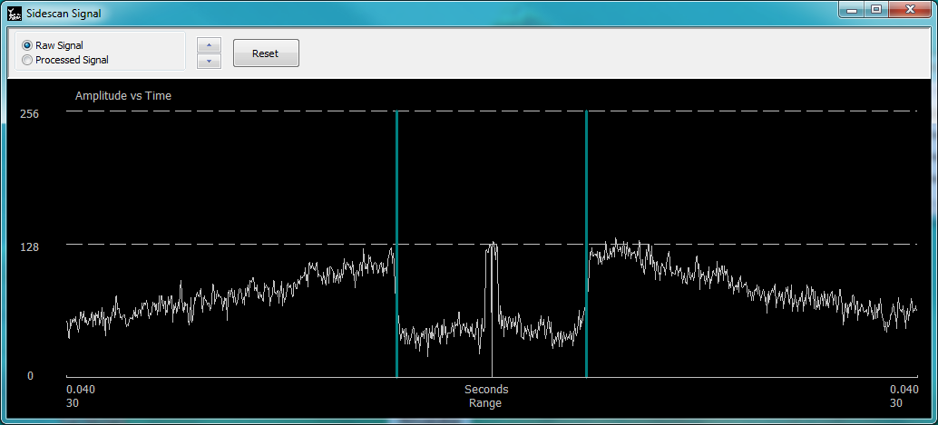
What You Find With A Side Scan Record
Signal vs. Time
T₁
T₁
T₂
Time
T₀
Time
T₂
T₂
T₁
T₀
T₁
T₂

Slide 11
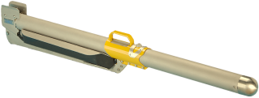

Sonar System Components
Topside
Sonar->Topside->HYPACK

Slide 12
What Is A Side Scan’s Resolution?
Along track resolution
Sonar aperture
  Typically (0.25° to 0.8°).
Across track resolution
Sonar frequency

Slide 13
Along Track Resolution
Along Track Resolution
Good ☺
Bad ☹
Horizontal beam width
Improves closer to sonar
Farther from sonar, objects can merge

Slide 14
Across Track Resolution
Across Track Resolution
Bad ☹
Good ☺
Improves farther from sonar
Nearer to sonar, objects can merge

Slide 15
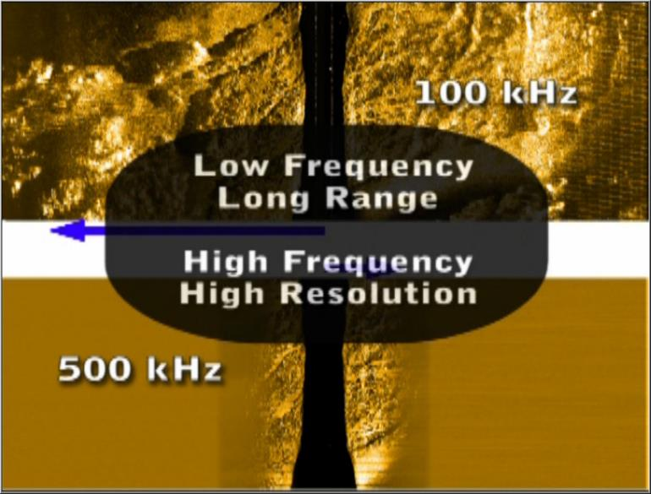
Frequency Determines Effective Range
Low frequency:
Long range
Blurrier image
High frequency:
Short range
Sharper image

Slide 16
Goldilocks Zone
Balances along and across track resolution
  Along track: good up close
  Across track: good far away

Slide 17
Nadir Gap
Blind spot directly below sonar

Slide 18
Survey Planning: 100% And 200% Coverage
Signal width:
200m
Line spacing
160 meters
Notice the nadir is NOT covered
Line spacing
80 meters
Nadir is covered here

Slide 19


Survey Speed
Too fast creates gaps
Speed < Max Speed
Speed > Max Speed

Slide 20
Side Scan Operations
Towed vs. hull-mounted (fixed) systems
 | Benefits | Problems
Towed | Close to bottom Minimal motion Deep water | Position imprecise
Hull Mounted | Accurate position Won’t hit bottom Shallow water | Poor for deep water Vessel motion affects data

Slide 21
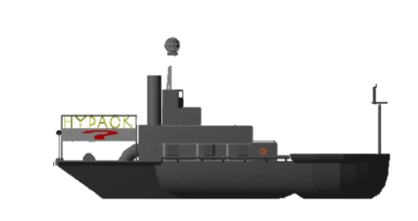

Towed vs Hull-mounted Side Scan
HYPACK
A side scan “towfish”
A hull-mounted side scan

Slide 22
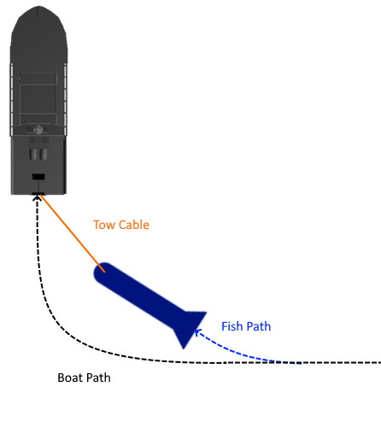
Towed Positioning
Boat position is known
Fish position can only be guessed
  USBL can help
?

Slide 23
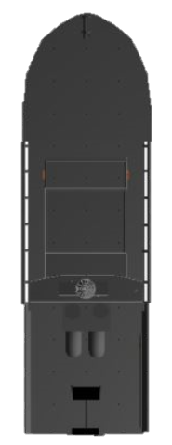
Hull-Mounted Offsets
For a hull mount, align your side scan with the vessel keel

Slide 24
Side Scan Imagery Examples

Slide 25
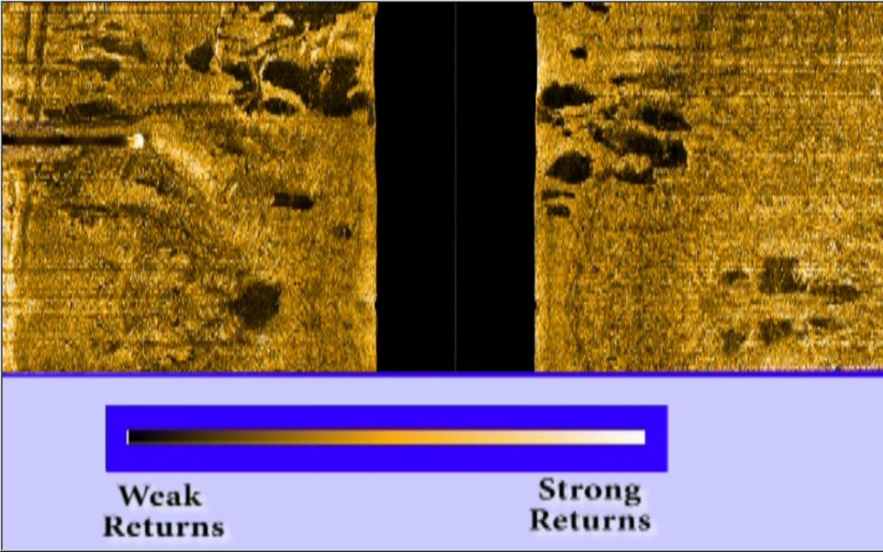
Interpreting Color Palettes

Slide 26
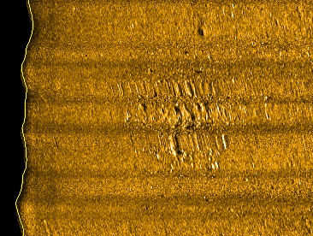
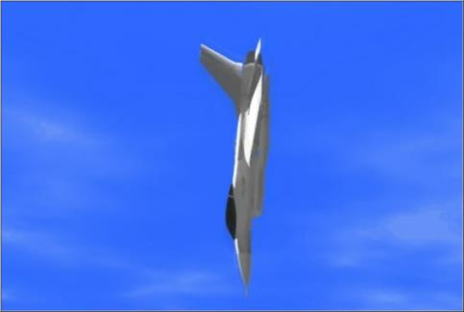
Targets May Be Hard To Identify
This is what a fighter jet looks like when it hits the water very fast.
This is a verified
F-16 after it hit the water.

Slide 27
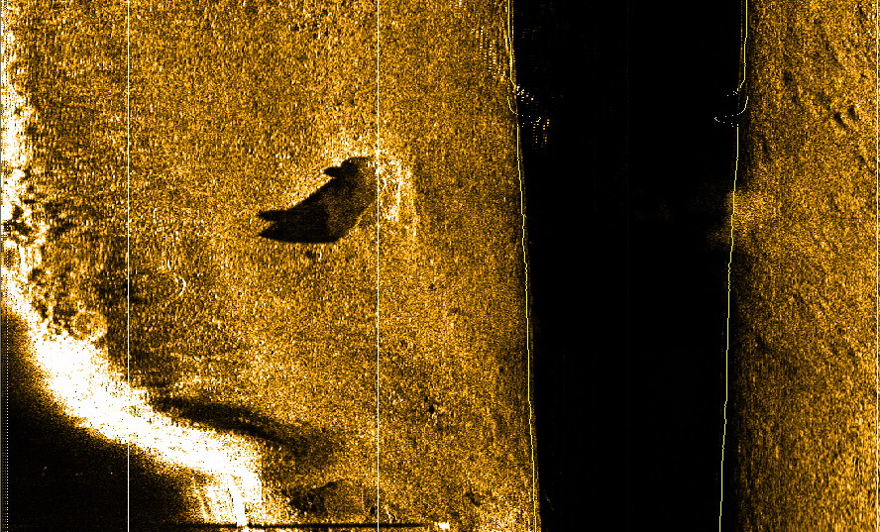
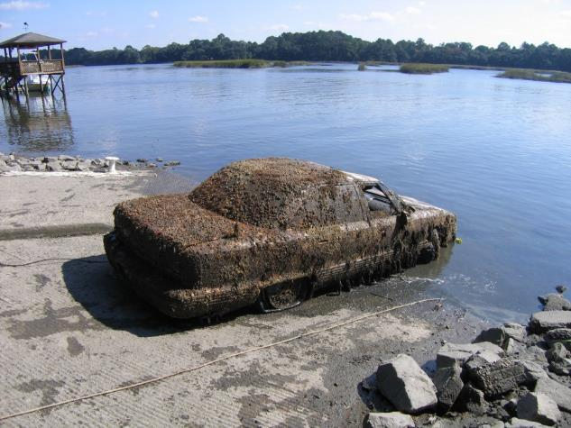
Can You Identify This Object?
Hint
The object is upside down.
Pay attention to the shadow.

Slide 28
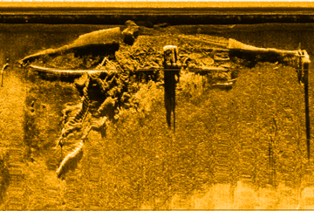
Ships On The Seafloor
1
2
Two ships—sunk at different times—at the same location.

Slide 29
Common Side Scan Issues

Slide 30
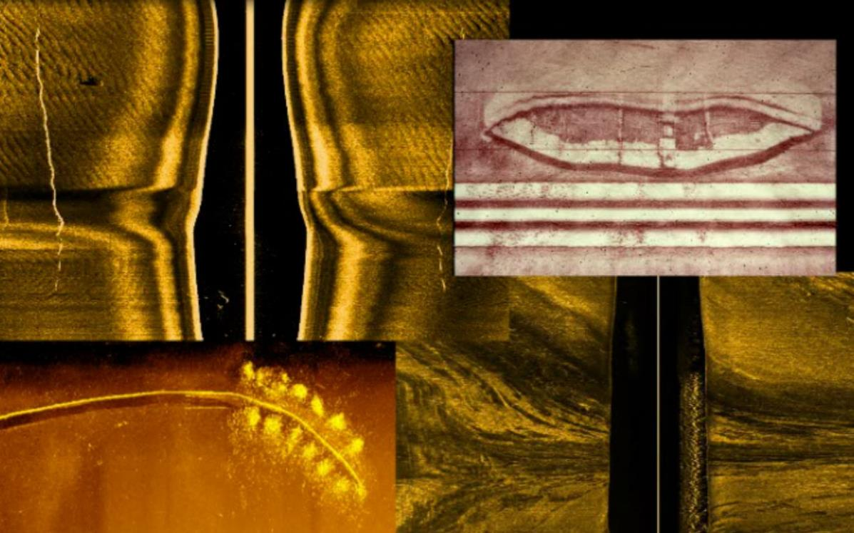
Effect Of Turns On Imagery

Slide 31
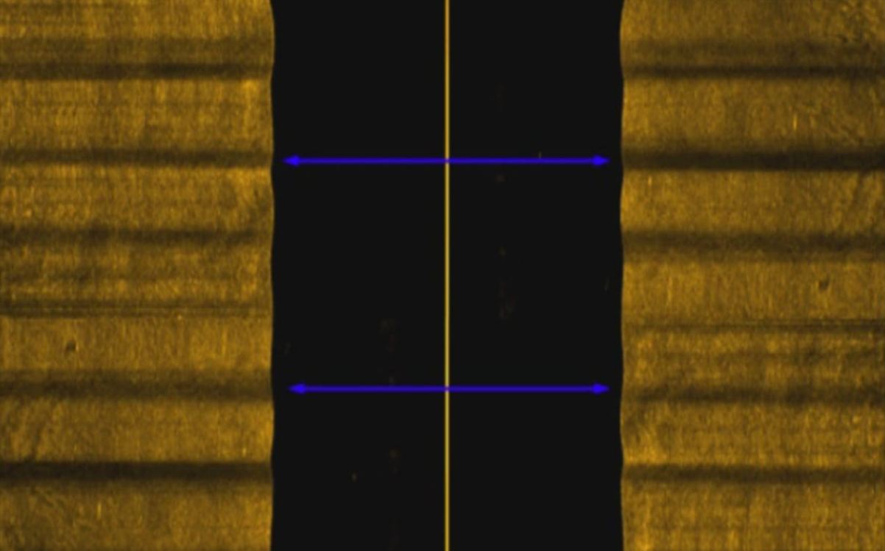
Heave Artifacts

Slide 32
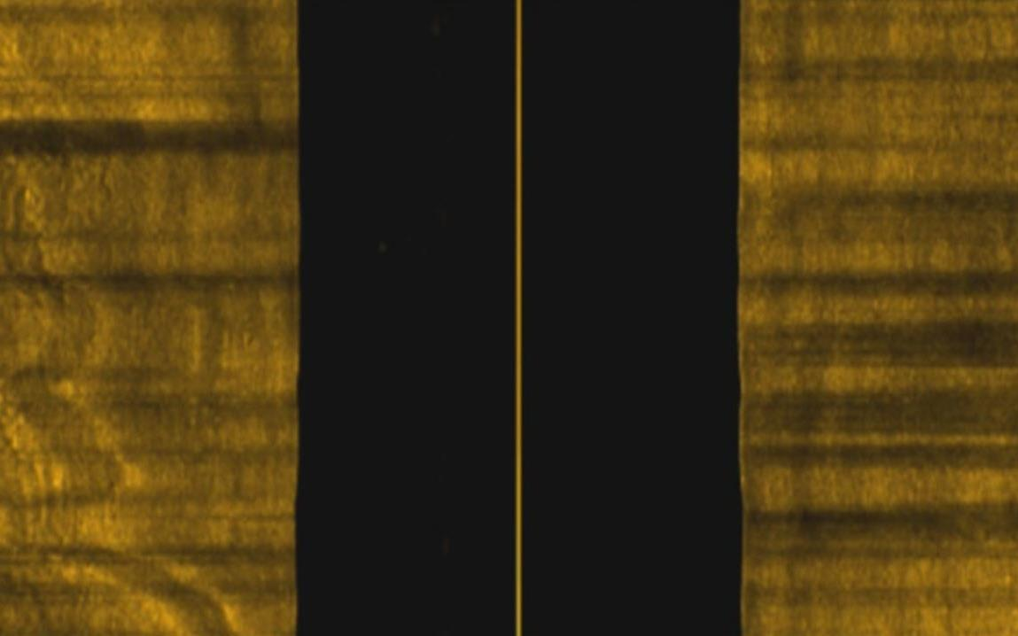
Roll Artifacts

Slide 33
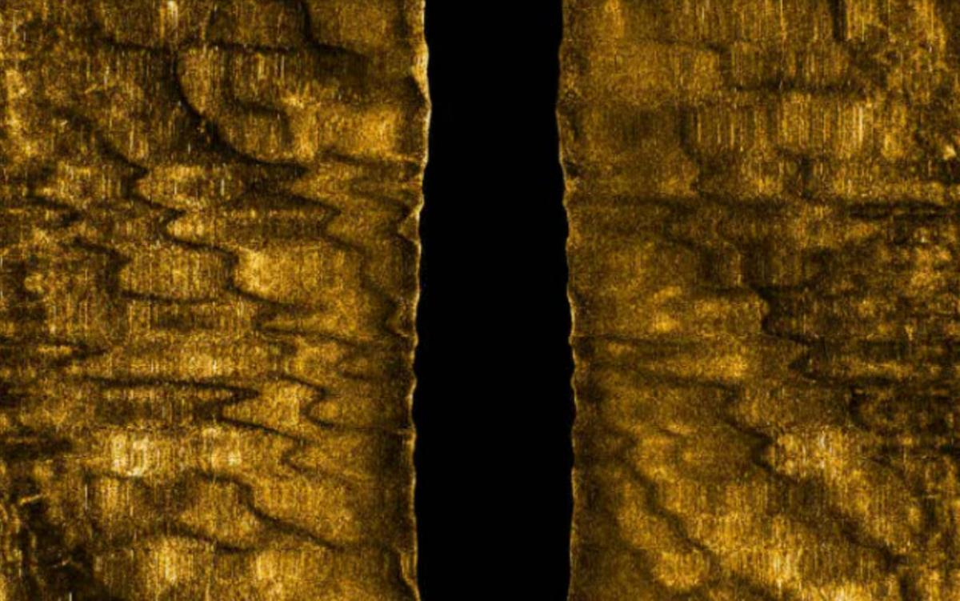
Yaw Artifacts

Slide 34
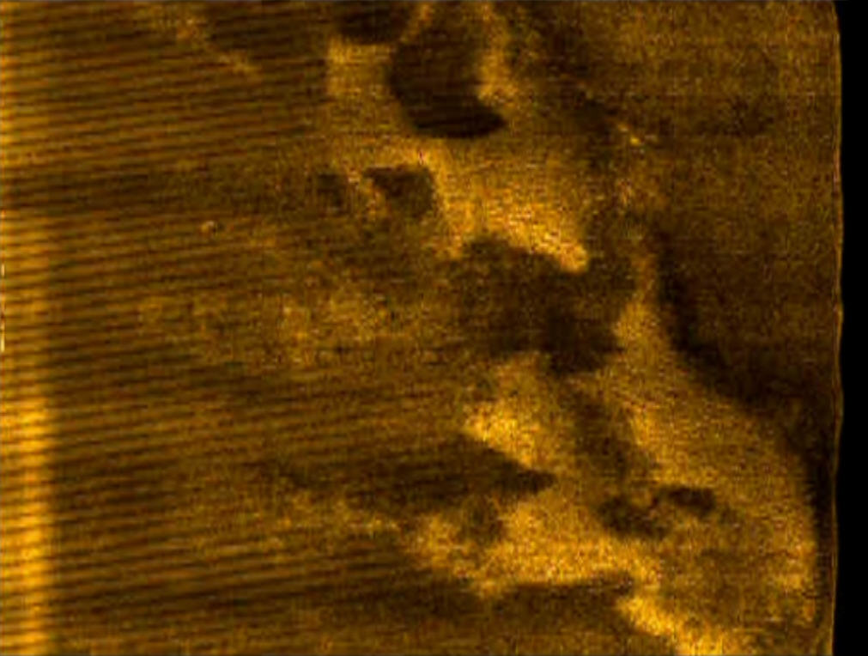
Generator Noise

Slide 35
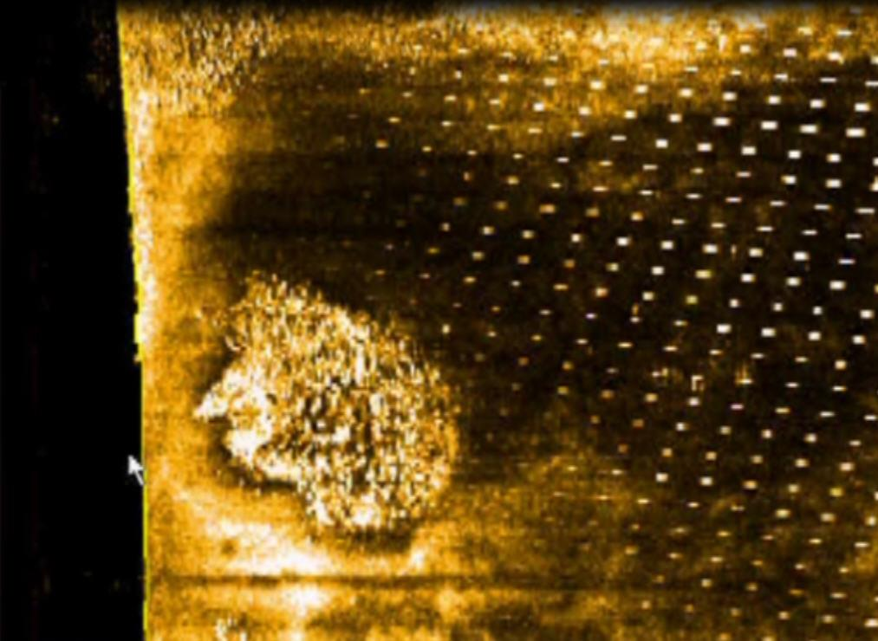
Echosounder Noise

Slide 36
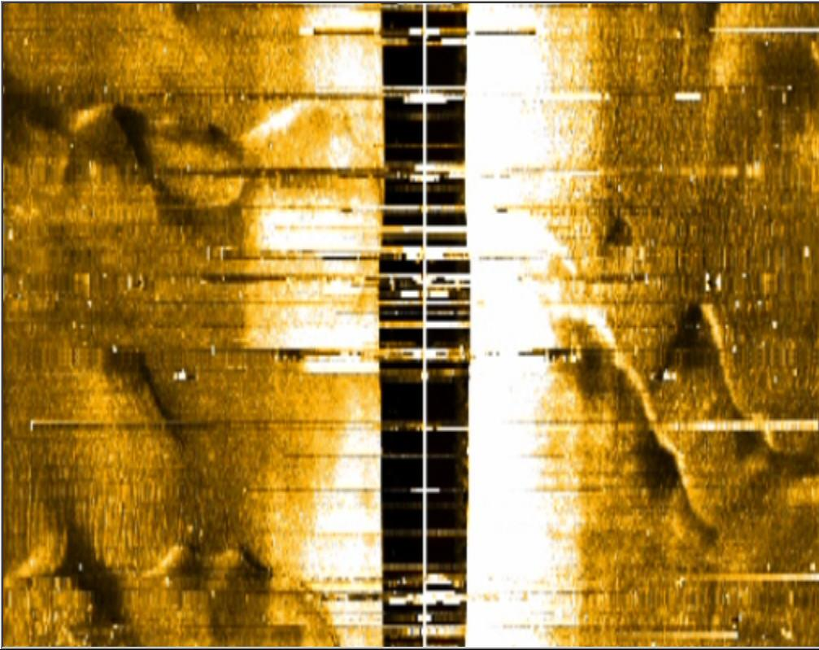
Electronic Noise

Slide 37
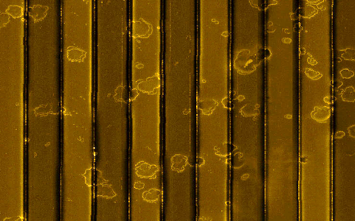
Good Side Scan Data

Slide 38
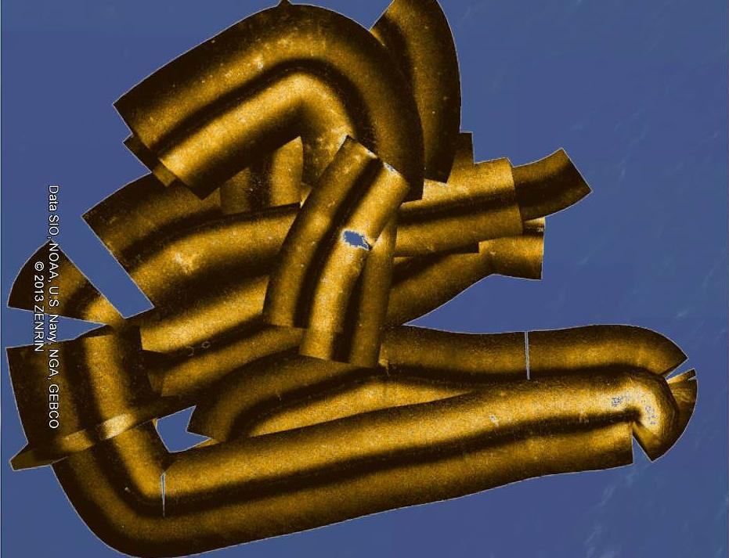
Bad Side Scan Data

Slide 39
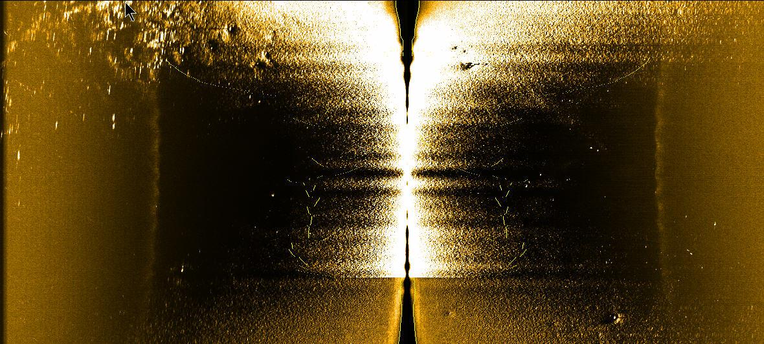
Can You Guess What Happened Here?
The sonar hit the bottom

Slide 40
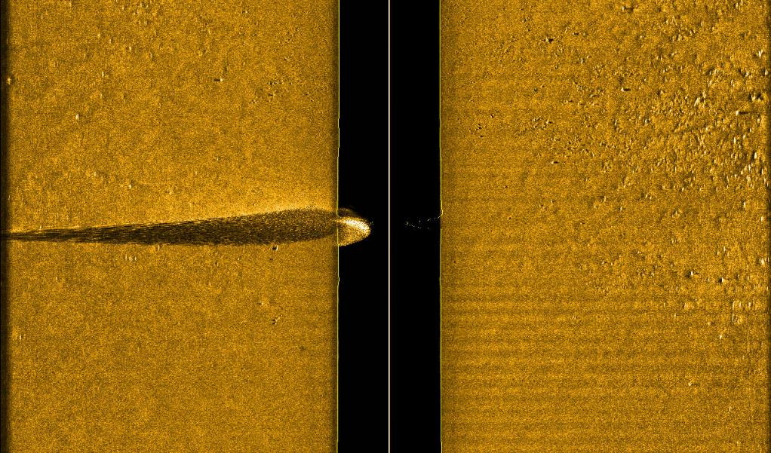
The Importance Of Shadows
Shadow beyond end of record = sonar is below the object

Slide 41
Connecting A Side Scan Device

Slide 42

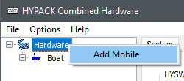
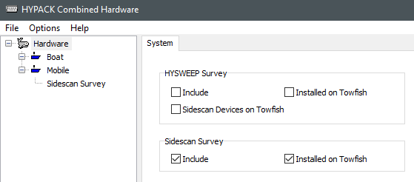
Setting Up A Towed Side Scan
Launch Hardware
Right-click “Hardware”, select “Add Mobile”
Select “Hardware” on the left
Under “Side Scan Survey”, check “Include” and “Installed on Towfish”

Slide 43
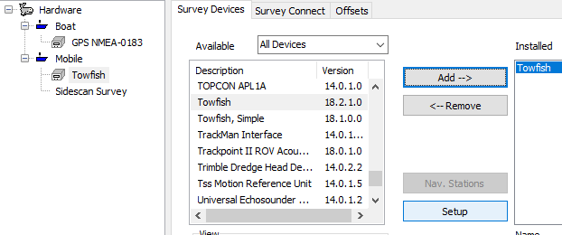
Setting Up A Towed Side Scan, Positioning
Select “Boat”, add your positioning device
Select “Mobile”, add “Towfish”
With “Towfish” selected, click “Setup”
1
3
2
4

Slide 44
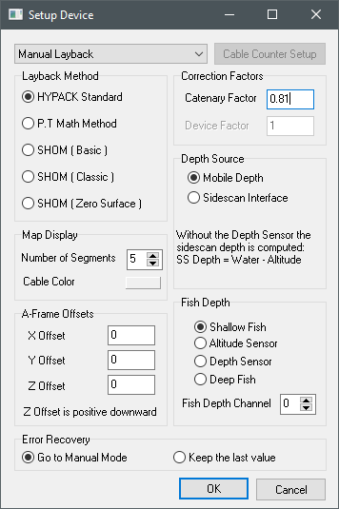
Setting Up A Towed Side Scan, Towfish Setup Pt. 1
Important settings:
  Cable counter at top
  Layback method PDF
  A-Frame Offsets
    Measurements from GPS to tow point
  Fish Depth
    Choose sensor to use
    “Shallow Fish” will not use depth

Slide 45
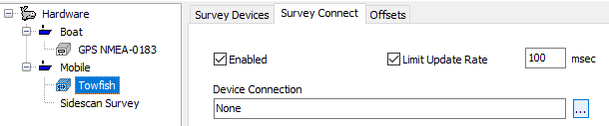
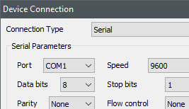
Setting Up A Towed Side Scan, Towfish Setup Pt. 2
Connection setup:
Select the “Survey Connect” tab
Click “…” button beside “Device Connection”
Configure the connection here
1
2
3

Slide 46
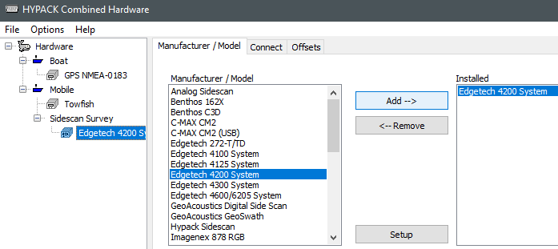
Setting Up A Side Scan, Device Connection
Select “Side Scan Survey” along left
Select device, click “Add”
Click “Setup” to configure device
Select “Connect” to configure connection
    Some devices must have manufacturer software running
4
2
1
2
3

Slide 47
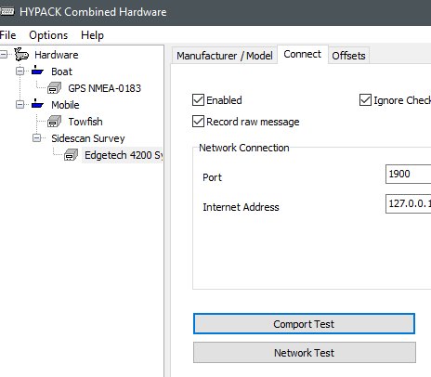
Setting Up A Side Scan, Connection Test
Comport Test: Displays comport activity
Network Test:
  Lets you “ping” an address
  Lets you view UDP data
    TCP connections won’t show data here

Slide 48
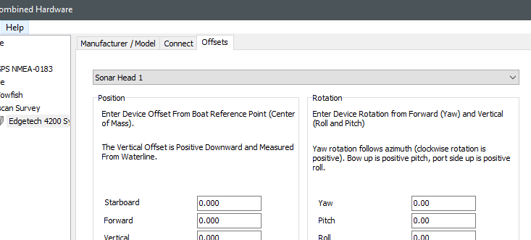
Setting Up A Side Scan, Offsets
Position offsets: Relative to vessel (boat or towfish)
    Usually 0 for a towed side scan

Slide 49
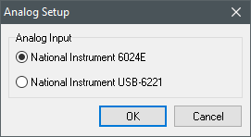
Analog Side Scan
Select NI USB-6221
  Other device is deprecated

Slide 50
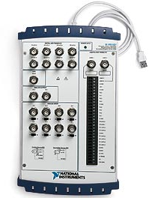
Analog Side Scan: USB-6221
USB connection
Connections:
    AI0 = Port signal
    AI1 = Starboard signal
    AI2 = Trigger
Must install National Instruments software

Slide 51
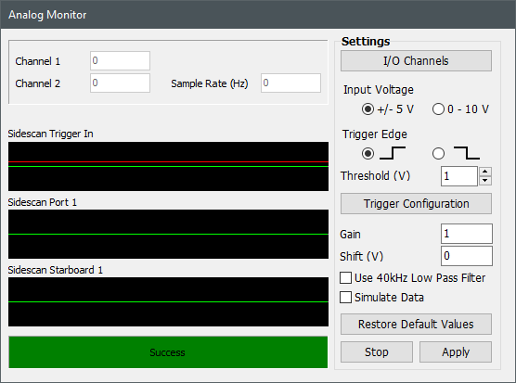
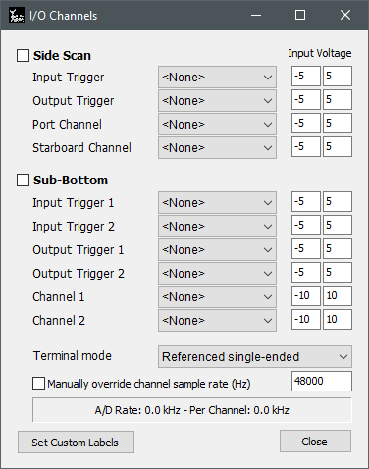
Analog Side Scan Software Setup
Launch Side Scan Survey
Use Analog Monitor window to configure side scan
This window must remain open

Slide 52
Side Scan Operation

Slide 53
Survey Planning: 100% Coverage
100% coverage:
  Efficient coverage for large areas
  Space lines at twice sonar range
  Subtract some to allow for errors
  E.g. sonar with 100m range, lines spaced ~160m
    100m range x 2 – 40m error = 160m
Signal width:
200m
Line spacing
160 meters

Slide 54
Survey Planning: 200% Coverage
200% coverage:
  Better imagery coverage
  Bottom is covered twice
  Nadir is covered
  Half line spacings of 100% coverage
Signal width:
200m
Line spacing
80 meters

Slide 55
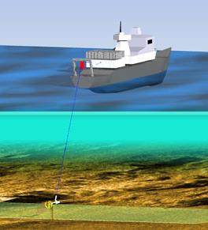
Collection: Side Scans Vs. Echosounders
4-5 kts
Do not stop while towing
No turns during collection
Nadir area is obscured
Image courtesy of Jim Kidd

Slide 56
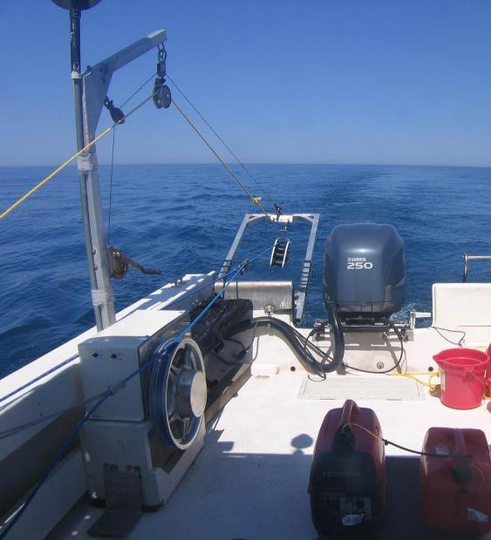
Side Scan Positioning
Cable out (layback)
Acoustic positioning system (USBL)
ROV
Ship mounted
A-frame for towing a fish behind the vessel

Slide 57
How To Do An Object Detection Self-check
Run past a known object (buoy, sand waves, etc.)
If you don’t see a known object, you won’t find an unknown object.

Slide 58
Towfish Height Above The Bottom
Fish height = 8-20% of sonar range
Why?
Provides ideal angle for reflections
Shadows are noticeable but not too long/short
Poor reflections, short shadows

Slide 59
Running A Survey

Slide 60
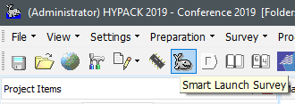
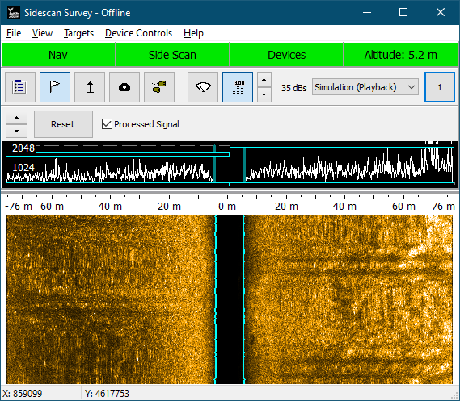
Starting A Survey
Click “Smart Launch Survey”
Side Scan Survey and HYPACK Survey will launch

Slide 61
HYPACK Survey vs Side Scan Survey?
Your computer
HYPACK
SURVEY
SIDE SCAN
SURVEY
GPS
Side Scan Sonar
Both programs run simultaneously
Side Scan Survey:
  Side scan sonar
  Optionally: MRU, heading, pressure sensor
HYPACK Survey:
  Everything else (GPS, single beam, tide data)

Slide 62
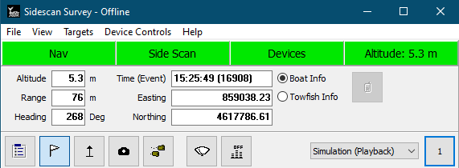
Window For Display And Control
Alarms:
  Green = Good ☺
  Yellow = Caution – Bad sensor data
  Red = Danger – No sensor data
System Measurements:
  Boat or towfish

Slide 63
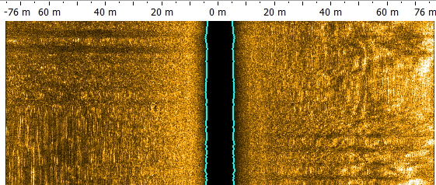
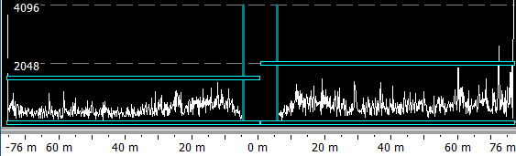
Waterfall and Signal Graph
Waterfall: Imagery from sonar
Signal graph: Amplitude (signal strength) over time

Slide 64


Options And Menus
Logging commands sync between Side Scan and HYPACK Survey
Saved as HSX files in Project’s Raw folder
Logging Option:
  File Overlap: New files will overlap with old files for X seconds
  XTF logging: Not recommended. Use HSX Converter afterwards

Slide 65




Side Scan Device Controls
Tools -> Side Scan Device Control (or Ctrl+Alt+S)
Alternatively, use manufacturer’s software
Warning: | Be careful when making changes here. Adjustments made in the Device Control window DO affect the recorded data.

Slide 66

Side Scan Buttons
Select display frequency
Select display device
Quick gain settings
Speed compensation
Set bottom track altitude
Capture image
Measure height
Show signal graph
Options
Notes:
A_tgt1.avi?

Slide 67


Real Time Mosaic In HYPACK SURVEY
See real-time mosaics in HYPACK Survey
Chart->Sidescan Mosaic->Enable
  Update: sets when the mosaic will draw

Slide 68
Adjusting The Image

Slide 69



First Steps
Click “Sidescan Signal” button
Turn OFF “Processed Signal”
Adjust with buttons on left until signal is roughly halfway
Notes:
Processed signal = gains – already looking at output
unchecked = raw signal – now we see the input
What gets written to disk

Slide 70
Signal Window Pt. 2
“Processed Signal” shows gains
“Reset” will automatically set the bars

Slide 71


Side Scan Controls - Colors
View->Side Scan Controls (or Side Scan Controls button)
All settings apply immediately
Choose and adjust your colors

Slide 72




Side Scan Controls - Gain
Basic Gains: Not recommended
Auto TVG: “Smart” TVG
  Higher sensitivity = brighter image
  Across-Track Smoothing smooths gain
dBs / 100 Meters: dB multiplier
Formula: Applies shown formula
  ‘r’ is range

Slide 73
Which Ones Are Best?
Auto TVG
  Fast, simple
dBs / 100 Meters
  More control
  Less artifacts

Slide 74

Side Scan Controls - Display
Display Optimal Fish Altitude: Marks a red line at 10% of the signal range
Remove Water Column: Leave this unchecked
  Important to see water column while surveying

Slide 75

Why You Don’t Remove The Water Column
Harder to see your altitude.
If you see something like this…
Speed up or pull the cable in, fast!

Slide 76

Side Scan Controls – Bottom Tracking
Use HYSCAN Bottom Tracking
  Auto bottom detect
  Uses side scan imagery
  Sensitivity: Higher = lock on to bottom sooner in water column
  Blanking: Ignore this much range
  Gate Size: Look this far up or down from the last ping’s bottom
Use Fish Sensor

Slide 77
Side Scan Survey Windows

Slide 78



Side Scan Survey Windows
Sidescan Waterfall: New waterfall window
  Useful for multi-frequency sonars
Tow Fish Altitude
  Configurable window displaying current altitude
Towfish Sensors
  Miscellaneous towfish info

Slide 79



Side Scan Survey Windows
Coverage map
Graphical HPR

Slide 80

Side Scan Data Display Windows
Device Selections:
Can select device for certain measurements
Only affects acquisition display

Slide 81
Marking Targets

Slide 82

Targeting
Double-click to mark target
Dropdown at top selects recent targets
Click “Retarget” then click in window to move target
Zoom Box and zoom Extents
Image Settings to adjust the image

Slide 83

Targets Options
Naming style
“Capture adjacent” adjusts number of pings to capture
“Automatic 30%” trims width to 30% of range
JPEG Options:
  Either show water column or slant range correct
  Option to show range ruler

Slide 84


Image Capture Target
Select the Camera Icon
Click-and-drag to capture image
Image will appear in HYPACK Shell

Slide 85

Height Measurement
Capture and Measuring a Target
Select the Height Measurement tool
Click on the object you wish to measure

Slide 86


Height Measurement
Fish altitude: Drag to bottom
Range to object: Drag to object
Object Height: Drag to end of shadow

Slide 87
Processing

Slide 88
Data Flow
Mosaic Data Flow
Mosaics
Average Backscatter Data from Multibeam
Individual tifs can be created from each line, or a single tif from all lines
HYSWEEP SURVEY
HSX
SIDE SCAN MOSAIC PROGRAM
(HYSCAN)
TIF
24 or 8 bit
HS2 or XTF
SIDE SCAN
SURVEY
Side Scan Data
Entire Data Set
HSX
TIF
Line 1
TIF
Line 2
TIF
Line 3
HSX files created in Data Converter
Targets
CM2
JSF
SDF
XTF
TIF
Targets can be saved into a report and displayed in Target Viewer.
3rd PARTY SIDE SCAN
FILES
TGT
TIF
TIF
Notes:
88

Slide 89

Menu Icons
Icons in Side Scan Mosaic
Load Files (HSX, HS2, XTF, JSF, SDF, CM2)
Save to HS2 File
Raw Data Mode – displays altitude, heading, and tracks
Scan View – displays waterfall and target captures
Mosaic View – dialog for creating mosaic
Redraw Screen
Sidescan Controls
Next/Previous Line Selection
Remove Line
Notes:
89

Slide 90

Processing Stage 1: Raw View
Side Scan Mosaic Processes
Load files – HSX, HS2, XTF, JSF, SDF, or CM2 files
Adjust:
  Bottom track
  Smooth heading
  Smooth track line
Notes:
90

Slide 91

Processing Stage 2: Scan View
Side Scan Mosaic Processes
Scan View
Adjust color, gain, TVG, and display options
Create targets and images
Notes:
91

Slide 92

Processing Stage 3: Mosaic
Side Scan Mosaic Processes
Create georeferenced mosaics
Notes:
92

Slide 93
Loading and Stage 1

Slide 94



Loading a File, pt. 1
Select “Open File”
Open either the Raw or the Edit folder
  Raw: Survey files
  Edit: Modified files
Select the lines you are interested in

Slide 95


Loading a File, pt. 2 (Read Parameters)
Selections: Choose devices
Device Info: Set offsets
Survey Info: Basic data from the survey
Advanced:
  Smooth bottom track, heading, or navigation
  Adjust bottom track up/down
Notes:
Attempt to match devices between files: For example, if, in file 1, the first device is navigation and the second is the sonar, and in file 2 the first device is sonar and the second navigation, it will detect that and swap them

Slide 96

Stage 1
Stage 1: View and Options
Towfish Altitude Window:
Review and edit bottom detection
Smooth and adjust bottom detection
Navigation Window:
Smooth position
Remove bad positions
Heading Window: Smooth heading
Note: | Adjustments to the file will be used in mosaicking process. Saving these adjustments to an HS2 file will allow you to re-load the files with adjustments already done

Slide 97




Stage 1: Heading and Tracklines
Stage 1: Altitude and Heading data
Heading
Smooth heading with
Tracklines
Remove navigation spikes with
Click and drag to select a section of line, then:
  Delete positions with
  Hide imagery with
Notes:
Positions can be selected or excluded for smoothing
Areas can also be selected to exclude from the final imagery
Right-click -> Show Charts
97

Slide 98

Stage 1: Bottom Tracking
Stage 1: Bottom Tracking
Choose port or starboard
Use Auto Bottom Detection
    Set a blanking, gate size, sensitivity
    Click Apply
Use the Digitize button to manually set the bottom
Use the Smooth button to smooth the altitude
Use the Up/Down arrows to move the altitude up or down slightly
Note: | Gains are not applied in stage 1
Towfish altitude view. The blue line should closely follow the bottom
Notes:
98
Blanking: How much of the swath to ignore. Move your mouse to the highest point where imagery appears and copy the Range (near the top) into the Blanking field.
Gate Size determines how much above or below the last ping’s altitude to look for the current ping’s altitude. If no altitude is found in the gate, it will ignore the gate and find a new altitude.
Sensitivity: Higher sensitivity will use samples with lower returns for the bottom, while lower sensitivity will use samples with a higher return for the bottom. Generally, high sensitivity will return a higher altitude than low sensitivity.
Digitize: Click to enter “digitize mode”. Click on the imagery to set the altitude. When finished, click the digitize button to exit digitize mode and set the altitude.

Slide 99
Stage 2 and Adjusting the Image

Slide 100



Stage 2
Stage 2: Features & Options
Apply gains and color adjustments
Create targets
Export data to spreadsheet
Save non-georeferenced image
Adjust layback
Notes:
100

Slide 101

Stage 2: Bottom Tracking
Select Digitizer tool
Click along bottom
Reselect Digitizer tool to apply

Slide 102


Sidescan Controls - Colors
Right-Click -> Sidescan Controls, View->Sidescan Controls, or Shift + F9

Slide 103




Sidescan Controls - Gain
Basic Gains: Not recommended
Auto TVG: “Smart” TVG
  Higher sensitivity = brighter image
  Across-Track Smoothing smooths gain
dBs / 100 Meters: dB multiplier
Formula: Applies shown formula
  ‘r’ is range
Angle-Varied Gain: Geocoder gain

Slide 104

Sidescan Controls - Display
Blank Imagery Adjacent to Nadir: Blanks imagery at given range from nadir

Slide 105

Stage 2
Saving Image as BMP file
Save a non-georeferenced image of entire waterfall
Notes:
105

Slide 106


Stage 2: Spreadsheet
Spreadsheet Options
View->Spreadsheet if not visible
Displays information for each ping
View->Options (or F9), Spreadsheet tab
  Add/remove columns
Output data to a single file or multiple files
Use to adjust Layback for individual pings
Note: Use Tools->Adjust Layback to modify layback for entire file
Set-up dialog box
Notes:
106

Slide 107

Stage 2: Coverage
Saving Coverage as TIF file
Current view in display is bounded by blue box
Display coverage of all tracks, background charts & soundings
Current view in display is bounded by blue box
Notes:
107

Slide 108
Targeting

Slide 109


Stage 2: Targeting
Target window opens
Select Target (double left-click on feature)
Double-click to mark target
Sliders at top are used for measurements
Click camera icon, click and drag to create image
Notes:
109

Slide 110



Stage 2: Quick Targets
Bulls-eye icon:
Select, then click to mark target
Shift-right click to remove a target
Options available to adjust targeting
Images saved to “Side Scan Images” folder in shell

Slide 111


Target Viewer
Tools->Target Viewer
Edit previous targets
Export to RTF file

Slide 112


Target Classification
Target Classification Database
Select classification from dropdown
Use the ? to open the comparison window

Slide 113






Target Classifications
Target Classification Database
Launch from HYPACK->Side Scan->
Target Classifications
Create/Edit/Delete a classification
Add/Delete a reference image
Scroll through existing images
How “confident” you are an
image belongs to this
classification (0-7)
Notes:
113

Slide 114

Stage 2: Comparing Targets
Using Coverage Map to Manage Targets
Blue target = previous line
Red target = current line.

Slide 115
Stage 3: Mosaicking

Slide 116

Stage 3
Stage 3: Side Scan Mosaic
Notes:
116

Slide 117

Mosaicking Process
Stage 3: Mosaic
Select files to mosaic
Enter resolution
Select Overlap & Filter methods
Single TIFF or one per line
Use Border file for specific area mosaic
Name the TIFF file
“Make Mosaic”
Notes:
117

Slide 118

Blanking the Nadir region for Mosaic
Ignore a certain distance from nadir
Area adjacent to nadir can often have poor imagery
Useful when lines overlap

Slide 119

Resolution Calculator
Useful for choosing optimal resolution
Enter your sonar properties
Can be saved to apply later
On close, resolution is set automatically

Slide 120



Mosaic Filters
Mosaic Filter Options
AVERAGE:
Smooths the mosaic by setting each pixel to the average of the 3x3 pixel neighboring cells.
SHARPEN:
Sharpens the mosaic by enhancing pixel contrast relative to a 3x3 pixel neighboring cells.
MEDIAN:
Smooths the mosaic while preserving edges by setting each pixel to the 3x3 median value.
Notes:
120

Slide 121
Saving, Batch Mosaicking, and Merge Mosaics

Slide 122


Saving Your Data:
Data can be saved as:
  HS2 – All settings (gain, bottom track, navigation editing) are saved.
  XYIntensity – Each point will have an intensity value.
  Export to XTF – For non-HYPACK programs.

Slide 123

Auto Mosaic
Batch Mosaicking
Run SIDE SCAN MOSAIC (HYSCAN) all the way to Stage 3.
Enter all settings and then select “Add to Batch File…”.
Close SIDE SCAN MOSAIC program without generating the mosaic.
When you are ready to make a mosaic, run SIDE SCAN AUTO MOSAIC
Notes:
123

Slide 124

Merge Mosaics
Merge Mosaics
Separate TIFF File for Each Survey Line
SIDE
SCAN MERGE MOSAICS
Single TIFF File Composed of All Individual TIFF Info
SIDE
SCAN MOSAIC
TIFF
Line 1
TIFF
Line 2
TIFF
TIFF
Line 3
TIFF
Line 4
TIFF
Line …..
Run SIDE SCAN MOSAIC (HYSCAN).
Generate a separate mosaic TIF for each file.
Run SIDE SCAN MERGE MOSAICS to combine the separate TIFS into a single TIF.
Notes:
124

Slide 125
Thank You !
Contact Us:
Sales@HYPACK.com
Help@HYPACK.com
(860) 635 - 1500
Links to more information:
HYPACK on Youtube.com ( Historical Sessions ) HYPACK Live Chat
HYPACK on Youtube.com ( Newer Sessions ) HYPACK Ustream
HYPACK SUPPORT Site HYPACK Website

