Slide 1
Sub-Bottom Data Collection & Processing

Slide 2
Objectives of this session
1
2
3
Hardware Setup
Configure your device in HYPACK Hardware
Analog Setup
Installing NIDAQ software
Configuring connection
Surveying
Adjusting imagery
Adjusting display
4
5
Analog Configuring
Configuring Analog Monitor
Post Processing
Creating imagery
3D fence diagrams
Notes:
Stressed Water Supply
Issue
Maintain the health of traditional water sources and execute a water source diversification strategy
Solution
Xylem’s leading-edge technologies monitor, pump and treat water from all sources and enable water reuse
Aging Infrastructure
Issue
Utilities have to effectively assess and identify high-risk areas for repair/replacement before problems occur
Solution
Xylem’s intelligent pipeline and critical infrastructure services perform condition assessment, identify defective assets, provide bypass services and replacement technologies, reduce or eliminate combined sewer overflows and leaks/non-revenue water
Stormwater & Flooding
Issue
Significant increase in severe weather patterns is causing flooding and related damages to communities
Solution
Xylem’s flood management solutions include sensors for early warnings, dewatering for disaster response, communications for recovery and submersible pumping for resilient infrastructure
Regulatory Compliance
Issue
Utilities must successfully comply with a growing body of compliance regulations
Solution
Xylem’s analytics and sensors evaluate a broad range of water quality parameters, and our technologies treat water and wastewater to meet regulatory standards
Non-Revenue Water
Issue
Utilities have an important opportunity to reduce persistent and costly water losses from leaks and faulty meter readings
Solution
Xylem’s broad portfolio of solutions monitors for, and identifies, water leaks, as well as faulty meters. Our communications network enables point-to-multipoint communications throughout the system
Operating Strategy Reducing Costs
Issue
Utilities want to lower operating and energy costs, and leverage new revenue opportunities
Solution
Xylem offers industry-leading pumping and treatment solutions for energy efficiency, and software-enabled solutions to optimize operations and identify revenue opportunities

Slide 3
Sub-Bottom Data Collection

Slide 4
Sub-Bottom Profiling Systems
EdgeTech 3000
DIGITAL SYSTEMS
Innomar SES-2000
One DLL is used for all systems
SyQwest B2010/SB3510HD
Stratabox
HYPACK®
SURVEY
GeoAcoustics GeoPulse Chirp
SUBBOT.DLL
Teledyne Odom Chirp III
Benthos Chirp
Manufacturer
Control Program
(system dependent)
Falmouth HMS-622
Knudsen
Specialty Devices
ANALOG SUB-BOTTOM CH-1
A/D Box
NI-USB-BNC 6221, 6341 or 6212
ANALOG SYSTEMS
HYPACK®
SURVEY
ANALOG SUB-BOTTOM CH-2
SUBBOT.DLL

Slide 5
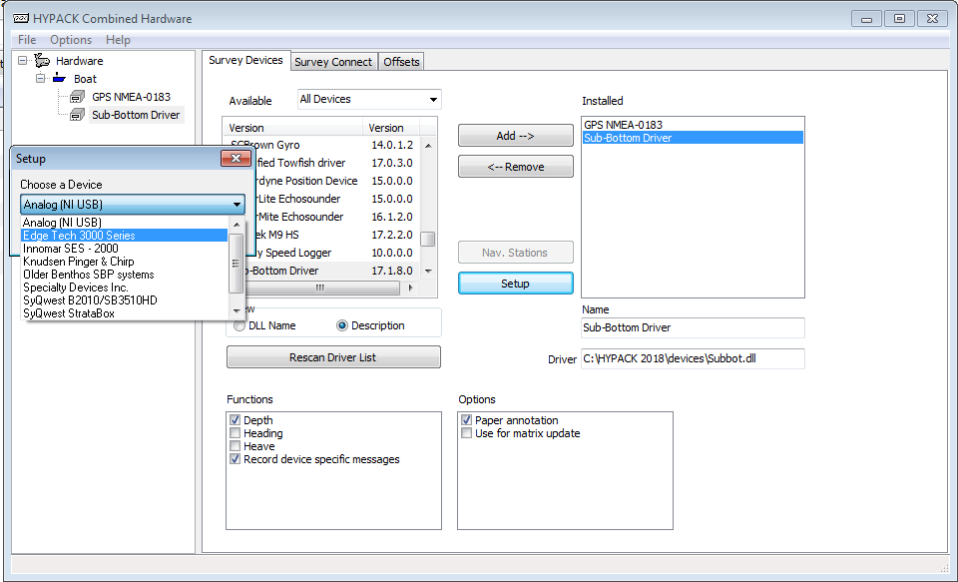
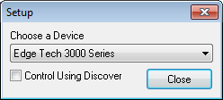
Hardware Setup
Add positioning device
Add Sub-Bottom Driver
Click “Setup”, choose sub-bottom device
Click “Survey Connect”, configure connection
Notes:
5

Slide 6
Setting up a NI-DAQ Device:
Analog SBP & SSS

Slide 7
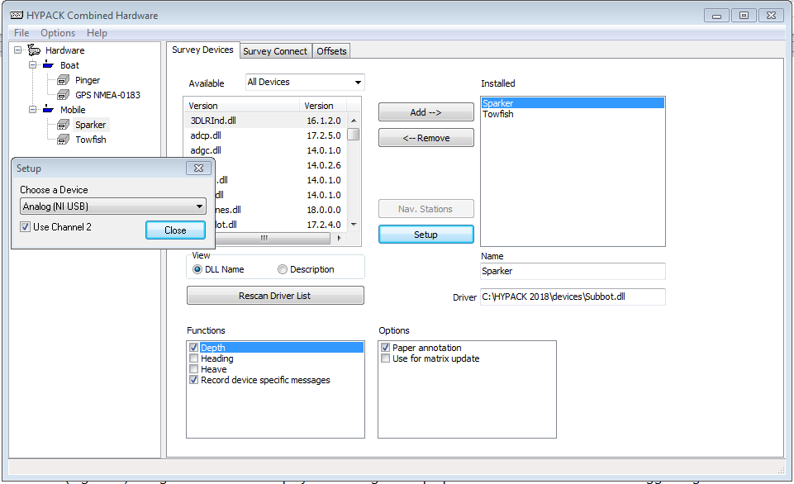
Analog Hardware Setup
Add Sub-Bottom driver
Choose “Analog” from dropdown
  For dual-channel:
    Add second sub-bottom driver
    Select “Analog”
    Check “Use Channel 2”
Rename device
Notes:
7

Slide 8
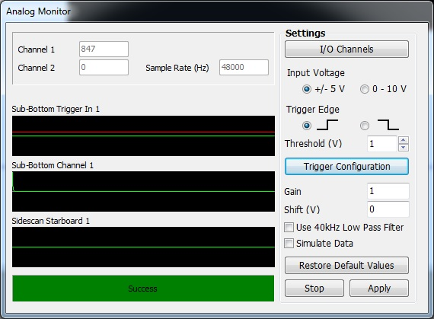
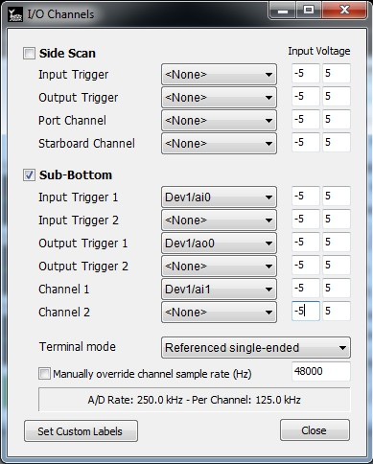
Analog Sub Bottom Monitor
Launch SURVEY to start Analog Monitor
Select “I/O Channels”
  Configure each channel to match your NI USB device
Pinger/chirper: Use -5V/+5V to -2V/+5V trigger voltage
Boomers/sparkers/etc: Use -1V/+1V to -5V/+5V
Use the default Terminal Mode (RSE) and default channel sample rate
Notes:
8

Slide 9
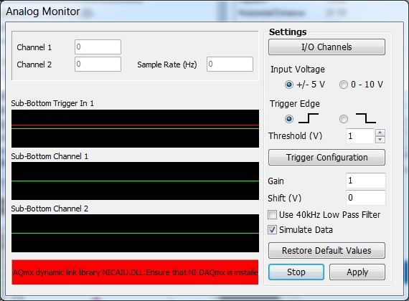
Analog Sub Bottom Monitor Continued
Set the voltage range about one third higher than the actual input signal voltage to prevent signal clipping
Configuration problems will be reported as a red message
Click the labels to cycle through the channels
The trigger threshold is displayed as a red line. It should be set just above the base voltage
  Every time the trigger signal crosses this line, a ping is logged
Notes:
9

Slide 10
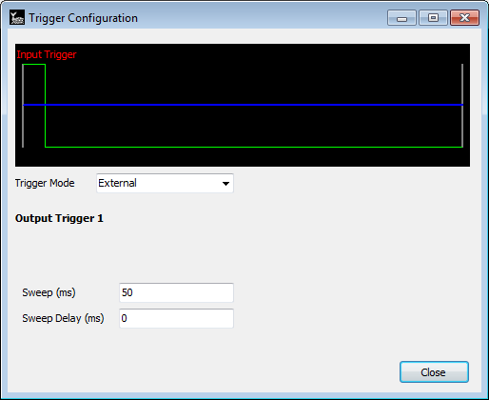
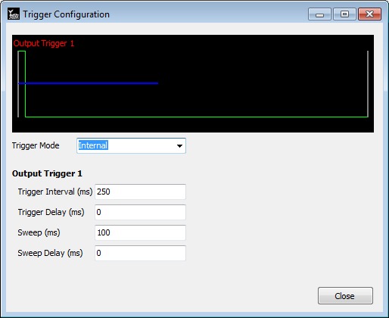
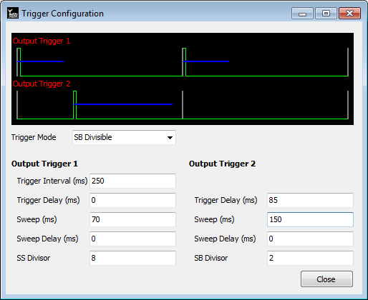
Analog Settings – Triggers & Sweep Rates
External Trigger: The sub-bottom system is being triggered by another source and HYPACK ‘listens’ for the returns.
Internal Trigger: HYPACK provides a trigger to the sub-bottom system via the NI USB A/D box.
Internal – SB Divisible: Used to avoid interference between two sub-bottom systems.
Sweep Period: How long the Sub-Bottom driver listens for returns.
Sweep Delay: How long the sub-bottom driver waits after the ping before starting listening.
  This feature can be used in deeper water to reduce the length of the water column in the data.
Notes:
10

Slide 11
Analog Settings – Triggers & Sweep Rates Continued
To prevent interference, neither blue line should overlap
Below is a table for best settings to use at 30m depth
Notes:
11

Slide 12
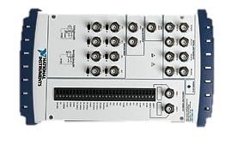
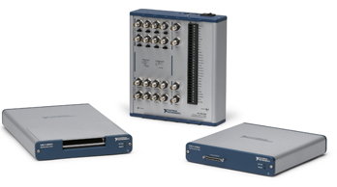
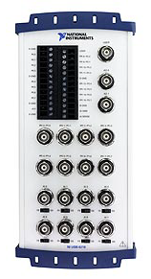
NI-DAQ Models
NI USB-6221 BNC – current HYPACK recommendation (Legacy Product
Research summary spreadsheet of replacement models.
New 16-bit recommendations are:
      USB-6341 with BNC 2110
      USB-6212 BNC
Chesapeake Technologies
      USB-6210 (no triggering support) – works with HYPACK
      USB-4431 (24-bit) – does not work with HYPACK

Slide 13
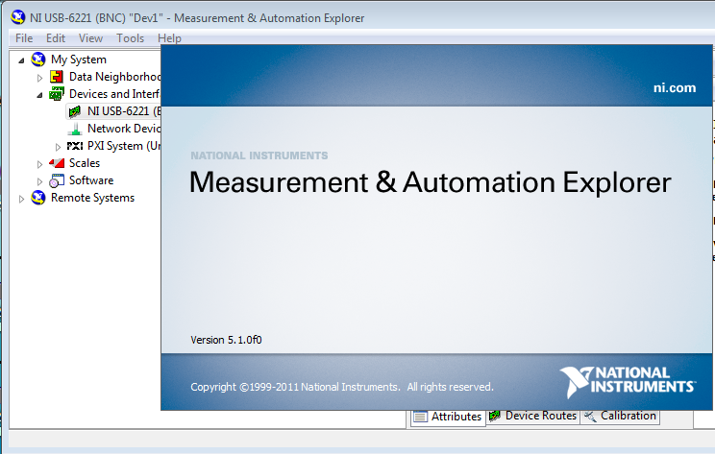
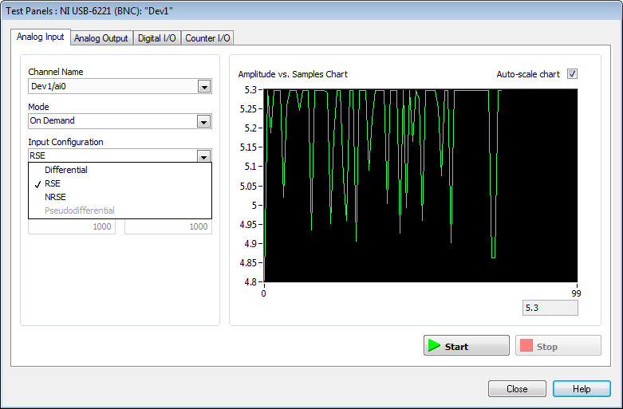
Installing NI-DAQ Software
Install and update the NIDAQ951f2.exe onto the acquisition PC (this can take more than an hour)
Connect NI-USB device & start NI-DAQ software
Test system
The NI-DAQ software should not be running when using HYPACK.

Slide 14
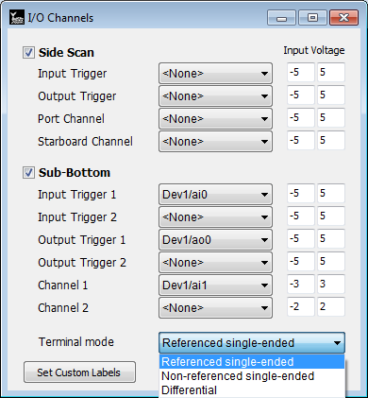
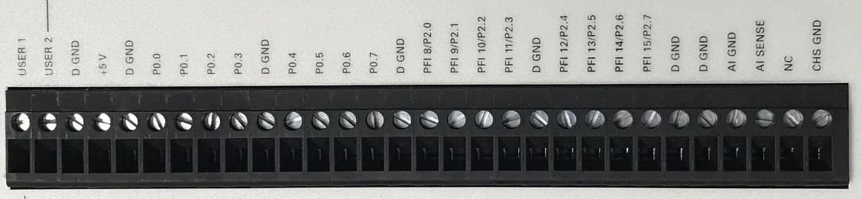

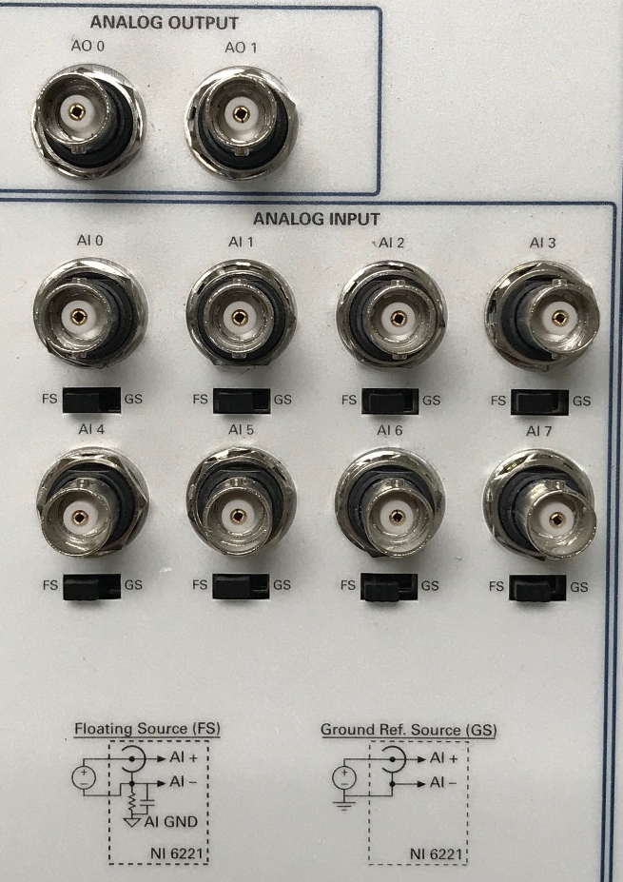
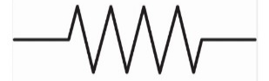
Configuring Single Channel SBP – Internal Trigger
Uncheck this box
Analog
Monitor
Set voltage to ±¹/₃ higher
than input voltage
Passive High-Pass Filter
(resistor & capacitor)
BNC T
SBP Trigger Input
48 Hz passive HPF
*
*
SBP Ch 1 Signal Output
Analog Output 0 is sent to Analog Input 0 (to trigger both device and HYPACK)
  Split this using a BNC T connector
Analog Input 1 is connected to the SBP signal output
Set the signal source to Floating Source (FS) *

Slide 15
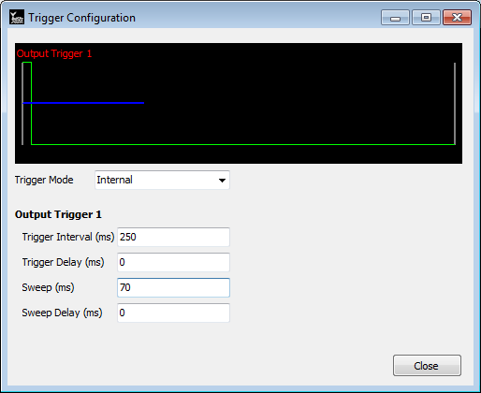
Configuring Single Channels SBP – Internal Trigger
Set the Trigger Mode to Internal.
Set the Trigger Interval to 250ms & the Sweep to 70ms (52 m).
Trigger
Configuration

Slide 16

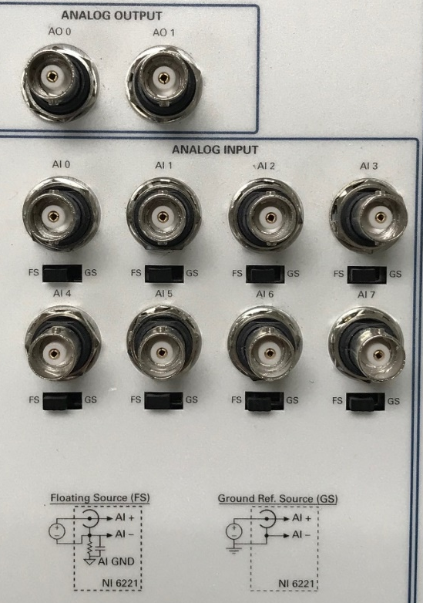
Configuring Single Channel SBP – External Trigger
Uncheck this box
Analog
Monitor
SBP Trigger Input
48 Hz passive HPF
*
*
SBP Ch 1 Signal Output
The external is sent to Analog Input 0
Analog Input 1 is connected to the SBP signal output
Set the signal source to Floating Source (FS) *

Slide 17
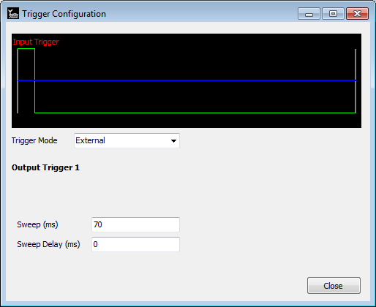
Configuring Single Channels SBP – External Trigger
Set the Trigger Mode to External.
Set the Sweep to 70ms (52 m).
Trigger
Configuration

Slide 18
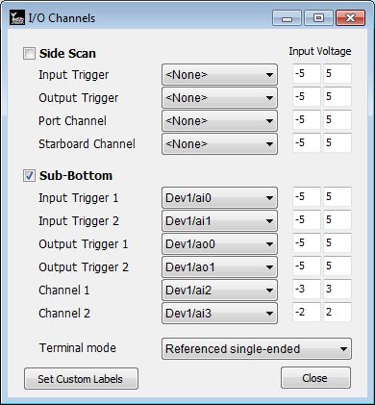
Configuring Two Channels SBP – Internal Trigger
Analog
Monitor
Analog Output 0 is sent to Analog Input 0 and Analog Output 1 is sent to Analog Input 1 (triggering both channels of HYPACK and SBP)
  Split using two BNC T connectors
Analog Input 2 is connected to the SBP signal output Ch 1 & Analog Input 3 to Ch 2.
BNC T
SBP 1 Trigger Input
BNC T
SBP 2 Trigger Input
*
*
SBP Ch 1 Signal Output
48 Hz passive HPF
SBP Ch 2 Signal Output

Slide 19

Configuring Two Channels SBP – Internal Trigger
Channel 1:
  Set the Trigger Interval to 250ms & the Sweep to 70 ms (52 m)
Channel 2:
  Set Trigger Delay 2 by 80ms so these is no interference with Ch1
  Set the Ch 2 Sweep to 150ms (112 m) for no interference with Ch1
Trigger
Configuration

Slide 20

Configuring the Analog Monitor, Setting Triggers, Delays & Sweep Length
Sounding Better April 2017
Setting the Trigger Intervals & Sweep Rate

Slide 21
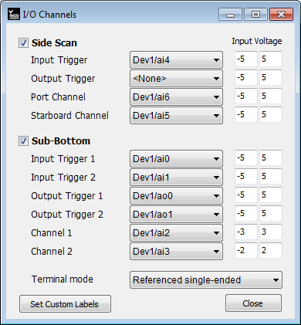

Configuring Two Channels SBP & SSS– Internal Trigger
BNC T
BNC T
SBP 1 Trigger Input
BNC T
SBP 2 Trigger Input
*
*
SBP Ch 1 Signal Output
BNC T
SBP Ch 2 Signal Output
Analog
Monitor
SSS Port Channel
48 Hz passive HPF
SSS STD Channel
SSS Trigger Input

Slide 22
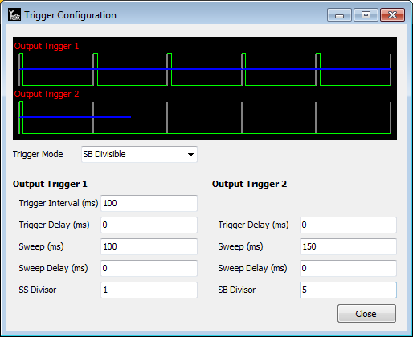
Configuring Two Channels SBP & SSS– Internal Trigger
Trigger
Configuration
Set the SSS & Pinger trigger to 100 ms & the sweep rate to 100 ms (75 m).
Divide the Trigger 1 (100 ms) by five to make Trigger 2 500 ms.
Trigger delay will not help with interference between the systems.
Set the Sparker (Ch 2) sweep rate to 150 ms (112 m).

Slide 23
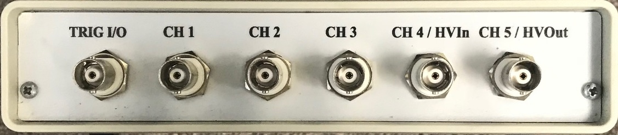
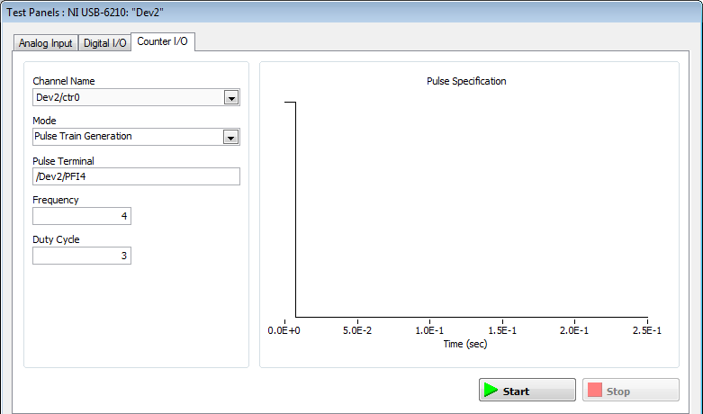

Configuring the NI USB-6210 (Chesapeake Technologies)
The NI USB-6210 can be use with HYPACK but the trigger must be generated in the NI software or other external source. The NI USB-6210 can be used for SBP or SSS data collection.
SBP 1 Trigger Input
48 Hz passive HPF
SBP Ch 1 Signal Output
In the NI Test Panel Counter I/O:
Set mode to Pulse Train Generator
Set Frequency to 4 for 250 ms trigger (or any desirable trigger interval)
Set Duty Cycle to 3
A trigger of 250 ms will know be generated for the SBP or SSS.
A SSS will require CH2 input for the
Other SSS channel.
NI Software
used for Trigger
Analog
Monitor

Slide 24
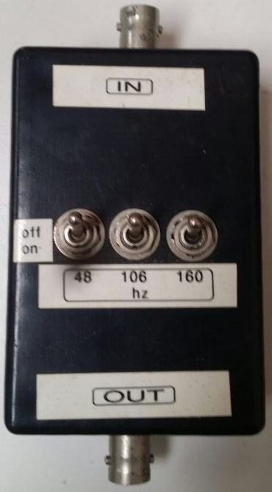
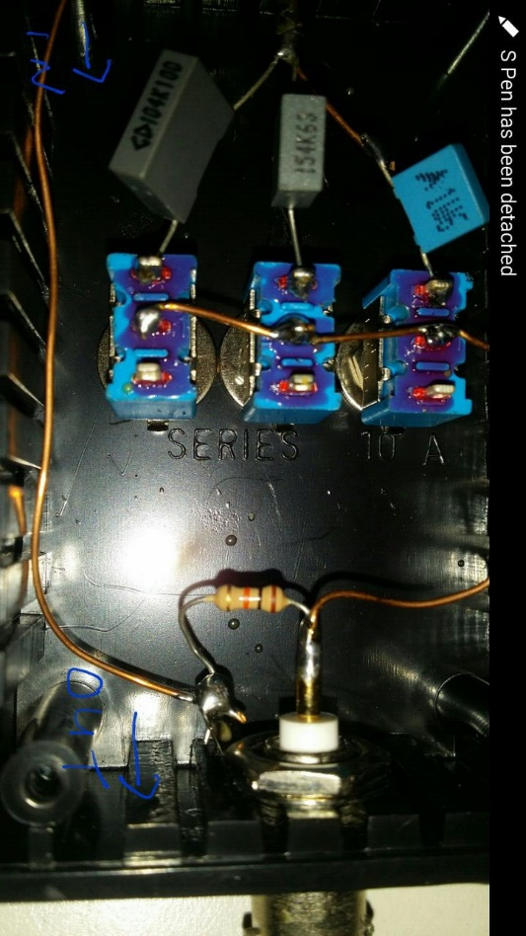
Making a 48 Hz Passive High-Pass Filter Box
A 48 Hz PHP filter can remove the characteristic hydrostatic “swell” (wiggle) associated with towed hydrophone array. This PHP filter is not necessary for transducer based systems. Refer to the images below to build a 48 Hz passive high-pass filter box.
SBP Ch 1 Signal Output
1W6 Capacitor
Resistor
(brown/black/orange)
NI-DAQ

Slide 25
Running a Sub Bottom Survey

Slide 26
Running SURVEY (Single SBP)
Notes:
26

Slide 27
Running SURVEY (Dual SBP)
Notes:
27

Slide 28
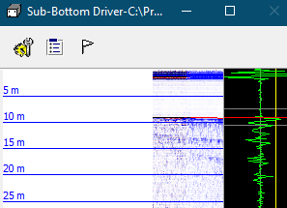
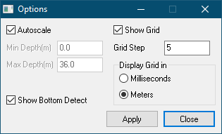
Sub-Bottom Controls in SURVEY
Options
Autoscale: Shows entire ping depth
Min/Max depth: trim to desired depth
Note: these corrections are not applied to the SEG-Y data files as HYPACK always records the raw data to the SEG-Y file.
Notes:
28

Slide 29
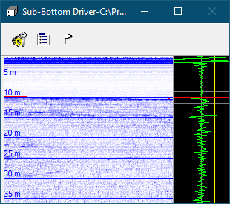
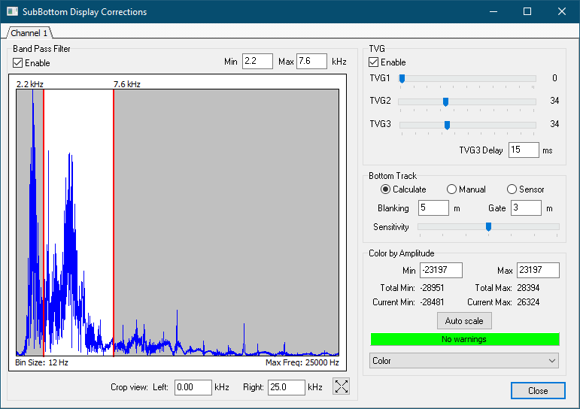
Sub-Bottom Controls in SURVEY
Sub-Bottom Corrections
Band Pass Filtering: reduces signal noise
  Low pass start frequency = half the sub-bottom transmit frequency
  High pass end frequency = double the sub-bottom transmit frequency
  Do not apply to chirp data
TVG (Time Varied Gain)
  TVG1 rate applies through the water column
  TVG2 rate applies from the seabed bottom tracking through the seabed strata
  TVG3 rate applies during the final part of the sweep period
Note: these corrections are not applied to the SEG-Y data files as HYPACK always records the raw data to the SEG-Y file.
Notes:
29

Slide 30
Sub-Bottom Controls in SURVEY
Sub-Bottom Corrections
Bottom tracking
  Calculate: Detect bottom based on the signal amplitude levels
  Manual: Set custom depth by clicking in signal graph in main window
  Sensor: Read bottom tracking from the sub-bottom system (if available)
Color by Amplitude
  Auto scale: click to set upper/lower signal strength bounds for coloring
  Choose a color option you like
Note: these corrections are not applied to the SEG-Y data files as HYPACK always records the raw data to the SEG-Y file.
Notes:
30

Slide 31
Sub-Bottom Data Processing

Slide 32
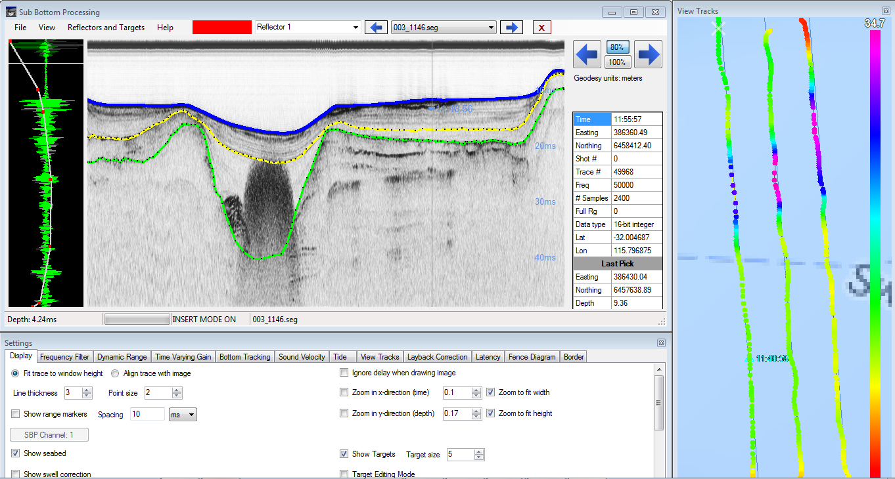
Introduction
Mark targets
Manually digitize acoustic layers
Located under ‘Processing’ menu
Used to process small & large SEG-Y or JSF datasets.
Full suite of processing features.
Digitizing layers & color polygons
Mark targets
3D fence diagrams
Notes:
32

Slide 33
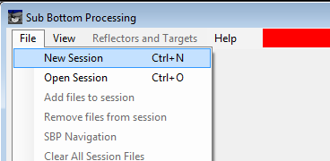
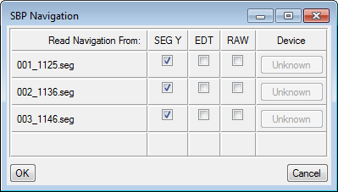
Loading Files
Select “New Session” to load SEG-Y/JSF/Log files
Select “Open Session” and click on the SBP.xml file to load a previous session
If the user clicks “New Session”, your old files are backed up
Navigation can be read from the SEG-Y (or JSF) file, RAW file or EDT file
Notes:
33

Slide 34
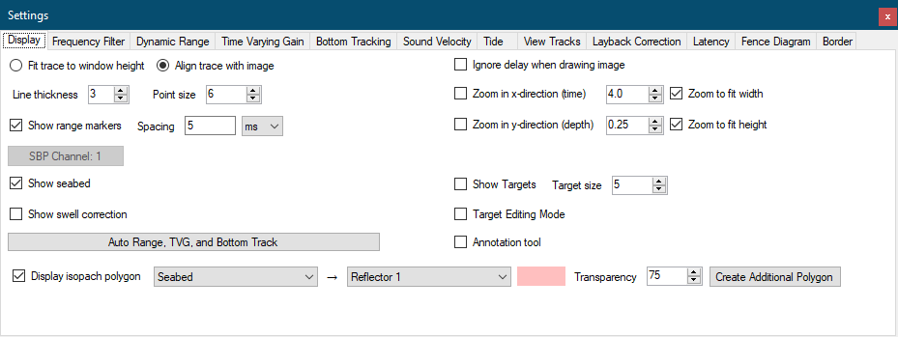
Data Processing
  Settings window: contains all your tools for modifying the imagery
  Auto Range, TVG & Bottom Tracking button: can provide initial settings for the data display
Notes:
34

Slide 35
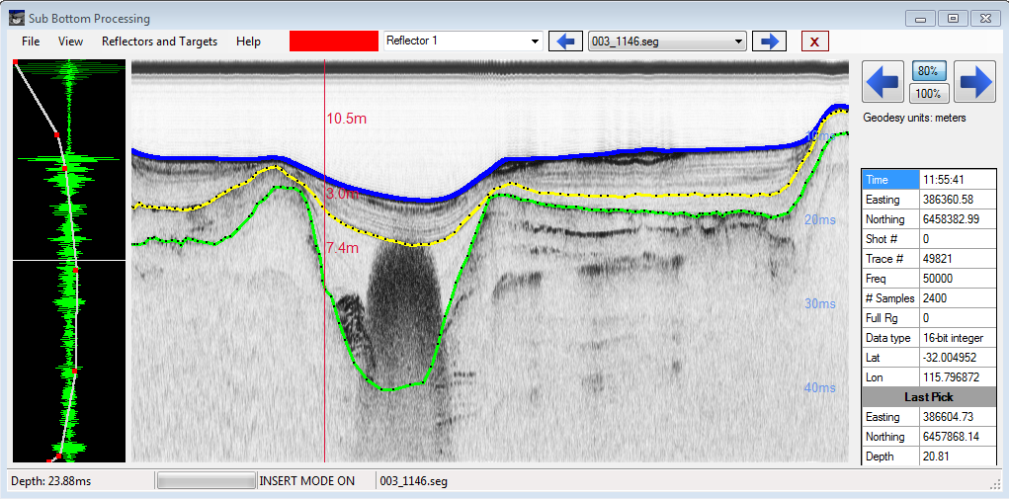

Digitizing Layers
Digitize up to 20
different layers (custom names & colors)
Annotation Tool
Layers can be exported to EDT or XYZ format
Manually digitize acoustic layers
  Select Reflector from dropdown at top of screen
    Left-click to add a point. Shift-click to remove a point. Ctrl-click to move a point
  Select “Annotation tool” under the Display Tab to add depth & sediment thickness information
    Annotations can be added to the data or removed in the same way as Reflector editing
Notes:
35

Slide 36
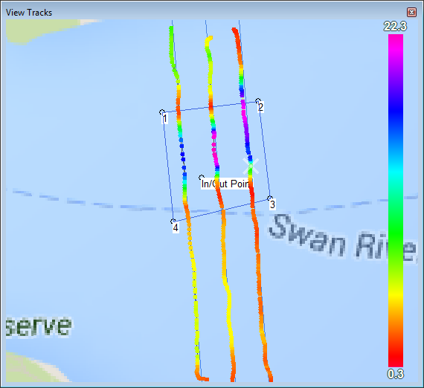
Map View of Digitizing Layers
  Reflectors can be seen plotted on the View Tracks window
  These can represent either depth or isopach
Isopach/depth digitizing “points”
Notes:
36

Slide 37
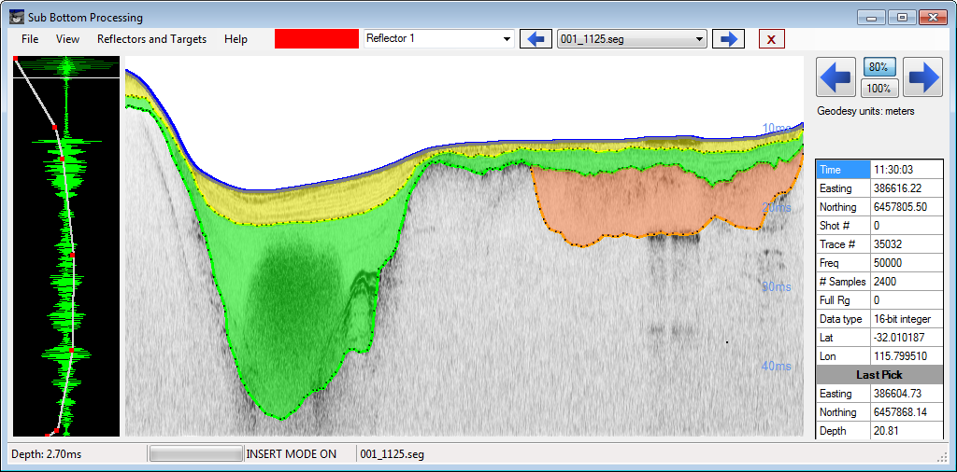
Coloring Layers
Colored geological polygon
  Reflectors can have colored polygons filled between them
Notes:
37

Slide 38
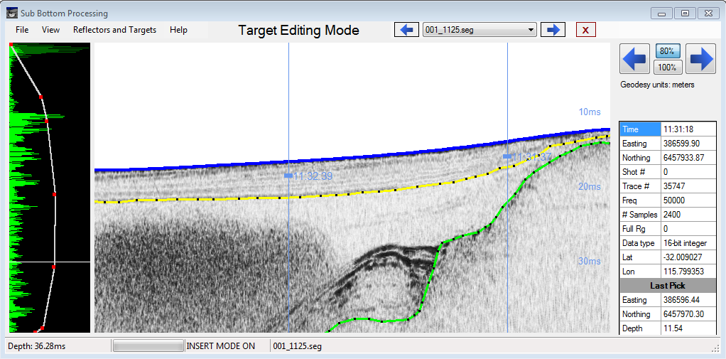
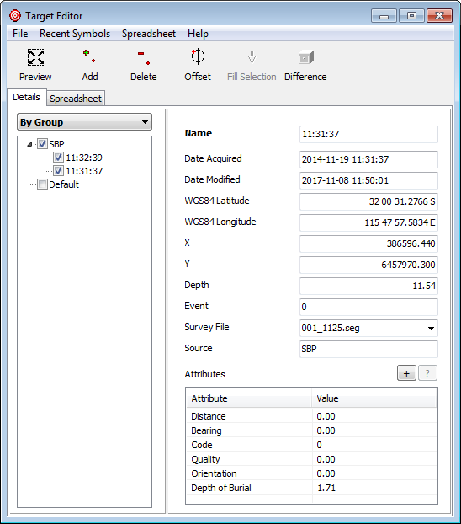
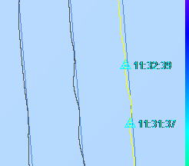
Targeting
Targets
Add, edit, or delete targets in Target Editing Mode.
Drag target's handle to mark depth & isopach.
Saved to SBP.tgt in the project folder.
Targets also displayed in View Tracks.
Notes:
38

Slide 39
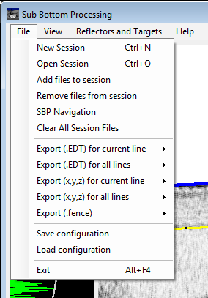
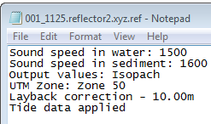
Exporting Data & Corrections
Reflectors can be output as XYZ or EDT files. You can apply:
Sound velocity, tide, layback, and latency corrections
  See Sounding Better May 2018 for details.
Trim to border file
A .ref file will be created with your output with corrections info
Files can be used in TIN or other GIS/CAD software
Notes:
39

Slide 40
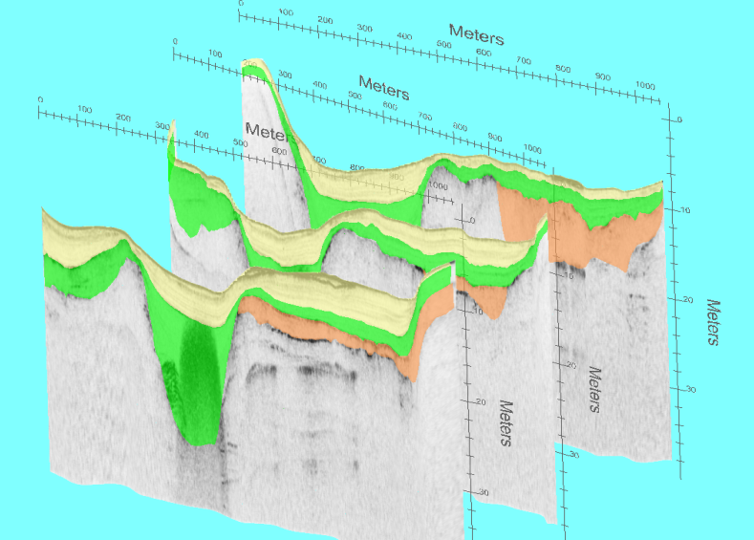
3D Fence Diagrams
3D fence diagrams help you visualize your survey
Go to File->Export Fence
Reflectors and colored polygons are visible
Rotate, zoom, pan in 3D
Great for correlating data
Use Shift left mouse click to rotate the Fence.
Mouse wheel to zoom in/out.
Right mouse click to pan.
Notes:
40

Slide 41

3D Fence Display
3D fence diagram of two intersecting sub-bottom profiling lines.

Slide 42
Thank you!

