Slide 1
MBES – Advanced Data Processing

Slide 2
Learning Objectives this session
1
2
3
Ongoing USACE Projects
eHydro
Feature Detection
Processing Methods
TPU Introduction
RTK Tide Methods and Comparison
Multiple SV Profiles
Grid Convergence Option
Adjustment Tools
SBET Editor
POS MV True Heave
POSPac Adjustments
HYPACK RAW File Adjustments
GPS Recalc
4
5
New Stuff
Faster Matrix and Point Cloud Drawing
Cloud Popup Calibration
Color File Export
6
Statistical Methods
Statistical Filters
CUBE
Thank You
Notes:
Stressed Water Supply
Issue
Maintain the health of traditional water sources and execute a water source diversification strategy
Solution
Xylem’s leading-edge technologies monitor, pump and treat water from all sources and enable water reuse
Aging Infrastructure
Issue
Utilities have to effectively assess and identify high-risk areas for repair/replacement before problems occur
Solution
Xylem’s intelligent pipeline and critical infrastructure services perform condition assessment, identify defective assets, provide bypass services and replacement technologies, reduce or eliminate combined sewer overflows and leaks/non-revenue water
Stormwater & Flooding
Issue
Significant increase in severe weather patterns is causing flooding and related damages to communities
Solution
Xylem’s flood management solutions include sensors for early warnings, dewatering for disaster response, communications for recovery and submersible pumping for resilient infrastructure
Regulatory Compliance
Issue
Utilities must successfully comply with a growing body of compliance regulations
Solution
Xylem’s analytics and sensors evaluate a broad range of water quality parameters, and our technologies treat water and wastewater to meet regulatory standards
Non-Revenue Water
Issue
Utilities have an important opportunity to reduce persistent and costly water losses from leaks and faulty meter readings
Solution
Xylem’s broad portfolio of solutions monitors for, and identifies, water leaks, as well as faulty meters. Our communications network enables point-to-multipoint communications throughout the system
Operating Strategy Reducing Costs
Issue
Utilities want to lower operating and energy costs, and leverage new revenue opportunities
Solution
Xylem offers industry-leading pumping and treatment solutions for energy efficiency, and software-enabled solutions to optimize operations and identify revenue opportunities

Slide 3
Ongoing USACE Projects

Slide 4
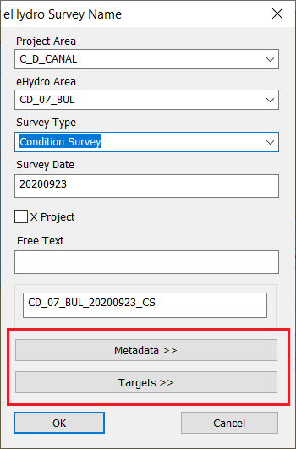
USACE eHydro
Use Tools menu, USACE eHydro.
Easy submission of survey data to eHydro. (eHydro = US Army Corps of Engineers online survey database)
Survey Naming Support
Select Project Area, eHydro Area and Survey Type from drop down lists.
Each district has it’s own project/area file: eHydroProjectAreaExport.xml in the HYPACK root folder.
Survey Date filled automatically.
Metadata and Targets are accessed with the buttons.
Notes:
4

Slide 5
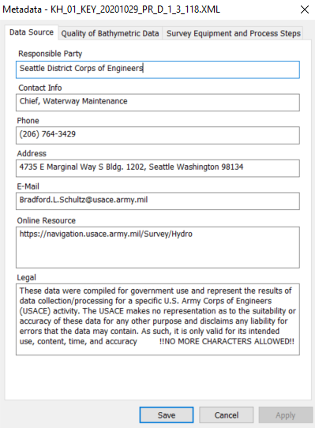
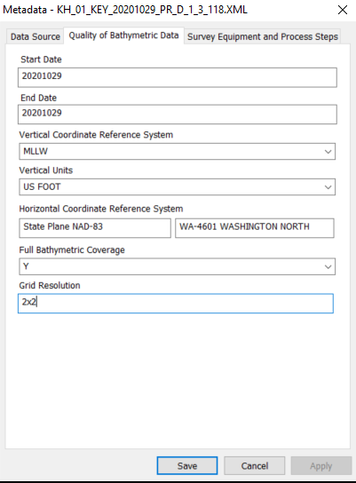
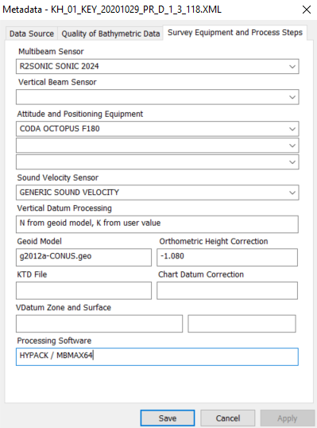
eHydro Metadata
Limited metadata, the details come from HYPACK logged data.
Notes:
5

Slide 6
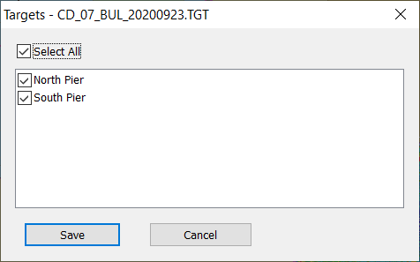
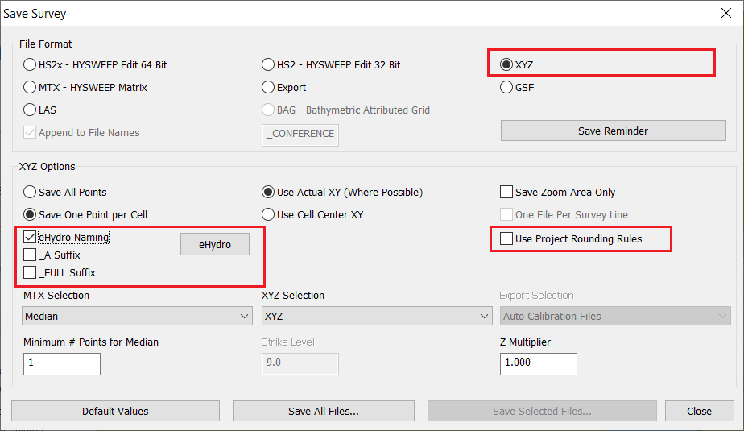
eHydro - Targets and XYZs
Target selections for eHydro export
eHydro XYZ naming options.
Notes:
6

Slide 7
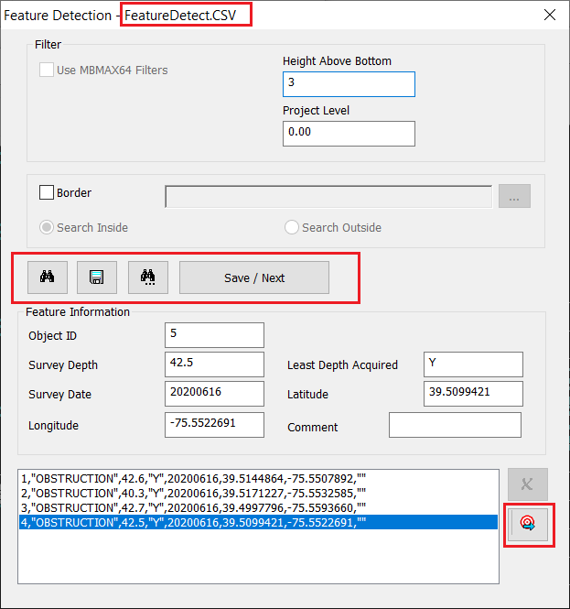
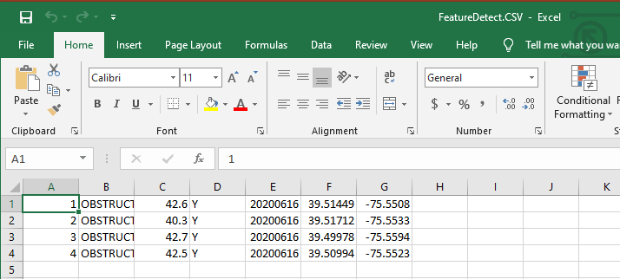
Feature Detection
Use Tools menu, Feature Detection. Combined Auto/Manual method for detecting bottom features
Enter target Height Above Bottom. Enter Project Level if searching only for obstructions.
Select a Border to Include/Exclude sections.
Search / Save / Find Next feature.
Export features to the HYPACK Target Database.
Features are always saved to “FeatureDetect.CSV” in the project folder.

Slide 8
Processing Methods

Slide 9
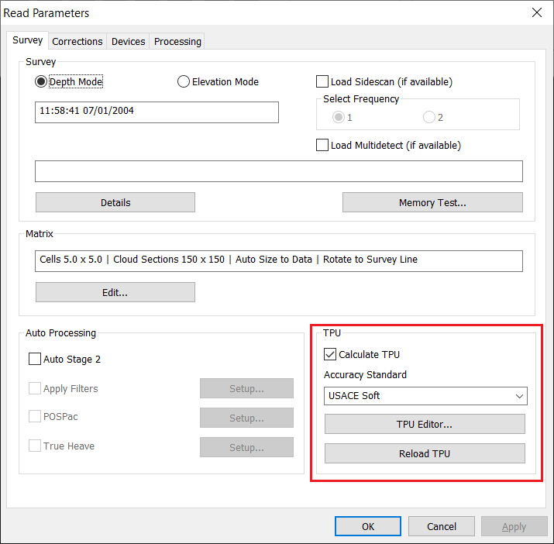
TPU Setup
If you want to use CUBE (Combined Uncertainty and Bathymetry Estimator), you need to setup TPU (Total Propagated Uncertainty).
Select USACE or IHO survey order.
Click TPU Editor and enter settings / use defaults settings as appropriate.
Google “Sounding Better TPU” for a thorough description of TPU setup.

Slide 10
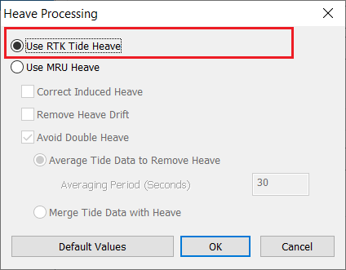
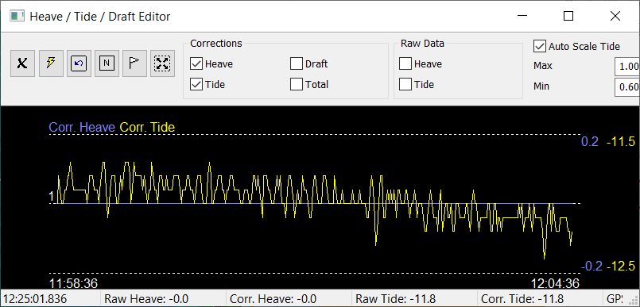
RTK Tide Method 1
In this method we ignore the heave measurement from the MRU / IMU completely.
Boat heave only from RTK-GPS.
Requires a high update rate (at least 20 HZ).
Can be used as fallback if MRU fails.
Drawback: If RTK drops out you’ve got a problem.
MRU: Motion Reference Unit.
IMU: Inertial Measurement Unit.
They both provide heave.

Slide 11
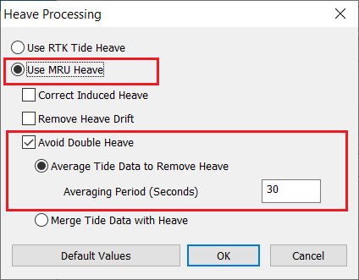
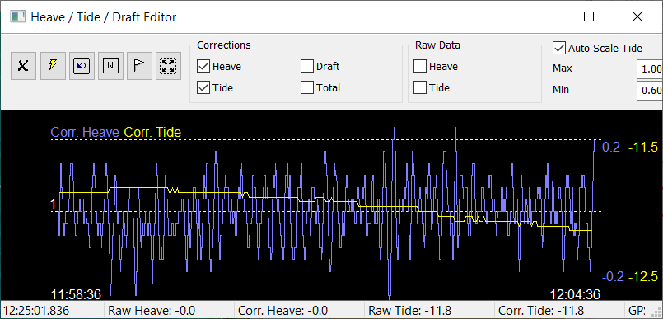
RTK Tide Method 2
In this method we use the MRU heave measurement and average RTK tides. Averaging removes the heave component.
Does not require precise timing between RTK-GPS and the MRU. (This is obsolete thinking now that both data come from the same device and all devices provide accurate UTC time tags).
Drawback: Averaging can be imprecise.

Slide 12
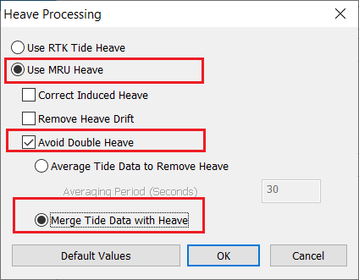
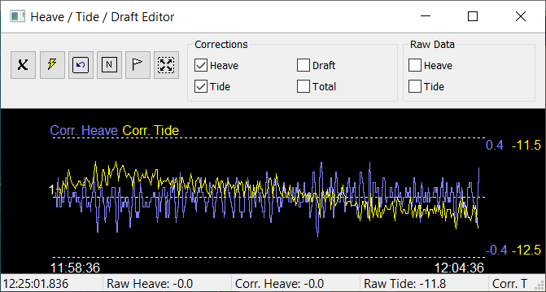
RTK Tide Method 3
In this method we merge MRU heave with RTK tides. (Heave is re-referenced at each RTK tide point.)
Drawback: None, as long as time tags are precise. Best we can do.

Slide 13
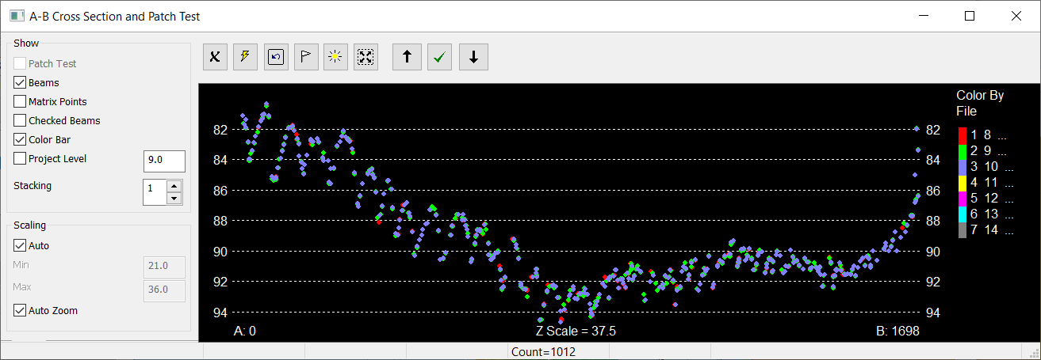
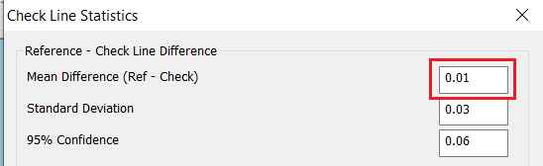
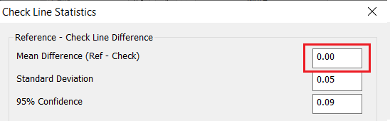
Comparison of Methods
No appreciable difference seen in cross section.
Method 1 (RTK only) vs. method 3 (merge tide with heave). 0.01 foot bias.
Method 2 (average tide to remove heave) vs. method 3. 0.00 foot bias

Slide 14
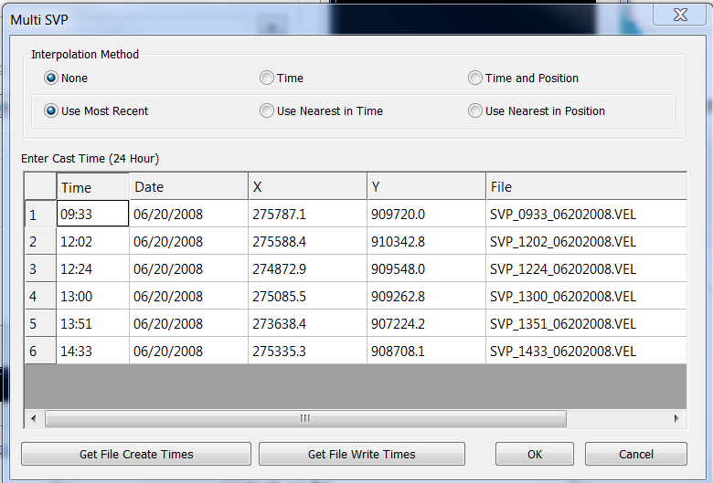
Multiple SV Profiles
Option to apply multiple SVP casts. Methods:
No Interpolation, three options to chose from
  Most recent cast.
  Cast nearest in time.
  Case nearest in position.
Time. Picks casts before and after then does interpolation based on ping time
Time and Position. Picks casts before and after then does interpolation based on ping and cast locations.
Newer style VEL files have date/time and position embedded. Older style requires spread sheet entry.

Slide 15
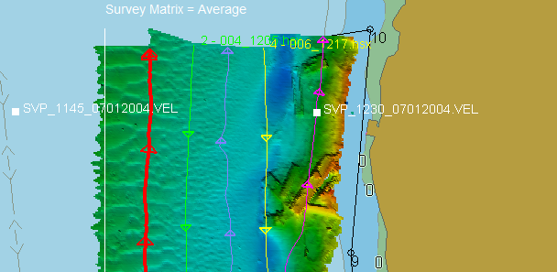
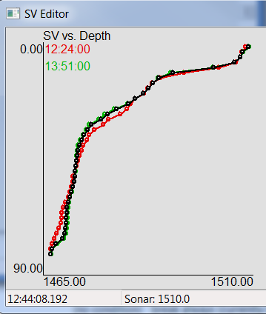
Multiple SVP Results
Interpolation is shown in the SV edit window.
Red and green are profiles before and after ping time.
Black is interpolated.
Cast locations can be seen in the Survey window.
Lets try it out

Slide 16
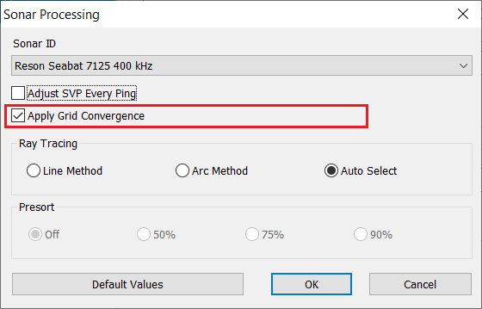
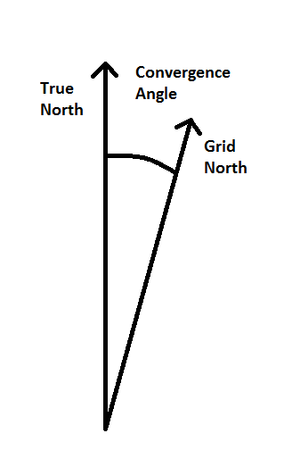
Grid Convergence Option
Check box controls whether this angle is applied or not. Angle is larger toward edge of projections.
Rule of thumb:
If you always survey in the same area or if you patch test in each new area, convergence is not necessary. Yaw testing automatically compensates.
If you move about and do not want to recalibrate yaw, apply convergence to your patch test and surveys.
There’s a Sounding Better link for this. Google “Grid Convergence in MBMAX64”

Slide 17
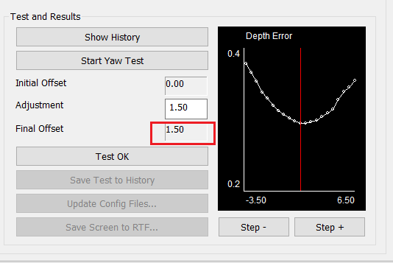
Yaw Test Without Convergence
Here an example from Sample_Patch_Test_Single_Head
Final Yaw Offset = 1.5 degrees

Slide 18
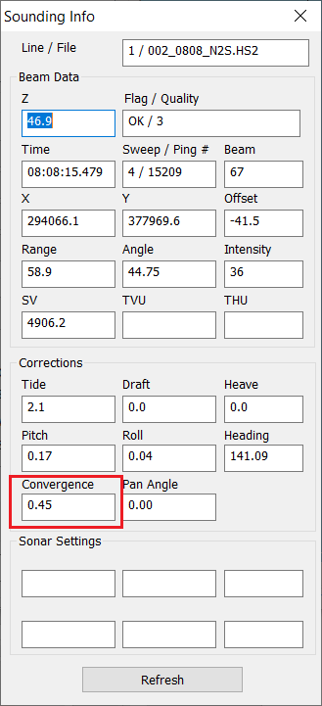
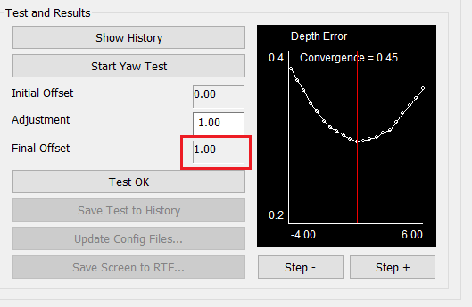
Yaw Test With Convergence
Final Yaw Offset = 1.0 degrees after convergence correction.

Slide 19
Adjustments Tools

Slide 20
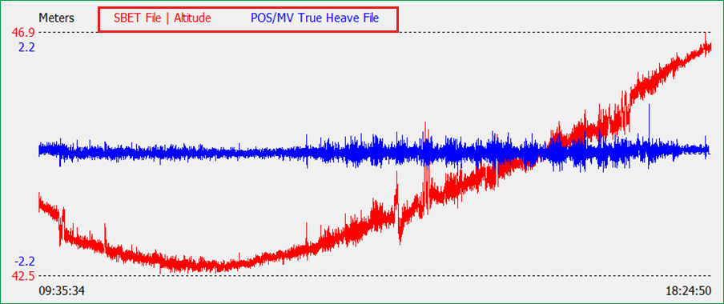
SBET Editor
Use Tools Menu, SBET File Editor
Clean and Save SBET files
True Heave Fills Gaps Between Interpolations
Notes:
20

Slide 21
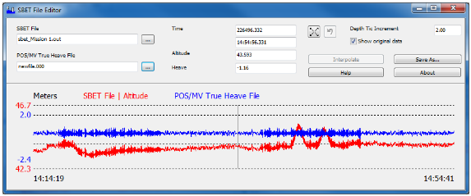
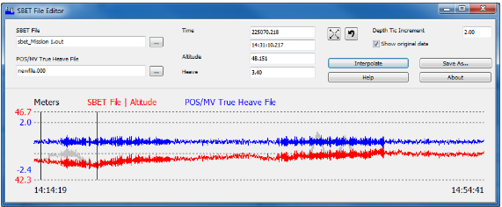
SBET Editor
Before interpolation.
Compares the SBET elevations with the POSMV true heave elevations.
Removes bad data and automatically superimposes the heave motion on the interpolation.
After interpolation

Slide 22
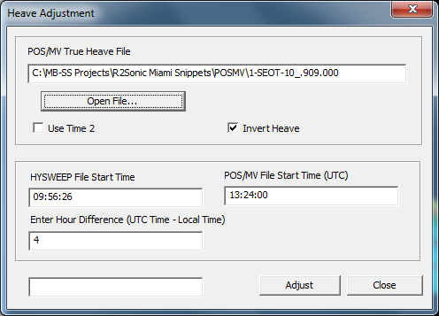
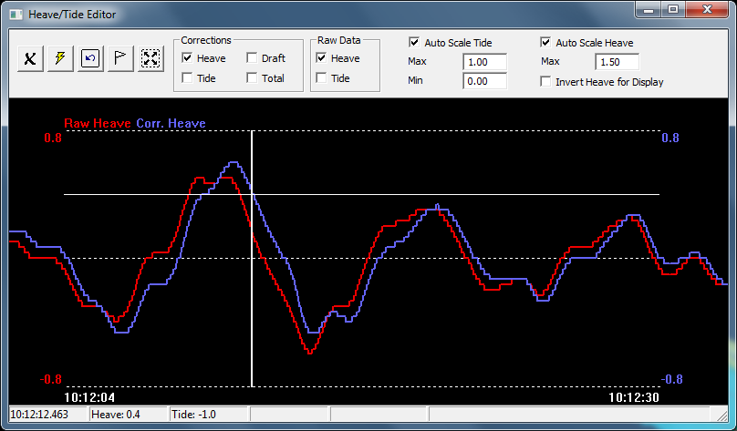
POS MV True Heave Adjustments
.
Use Heave Adjustments, POS/MV True Heave
Open One or More True Heave Files.
Enter Offset, Local to UTC Time.
Use Adjust Button to Replace Heave.
Coda/Octopus, Novatel, SBG and Kongsberg also provide post processed heave.
True Heave vs. Raw Heave in Heave / Tide Editor
True Heave in Blue.
Raw Heave in Red.
True Heave is Correct.
What Does That Say About Raw Heave? It’s not always right
Notes:
22

Slide 23
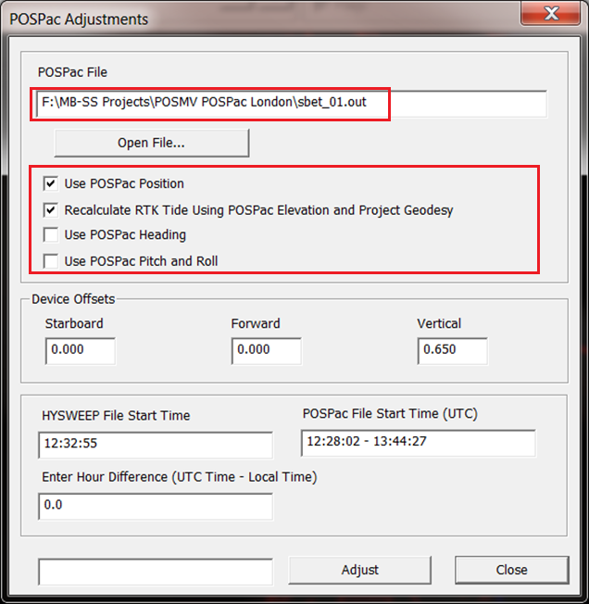
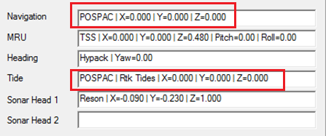
POSPac Adjustments
Use Tools menu, POSPac Adjustments.
Make Sure Geodetic Parameters are right.
Open a POSPac File: *.OUT.
Select Data To Replace
POSPac Does Not Replace Heave.
Verify Device Offsets.
Click Adjust to Replace Data.
Navigation and Tide Devices are replaced with “POSPAC”.
Notes:
23

Slide 24
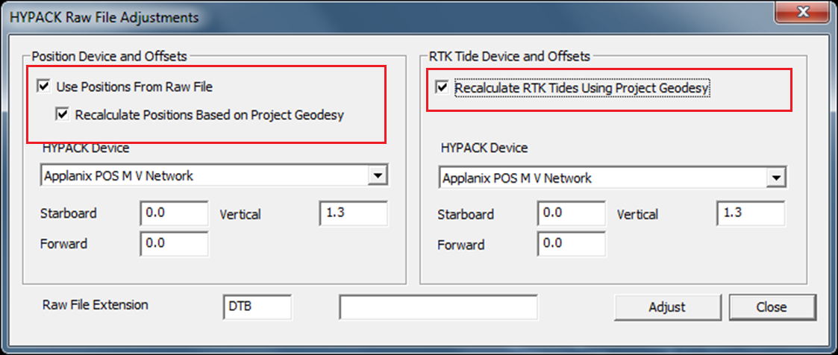
HYPACK RAW File Adjustments
Use Tools Menu, HYPACK Raw File Adjustments.
Mainly to recalculate RTK tides. Can also replace or recalculate XY positions.
Notes:
24

Slide 25
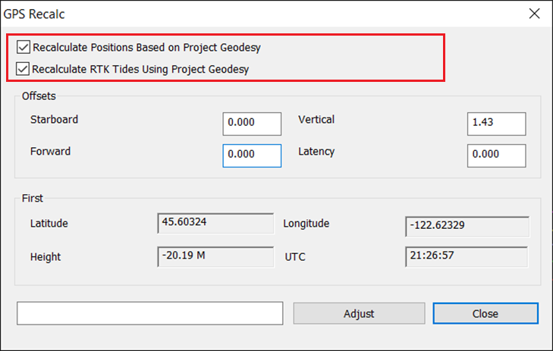
GPS Recalc
Use Tools Menu, GPS Recalc.
Similar to HYPACK RAW File Adjustments except GPS data comes from HSX files.
Requires logging in HYPACK 2021 or newer.
Notes:
25

Slide 26
Statistical Methods

Slide 27
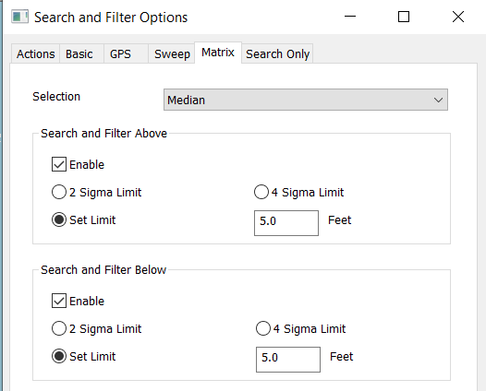
Statistical Filters
One line at a time (Sweep Filters):
Median and S-G filters can be useful. Use with care as they may remove good soundings.
Median. Uses beams along track and across track.
S-G filter calculates a trend line. Order controls flexibility of the line (2 = straight). Window size gives number of sounds used to curve fit. Gate is allowed distance from the line.
Entire Survey (Matrix Filters):
These work with cell statistics for filtering. Use them with care.
For example, filter any sounding 5’ above or below cell median depth.

Slide 28

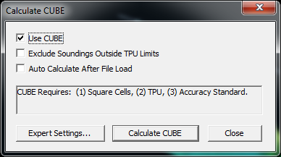
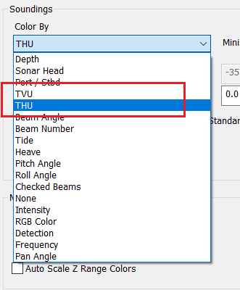
CUBE – Combined Bathymetric and Uncertainty Estimator
The CUBE engine can run inside MBMAX 64
Option to Exclude Soundings Outside TPU Limits:
Careful with this box. If checked and soundings are outside accuracy limits CUBE comes back empty!
Color soundings by TVU and THU. Green = good (inside limits), red = not.
TVU = Total Vertical Uncertainty
THU = Total Horizontal Uncertainty.

Slide 29
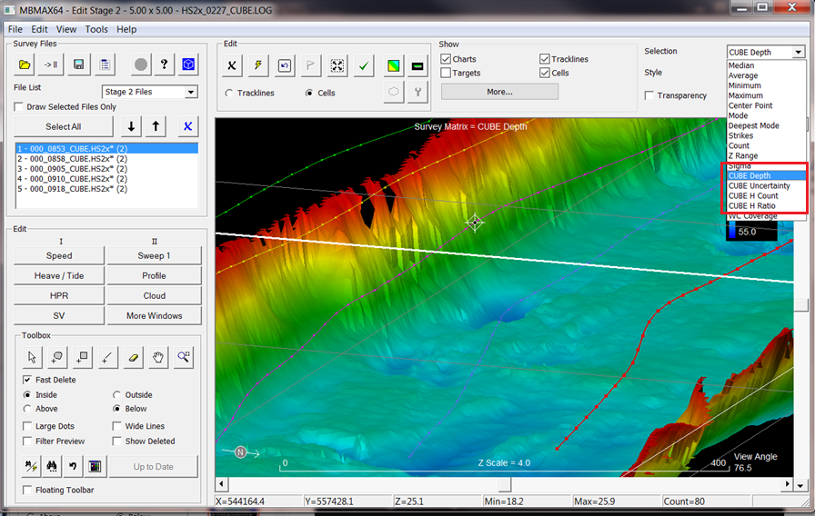
CUBE Part 2
After a CUBE run.
Note the selection for depths now include depth, uncertainty, count and ratio computed by CUBE

Slide 30
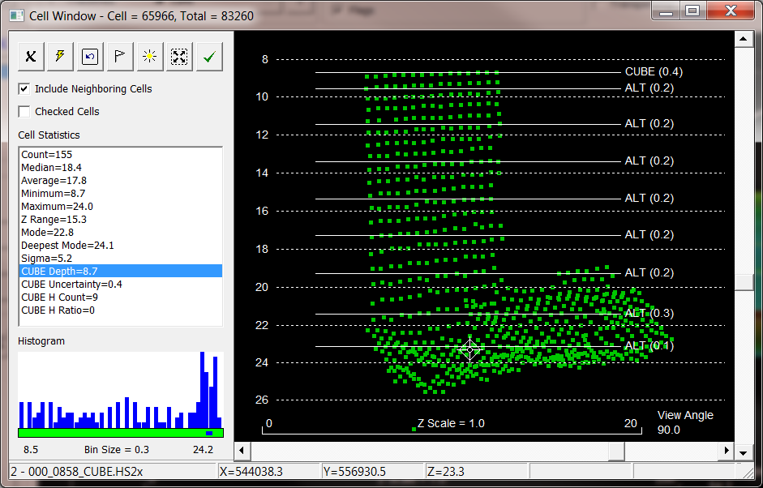
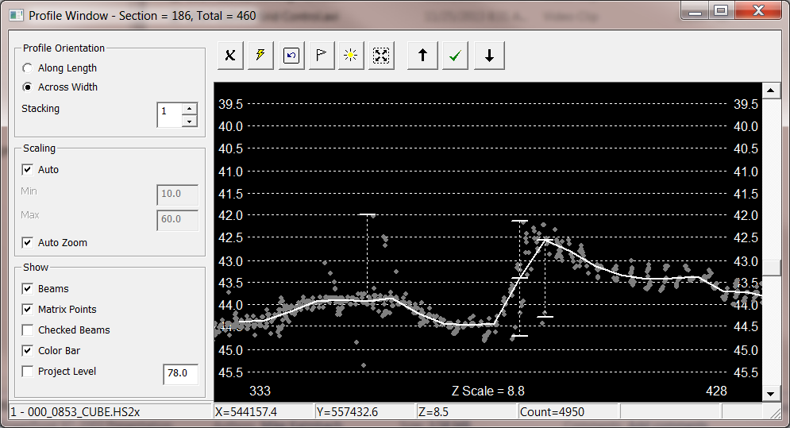
CUBE Part 3
Cell Window:
Depth lines at CUBE depth and alternates
Std. Deviation in parentheses
Click alternate for new CUBE depth.
Profile Windows:
Bar at CUBE depth and alternates.
Click alternate for new CUBE depth.

Slide 31
New Stuff

Slide 32
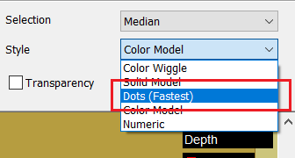
Faster Matrix and Point Cloud Drawing
Hard to show speed improvements in Power Point…
~10x draw speed improvement in Matrix and Cloud displays. Much faster responding to mouse zoom, rotate and pan.
We make it clear that Matrix dots draw faster than the shaded models. If draw speed is an issue, draw dots.
Wiggle display is pretty quick.
Numeric display still painfully slow.

Slide 33
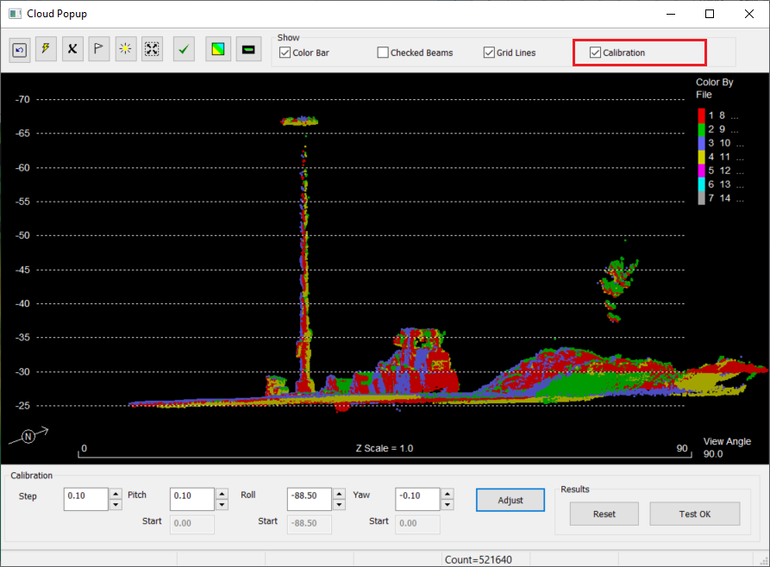
Cloud Popup Calibration
Check the Calibration box to enable cloud calibration.
Manual method using point cloud. Primarily for LiDAR.
Use Step to change the angle step. Default = 0.1 degree.
Use Up/Down to step Pitch, Roll or Yaw Angle. Or enter an angle then click Adjust.
The visible cloud will recalculate to show points with angle changes. Repeat as often as needed. Then:
Reset: Resets to the angles you started with.
Test OK: Accepts angle changes. The entire survey will be updated, which you will see in Survey window matrix display.

Slide 34
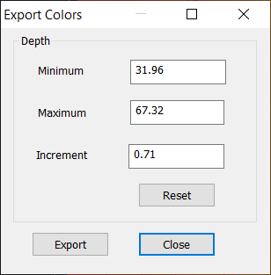
Color File Export
Really Useful! Exports MBMAX64 depth colors for use in the HYPACK Shell and other programs.
Minimum, Maximum and Increment are the exact values used in MBMAX64. You can adjust them as desired.
Export defaults to ‘MBMAX_ColorRange.HCF’ in the current project.
To use in the HYPACK Shell, go to the Sounding Colors tab and Select Color Table.
Notes:
34

Slide 35
Bonus Content

Slide 36
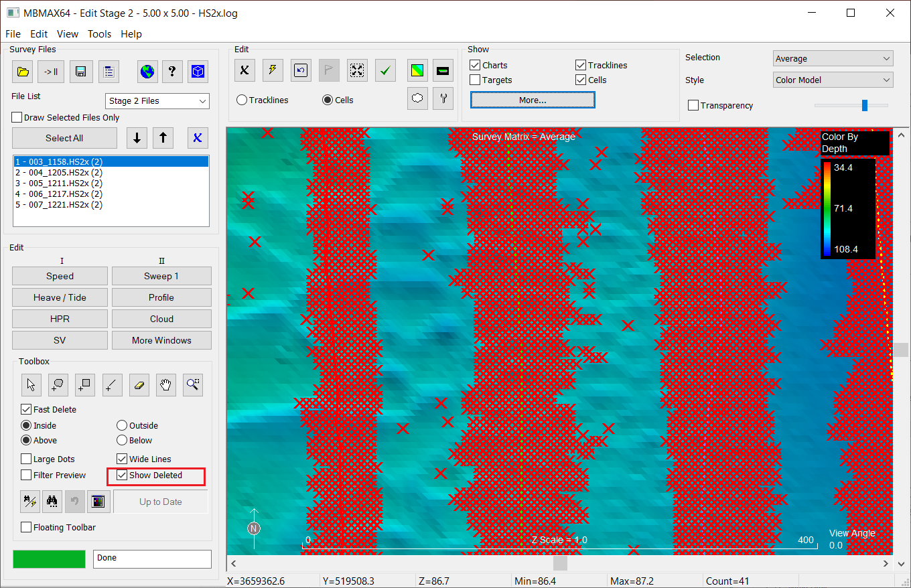
Delete / Undelete
Deleted points in MBMAX64 are not actually removed. That being the case, they can be brought back!
Use Show Deleted to see removed points. Red X’s

Slide 37
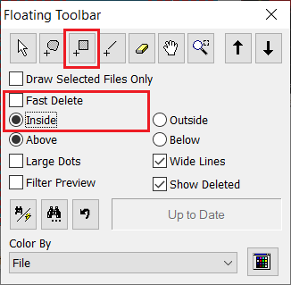
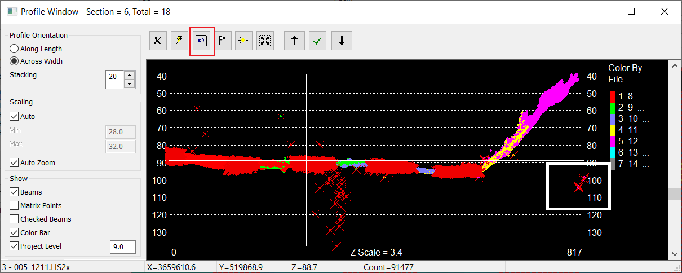
Small Undelete
Use the Toolbox or Floating Toolbar to select the Block Rectangle tool. Fast Delete unchecked, Inside selected.
In the Profile window, box in a block of deleted points.
Use the Undelete button to restore the points.
Undelete works in all MBMAX64 edit windows.

Slide 38
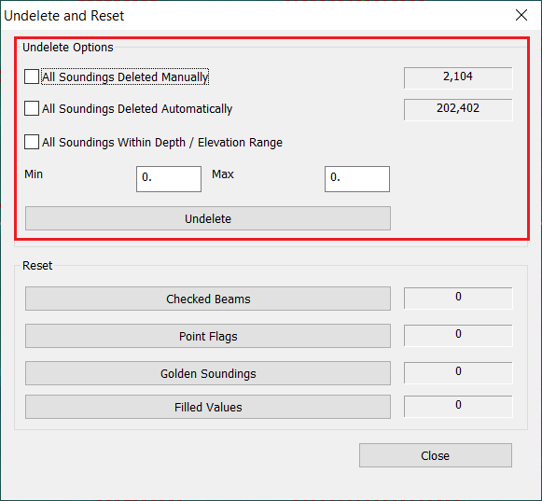
Big Undelete
Use Edit menu, Undelete and Reset. Three undelete options are available. Pick one or more option then hit the Undelete button.
(Nice to know the number of soundings deleted manually vs. automatically.)

Slide 39
Thank You !
Contact Us:
Sales@HYPACK.com
Help@HYPACK.com
(860) 635 - 1500
Links to more information:
HYPACK on Youtube.com ( Historical Sessions ) HYPACK Live Chat
HYPACK on Youtube.com ( Newer Sessions ) HYPACK Ustream
HYPACK SUPPORT Site HYPACK Website

