Slide 1
MBES – Basic Data Processing

Slide 2
Objectives of this session
1
Demonstration of an MBMAX64 Basic Edit Session
Starting Out
Loading Files
Stage 1 Editing
Stage 2 Editing
Review and Saving Your Work
Notes:
Stressed Water Supply
Issue
Maintain the health of traditional water sources and execute a water source diversification strategy
Solution
Xylem’s leading-edge technologies monitor, pump and treat water from all sources and enable water reuse
Aging Infrastructure
Issue
Utilities have to effectively assess and identify high-risk areas for repair/replacement before problems occur
Solution
Xylem’s intelligent pipeline and critical infrastructure services perform condition assessment, identify defective assets, provide bypass services and replacement technologies, reduce or eliminate combined sewer overflows and leaks/non-revenue water
Stormwater & Flooding
Issue
Significant increase in severe weather patterns is causing flooding and related damages to communities
Solution
Xylem’s flood management solutions include sensors for early warnings, dewatering for disaster response, communications for recovery and submersible pumping for resilient infrastructure
Regulatory Compliance
Issue
Utilities must successfully comply with a growing body of compliance regulations
Solution
Xylem’s analytics and sensors evaluate a broad range of water quality parameters, and our technologies treat water and wastewater to meet regulatory standards
Non-Revenue Water
Issue
Utilities have an important opportunity to reduce persistent and costly water losses from leaks and faulty meter readings
Solution
Xylem’s broad portfolio of solutions monitors for, and identifies, water leaks, as well as faulty meters. Our communications network enables point-to-multipoint communications throughout the system
Operating Strategy Reducing Costs
Issue
Utilities want to lower operating and energy costs, and leverage new revenue opportunities
Solution
Xylem offers industry-leading pumping and treatment solutions for energy efficiency, and software-enabled solutions to optimize operations and identify revenue opportunities

Slide 3
MBMAX64 – Starting Out

Slide 4
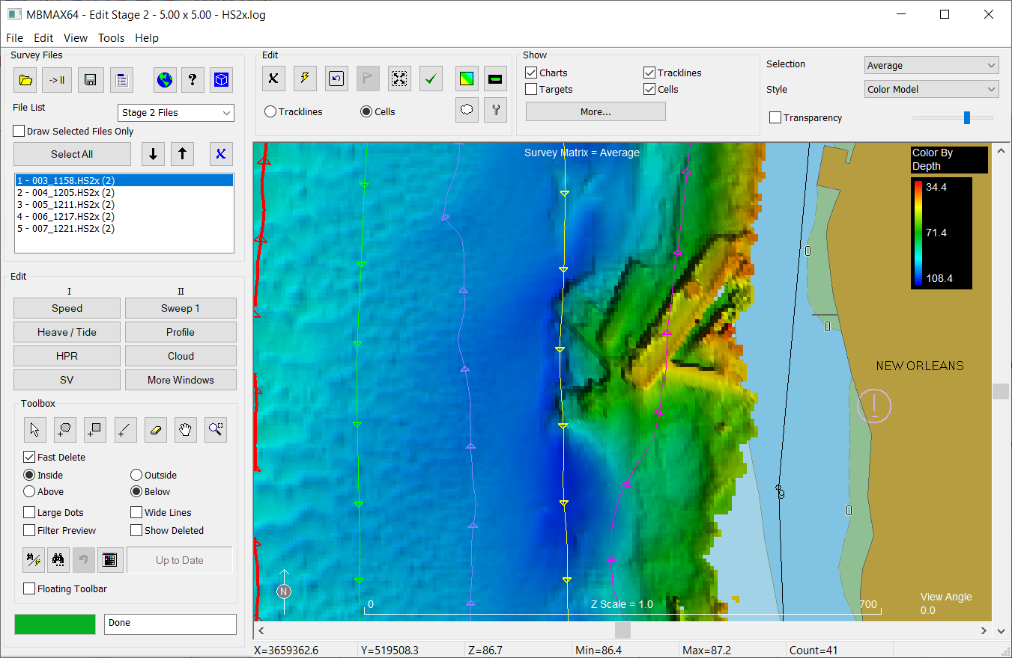
Here’s the Multibeam / LiDAR Processing Program - MBMAX64
A lot going on here.
The remainder of this presentation goes through a basic processing demonstration. Only an hour, details will be skipped to avoid getting bogged down.
You can follow along with sample project “Sample_Editing_in_MBMax”

Slide 5
Demonstration Preview*
How to launch MBMAX64 (it gets harder after this).
Initial setup (the update mode).
Input files and how to load them.
Read parameters.
Edit/clean sensor data (positions, tides, motion, sound speed). What we call Stage 1.
Edit/clean depth data. What we call Stage 2.
How the matrix fits in.
Review and save your work.
*see “MBES – Data Processing.pptx” for all the details.

Slide 6
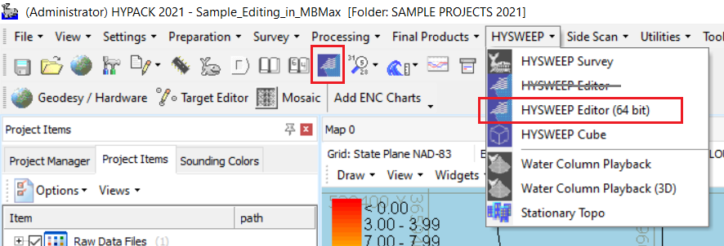
Launching MBMAX64
Make sure to launch the 64 bit version!

Slide 7
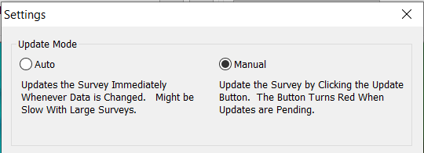
Initial Setup – The Update Mode
Use Edit Menu, Settings
Update Mode
Auto: Updates the survey immediately whenever data is changed. Might be slow with large surveys or weak computers.
Manual: Update the survey by clicking the update button. The button turns red when updates are pending.
Let’s start with manual mode.

Slide 8
Loading Files

Slide 9

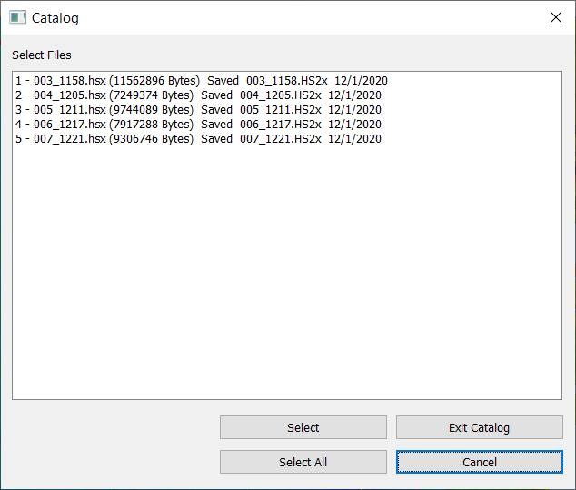
Input Files and How to Load Them
File menu, Load Survey or
From the project Raw folder we load a LOG file containing five HSX files.
HSX. File format logged by HYSWEEP Survey. Each HSX is a survey line.
LOG. Contains multiple HSX files.

Slide 10
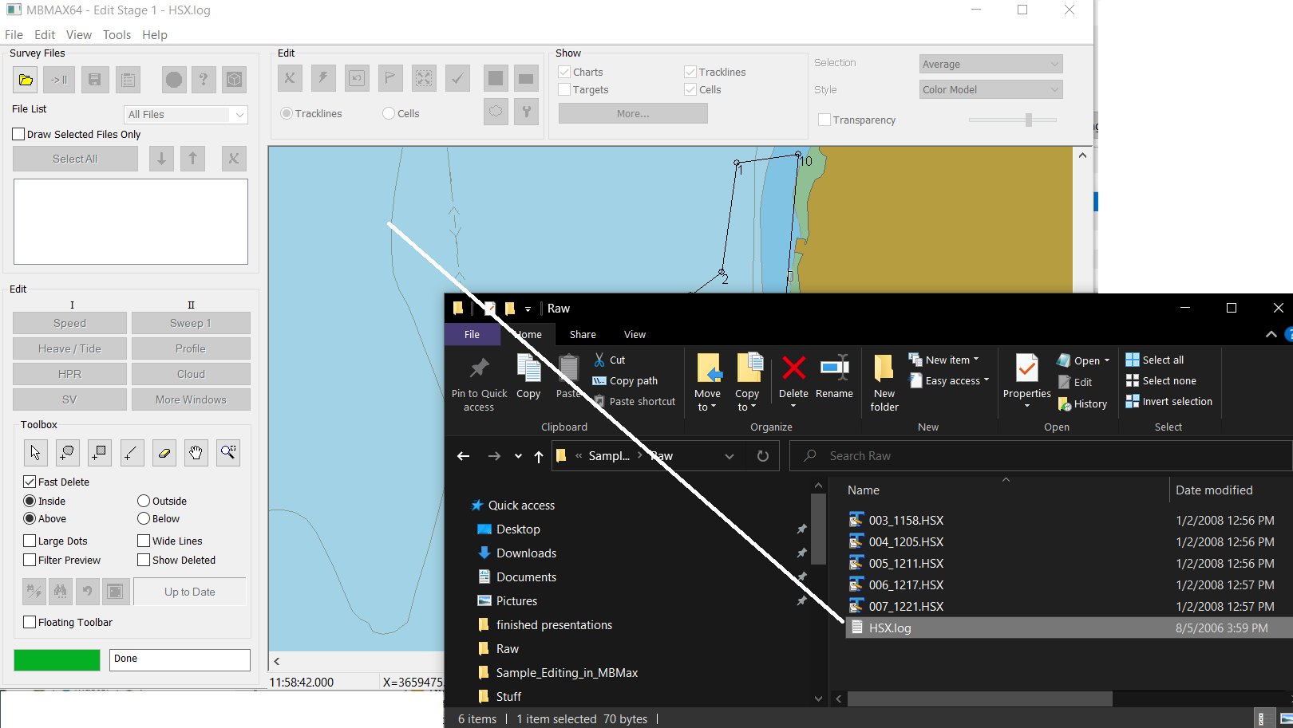
Drag and Drop
From Windows File Explorer or HYPACK Shell.

Slide 11
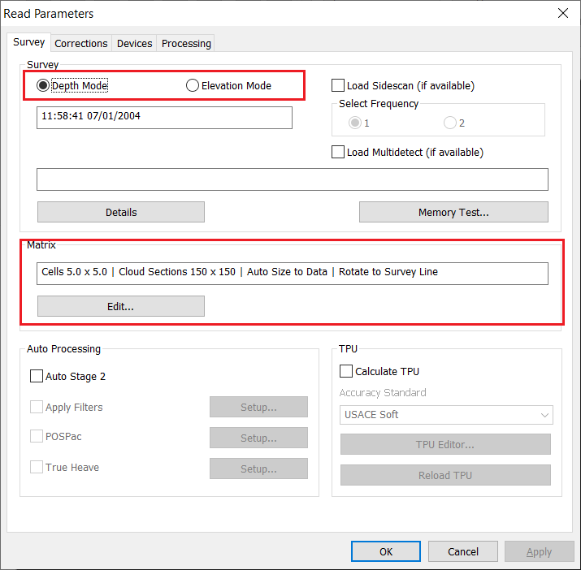
Read Parameters - Survey
Working in Depth or Elevation mode.
Matrix gridding to 5’ x 5’ cells.

Slide 12
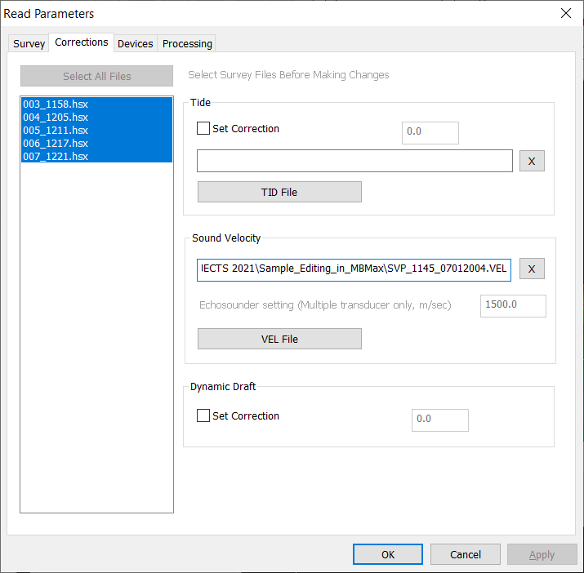
Read Parameters - Corrections
No TID file required here. Water level comes from RTK GPS.
VEL file is selected for the sound velocity profile.

Slide 13
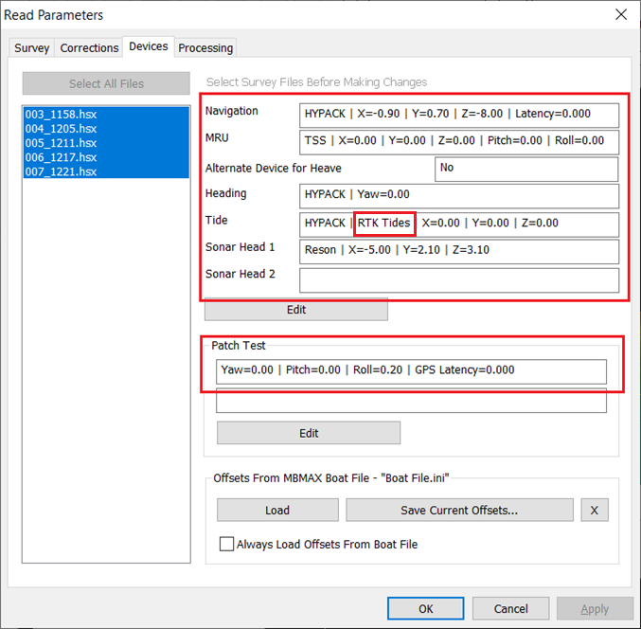
Read Parameters - Devices
All the devices and offsets. RTK Tides are selected meaning lever arms are needed for tide calculation.
The patch test offsets.

Slide 14
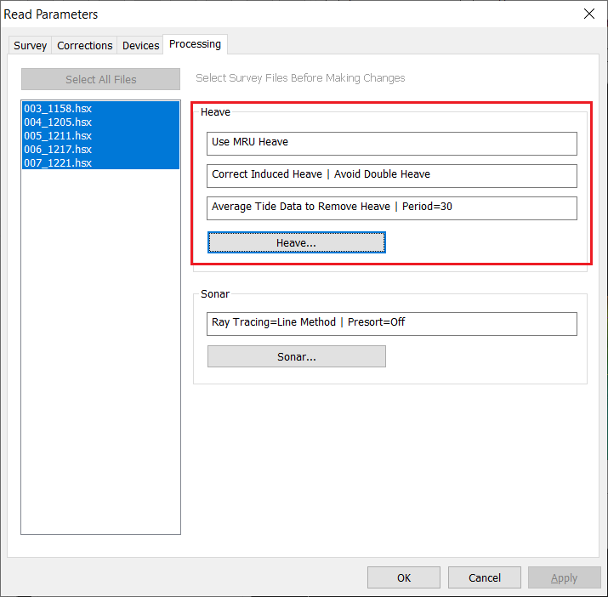
Read Parameters - Processing
Care is taken to avoid double correction. RTK GPS antenna + heave motion sensor.

Slide 15
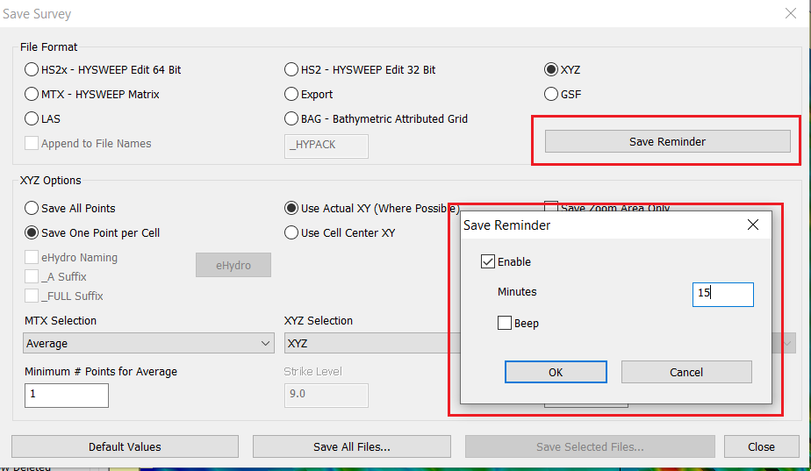

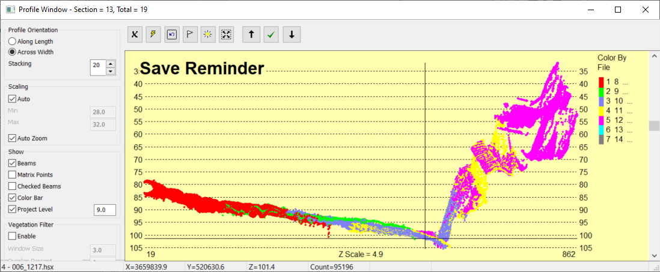
Initial Setup – Save Reminder
Set the reminder in Save Survey
Edit windows turn ugly when the reminder expires. Stop and Save.

Slide 16
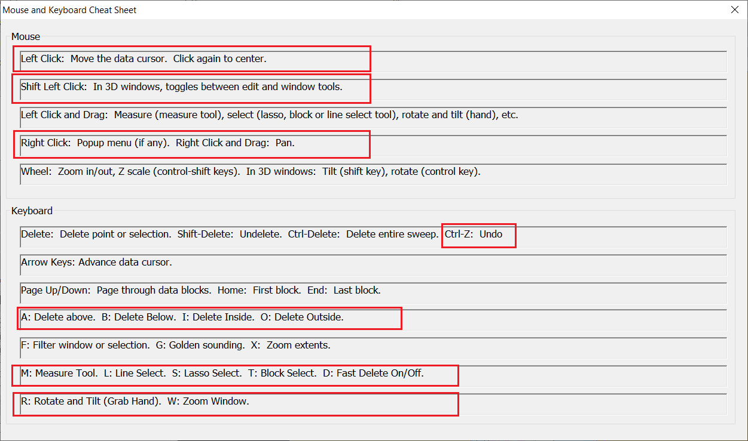
Short Cut Cheat Sheet
Use Edit menu, Mouse and Keyboard Cheat
Sheet.
Toolbox is duplicated with shortcut keys

Slide 17
Stage 1 Editing

Slide 18
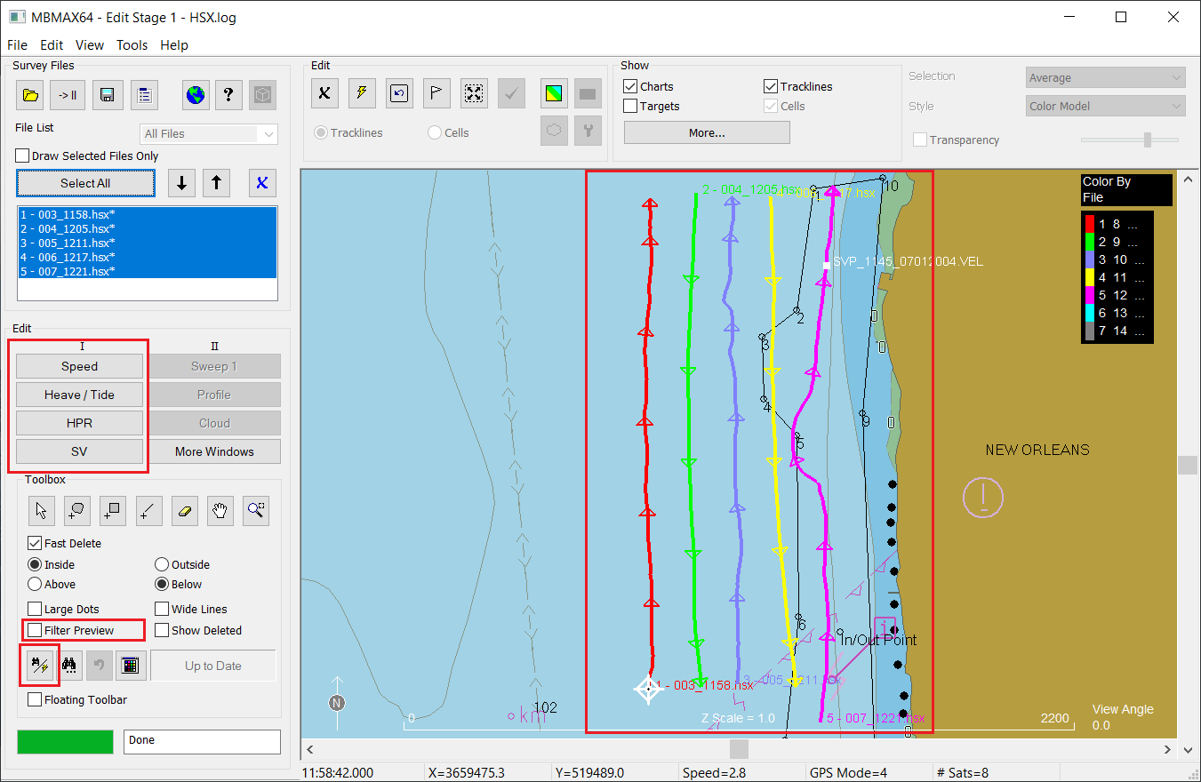
The Stage 1 View
Track lines overlayed on background map. Visual inspection shows track lines to be OK.
Buttons used to show sensor editors.
Filter preview option.
Search and filter setup.

Slide 19
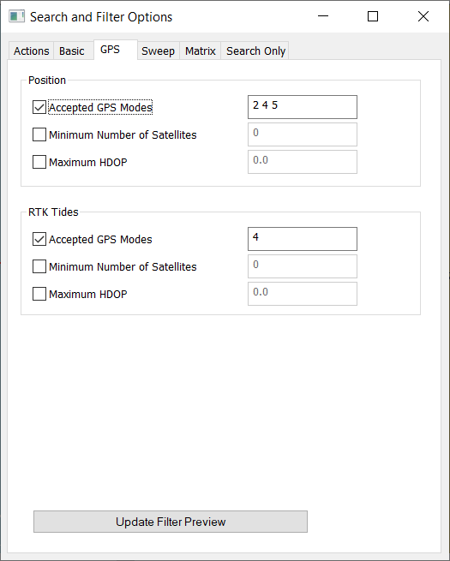
GPS Filter Setup
Works well with NMEA 0183 codes but a visual check is still recommended.
Positions
Codes 2 (Differential), 4 (Fixed RTK) and 5 (Float RTK) accepted.
RTK Tides
Code 4 (Fixed RTK) only accepted for tides.

Slide 20
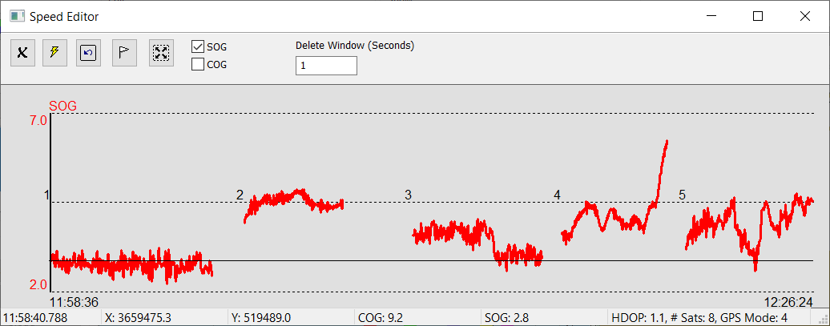
The Speed Editor
Position spikes show up dramatically in the Speed Over Ground graph. All looks OK here.

Slide 21
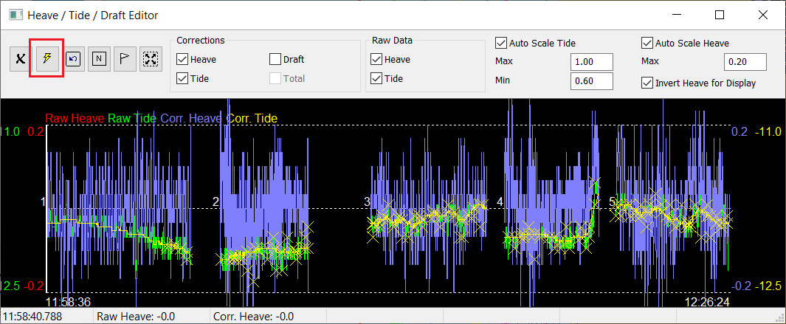
The Heave / Tide Editor
Yellow X’s show tide points outside filter limits. Use the lightning bolt to delete.

Slide 22
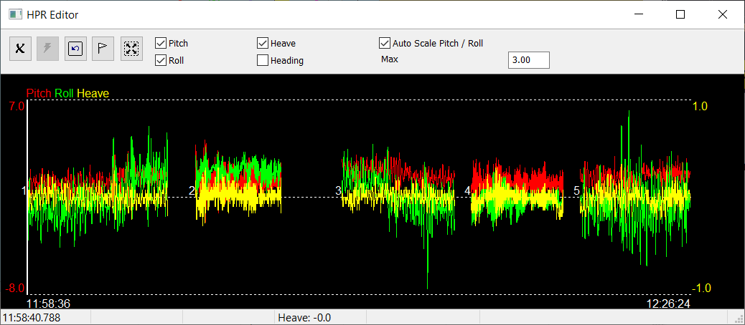
The HPR (Heave, Pitch, Roll, Heading) Editor
Not much to edit here. You can see sensor flat lines, boat attitude bias, extreme heave, pitch and roll conditions, etc., which can be clues to bad survey results.

Slide 23
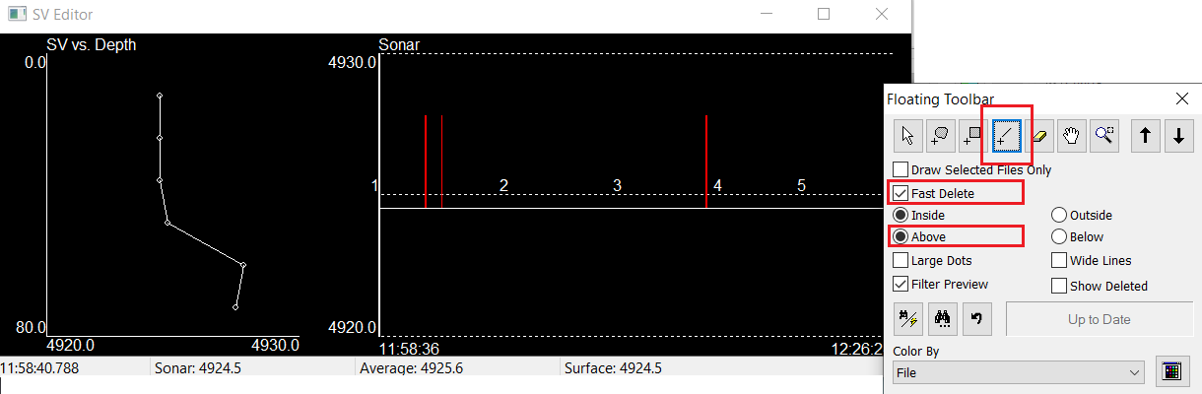
The SV Editor
SVP (left) and sound speed at the sonar head. The Line edit tool, Fast Delete Above can be used here to remove spikes quickly.

Slide 24
Stage 2 Editing

Slide 25
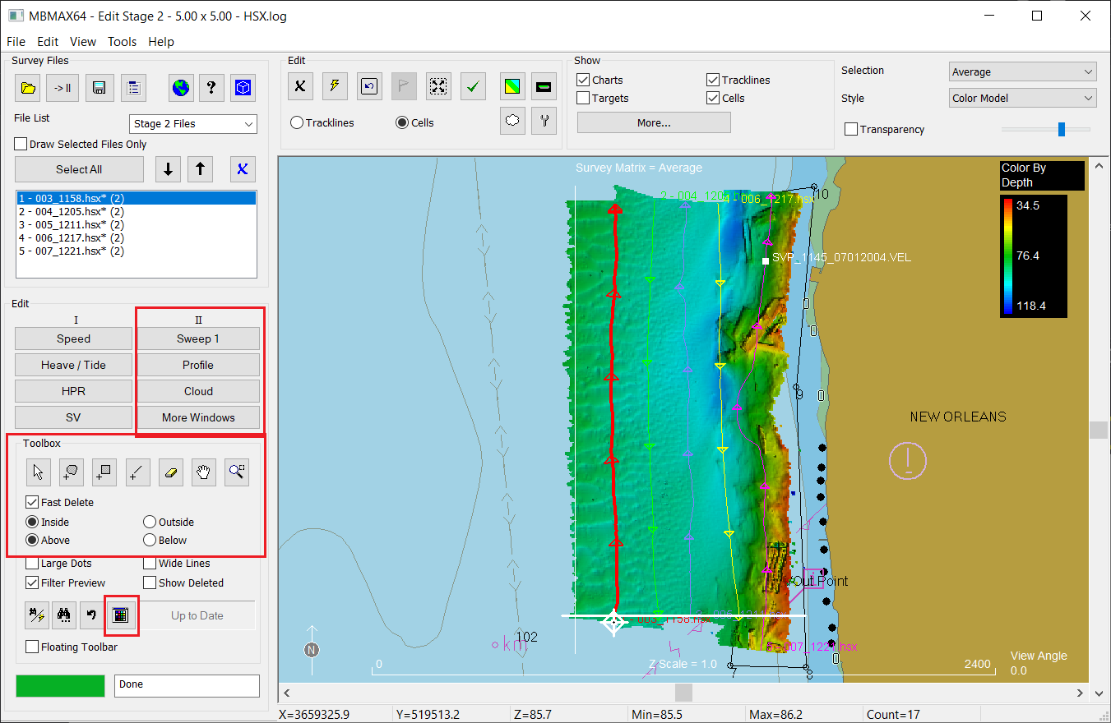

The Stage 2 View
Use File menu, Stage 2 or
Survey matrix overlayed on background map. Try Shift-Click to pan and tilt. Shift-Click again for previous tool.
Buttons used to show depth editors.
Tool box and color settings are very useful in stage 2.

Slide 26
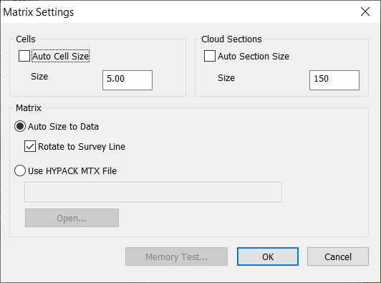
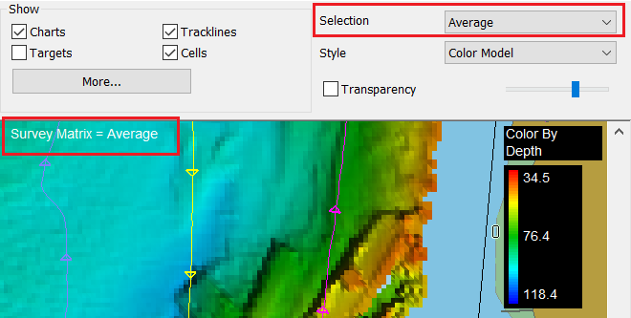
How The Matrix Fits In
The matrix controls MBMAX64 gridding. Gridding shows up in many places.
Data displayed in the survey window are statistics from matrix cells. Not individual soundings.
The profile window cuts across matrix cells. The cell window shows individual cells.
Gridded XYZ spacing is based on cells.
An entire filtering class is based on matrix cells.

Slide 27
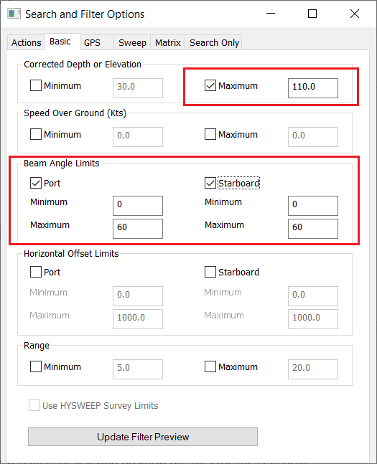
Basic Depth Filters
These filters are completely safe. That is, no chance of removing soundings that should be retained.
Based on previous knowledge of the survey and sonar system.

Slide 28
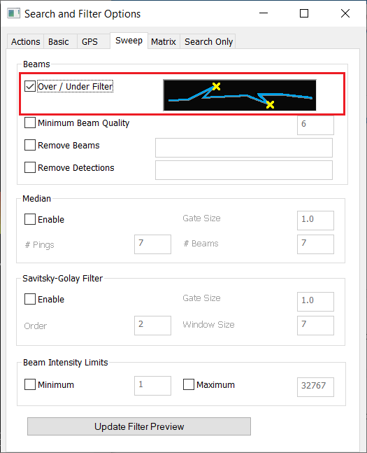
Sweep Filters
When we say ‘Sweep’ we mean all soundings from a multibeam ping.
Over / Under is usually safe for fish and water column multiples. But it can remove structures.

Slide 29
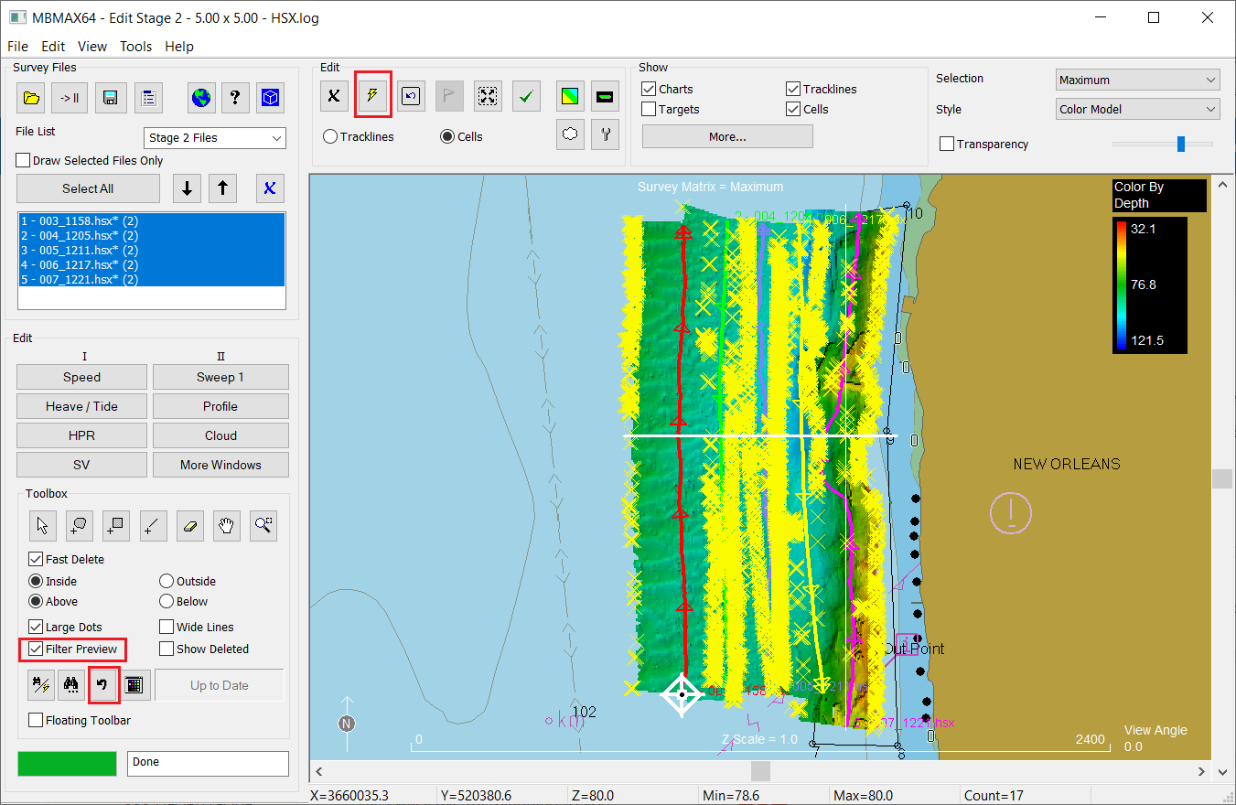
Apply the Depth Filters
Select Preview for yellow X’s.
Lightning bolt to apply.
The Undo button (control-z) will become a best friend while editing.

Slide 30
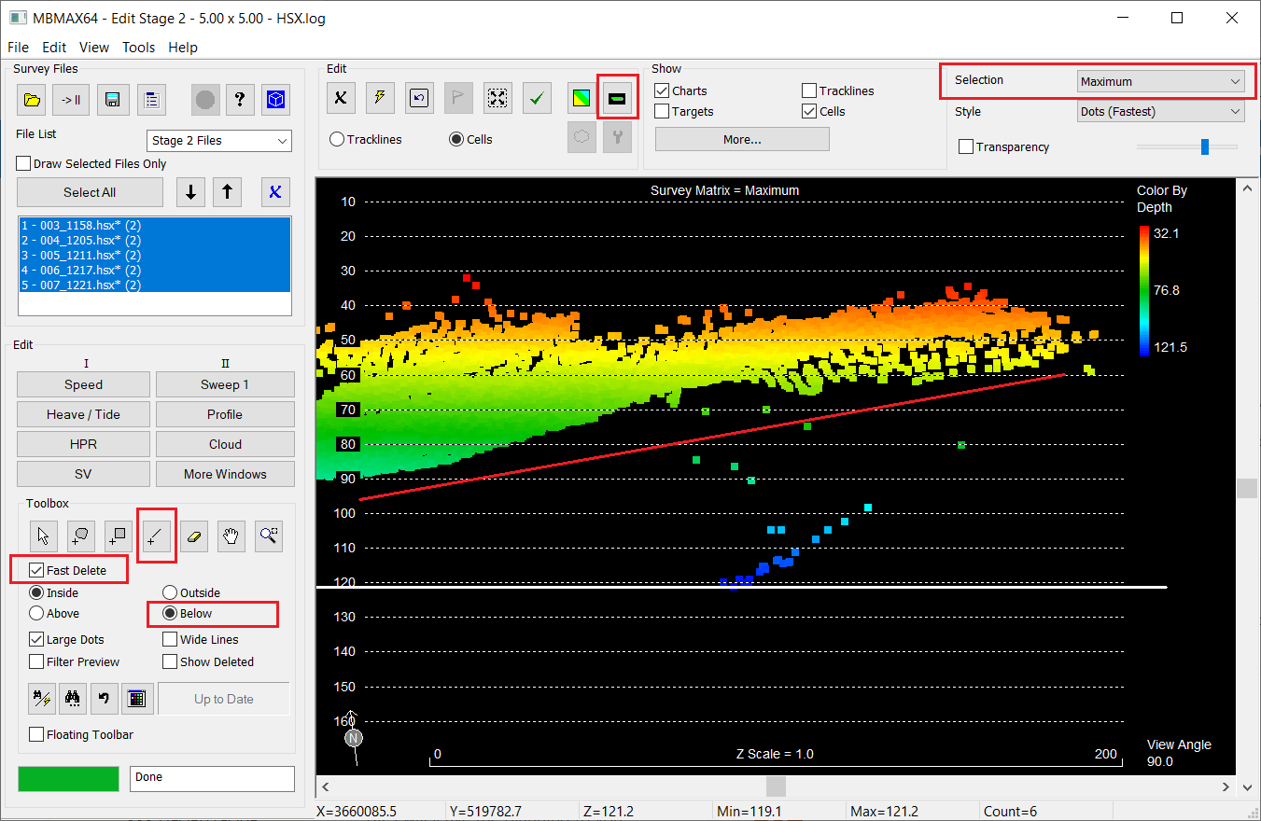
Manual Editing in the Survey Window
To remove soundings below the depth surface
Select matrix maximum depth
Select the Line Tool, Fast Delete, Below then mouse draw the line.
To remove soundings above the depth surface select matrix minimum depth and line tool above.
If you make a mistake with your line use the Escape key to cancel.

Slide 31
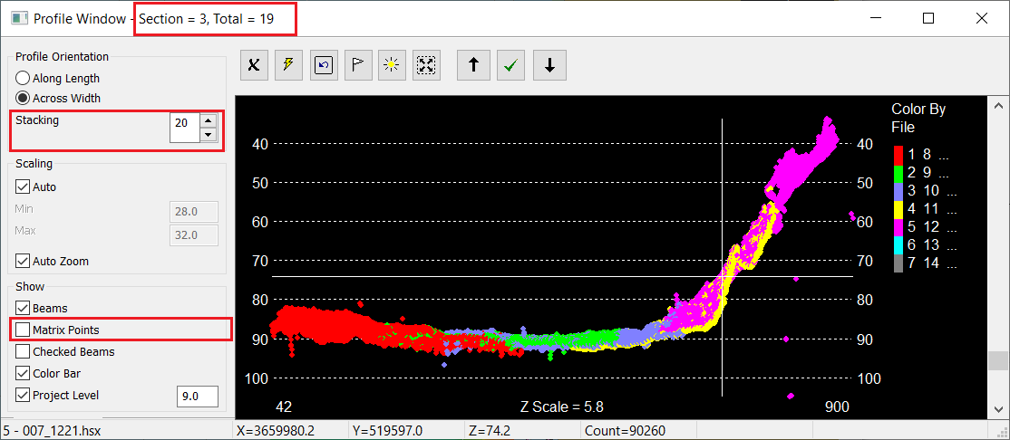
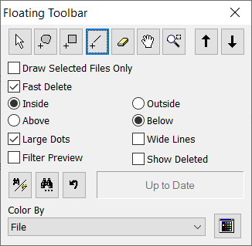
Profile Editing
Step through profiles for fast manual editing.
Stacking will speed things up
Use Matrix Points to show the gridded surface.
Control-T brings up the floating toolbar.

Slide 32
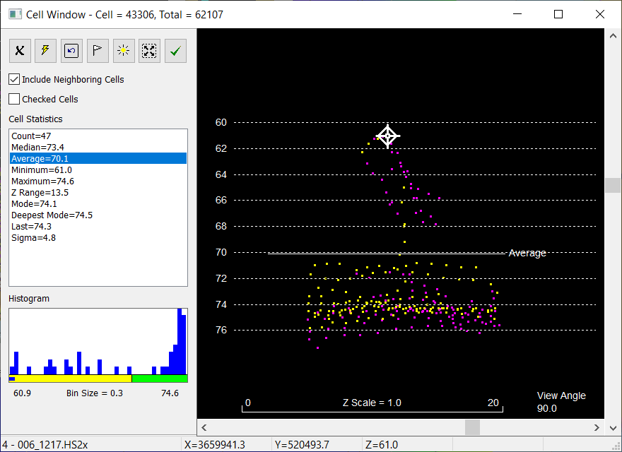
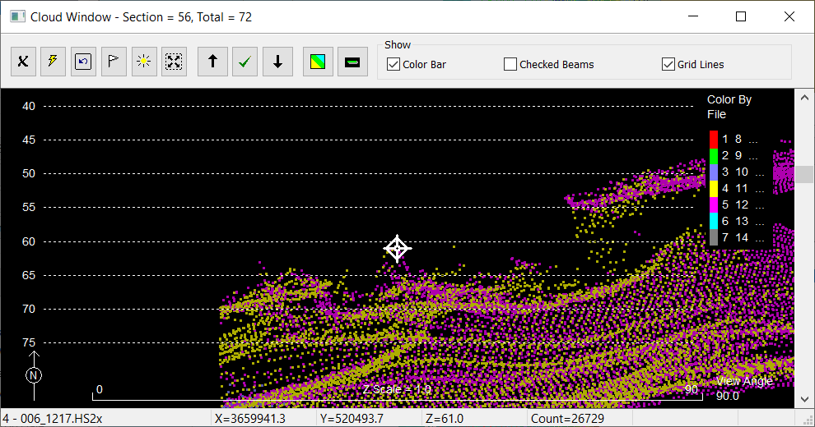
Cloud and Cell Edit Windows
Alternate view of the soundings.
Cursors are synchronized.
Cell window gives full statistics.

Slide 33
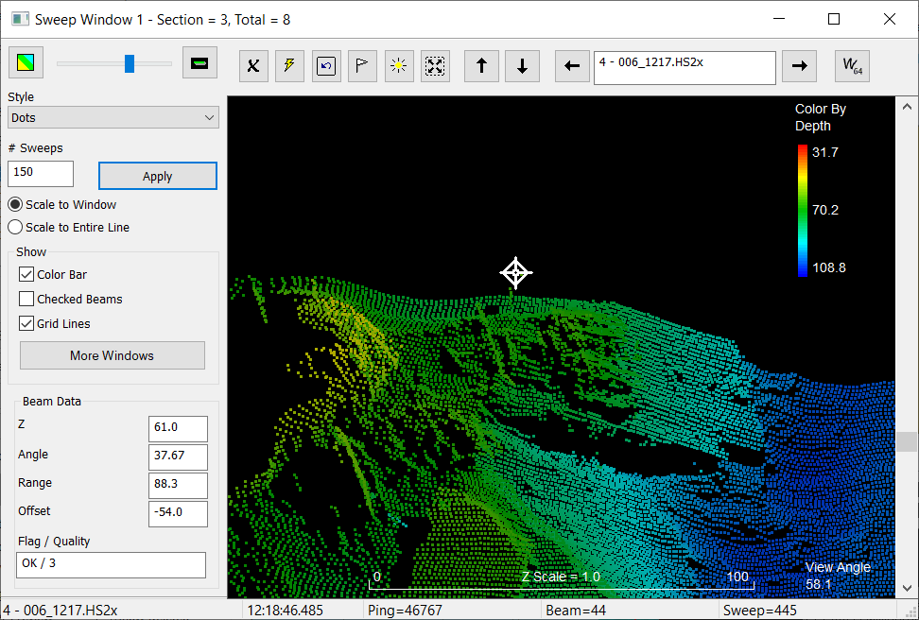
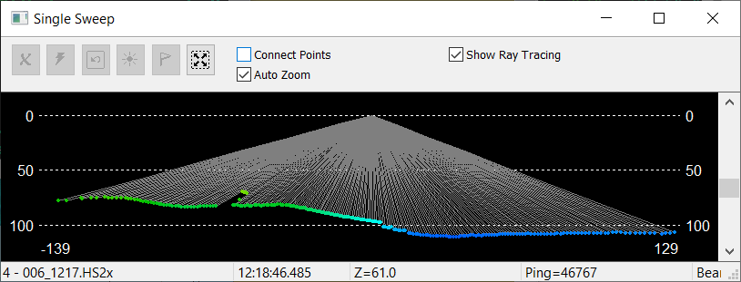
Sweep Edit Windows
One line at a time in the Sweep window.
One ping at a time in the Single Sweep window.
Cursors are synchronized.

Slide 34
Review and Saving Your Work

Slide 35
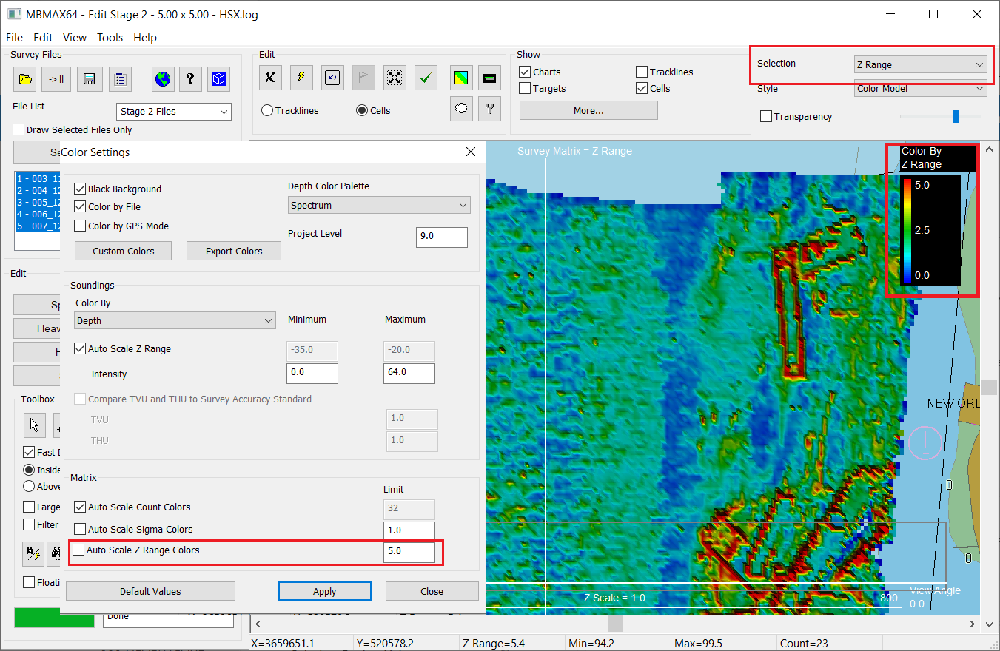
Review
Quick inspection for missing outliers and banding. Sometimes useful, sometimes not.
Select Z Range for the matrix display.
Set Z Range color limit in Color Settings.
Inspect the survey and click on cells with large Z range. The point cursor will sync in Profile and Cloud windows.

Slide 36
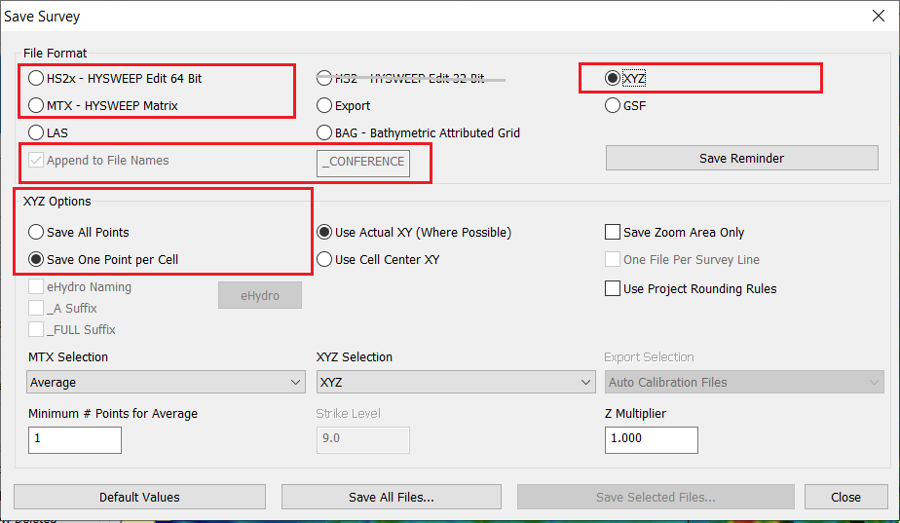
Saving Your Work
HS2x saves everything. Always save to this.
MTX (matrix) format is useful for HYPACK Shell coverage displays, dredging, etc.
Never use HS2 (obsolete).
You can append a suffix to file names to distinguish between results.
Save all XYZ points and/or one point per matrix cell depending on needs.

Slide 37
Thank You !
Contact Us:
Sales@HYPACK.com
Help@HYPACK.com
(860) 635 - 1500
Links to more information:
HYPACK on Youtube.com ( Historical Sessions ) HYPACK Live Chat
HYPACK on Youtube.com ( Newer Sessions ) HYPACK Ustream
HYPACK SUPPORT Site HYPACK Website

