Slide 1
MBES – Patch and Performance Testing

Slide 2
Objectives of this session
1
2
3
Understanding the Patch Test
Why Patch Test?
Patch Test Location
Planning and Running Survey Lines
Cross Sections and Why
MBMAX64 Patch Test
How to Load Files
Introduction to the Patch Test Window
How to Run a Test
How to Interpret Results
Using Patch Test History
Run Examples
Order is Important
Auto Cross Sections
Manual Cross Sections
Latency Test
Roll Test
Pitch Test
Yaw Test
4
5
6
Modifications for Dual Head and Lidar
Dual Head MBES test
Lidar Test
Performance Test
How to Make a Reference Surface
Check Lines
Beam Angle Test
New Beam Angle Test
Multibeam - Single Beam Comparison
Reference Surface
Check Lines
Check Line Statistics
Notes:
Stressed Water Supply
Issue
Maintain the health of traditional water sources and execute a water source diversification strategy
Solution
Xylem’s leading-edge technologies monitor, pump and treat water from all sources and enable water reuse
Aging Infrastructure
Issue
Utilities have to effectively assess and identify high-risk areas for repair/replacement before problems occur
Solution
Xylem’s intelligent pipeline and critical infrastructure services perform condition assessment, identify defective assets, provide bypass services and replacement technologies, reduce or eliminate combined sewer overflows and leaks/non-revenue water
Stormwater & Flooding
Issue
Significant increase in severe weather patterns is causing flooding and related damages to communities
Solution
Xylem’s flood management solutions include sensors for early warnings, dewatering for disaster response, communications for recovery and submersible pumping for resilient infrastructure
Regulatory Compliance
Issue
Utilities must successfully comply with a growing body of compliance regulations
Solution
Xylem’s analytics and sensors evaluate a broad range of water quality parameters, and our technologies treat water and wastewater to meet regulatory standards
Non-Revenue Water
Issue
Utilities have an important opportunity to reduce persistent and costly water losses from leaks and faulty meter readings
Solution
Xylem’s broad portfolio of solutions monitors for, and identifies, water leaks, as well as faulty meters. Our communications network enables point-to-multipoint communications throughout the system
Operating Strategy Reducing Costs
Issue
Utilities want to lower operating and energy costs, and leverage new revenue opportunities
Solution
Xylem offers industry-leading pumping and treatment solutions for energy efficiency, and software-enabled solutions to optimize operations and identify revenue opportunities

Slide 3
Understanding the Patch Test

Slide 4
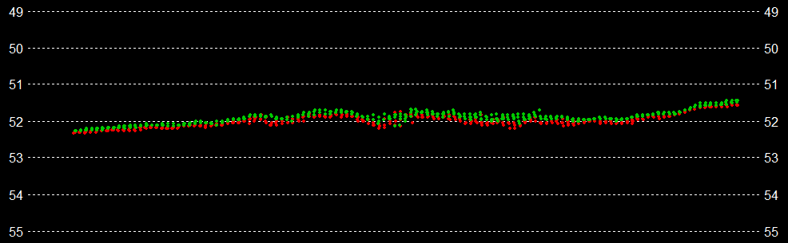
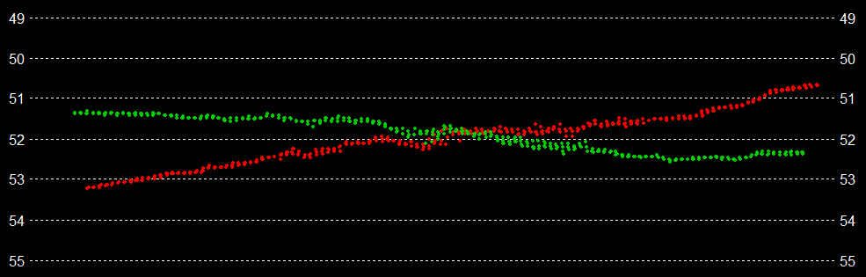
Why Patch Test?
Multibeam and Lidar systems are very directional.
Small angular alignment errors lead to large data errors.
Cross section from two survey lines that overlap well:
Correct Roll offset = Angularly aligned = No Roll bias.
Cross section from two survey lines with poor overlap:
Incorrect Roll offset = Angularly misaligned = Significant Roll bias.
Patch Testing finds correct Roll, Pitch and Yaw offsets (misalignment angles).
Also corrects for Position system Latency.

Slide 5
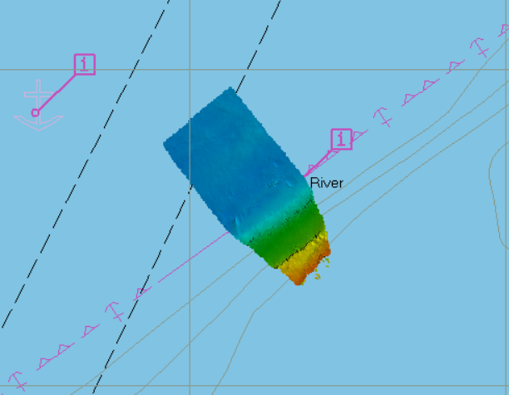
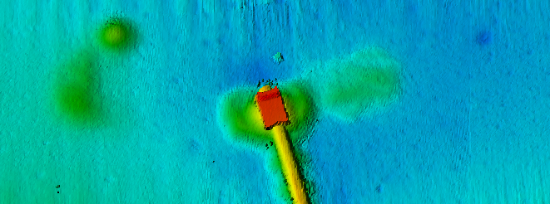
Patch Test Location
Finding a proper location can be difficult
Roll Test - A reasonably flat and level bottom is needed. (As seen in previous slide)
Pitch, Yaw, and Latency Test - An area of bottom with variable terrain changes
Channel with side slope works well.
Be aware the traveling perpendicular to the current, will cause problems with obtaining proper overlap.
This has everything. Perfect.

Slide 6
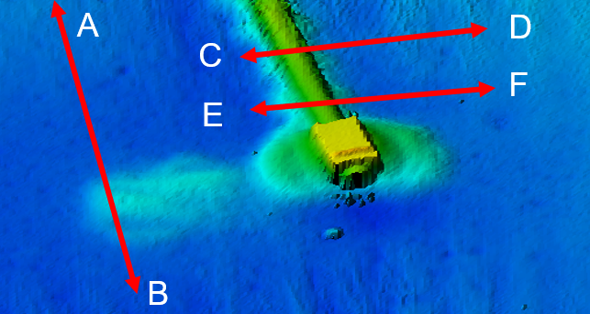
Planning and Running Survey Lines
Basic survey line layout for single head MBES. This line geometry doubles any alignment errors.
Roll Test: A-B both directions, survey speed.
Pitch Test: C-D both directions, survey speed.
Yaw Test: C-D and E-F, same direction, survey speed. Offset = ½ average depth.
Latency Test: C-D, same direction, high then low speed.
This is the basic line layout. With experience you will find short cuts. For example, line C-D could be extended for roll testing also.

Slide 7
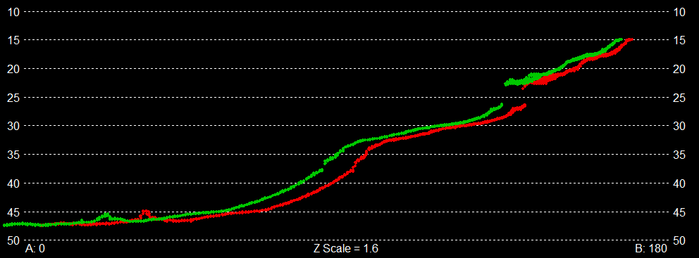
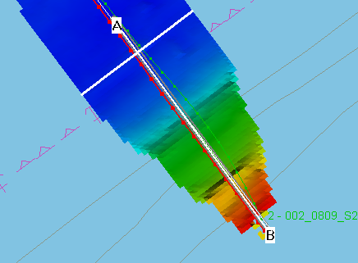
Cross Sections and Why
Line geometry and survey are intended to double alignment errors when cut in cross section.
Roll cross sections are taken across track.
Pitch, Yaw and Latency cross sections are taken along track.
MBMAX64 processing picks the proper cross section when lines are loaded in pairs.
A-B Cross Section views.

Slide 8
MBMAX64 Patch Test

Slide 9
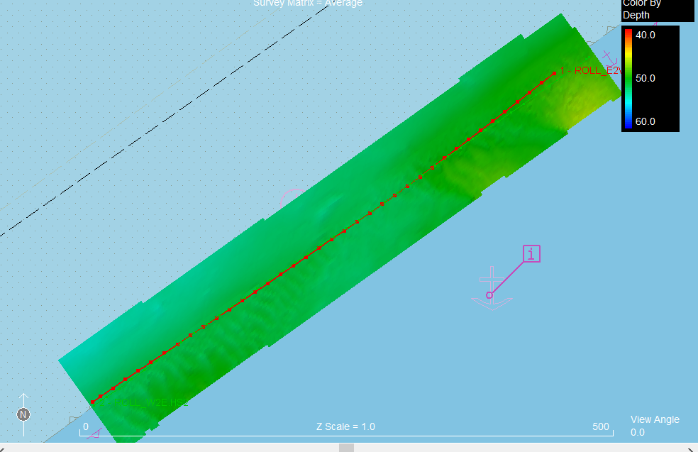
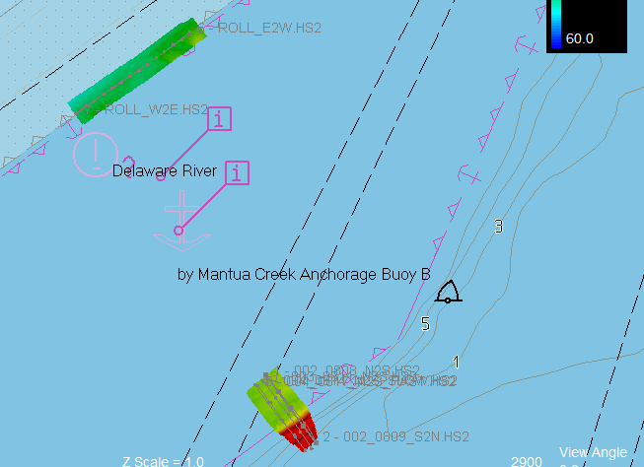
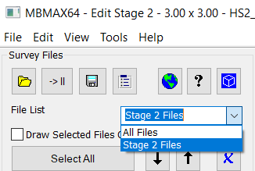
How to Load Files
Files may be loaded in pairs or the entire survey may be loaded at once.
Loading just the Roll Test. Loading files in pairs is good when you are new at this. The testing process may be easier to keep track of.
Loading the entire test. An efficient way of working. Requires somewhat advanced MBMAX64 skills to switch between Stages 1 and 2.

Slide 10
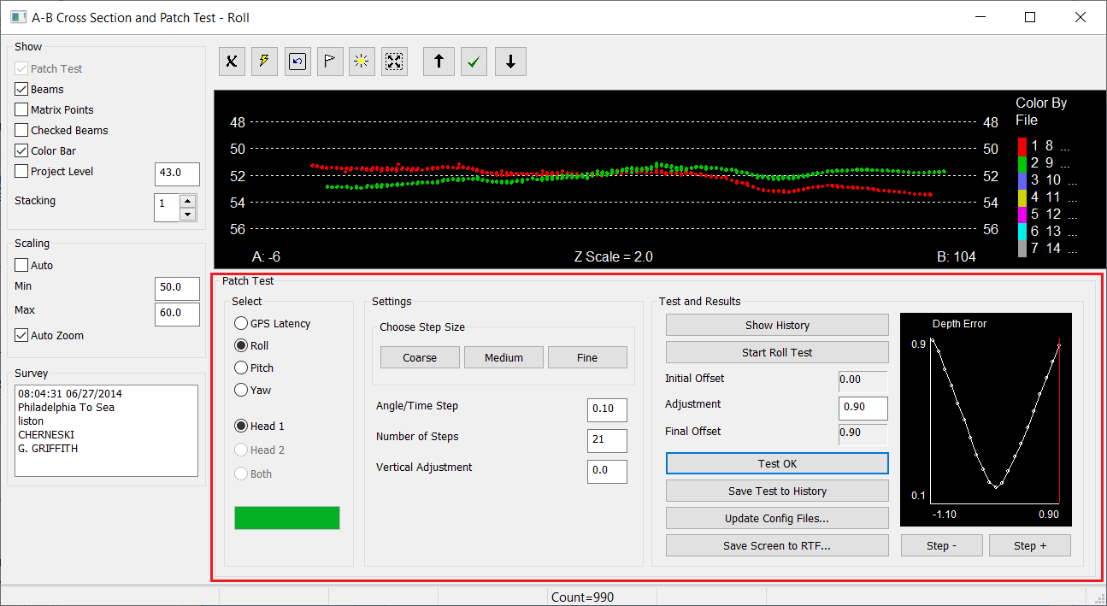
Introduction to the Patch Test Window
Doubles as an edit window (A-B Cross Section at top)
Patch testing controls and results at the bottom.
Enough already, run the program!

Slide 11
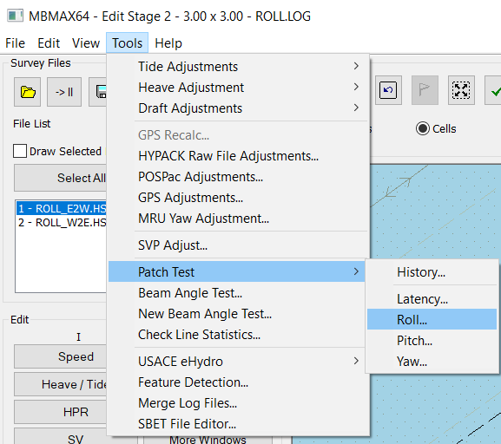
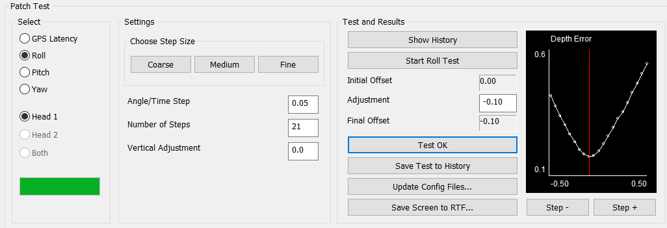
How to Run a Test
Run MBMAX64 and load a pair of files. Roll test is good for starters. Advance to stage 2 editing.
Use Tools menu, Patch Test, Roll to bring up the test.
Select Roll Test, Head 1, Coarse Steps then Start Roll Test.
Click Medium Steps to start again. Click Fine Steps to start one more time. If things went right click Test OK and you should see something like below.

Slide 12
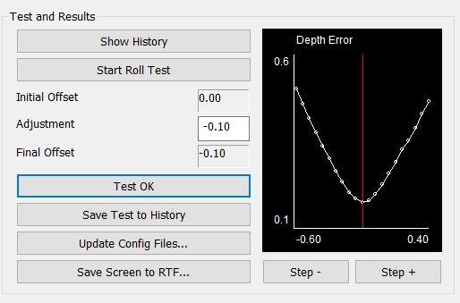
How to Interpret Results
Results from a good Roll test. The pronounced V-Shaped curve shows best fit overlap between cross section.
Initial Offset: From HYSWEEP Hardware setup.
Adjustment: Patch test change to Initial Offset.
Final Offset: Test result for updating offsets.
Test OK: Click this to accept results.
Save Test to History: Use this to keep a history of testing. It’s a good idea because there will be slight variations between tests.
Step + / Step -: Visually inspect and manually override statistical selection at different offset steps. Sometimes there’s a better answer!

Slide 13
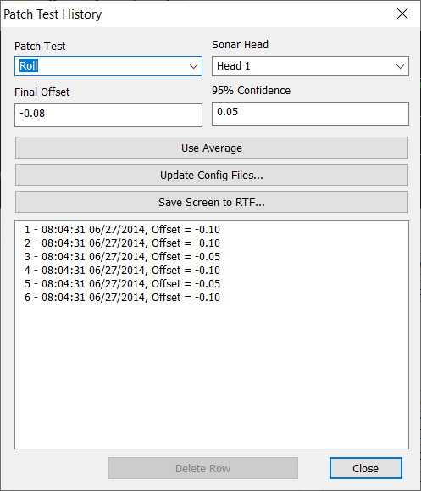
Using Patch Test History
History tracking finds the statistical best result.
History is tracked for each test – Latency, Roll, Pitch and Yaw.
Each head is tracked for dual head systems.
Final Offset = Average of all test.
95 % Confidence shows any ‘bias’ and how well tests agree.
Use Average updates current testing. (What you are doing now).
Update Config Files puts the average result in HYSWEEP.INI
Save Screen to RTF generates a report file.
Be suspicious of patch test modules that give results to 5 digits after the decimal!

Slide 14
Run Examples

Slide 15
Order is Important
Remember LRPY – Latency then Roll then Pitch then Yaw.
Find the Latency offset first (Should be 0.00, but should be tested for verification).
Latency will be applied to the Roll Test files.
Latency and Roll values will be applied to the Pitch Test files
Latency, Roll, and Pitch values will be applied to the Yaw Test files
Do it again (using same order) to check results. The second run should give finer results.
If a test comes up with a value that is totally different something went wrong.
Possible that the ‘wrong’ files were selected for the Test.
Rerun the tests until there is agreement and consistency.

Slide 16
Auto Cross Sections
MBMAX64 can find a correct cross section when files are loaded in pairs. For example,
Load a pair of Roll lines then advance to Stage 2.
Click Tools > Patch Test > Roll to start testing.
Repeat for Pitch and Yaw.
Perform test for Latency, as needed.
Testing is the same for Auto or Manual cross sections.

Slide 17
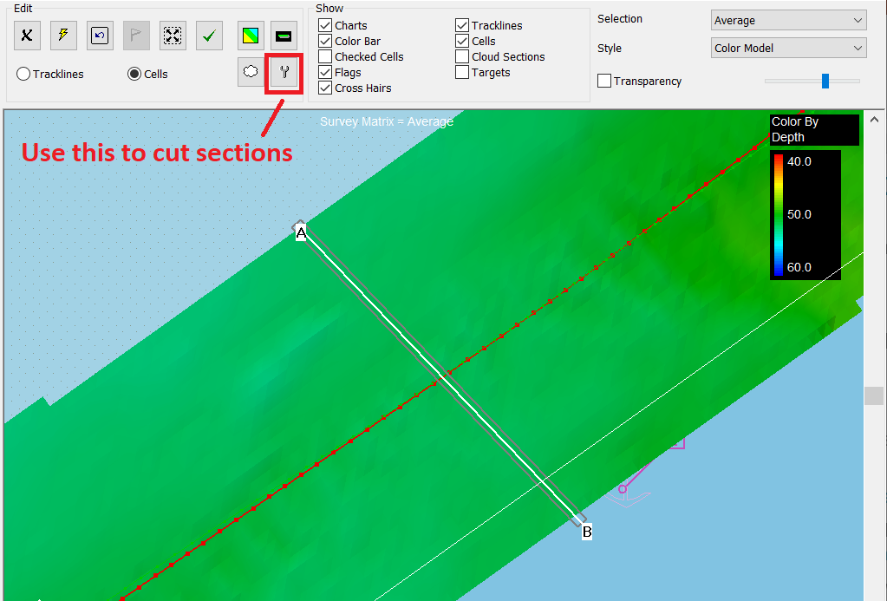
Manual Cross Sections
Manual Cross Section Method
Load all survey lines at once and get to Stage 2
Select pairs for each Test
Use the Wrench to cut sections.
Roll: Across track in the flat area.
Pitch and Latency: Along track under the sonar head.
Yaw: Along track half way between survey lines.

Slide 18
Latency Test
The Latency Test isn’t strictly necessary with modern GPS and Inertial Systems providing the multibeam with UTC timing. Latency is effectively 0.00 when this is done properly.
Lines run in the same direction at different speed. Cross section is cut Along-track.
This cross section shows an extreme Latency error. Why a Latency Test should always be done.
NOTE: Speed of the Vessel should be a twice difference between the files or more (3 kts vs 6 kts)

Slide 19
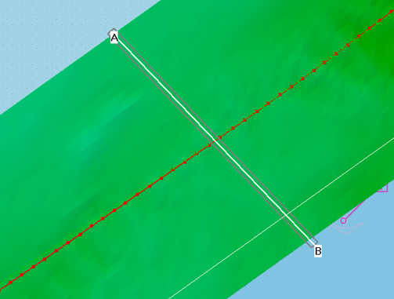
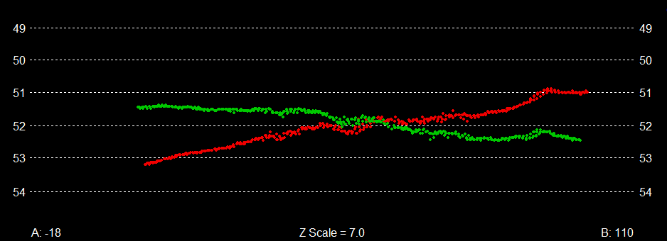
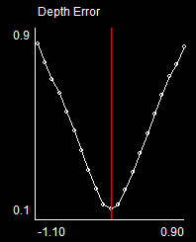
Roll Test
The Roll Test is very important. Large depth errors are caused by roll misalignment.
Reciprocal lines run over a flat area at normal survey speed.
Cross section is Across-track.
A misalignment of ‘one degree’ (shown here) will cause a significant depth error (2’ in 52’ of water).

Slide 20
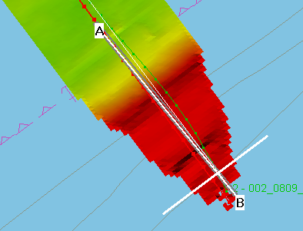
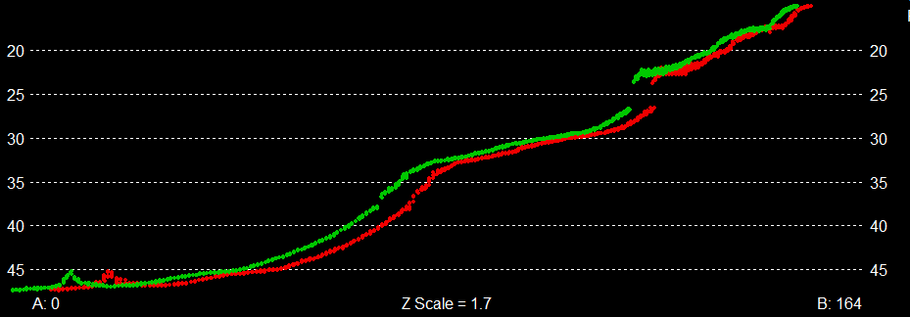
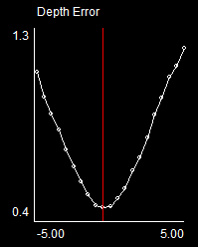
Pitch Test
Pitch misalignment leads to depth and position errors.
Reciprocal lines run over changing depth at survey speed.
Cross section is Along-track.
A slight angular misalignment adjustment will correct for the separation seen here.
The Depth Error Curve shows how much misalignment was found

Slide 21
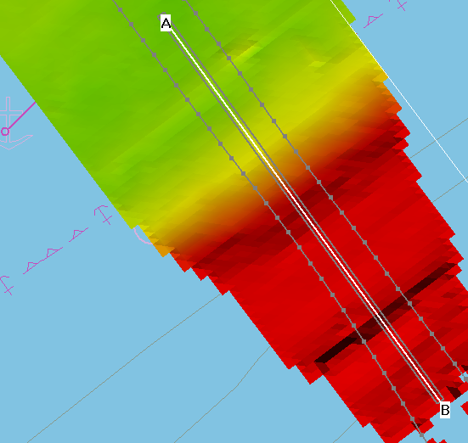
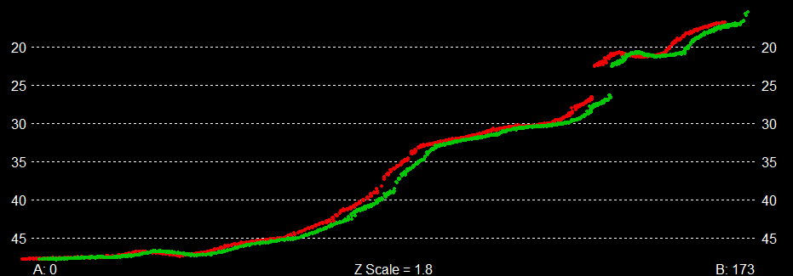
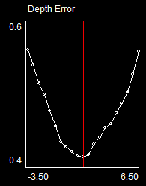
Yaw Test
Yaw misalignment only leads to positions errors.
Offset lines run in the same direction at survey speed over changing depth.
Cross section is Along-track.
Although Yaw misalignment only leads to position errors, depth errors are seen along the cross section.

Slide 22
Modifications for Dual Head and LiDAR

Slide 23
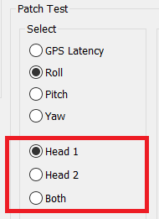
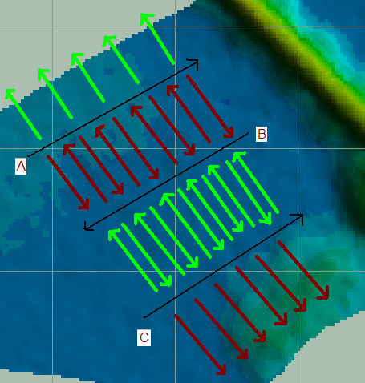
Dual Head MBES Test
Different geometry of the Heads requires that you overlap the Port and Starboard heads separately.
Latency and Yaw still only require 2 lines.
Roll and Pitch tests require 3 lines instead of 2.
Yaw requires a slightly different spacing and Overlap scheme
Some Dual Head systems in engineered mounting frames can be treated as single head.
You need to select sonar head in patch test.

Slide 24
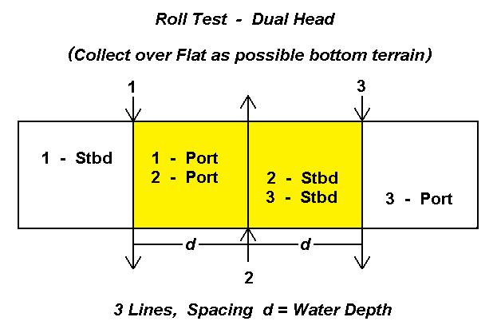

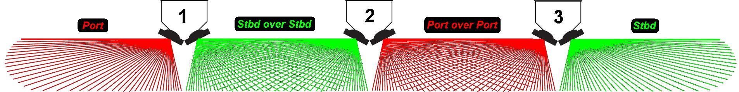
Dual Head MBES Test
Select the correct Sonar Head when
performing the Test

Slide 25
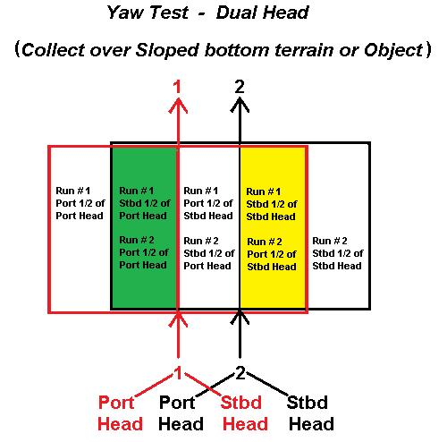
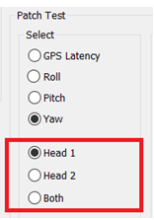
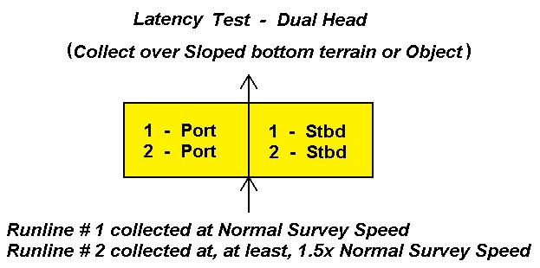
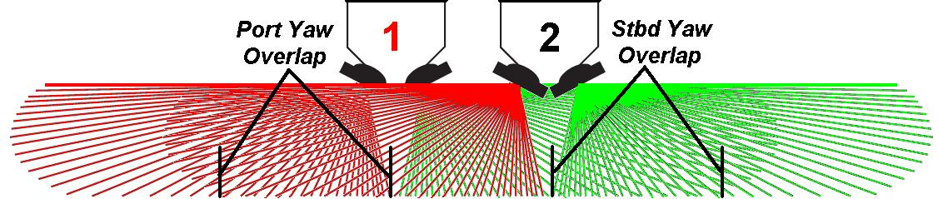
Dual Head MBES Test
Select the correct Sonar Head when
performing the Test

Slide 26
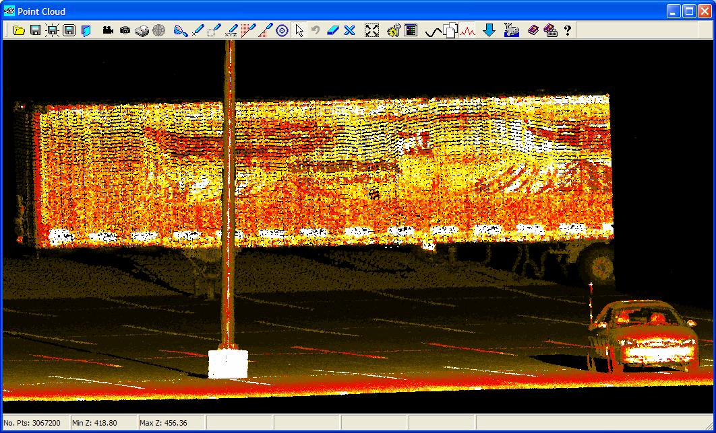
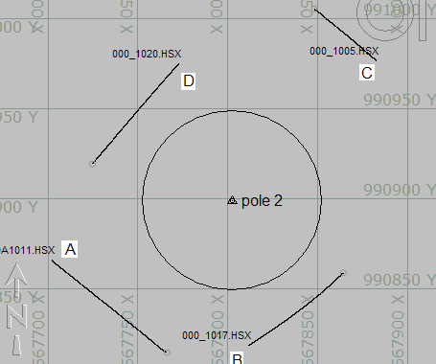
LiDAR Patch Test
The best patch is a parking lot with light posts. If you need to test in water, find a day marker or piling out of water.
Line pairs A-C or B-D can be compared for all alignments; Roll, Pitch and Yaw.
HYPACK® DATA FROM Teledyne-Optech ILRIS scanner.

Slide 27
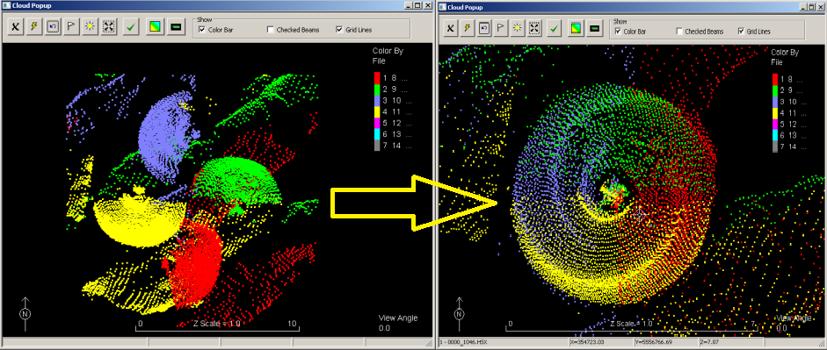
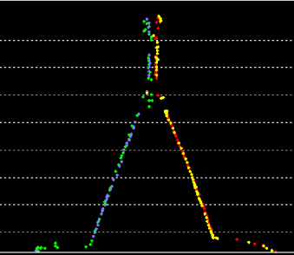
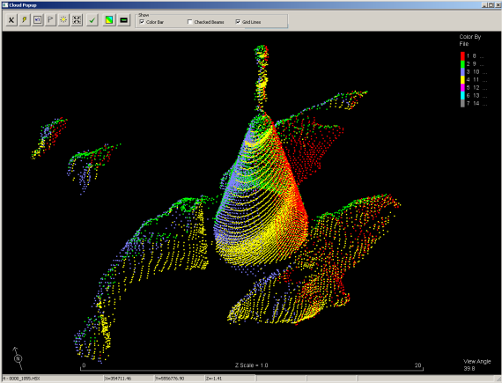
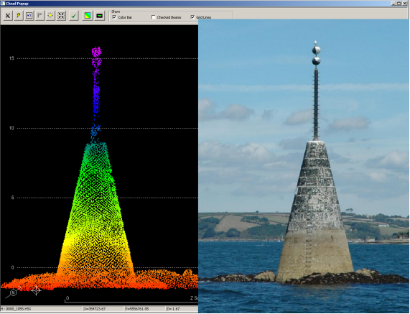
LiDAR Patch Test
LIDAR Patch testing runs the ’angular’ tests are run in ‘reverse’ order: Yaw, Roll, then Pitch
Yaw orients the four (4) halves
of the Light Pole and its base
Roll levels the flat surface
Pitch makes the Light Pole vertical

Slide 28
Performance Test

Slide 29
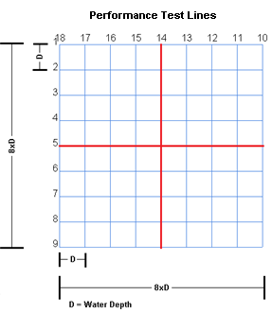
How to Make a Reference Surface
Location - Small area with a flat, uniform bottom
Preparation and Data Collection
Two sets of 9 parallel lines crossing at 90 degrees.
( 9 parallel lines allows for 150 degree Swath Width Test)
Line Spacing (Separation) = Water Depth
Collect data at ONLY a 90 degree Swath (if possible)
Survey at low or high tide to minimize vertical errors
SV cast immediately before data collection
Processing
Reference MTX with 1’ x 1’ cells.
Edit in MBMAX64. Filter to +/- 45 degrees
Careful removal of remaining flyers.
Save to XYZ. One point per cell, average, min 3 points/cell

Slide 30
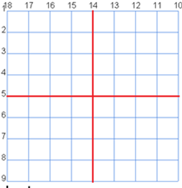
Check Lines
The Reference Surface need only be done once. The check lines are run periodically to test system performance.
Data Collection
Run the ‘middle’ lines of each set of perpendicular lines
(These lines are shown in red over the Reference Survey.)
Set Swath Width to the ‘widest’ that you want to test
(150 degrees = 7.4 times coverage, hence, the 9 lines)
Processing
Edit in MBMAX64 using the reference MTX from before and with the normal corrections (tide, SV).
Do NOT apply Angle Filters
Very ‘minimally’ remove flyers We want test just how ‘repeatable’ ALL the beams are, without removing too many points.
After editing we’re ready for the Beam Angle Test.
Check lines

Slide 31
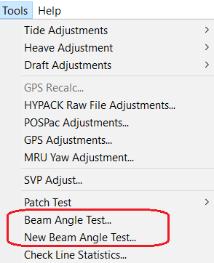
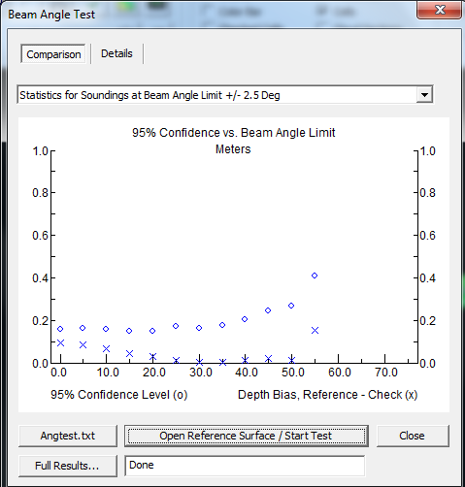
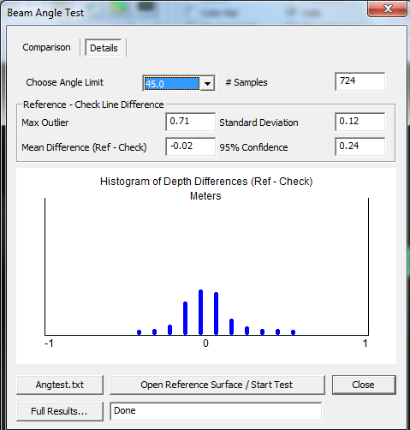
Beam Angle Test
With check lines loaded, run the beam angle test and open the reference XYZ to start test.
All stats are based on reference depth minus check.
Comparison tab is the overall result
o’s show ‘repeatability’
x’s show ‘bias’
Details tab is result at specific angle range

Slide 32
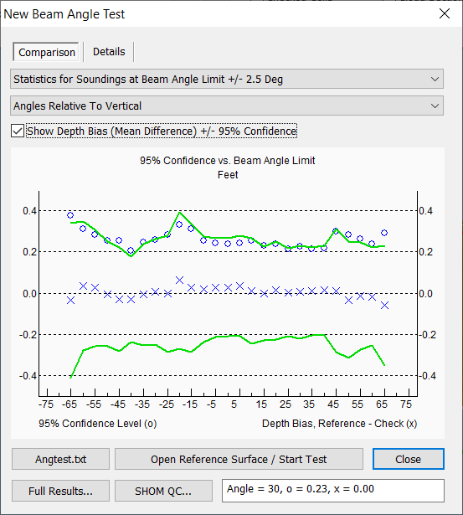
New Beam Angle Test
Improvements vs. the original test
Option to show angles relative to vertical.
Breaks out Port vs Starboard Beams (+/- angles)
Before, combined both sides and showed averaged values
Additional GREEN line = 95% confidence +/- bias
SHOM style QC report. A nice summary.

Slide 33
Multibeam – Single Beam Comparison

Slide 34
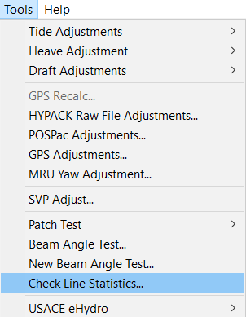
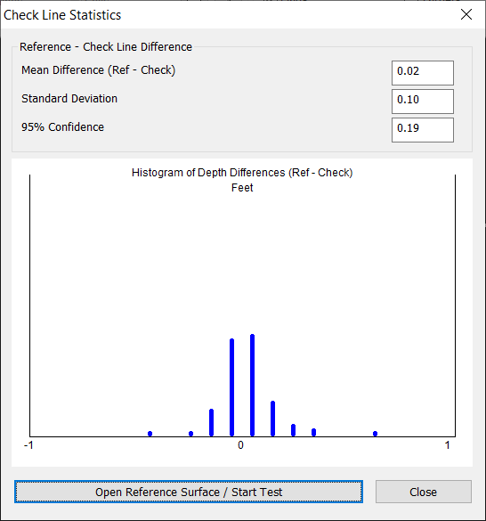
Reference Surface
Simple. Reuse the same one used for beam angle testing.
Check Lines
Run the same ‘middle’, just with a singlebeam echosounder.
Process to corrected XYZ using HYPACK® SBMAX or SBMAX64.
Check Line Statistics
Load the SB Check Lines XYZ
Tools > Check Line Statistics
Open the Reference XYZ
This is a good test.
Mean Difference = Bias = 0.02’

Slide 35
Thank You !
Contact Us:
Sales@HYPACK.com
Help@HYPACK.com
(860) 635 - 1500
Links to more information:
HYPACK on Youtube.com ( Historical Sessions ) HYPACK Live Chat
HYPACK on Youtube.com ( Newer Sessions ) HYPACK Ustream
HYPACK SUPPORT Site HYPACK Website

