Slide 1
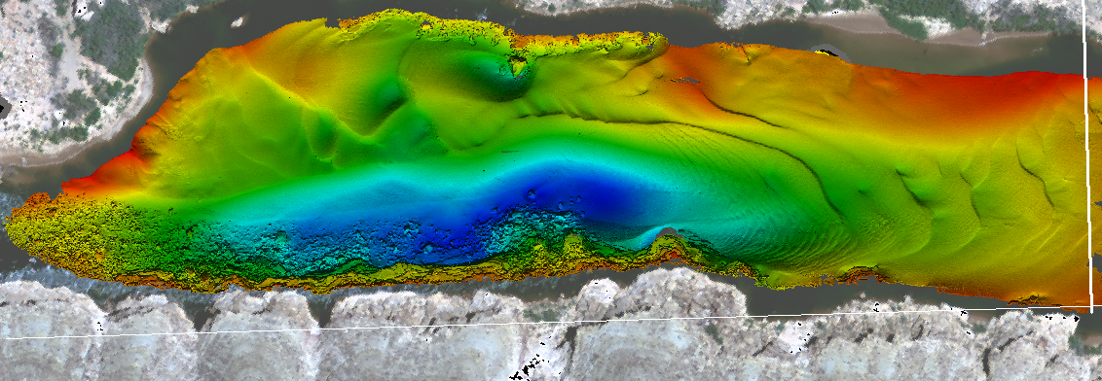
MBES – Data Collection

Slide 2
HYSWEEP® Overview

Slide 3
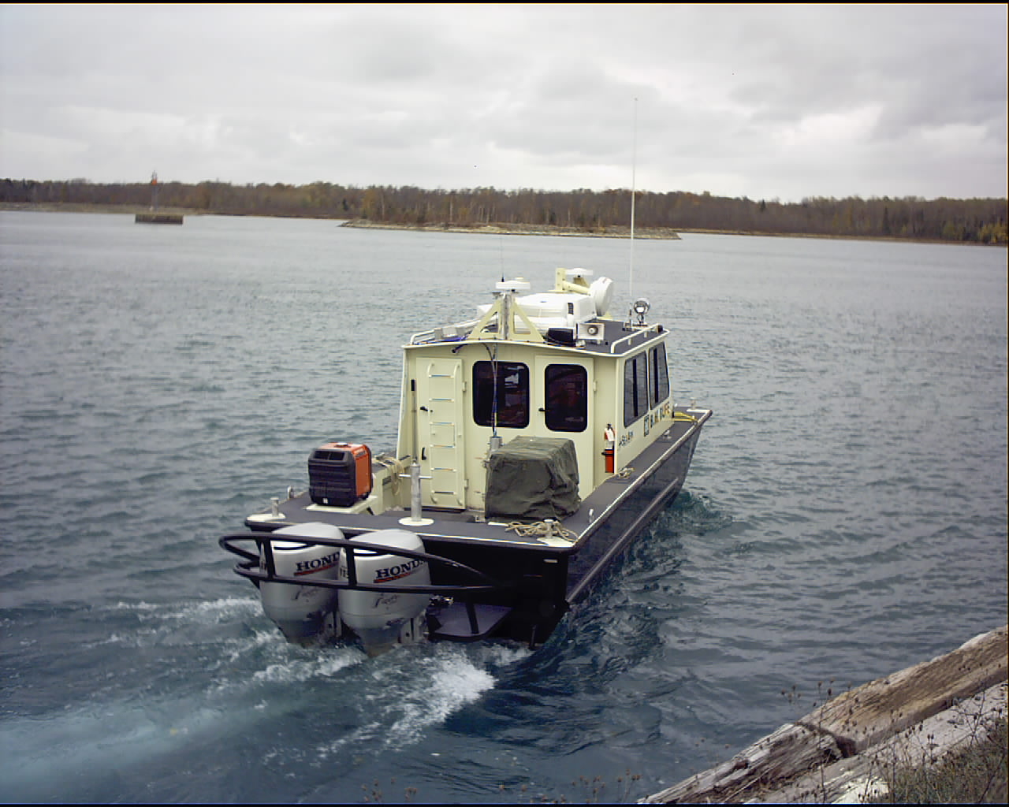
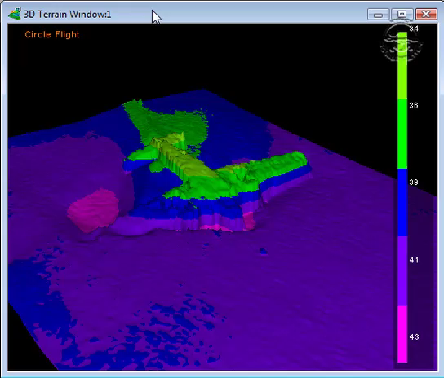
HYSWEEP® Overview
Full Coverage Survey of a DC3.
S/V Bufe - USACE Sault Ste. Marie Area Office

Slide 4
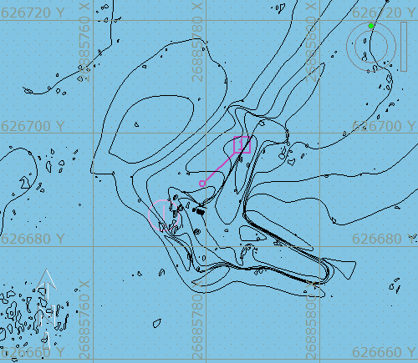
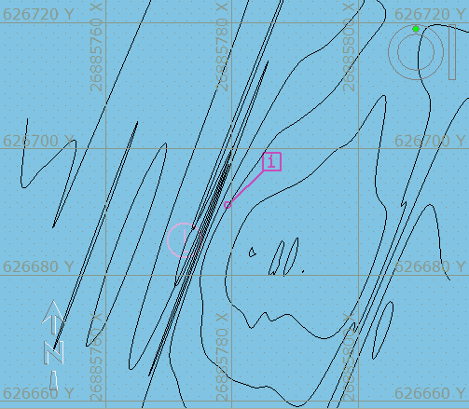
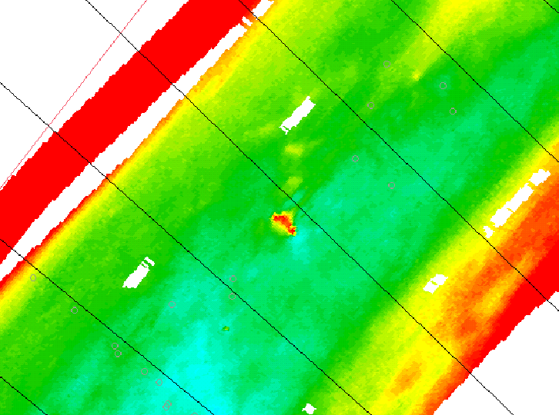
Multibeam vs. Single Beam
The Good:
Saves time: Multibeam provides high resolution and full coverage of the seafloor. The data is more accurate for volume computations.
The Bad:
More data to work with but takes more time to process. With additional sensors needed, there are more error sources.
The Ugly:
Plane is lost entirely in singlebeam contours.
Multibeam
Singlebeam
Example of using a Multibeam where previous work was with single beam sonar. An Obstruction was easily missed

Slide 5
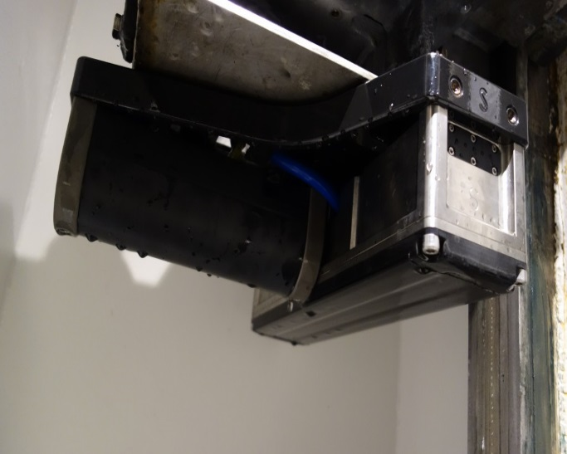
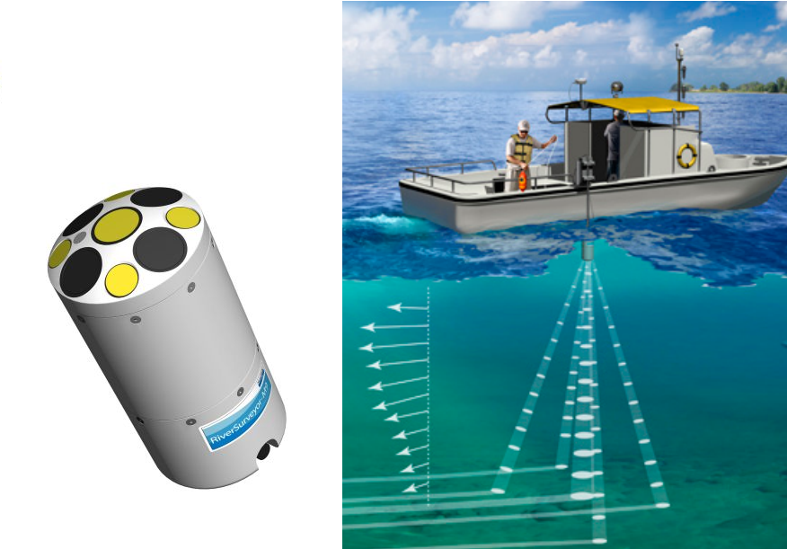
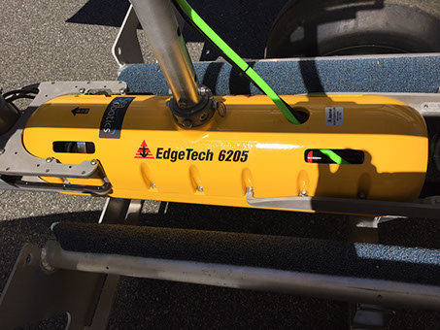
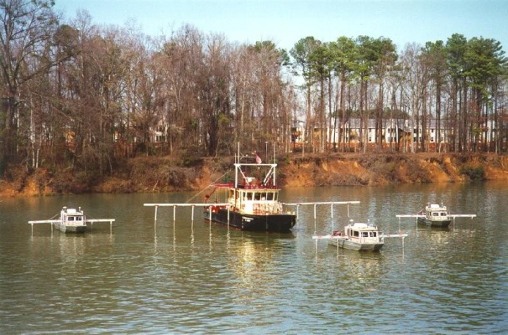
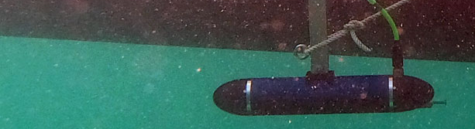
Multibeam Sonar Types
ADCP Systems:
Angular-set transducers
Beamforming Systems:
Forms beams using an array of transducer elements.
Each beam has a Maximum Response Angle, giving the direction of the beam.
Seabat T50-P
Interferometric Systems:
AKA ‘bathymetric sidescan’.
Forms beams from phase angle of backscatter.
SonTek M9
Edgetech 6205
CAATI Systems:
Computed Angle-of-Arrival Transient Imaging.
Multiple Transducer Systems:
Widely spaced Singlebeam transducers pointing down.
PING 3DSS-iDX-450
Ross Sweep System
Notes:
5

Slide 6
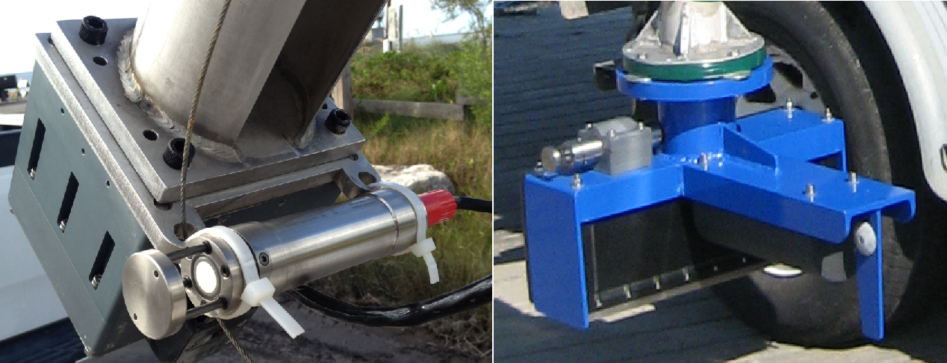
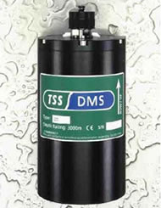
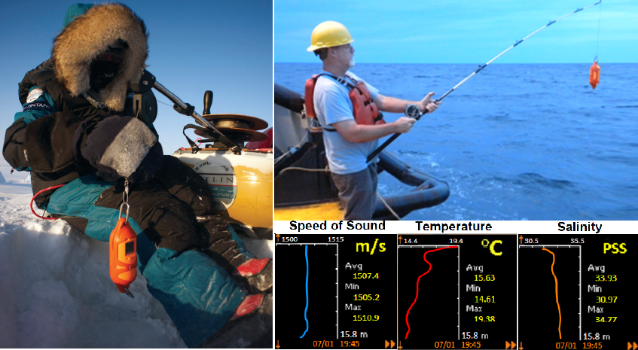
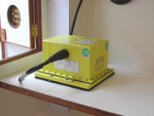
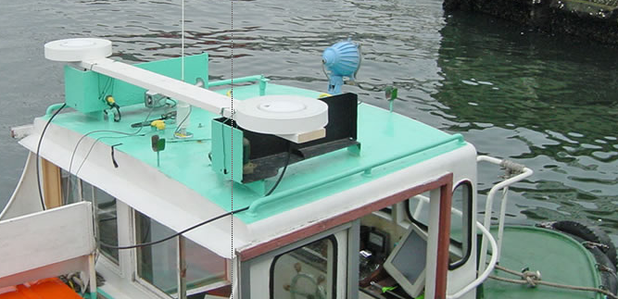
Support Sensors
Sound Speed Sensor & Profiler:
Sensor: Sound speed at sonar head.
Profiler: Sound speed through water column.
Heading: Using a gyro or dual GPS antenna array.
Motion reference (MRU / IMU):
Measures boat heave, pitch and roll.
Notes:
6

Slide 7
HYSWEEP® MB Interfaces
Multibeam Sonars Available in HYSWEEP®:
Atlas: Bomasweep, Fansweep, Hydrosweep MD2, MD/30, MD/50, DS.
Benthos: C3D.
BlueView: MB2250/1350, BV5000.
EdgeTech: 2205, 4600/6205.
Furuno: HS Series.
GeoAcoustics: GeoSwath.
Ibeam Multibeam
Imagenex: Delta T, DT100/101 SIR, Dual Delta T
IS Tech Multibeam
Kongsberg: MS1000, M3
Klein: 5000, Hydrochart 3500
Norbit: WBMS single and dual head, WINGHEAD
Odom: ES3, Dual ES3, Echoscan II, Miniscan, MB1 (dual), MB2 (Dual)
Picotech: PicoMBES
Ping DSP: 3DSS-DX, 3DSS-iDX
R2Sonic: SONIC 2020, 2022, 2024, 2026 (Dual – All).
Reson: Seabat 71xx, 81xx, 900x, T20P, T50P/R (Dual – All)
Ross: Smart Sweep.
SEA: Bathyswath, SWATHplus.
Seabeam: 2100, SB1000 Series, 3000 Series.
Simrad (Kongsberg): EM 302, 710, 1002, 2000, 2040(c), 2040 Dual Head, 3000, 3002, 3002 Dual Head, SM2000, ME70 (ALL & KMALL formats)
SonTek: M9 HydroSurveyor
Tritech: SeaKing.
WASSP: Multibeam, DRX
At last count, 50 different multibeam and multiple transducer systems are supported.
Notes:
7

Slide 8
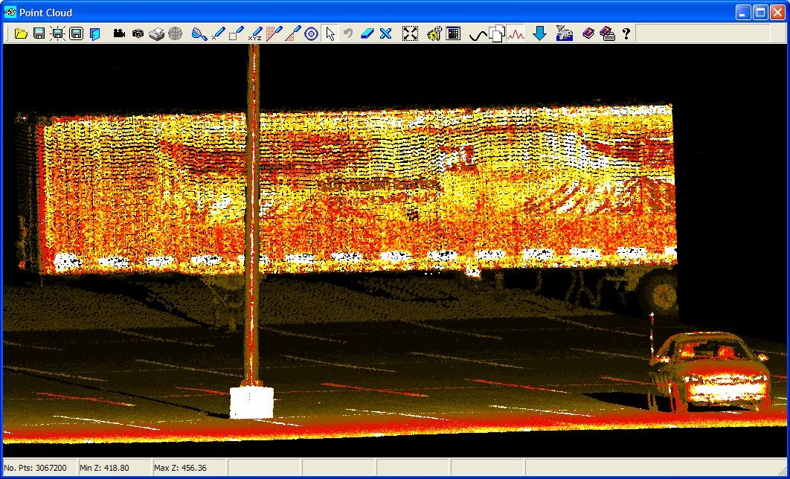
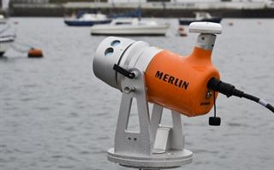
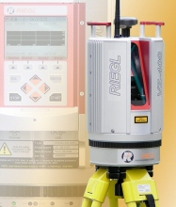
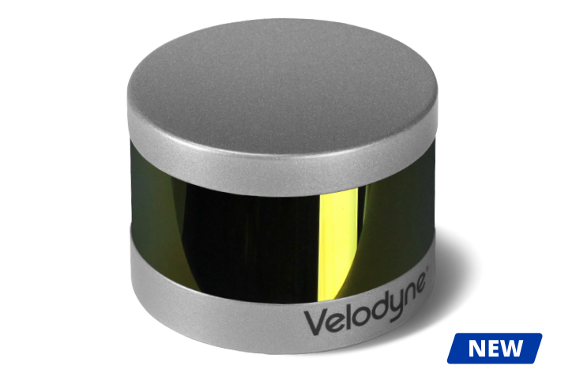
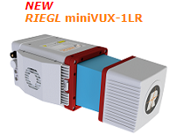
HYSWEEP® Topographic Lasers
2G Robotics ULS-500
Leica: P20/P15/P30/P16, P40, P50
Newton Laser (Beta)
Optech: ILRIS, Polaris
Ouster OS-1
Quanergy M8 Beta (Horizontal & Vertical)
Renishaw/Carlson: Dynascan & Merlin
RIEGL: LMS and V Series, miniVUX
Trimble: MX2
Velodyne: VLP-16 (Hi Res)/32, HDL-32E
Laser Scanners:
Renishaw Merlin
REIGL V-Series
Velodyne VLP-16
Notes:
8

Slide 9
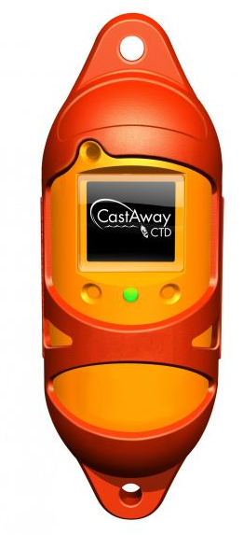

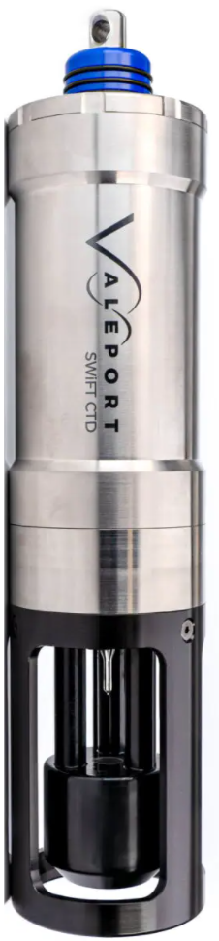
HYSWEEP® Driver Reference
Motion / Heading / Other Sensors:
Advanced Navigation: Spatial, Spatial Dual, Spatial FOG Dual, etc.
AML: AML-3, AML-6
Applanix: POS/MV, (Ocean, Wave, and Surf Master Models).
Coda Octopus: F180.
IXSEA: OCTANS, PHINS, Hydrins.
JAE: JM7531.
KVH: Gyrotrac.
Novatel: SPAN
Odim: MVP (Moving Velocity Profiler - HYPACK Survey driver).
SBG: Ellipse, Ekinox and Apogee Models
Seatex: MRUx.
SG Brown: 1000S.
Sontek YSI Castaway
TSS: 335B, DMS.
Valeport: Swift CTD.
*** - Other sensors available via the generic and NMEA drivers.
Sontek Castaway
CTD/SV Probe
AML AML-3
CTD/SV Probe
Valeport Swift CTD/SV Probe
Notes:
9

Slide 10
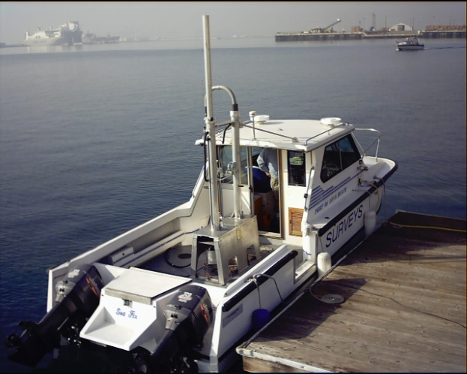
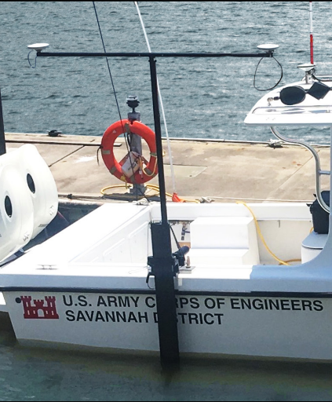
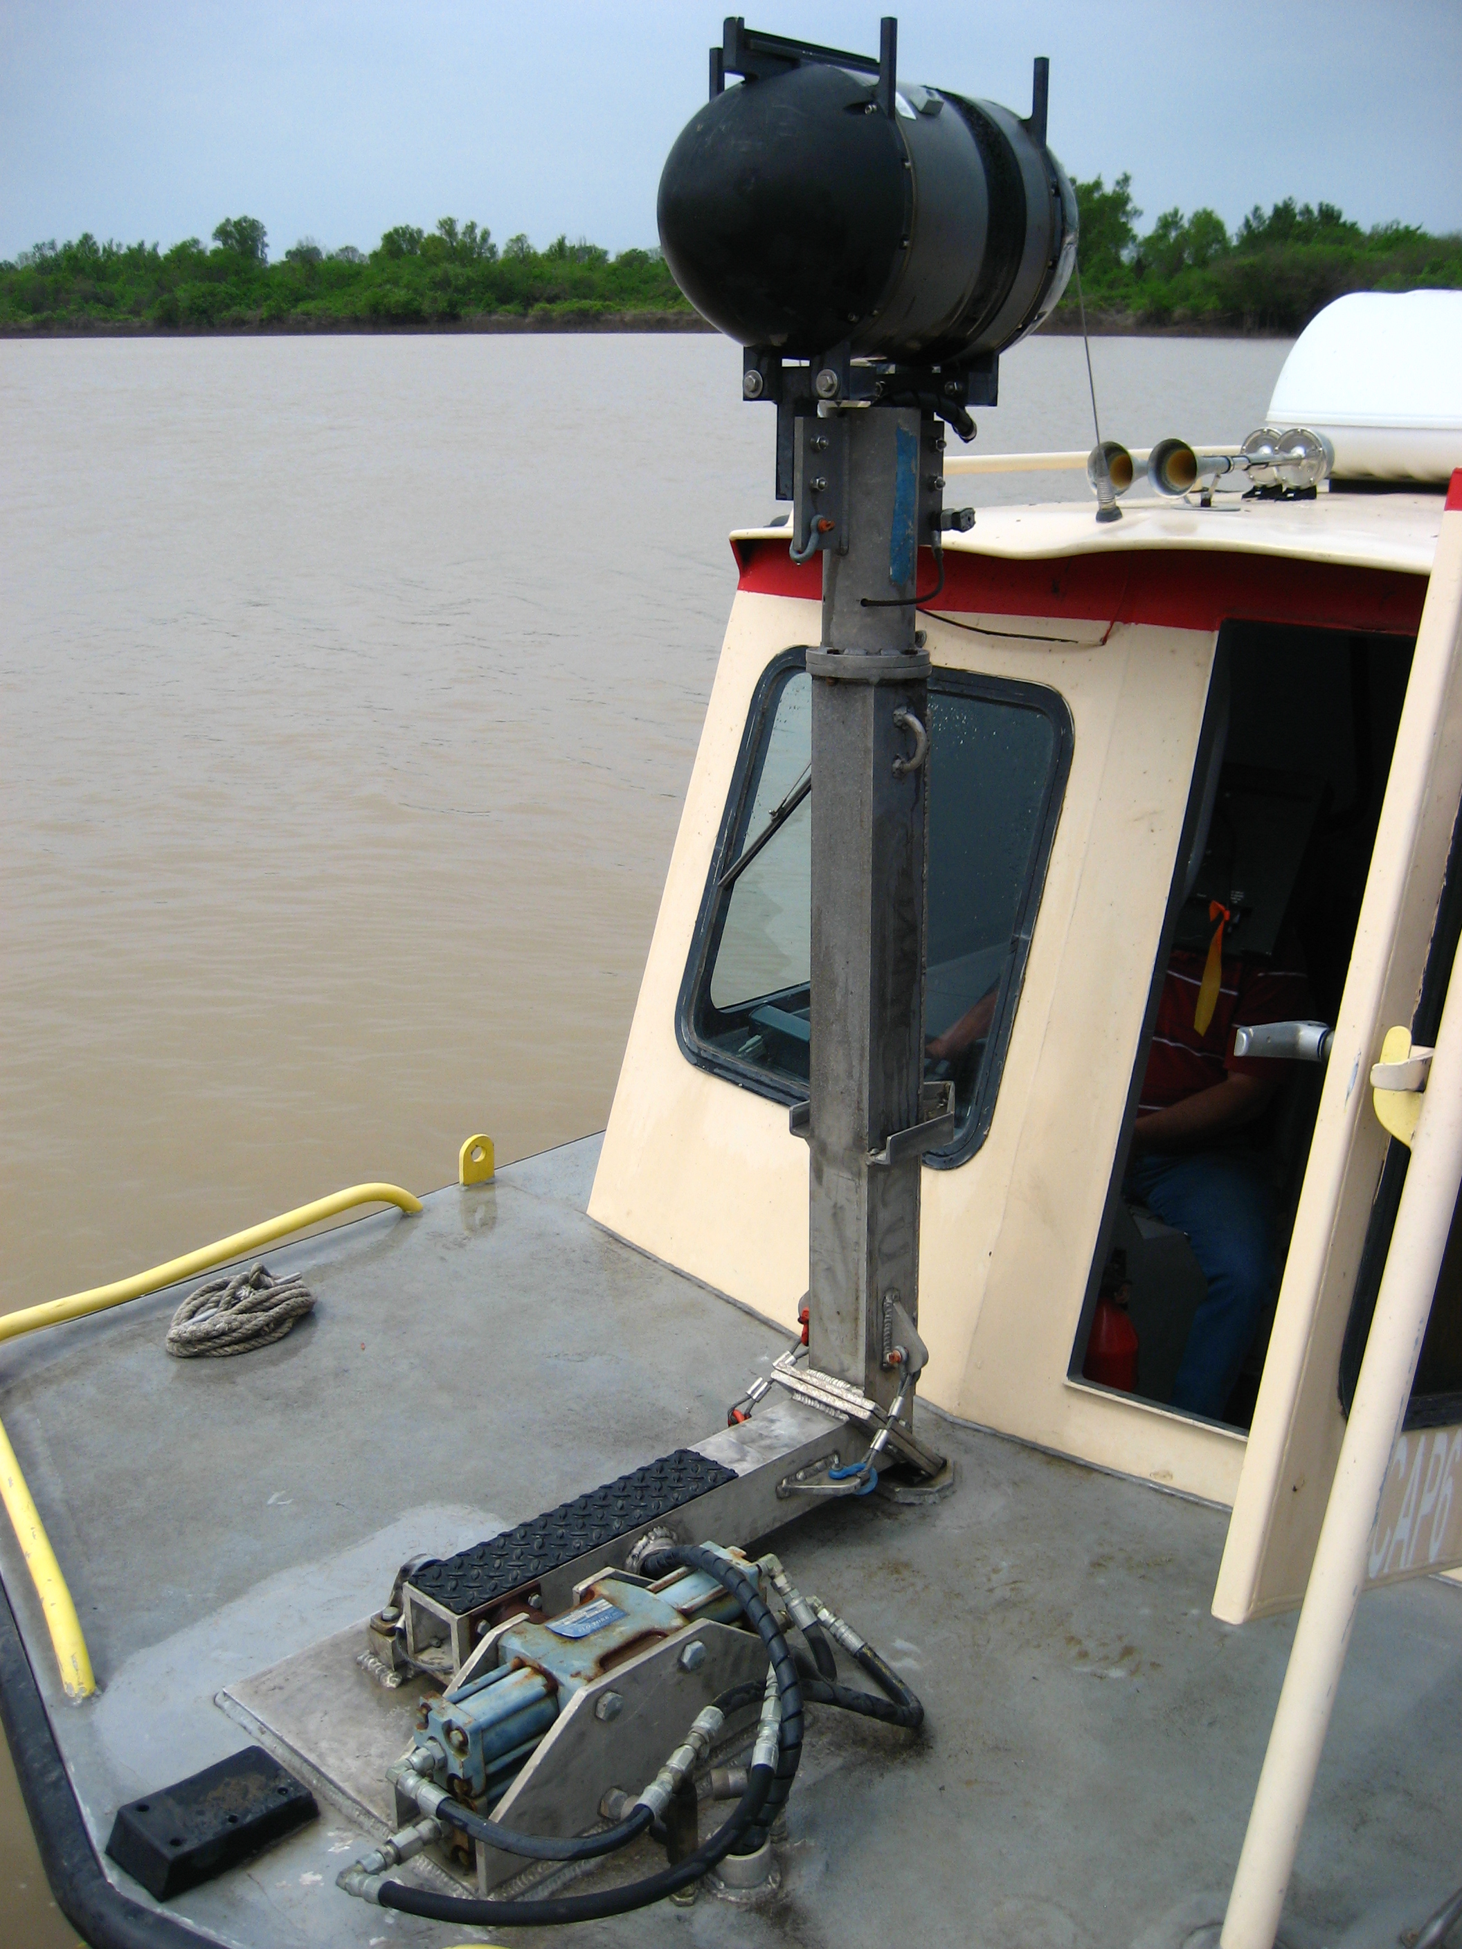
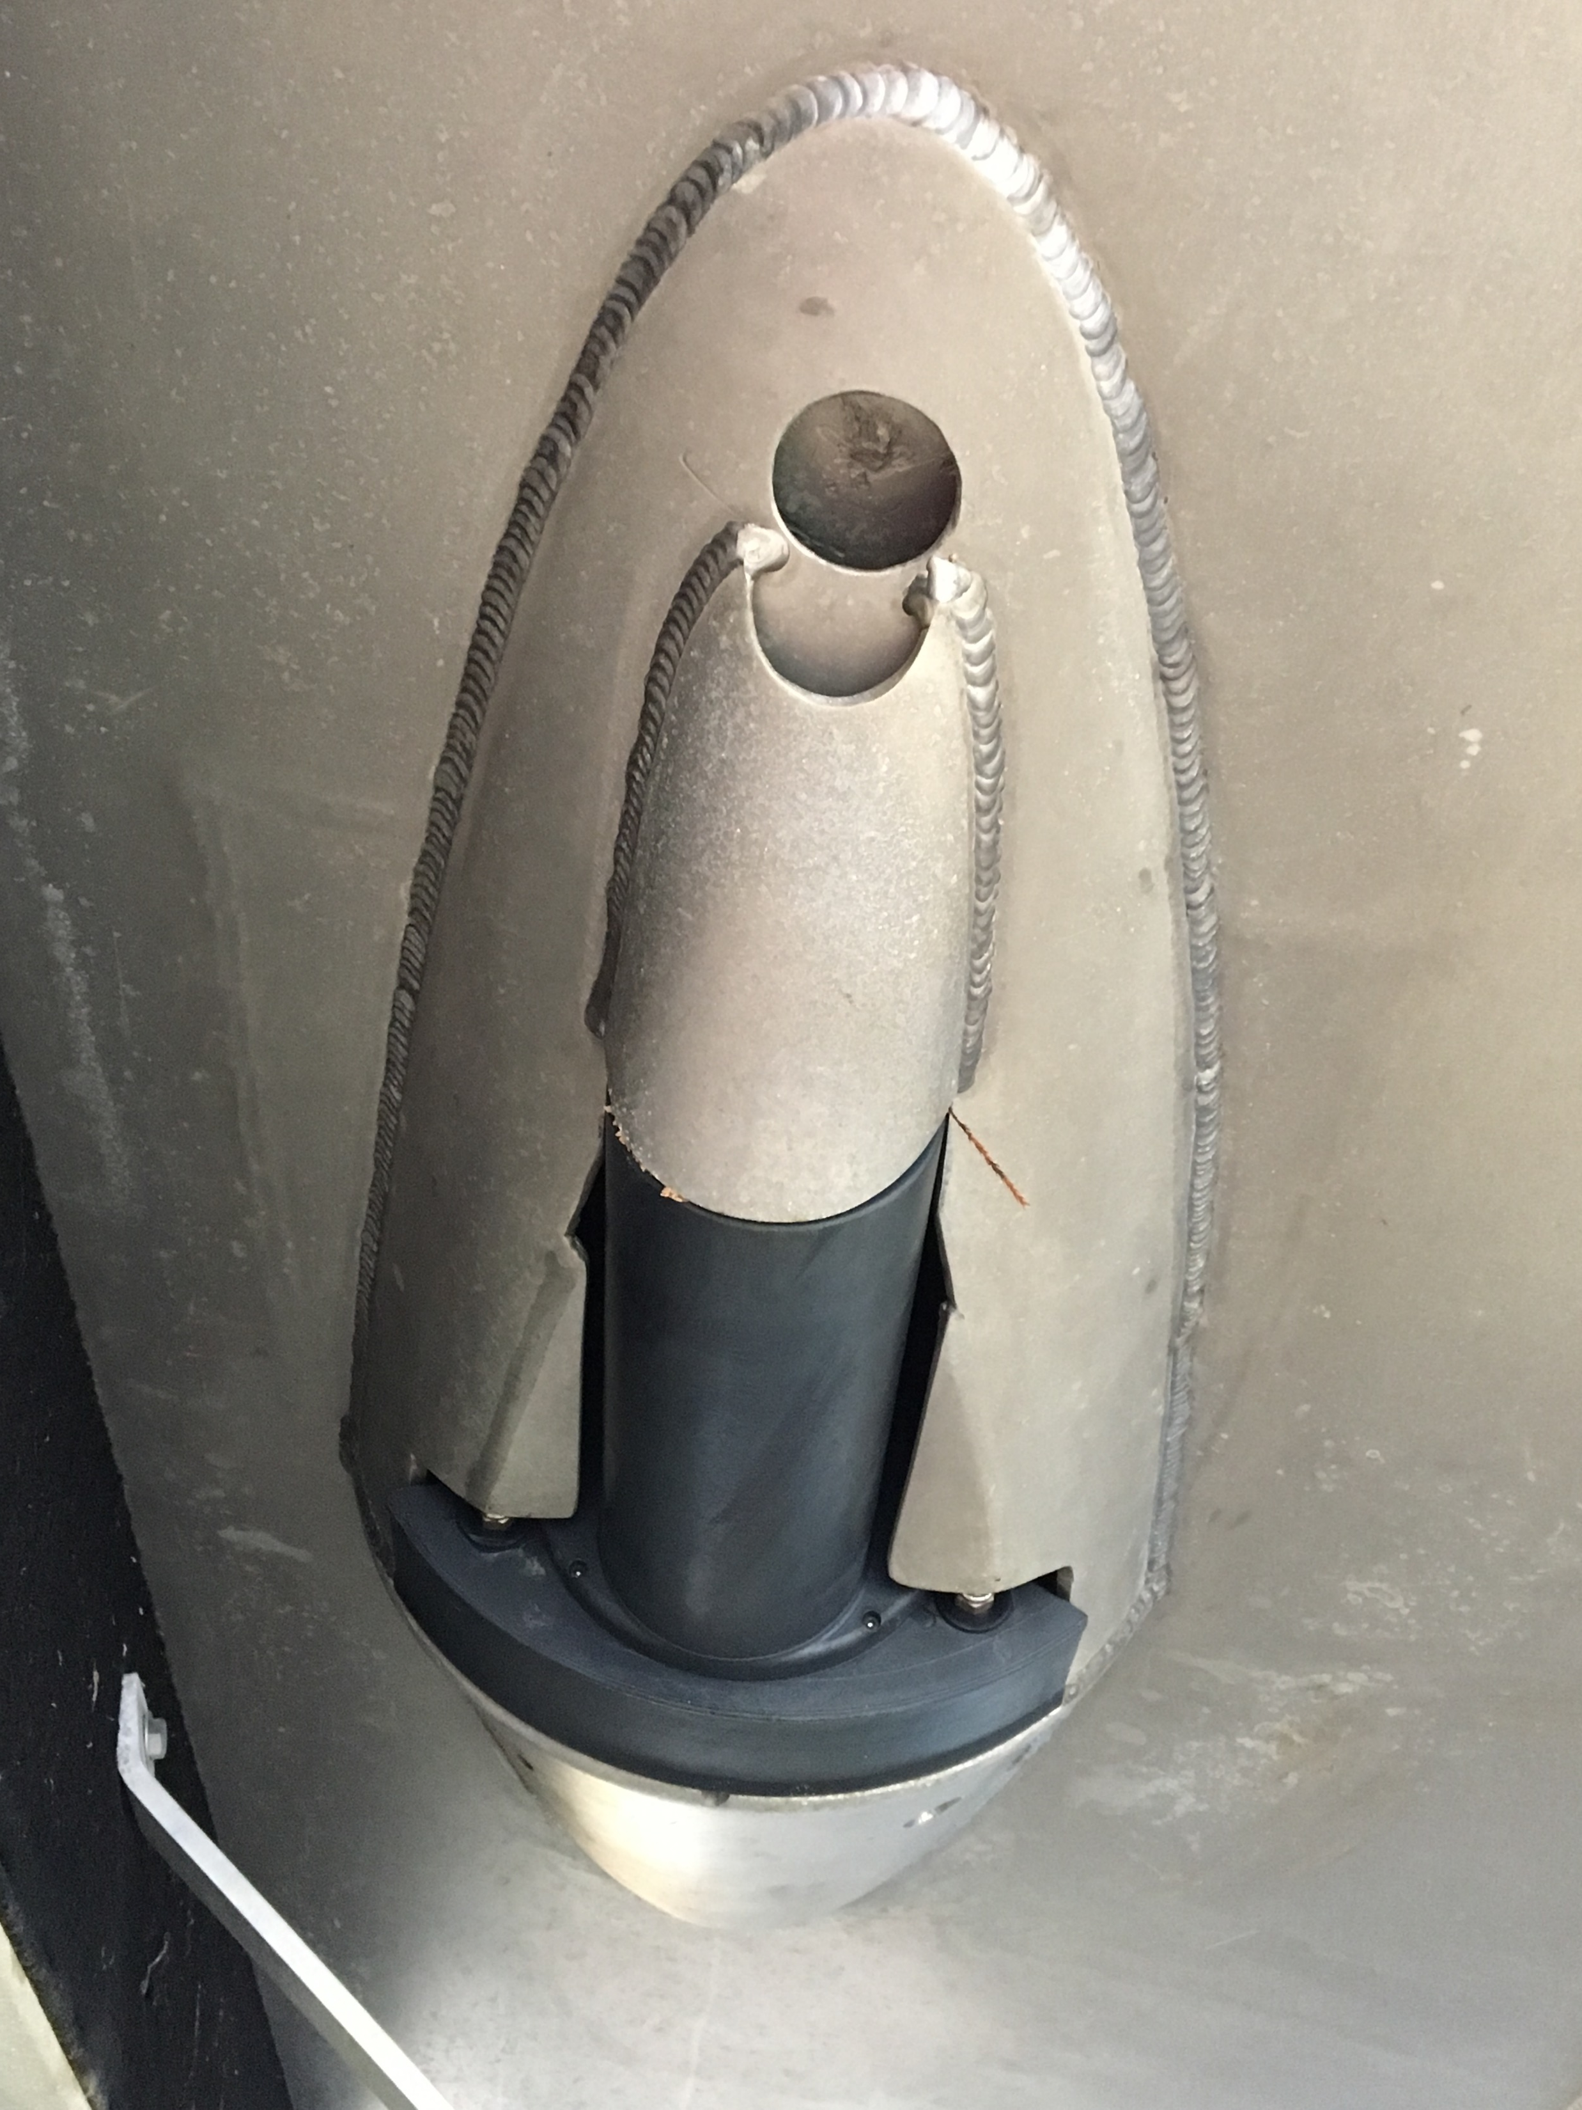
Installation
Hull Mount
Pole Mount: Over the Side
Pole Mount: Bow
Moon Pool
Sonar mounting (in order of preference for data quality):
Hull mount at boat CG
Moon pool at boat CG
Pole mount; bow or over the side
Motion Sensor: Mount at boat CG. Alternate location: As close as possible to boat CG.
Integrated MRU at the Sonar is becoming commonplace.
Notes:
10

Slide 11
HYSWEEP® HARDWARE

Slide 12
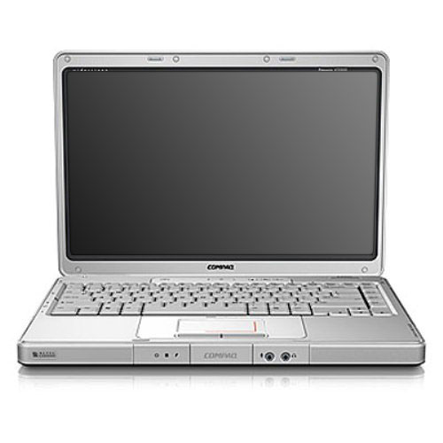
Sensor Interfacing
Bringing in the data
Network: For high volume data like multibeam. Data is received with UTC time tag.
Serial RS-232: For lower data volume like GPS.
Network and COM inputs
Time Tagging
Very Important - Device data are correlated by time tags.
All devices must use the same time base – UTC time or PC time.
Without it, data will not be good
Typically, Motion and Heading messages do not contain time tags. Data gets timed at arrival to COM port.
Exception is GPS ($GPGGA has a UTC time tag) and Inertial Systems (embedded time tag in data packet).
MB
MB
MB
MRU
MRU
MRU
MRU
POS
POS
+ time
Asynchronous data are correlated with time tags.
Notes:
12

Slide 13
Do I Need to Synch My Clock to UTC?
If you have a Positioning device that sends datagrams with UTC time stamps, AND devices that do NOT have embedded UTC time stamps, then the answer is:
Yes
Examples of when time synch to UTC is required:
GPS (UTC), Seabat (UTC), TSS DMS/05 (No time sent), Gyro (No time sent).
POS/MV (UTC), Seabat (UTC), Single beam on a COM port (No time sent).
Time Synchronization by GPS ZDA ONLY = +/- 10 – 30 mSec in Latency, however, it can be improved to
+/- 1 – 5 mSec in Latency by using a HYPACK 1PPS Box.
Notes:
13

Slide 14
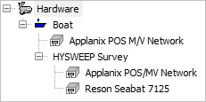
Reson Seabat 7125
HYPACK®/ HYSWEEP® Computer
Multibeam Data
Seabat 7125
Position, Time Sync, Heading, Motion
Groups (3,7,10,20,102)
Key
RS-232
Network
BNC (1 PPS)
Time Sync (ZDA)
Motion
1 PPS
POS/MV Inertial System
HYPACK does NOT require 1PPS
Note: HYSWEEP.dll is not required.
However, can still be used to share motion and heading information with the SURVEY program. Without this driver the SURVEY, the NADIR Depth of the MB and the time series plot of motion data will be unavailable.
Notes:
14

Slide 15

Kongsberg EM3002
Time-tagged Sonar, Heading & HPR
Kongsberg EM3002
HYPACK®/ HYSWEEP® Computer
Heading & HPR
Position (GGA) Time Sync (ZDA)
Key
RS-232
Network
BNC (1 PPS)
GPS
HYPACK does NOT require 1PPS, but using 1PPS is recommended
Note: HYSWEEP.dll is not required.
However, can still be used to share motion and heading information with the SURVEY program. Without this driver the SURVEY, the NADIR Depth of the MB and the time series plot of motion data will be unavailable.
Notes:
15

Slide 16
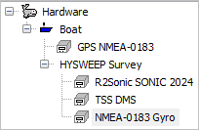
R2Sonic with 1PPS Box (example)
HYPACK®/ HYSWEEP® Computer
R2Sonic 2022/2024
TSS DMS/05
(HPR)
Sonar Data
PPS
Key
RS-232
Network
BNC (1 PPS)
Position (GGA)
Speed (VTG)
Time Sync (ZDA)
Motion (TSS)
GPS w/heading
To aid Motion (HDT, VTG & GGA)
1PPS Box
Heading
HYPACK requires time sync shown with the optional PPS box.
Note: HYSWEEP.dll is not required.
However, can still be used to share motion and heading information with the SURVEY program. Without this driver the SURVEY, the NADIR Depth of the MB and the time series plot of motion data will be unavailable.
Notes:
16

Slide 17
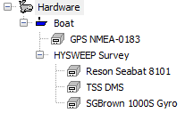
Reson 8101 with 1PPS Box:
Seabat 8101
TSS DMS/05
(HPR)
HYPACK®/ HYSWEEP® Computer
Sonar Data
Time Sync
Aiding
Key
RS-232
Network
BNC (1 PPS)
Position (GGA) Time Sync (ZDA)
GPS
SG Brown Gyro
(HDT)
1PPS Box
HYPACK requires time sync and shown with the optional PPS box.
Note: HYSWEEP.dll is not required.
However, can still be used to share motion and heading information with the SURVEY program. Without this driver the SURVEY, the NADIR Depth of the MB and the time series plot of motion data will be unavailable.
Notes:
17

Slide 18
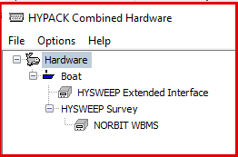
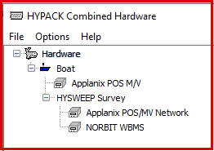
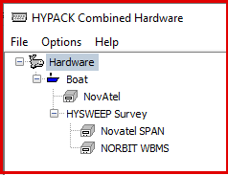
NORBIT iWBMS
Multibeam Data
NORBIT iWBMS
(w/ integrated IMU)
HYPACK®/ HYSWEEP® Computer
Position, Time Sync, Heading, Motion, Tide
HYPACK does NOT require 1PPS
Note: HYSWEEP_Extended.dll can also be used to ‘share’ Position, Tide, Motion, Heading and Nadir Depth information with the SURVEY program. Primarily for Dredge Monitoring.
Not recommended for detailed surveying or precise timing.
Notes:
18

Slide 19
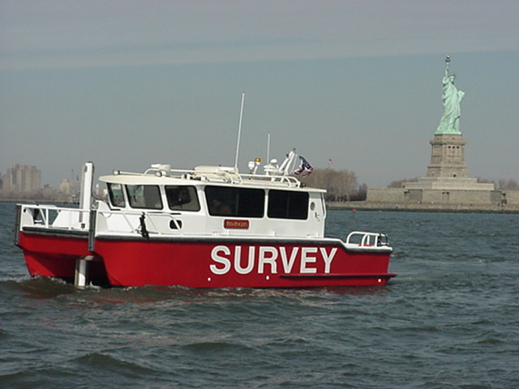
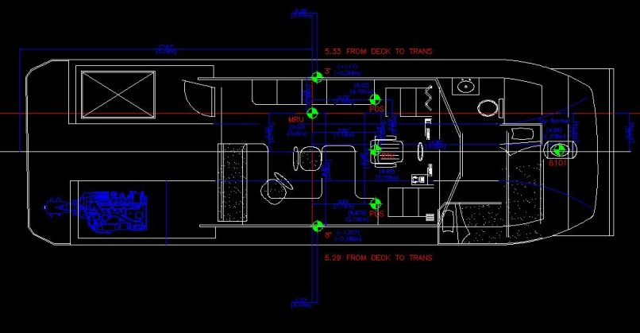
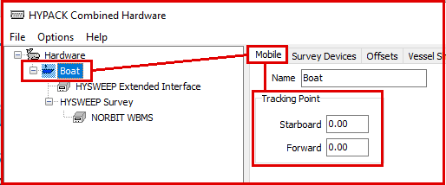
Offsets
Adjustment for:
Boat Origin (AKA Reference Point): Vessel Center of Gravity XY. Static waterline Z.
Device Location: Offsets in X (Starboard), Y (Forward) and Z (Vertical), as measured from boat origin.
(Be aware that X and Y are reversed in most Inertial systems)
Device Rotation: Pitch, Roll and Yaw orientation of directional devices such as multibeam sonar.
Device Latency: Time delay = data arrival time – data valid time.
“Red Rogers” and drawing (device locations).
Tracking Point: XY location of the sonar head. Used to adjust the Left/Right indicator.
HYPACK HARDWARE – Boat - Mobile
Notes:
19

Slide 20
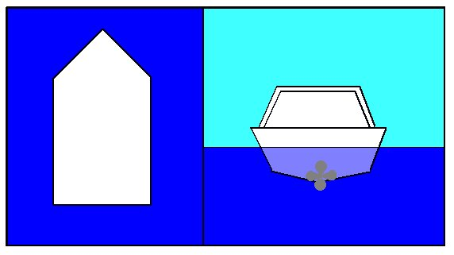
Boat Origin & Tracking Point
+Y
Boat Reference System
+X
MRU
Tracking Point
MRU
+X
Multibeam TRANSDUCER
Multibeam TRANSDUCER
+Z
In this example, the MRU is at boat origin, tracking point is over the transducer.
Notes:
20

Slide 21
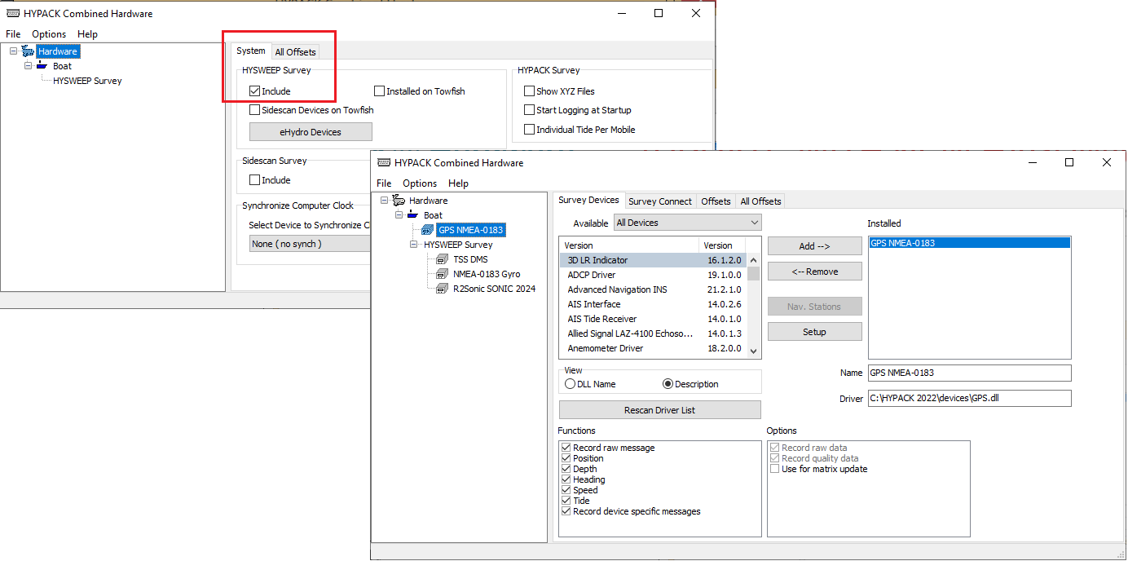
HYPACK® Hardware
Combined Hardware program will set the hardware for both HYPACK® and HYSWEEP®.
System Tab:
  Include HYSWEEP Survey
Main page:
  Configure HYPACK SURVEY (Boat) devices and then HYSWEEP SURVEY devices

Slide 22
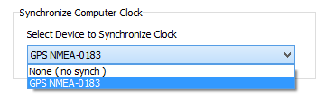
HARDWARE (HYPACK® SURVEY)
Positioning Devices (Heading and RTK Tide, as needed):
GPS.DLL (just about any make and model) COM Port or Network
ADVANCEDNAVIGATION.DLL (ANSS INS Systems) Network
POSMV.DLL (Applanix INS Systems) Network
F180.DLL (CODA F-series INS Systems) Network
HYSWEEP_EXTENDED.DLL (NORBIT INTEGRATED INS Systems) Network
IXSEA.DLL, PHINS.DLL, OCTANS.DLL (iXBlue/iXSEA INS Systems) Network
SEAPATH.DLL (Kongsberg INS Systems) Network
NOVATEL.DLL (Novatel INS Systems) Network
SBG.DLL (SBG INS Systems) COM Port or Network
SONARDYNE.DLL (Sonardyne INS Systems) Network
VECTORNAV.DLL (VectorNav INS Systems) Network
Select ‘Time Synch’ option on the HYPACK configuration page (as needed).

Slide 23
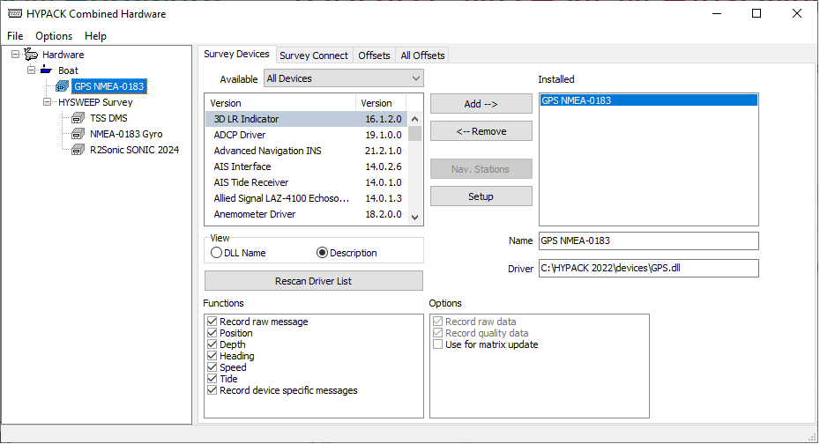
HARDWARE (Configure HYSWEEP®)
Configure the HYSWEEP® Survey section for:
Multibeam, Motion sensor and Heading.
Select from Manufacturer/Model list and “Add” to the INSTALLED section.
Note: Some multibeam systems may include MRU and Heading within their driver
No HYPACK® Navigation device under the HYWEEP Survey section.
It is automatically included in the Hardware program.
Notes:
23

Slide 24
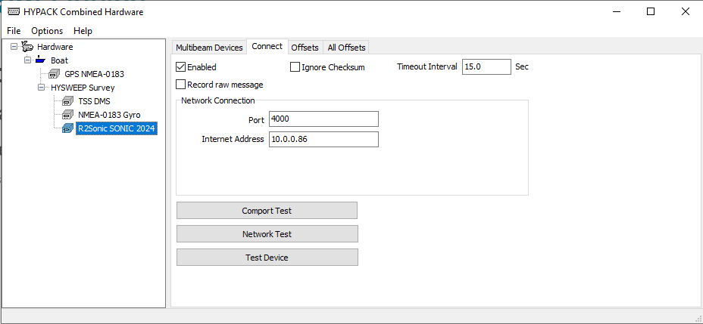
Multibeam Device
Connect:
Most sonars are network. (Enter the correct Port # and Internet Address, if not correctly defaulted)
TCP/IP devices ‘require’ the specific IP Address
Refer to “HYSWEEP Interfacing.pdf” for details (C:\Hypack 20xx\Documentation)

Slide 25
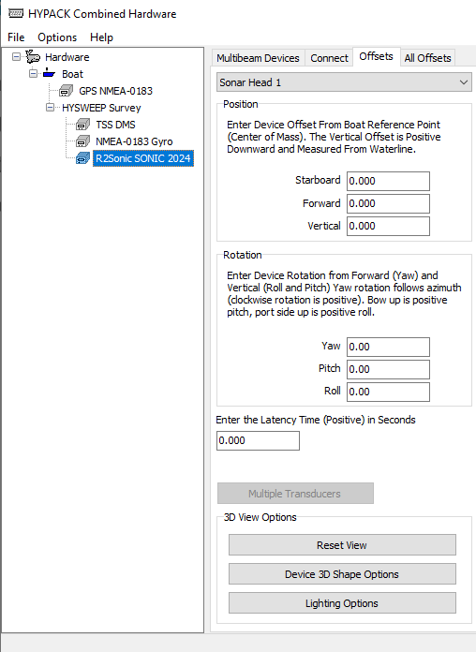
Multibeam Device – Offsets Tab
Select Sonar Head 1 or 2.
Enter Location offsets (Starboard, Forward, Vertical) as measured from Boat Reference Point.
Enter Rotation offsets (Yaw, Pitch, Roll) from Patch Test.
Latency should be 0.00.
(Navigation Latency is entered in the Positioning Device’s Offsets)

Slide 26
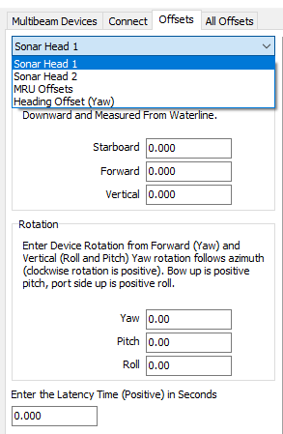
Multibeam Device – Offsets Tab (continued)
For multibeam sonars that include the Motion Sensor data embedded in their data packets, select MRU Offsets from the pulldown menu:
Enter Location offsets (Starboard, Forward, Vertical) as measured from Boat Reference Point.
Enter Rotation offsets (Yaw, Pitch, Roll) from Patch Test.
Latency should be 0.00, unless otherwise stated by the manufacturer.

Slide 27
Motion and Heading Sensors
Devices:
Select the driver, if listed. If not…
  The “TSS1” message is standard for Heave, Pitch and Roll (TSS DMS driver).
  The NMEA “HDT” message is standard for Heading (NMEA-0183 Gyro driver).
  The Generic Attitude driver can be configured to parse ASCII datagrams
Connect:
Enter Network or COM settings. (Consult the “HYSWEEP Interfacing.pdf”.)
Offsets:
MRU Location offsets measured from boat reference.
MRU Rotation offsets can be used to “zero” Pitch and Roll.
(https://www.hypack.com/File%20Library/Resource%20Library/Technical%20Notes/11_2017/HYSWEEP-Angular-Offsets---Static-Pitch-and-Roll.pdf)
Heading Rotation (Magnetic Declination) offset (Yaw) can be used to correct to Grid North.

Slide 28
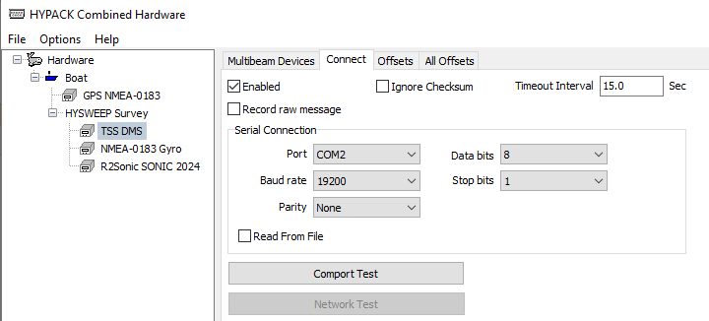
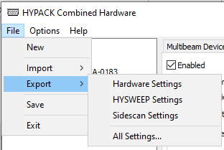
Testing and Saving…
CONNECT Tab: Use COM Test and Network test to verify sensor is sending data
Alternate Hardware Configurations:
Open and Save alternate configurations using the IMPORT and EXPORT
Notes:
28
I have a note about saving the changes. Last year’s slide says to save the changes [meaning click the Yes button when the prg asks to save changes] and gives the full path to the Hysweep.ini. That seems more clear/exact. There was a note on that slide [changes saved to Hysweep.ini] but this is another I don’t remember what he wanted different.

Slide 29
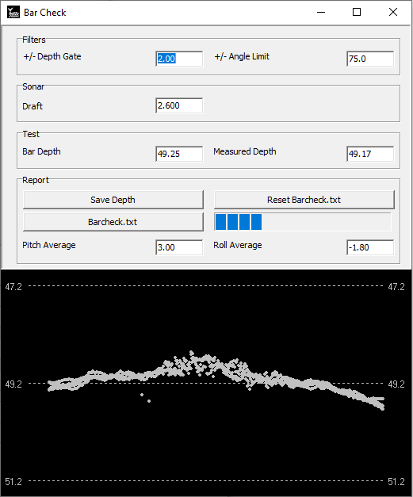
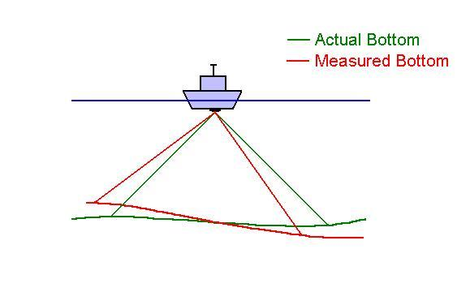
Calibration Tools
HYSWEEP® Bar Check
Much like single beam - verify draft measurement.
Multibeam systems need calibration!
HYSWEEP® Patch Test
Roll, Pitch, and Yaw angular alignments.
Determine the orientation of the sonar, with respect to the MRU and Heading devices.
Account for GPS Latency, if needed.
Why we need to Patch test.
Bar check window.
Notes:
29

Slide 30
HYSWEEP® SURVEY

Slide 31
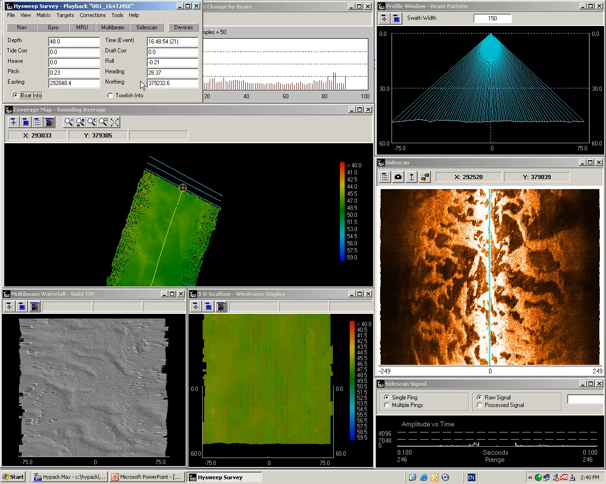
HYSWEEP® Survey
Multibeam Survey Program
Collects and logs multibeam and support sensors.
Displays are Real-time corrected and provide QC info.
For Simulation and Survey Practice:
https://www.hypack.com/File%20Library/Sounding%20Better%20Newsletter/2014/MB-Simulation_Playback_Automtx.pdf

Slide 32
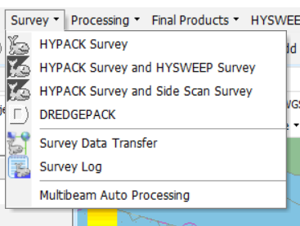


HYSWEEP® Survey
Survey Preparation:
Geodetic parameters and HYPACK® and HYSWEEP® hardware configuration
Planned lines or matrix for navigation
Pre-set TPU parameters in the TPU EDITOR if you want to use Total Propagated Uncertainty
Create Sound Velocity and Tide file to be used during survey
TPU setup
Launch Survey:
Use menu to run HYPACK® SURVEY and HYSWEEP® SURVEY together.
Use Smart Launch icon to run both.

Slide 33

Survey Preparation
Planned Survey Lines
Make parallel lines spaced for target coverage.
Sometimes difficult with multibeam, as coverage changes with depth.
Coverage Matrix
Alternative to planned lines.
“Mow the Grass” and ‘paint the bottom’ to assure proper overlap and 100% ensonification is achieved.
Large depth changes make line planning difficult. Alternative is “Mowing the Grass”.
Notes:
33

Slide 34


HYSWEEP® Survey
HYSWEEP® 3-D Seafloor
Same take-off angle, different ray paths.
Features
Data collection and logging.
Targeting and coverage mapping.
TPU and other QC checks visible in over 30 real time displays
Refraction Errors seen in real time
Refraction occurs at changes in sound velocity.
Errors when SV profile doesn’t match conditions – estuaries can be troublesome.
Look for ‘smiling’ or ‘frowning’ sweeps.
Notes:
34

Slide 35



Multibeam Auto Processing
Allows surveyor to ‘set’ pre-filtering processing parameters, so that a preliminary, Final data set can be ready, immediately after the Survey has been collected.
Yes: Use this first time to select devices and setup filters.
No: Use when there are no changes in device or filter settings.
Launch Auto Processing before data collection begins, preferably before launching SURVEY.
Yes: Loads, filters and saves survey files on end logging. Resets memory for the next file.
No: As above except files are retained in memory for coverage mapping.

Slide 36

HYSWEEP® Main Window
Data Filename or “Offline” in title area.
Alarm Indicators
Green = OK.
Yellow = Something’s not right here.
Red = Look Out!
(Click on the ‘button’ to read the Alarm details)
Various system measurements updated once a second.
Select Boat or Towfish for display of sensor data.
Typical Alarms:
Devices: Timeout, COM or Network port open error, checksum error.
QC: Heave drift, SV profile no longer valid (doesn’t match the sensor).
Notes:
36

Slide 37



View Options (F9)
Set Depth and Angle Limits.
Select Different Window Displays.
Select and Set Different QC Tests and Alarms.
Important NOTE: The ‘View Options’ ONLY affect the ‘display of the Real Time data’. It does NOT affect the ‘actual data’ that is being collected. Even if you incorrectly set one of these options, you will NOT affect the data being stored in the files.
Notes:
37

Slide 38



View Options (F9) (Continued)
Select which Coverages to Display.
Select which corrections to apply in Real Time.
Select and Set Different Laser Filters
Important NOTE: The ‘View Options’ ONLY affect the ‘display of the Real Time data’. It does NOT affect the ‘actual data’ that is being collected. Even if you incorrectly set one of these options, you will NOT affect the data being stored in the files.
Notes:
38

Slide 39








HYSWEEP® Survey (over 30 Display windows)

Slide 40



Profile and 3-D Seafloor
Profile Window
Single sweep from aft looking forward.
Color coding can be based on beam quality.
Useful QC.
Swath Width at top.
User defined scale for depth and swath
3-D Seafloor Window
Styles: Wire frame + solid / color TIN
Individual Sounding Points
Mouse targeting and measurement.
Great tool for bottom visualization.

Slide 41



Waterfall Windows
Multibeam Waterfall
Color or solid TIN display.
Good for visualization, targeting and comparison to sidescan.
Intensity Waterfall
Imagery. No depth info.
Average backscatter (one sample per sounding) or snippets (many samples).
Apply TVG Gains
Sidescan Waterfall
Sidescan data from the multibeam.
Full image control; colors, gains, bottom tracking, etc.

Slide 42


Interferometry
Processing the raw data from interferometry (bathymetric sidescan) systems
Select from many raw data filters. For example:
  Filter by Intensity: Simple filter - rejects data outside intensity limits.
  Filter Along Track: More complex – gating filter based on along track history.
Select beamforming method and settings
  Bin size and Max Width: Beam footprint and total swath width. Use this to manage file size and edit time.
Alternately, you can use simple downsample and store a maximum of 1440 points per ping - very large files.
Interferometry Window: Combines filter limits, raw data and beams.
Notes:
42

Slide 43


Laser Scanner Data (Topo)
Inside HSX data is stored in new message type (TOP)
Can run concurrent with a multibeam sonar
Works with Velodyne, Optech, Leica, Carlson/Merlin, RIEGL and more

Slide 44

HYPACK® Real Time Cloud
Fully corrected – sound speed, tide, motion, etc.
Simultaneous Multibeam + Topo Laser data.
Selectable 3D boat shapes
User defined number of points, (default is 4,000,000)
Tiltable and Rotatable
Take ‘still shot’ BMP’s
Create Targets of objects
Measure between points

Slide 45



HYSWEEP® SURVEY QC Tests
Some Useful Alarms
Heave Drift: Alarm if average heave exceeds threshold.
SV Profile Minus Sensor Difference: Alarm if difference exceeds threshold.
Evidence of heave drift.
Min/Max Sonar SV Probe Limits
(Warning that your Probe may be fowled with debris or reading a significant SV change)
QC Test Window
Select from four test displays.
“Std. Deviation by Beam” is a nice estimation if the bottom is reasonably flat.
Notes:
45

Slide 46


TPU – What is it?
Total Propagated Uncertainty
A method to account for all sources of measurement uncertainty in a sounding
  Echosounder uncertainties
  GPS accuracy
  Motion sensor accuracy
  Offset measurements
  Sound velocity profile corrections
Three major components
  TVU – Vertical only
  THU – Horizontal only
  Target Detection Size Limit
    Smallest target that can reliably be detected
Hare, Rob. "Depth and Position Error Budgets for Multibeam Echosounding." The International Hydrographic Review 72.2 (2015).

Slide 47

TPU in Real Time
In real time, HYSWEEP® SURVEY can display graphs of the Depth and Position Uncertainty, along with the Minimum Target Detection Size.
Non-compliant soundings can be excluded from the coverage matrix

Slide 48

TPU Windows
Select survey criteria
Parameters are entered in the HYPACK SHELL under:
  EDITORS – TPU Editor
Based on the TPU Parameters and real time sounding info, you can calculate and display:
  Total Sounding Uncertainty (Vertical)
  Total Positioning Uncertainty (Horizontal)
  Target Size Limit Value
Can display against:
  IHO Special Order Requirements
  IHO 1st Order Requirements
  USACE Hard Bottom Requirements
  USACE Soft Bottom Requirements

Slide 49



Coverage Map
(1) HYSWEEP® Coverage
(2) HYSWEEP® Filled Matrix
(3-4) HYPACK® Filled Matrix
Show Multibeam Coverage Four Ways
Multibeam Coverage in HYSWEEP®: Fast and easy ‘stick’ plot. No setup is required. Great for showing overlap.
Filled matrix in HYSWEEP®: Cut cross sections through the matrix and track overlap QC.
User-defined matrix in HYPACK®: Overlay on background files. No sections or QC.
Auto matrix in HYPACK®: Automatic matrix creation in HYPACK SURVEY. No need to create a Matrix before starting survey. MTX files will only be shown in HYPACK SURVEY.
(Use View Options and Matrix Options to configure the coverage map.)
Notes:
49

Slide 50




Other Windows (ENLARGE SCREEN CAPS)
Nadir Depth 1 and 2
Distance between your expensive sonar head and the bottom - turns RED when too shallow.
Graphical HPR:
Heading, Pitch, Roll and Heave. Cockpit style display.
Time Series:
Track Heave, Surface SV and RTK Tide in Real Time. Great for showing problems, as they happen.
Shore View
Laser scanner topographic display.
Notes:
50

Slide 51


Corrections
Sound Velocity
Type in depth and sound speed data or,
Import the profile from file or
Receive automatically from MVP.
The profile is applied in Survey for real time QC. Also saved for post-processing.
SONTEK CASTAWAY SV Probe. Simplified Bluetooth Upload.
Squat and Settlement
Enter a table of draft adjustment vs. speed.
Draft lookup is based on speed over ground, which does not account for current
HYSWEEP® Sound Velocity Editor
Notes:
51

Slide 52


Logging Data
HYPACK® Commands
Ctrl-S to Start, Ctrl-E to End logging.
Data logged to ASCII *.HSX file by HYSWEEP® Survey.
Logging Options
File Overlap to avoid gaps between files..
Custom Logging folder selection.
TOP message. For logging > 1440 shots per topo laser scan.
Two Data Files per Survey Line
Same root name (e.g., 002_1116), different extension (HSX and RAW).
HSX logged by HYSWEEP® Survey: All data required to process multibeam. Offsets, soundings, positions, motion and heading data, tide, draft, SV …
RAW logged by HYPACK® Survey: Navigation and detailed position information.
Notes:
52

Slide 53

HYSWEEP® Bar Check
Setup
+/- Depth Gate: Soundings outside bar depth +/- the gate are ignored.
+/- Angle Limit: Soundings with beam angle outside limits are ignored.
Running The Test
Run Bar Check from the Tools menu.
Click “Reset Barcheck.txt” to clear the report.
  Lower the bar and enter Bar Depth.
  When Measured Depth stabilizes, click “Save Depth”.
  Repeat for each bar depth.
  Adjust Sonar Draft if needed.
When done, click “Barcheck.txt” to view or print the report. Option to save Sonar Draft to HYSWEEP.INI on exit.
Important NOTE: Takes Pitch and Roll of the Vessel into account, which is why the ‘Pitch Average’ and ‘Roll Average’ are displayed, so that you can figure out what ‘Offset values’ to plug into Hardware, for the MRU device.
Bar Check averages depths for three seconds then saves and graphs the result.
Notes:
53

Slide 54


HYSWEEP® Playback
HYSWEEP® SURVEY can replay HSX files by clicking ‘File – Playback’

Slide 55
HYSWEEP® Water Column

Slide 56

Water Column Data
Multibeam Backscatter Throughout the Water Column.
Use HYSWEEP® Water Column Logger to log the data.
Playback Program for quick replay and exam.
You can re-digitize soundings in MBMAX64.

Slide 57


Hardware Configuration
HYPACK® Hardware Setup
Water Column is Supported for R2Sonic, Reason, and NORBIT Multibeam Systems.
Configure Sonar for Normal Bathymetry then,
Check the Box in Driver Setup.
Logging File Types:
R2Sonic: *.R2S
Reson, NORBIT: *.7K

Slide 58

HYSWEEP® Water Column Logger
Typical Data Rate = Two Giga Bytes per Minute.
Logger Runs Automatically with HYPACK® and HYSWEEP® Survey.
Real Time Display and Color Configuration.
Continuous and On Demand Logging.
Alarms. (For Example; Low Disk Space)

Slide 59

WC Logger – Color and Display Settings
Amplitude Graph: Backscatter Amplitude of the Nadir Beam.
Graph Max: Set scale limit of the amplitude graph.
Color Max = Color Saturation Limit: Any amplitude > this setting is shown in Red.
Dot Size: Of individual samples.
Soundings: Check this to overlay soundings in white.
Click and Drag the Blue Bar to quickly change the Color Saturation limit.

Slide 60

WC Logger – Ping Buffering
Find this in Logging Options
Number of seconds of WC data saved in program memory.
Gives the surveyor some leeway with On Demand Logging.
Equals the number of seconds between (1) spotting a feature and (2) clicking the Logging button.
Pings per Second: Filled in by program.
Bytes per Ping: Filled in by program.
Buffer Size (MB): Entered by the surveyor.
Buffer Time in Seconds: Calculated by the program.

Slide 61




WC Logger – Data Logging
Automatic Mode
WC Logging mirrors HYPACK® Survey.
On Demand Mode
Only Logs areas of interest.
HYPACK® Start / End Logging
WC Logging Button

Slide 62

Water Column Playback
Quick survey review.
Play / Pause / Fast buttons and shortcut keys.
Display setup like WC Survey.
Thumbnail map for referencing.
HYPACK® Targets.
Flag points for MBMAX64 editor search.

Slide 63
Thank You !
Contact Us:
Sales@HYPACK.com
Help@HYPACK.com
(860) 635 - 1500
Links to more information:
HYPACK on Youtube.com ( Historical Sessions ) HYPACK Live Chat
HYPACK on Youtube.com ( Newer Sessions ) HYPACK Ustream
HYPACK SUPPORT Site HYPACK Website

