Slide 1
SBES – Collecting data

Slide 2
Objectives of this session
1
Survey Windows
Typical displays that are available
Left / Right Indicator information
Data Display Options
2
Survey Online Controls
Shortcut Keys
Selecting Planned Line methods
Vessel Tracking options
3
Water Level Options
Water Level affect on Survey
Manually entering water level
Real Time Water Level
4
5
6
Targets
What is a Target in HYPACK
Various Display Options
Default Target Parameters
Information in the Data Display
Navigation Parameters
Start Line Gates to control logging
Event Marks
Advancing the Survey Line
Matrix Files
What is a Matrix File?
Different methods of updating the matrix
Notes:
Stressed Water Supply
Issue
Maintain the health of traditional water sources and execute a water source diversification strategy
Solution
Xylem’s leading-edge technologies monitor, pump and treat water from all sources and enable water reuse
Aging Infrastructure
Issue
Utilities have to effectively assess and identify high-risk areas for repair/replacement before problems occur
Solution
Xylem’s intelligent pipeline and critical infrastructure services perform condition assessment, identify defective assets, provide bypass services and replacement technologies, reduce or eliminate combined sewer overflows and leaks/non-revenue water
Stormwater & Flooding
Issue
Significant increase in severe weather patterns is causing flooding and related damages to communities
Solution
Xylem’s flood management solutions include sensors for early warnings, dewatering for disaster response, communications for recovery and submersible pumping for resilient infrastructure
Regulatory Compliance
Issue
Utilities must successfully comply with a growing body of compliance regulations
Solution
Xylem’s analytics and sensors evaluate a broad range of water quality parameters, and our technologies treat water and wastewater to meet regulatory standards
Non-Revenue Water
Issue
Utilities have an important opportunity to reduce persistent and costly water losses from leaks and faulty meter readings
Solution
Xylem’s broad portfolio of solutions monitors for, and identifies, water leaks, as well as faulty meters. Our communications network enables point-to-multipoint communications throughout the system
Operating Strategy Reducing Costs
Issue
Utilities want to lower operating and energy costs, and leverage new revenue opportunities
Solution
Xylem offers industry-leading pumping and treatment solutions for energy efficiency, and software-enabled solutions to optimize operations and identify revenue opportunities

Slide 3
Survey Windows

Slide 4
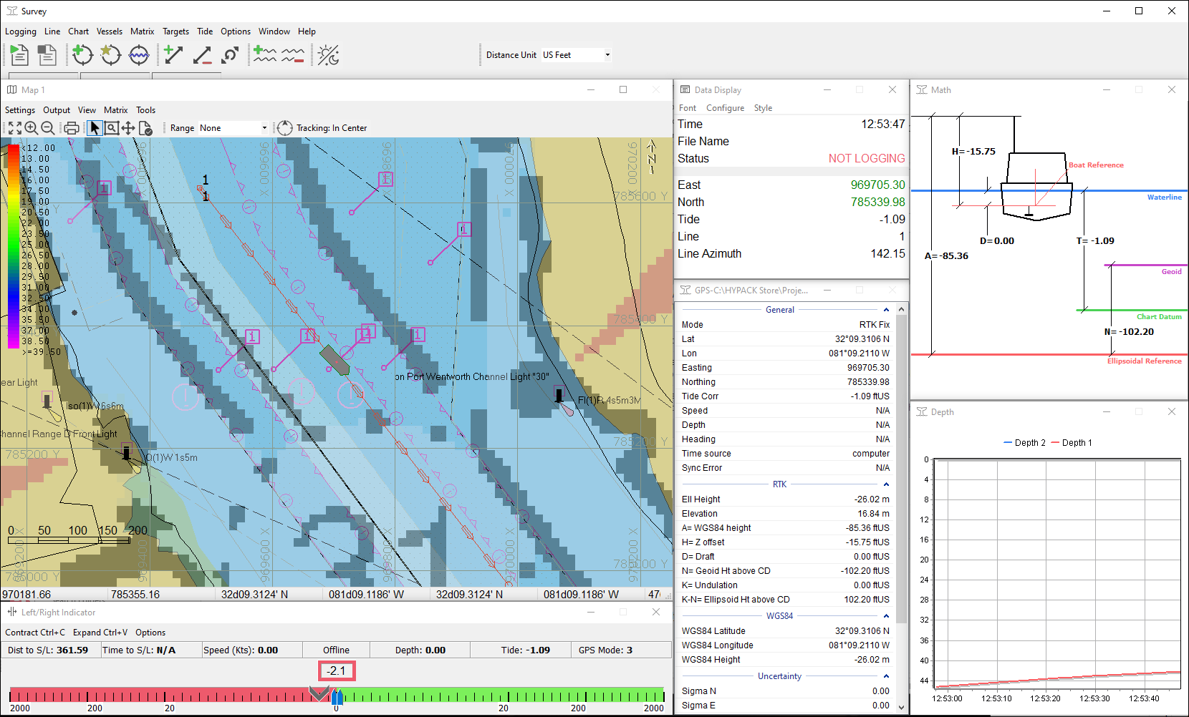
New Survey Program for 2022!
Codename: RAD Survey
Released as ‘Beta’ in 2021.
New codebase makes it easier to make changes / updates.
Modern icons.
Same hot keys as ‘classic’ Survey.

Slide 5
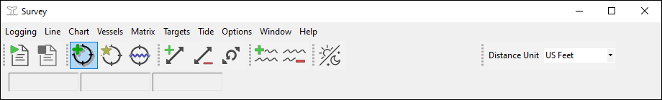
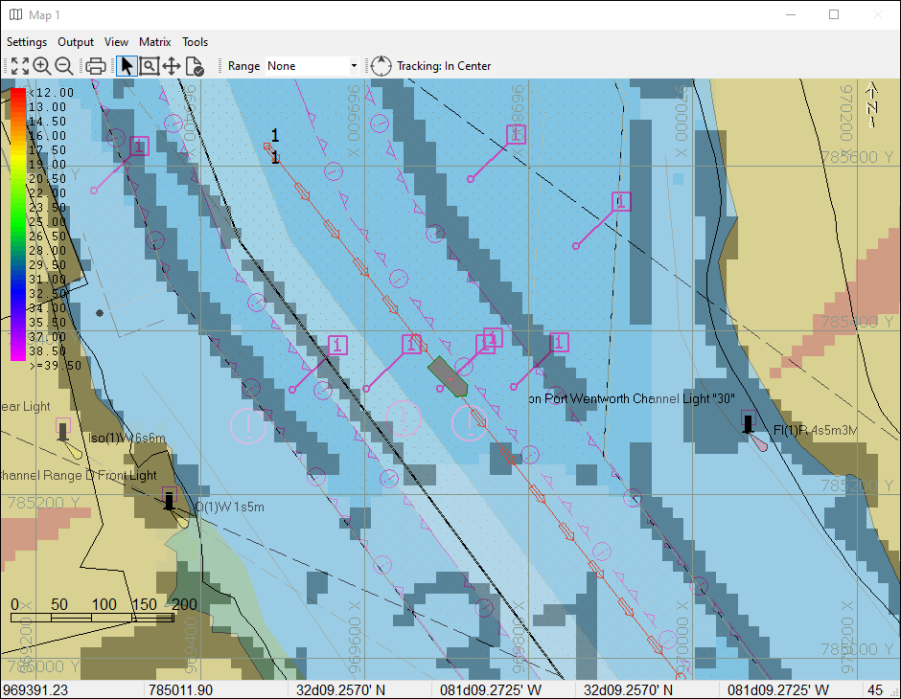
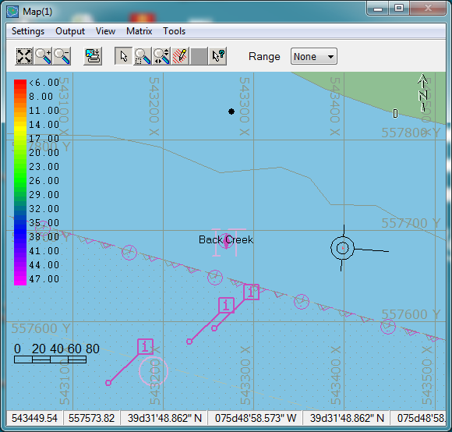
Main Window
The main window is the control panel for HYPACK Survey. Access all settings dialogs, data displays, and driver windows from the menus. The primary buttons allow quick access to
Start & stop logging
Select the active planned line
Mark targets and set the tide correction
And enable real-time data overlays like matrix coverage and side scan mosaicking.

Slide 6
Area Map Windows
The area map windows contain a plan view of your survey area.
The area map displays
Background files active in the SHELL
ECDIS Symbols for each configured mobile
Overlaid grids
Planned lines
Targets
Channels
Matrix files
And more…

Slide 7
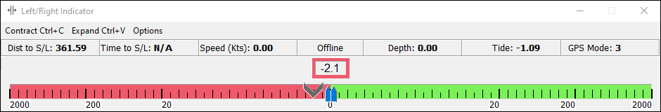

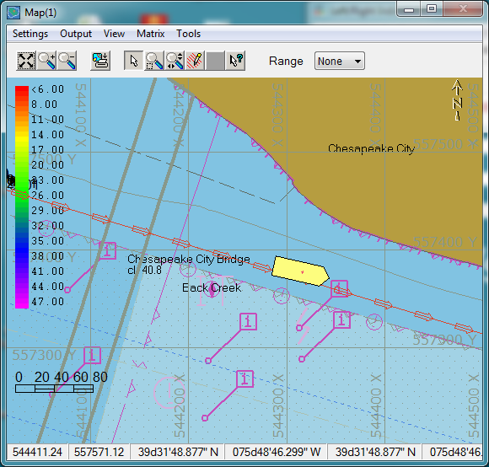
Left-right Indicator Windows
The left-right indicator windows only appear when you have planned lines loaded. They show the position of the main vessel relative to the planned survey line, as well as certain information of particular interest to the helmsman.
In this example, the helmsman is following the planned line closely. He is less than a foot off line.

Slide 8
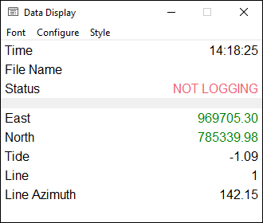
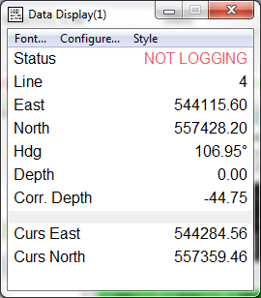
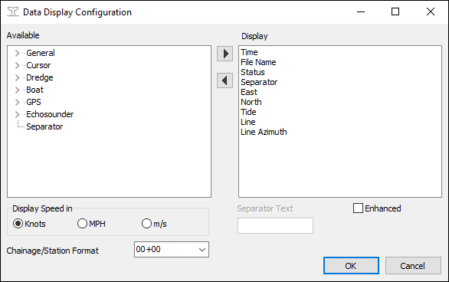
Data Display Windows
The data display windows show textual information about the survey or dredge project.
Select the items to display, their font, and the style of the display. Survey will restore the items and font in the same way when the program is restarted.

Slide 9
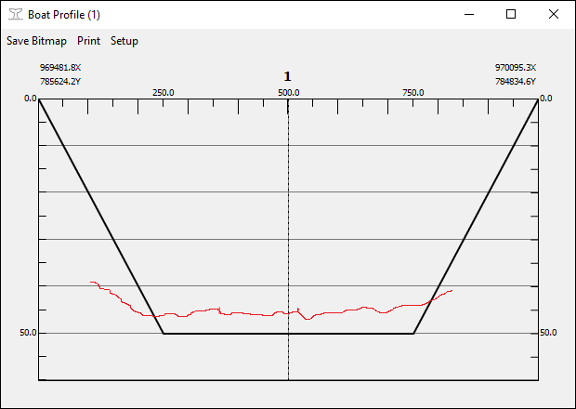
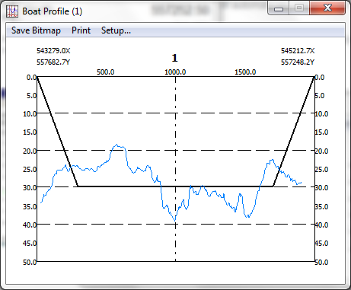
Boat Profile Window
The profile window shows a cross section view of the entire planned survey line.
If the planned line contains template points or a separate channel plan is loaded, this information will be overlaid on the depth graph.
When a new planned line becomes active, the profile will update accordingly.

Slide 10
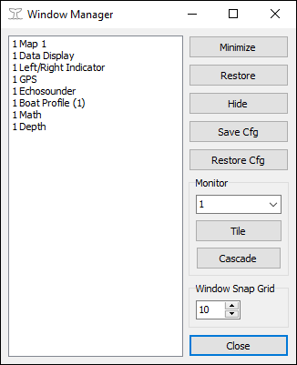
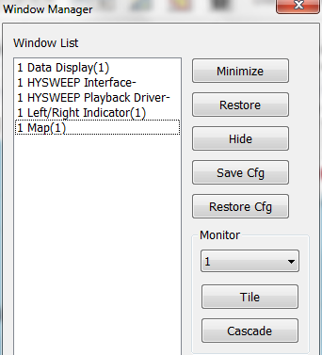
Window Manager
The window manager allows the operator to manipulate the placement of all the Survey windows across the available monitors.
Assign individual windows to different monitors, tile or cascade them, or use the tool to recover a window lost somewhere out in space.
Favorite layouts can be saved and restored so different operators can share equipment but retain their preferences.

Slide 11
SURVEY – Online Controls

Slide 12





Keyboard Shortcuts
Start Line
With these five keyboard commands, you are now a HYPACK Survey expert!
You can now skip the rest of this tedious presentation.
End Line
Increment Line
Decrement Line
Switch Line Direction

Slide 13

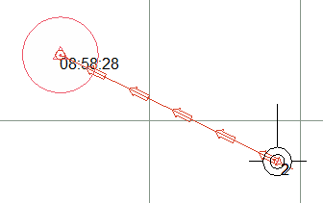
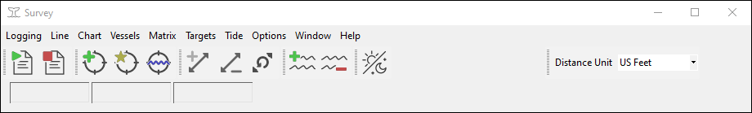
Selecting a Planned Line
On the line handle
To Select Line
Increment Line
Decrement Line
Current active planned line is red (default) with arrows.
or

Slide 14
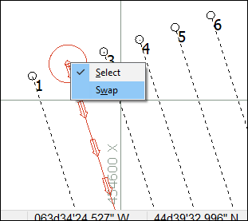
Changing a Line’s Direction
On the line handle
To Swap Line
Changes Line Direction
or
Set the default line direction mode in Navigation Parameters

Slide 15
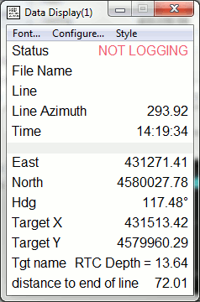
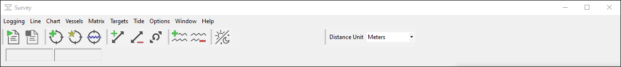
Control Logging
Check the ‘Status’ in the Data Display after you start each line to verify that you are ‘Logging.’
After logging is ended, Survey will update the selected planned line according to the line increment options in the Navigation Parameters dialog.
Start Logging
End Logging

Slide 16
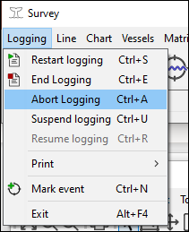

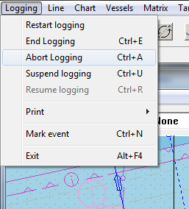
Aborting a Line
The surveyor can abort a line after it has begun logging with
Generates an immediate ‘End Line’ action.
The current data file is saved, but not included in the day’s LOG file.
The active planned line remains the same.
Go survey it again.

Slide 17
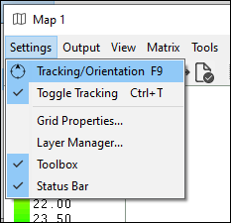
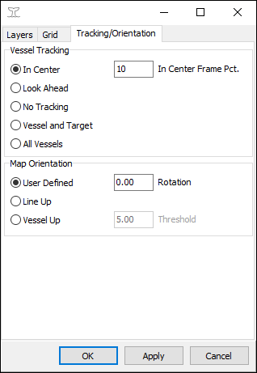

Area Map - Tracking the Vessel
Each Area Map maintains independent vessel tracking configuration.
In Center — As the vessel approaches the edge of the window, it jumps back to the center.
Look Ahead — As the vessel moves away from the edge of the window, it jumps back to the edge.
Vessel & Target — Automatically zooms in as the vessel approaches the active target.
No Tracking — The screen bounding box remains fixed.
All Vessels — Keeps all mobiles visible in the Area Map.
- Toggle tracking on and off from map.

Slide 18
Area Map - Orientation
Each Area Map maintains independent orientation settings.
User Defined — Uses a fixed rotation relative to north.
Line Up — The map will rotate to keep the active planned line oriented vertically up the screen.
Vessel Up — The map will rotate to keep the vessel heading pointing vertically up the screen when the change in heading exceeds the specified threshold.

Slide 19
Water Level Options

Slide 20
Water Level Corrections
The height of the water level relative to the chart datum is called the tide correction or water level correction.
In depth mode, tide is…
Positive if the water level is below the chart datum.
Negative if the water level is above the chart datum (normal).
Water Level
Tide Correction
Chart Datum
Chart Sounding
Measured
Sounding
Bottom
Chart Sounding =
Measured Sounding + Tide Correction +
Draft Correction + Other Corrections

Slide 21
Real-time Water Level Correction Methods
Manual entry in Survey
The most basic option.
Simply enter the tide value in Survey at the start of each line and on any change.
Suitable for local areas.
Automated Tide Gauge
Survey logs a tide record every time the gauge updates.
Requires a tide telemetry driver to communicate with the gauge.
RTK Tides
Real Time Kinematic (RTK) GPS receivers can measure the horizontal position and height above the reference ellipsoid from which you can determine water level corrections.
This topic is discussed in it own presentation.
Predicted Tide File
Survey logs a tide record read from a predictive tide model.
Uses a device driver—tidefile2.dll or tidedr.dll—to query the predicted model.

Slide 22
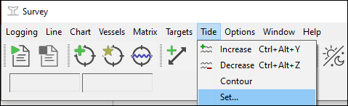
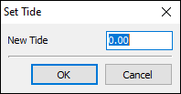
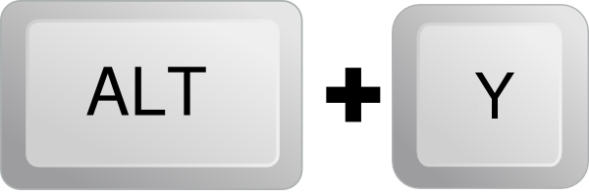

Manually Setting Tide in Survey
Manual entry in Survey
Simply enter the tide value in Survey at the start of each line and on any change.
A TID record will be logged to the RAW file only when the setting is changed.
Increase Tide by 0.1
Decrease Tide by 0.1

Slide 23
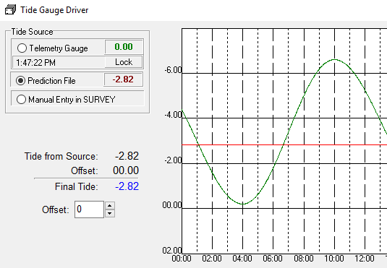
Using a Tide Gauge or Predicted Tides
Survey can read tide data from an automated gauge or a predicted tide file by adding a device driver to your hardware configuration.
The driver display window will show a graph of the tide as it is acquired.
The operator can switch between a gauge, prediction model, or manually entry during data collection.

Slide 24
RTK Tides
Supported by all advanced positioning drivers in HYPACK.
The tide solution is valid when GPS status is RTK Fixed or better.
Can be configured to use a Kinematic Tidal Datum (KTD) file as a reference.
See the dedicated RTK Tides presentation for more information.
H
D
Water Line
Vessel Static Ref.
T
Geoid Ref. (MSL)
K
Chart Datum
A
B
CS
N-K
N
Ellipsoid Ref.
Bottom
Notes:
This slide should always use the latest diagram from the RTK Tides presentation.

Slide 25
TARGETS

Slide 26
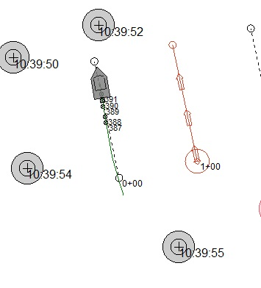
What is a Target?
A target is a position of interest. In addition to position, a target may have various associated attributes and metadata including name, depth, offset, and side scan targeting information.
Targets can be created in many ways such as by double-clicking in the area map, pressing the F5 shortcut key, in the Target Editor tool, or in many other device-specific display windows.

Slide 27
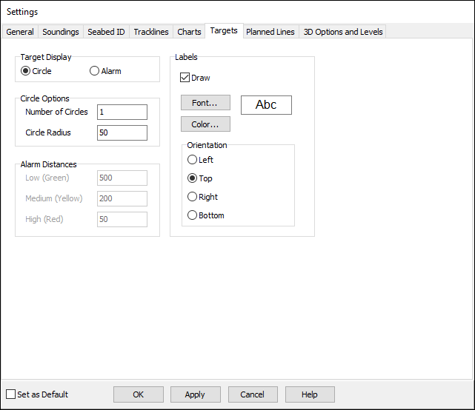
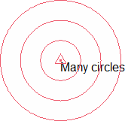
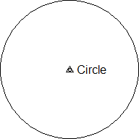
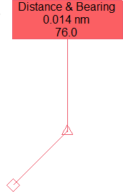
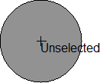
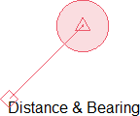
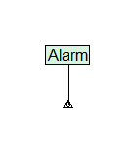
Many Display Options in SHELL & Survey
F9 Settings Menu in the SHELL

Slide 28
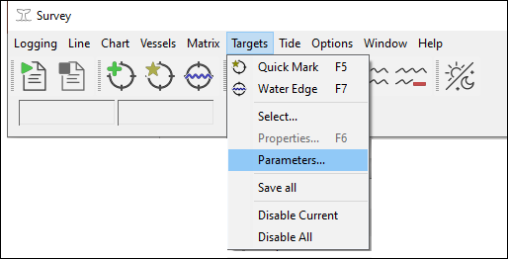
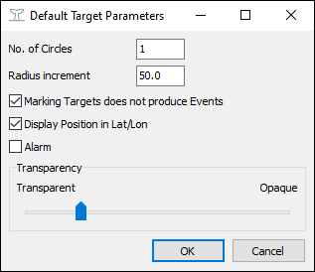
Default Target Parameters
The default target parameters window determines how new targets will be displayed by default.
After a target is marked, the default display options can be changed for each target individually.

Slide 29
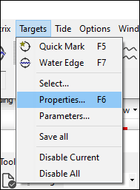
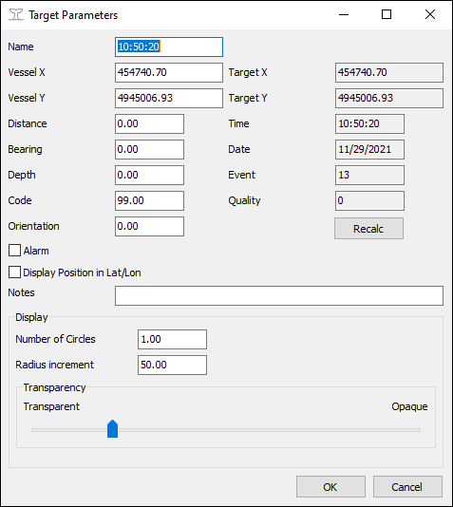
Editing a Target in Survey
The details of the active target can be modified on the target properties dialog (or click F6).
All options are stored in the target database for the active project and will be retained in the HYPACK SHELL.

Slide 30
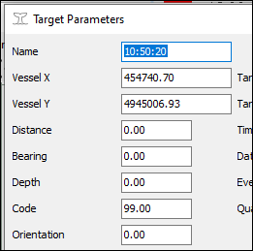
Distance and Bearing Offsets
A target’s position can be adjusted by giving it a distance and bearing.
In this case, the main position represents the vessel and the target’s position is measured relative to it. HYPACK can generate such targets automatically with certain laser rangefinders.
A distance & bearing target’s position can be re-adjusted in the Target Editor.

Slide 31
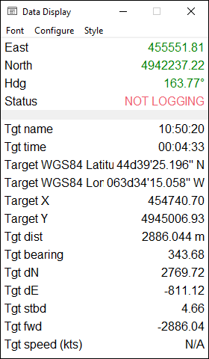
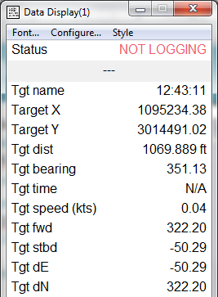
Target Information in the Data Display
The data display windows can show information about the active target.
Statistics relative to the primary mobile can be displayed including
distance and bearing
offset distance in absolute coordinates or relative to the vessel
time to intercept at current speed
necessary speed to intercept given a time specified in the target name.

Slide 32
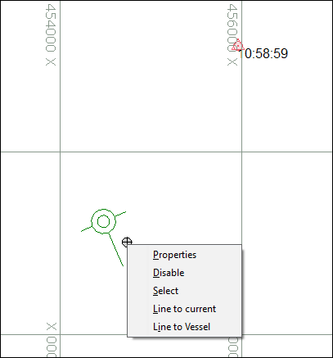
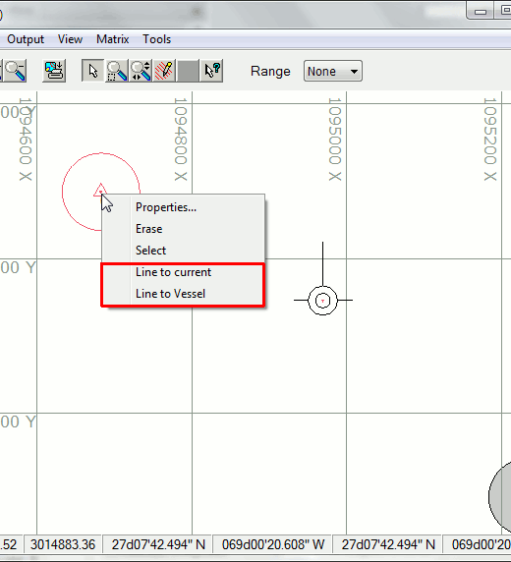
Creating Planned Lines To and From Targets
Planned lines can be created using targets as reference points with the right-click menu.
Line to current — Create a planned line between two targets, the current target (drawn in red) and the target right-clicked on.
Line to vessel — Create a planned line between the current vessel position and the target right-clicked on.
The created planned line will be appended to the active planned line file (LNW).

Slide 33
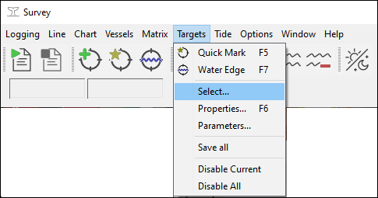
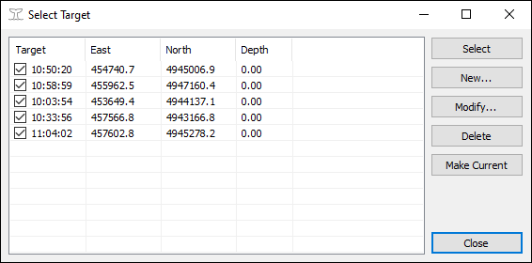
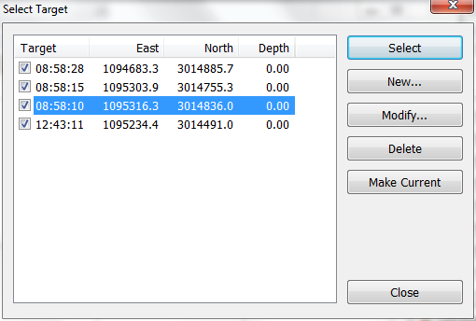
Managing Targets in Survey
This dialog allows the operator to manage targets from the current session.
Uncheck to hide a target
Create or delete targets
Modify a targets metadata or position
Make an existing target the “current” one

Slide 34
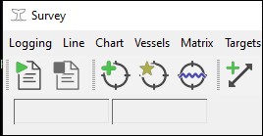
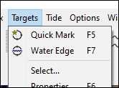
Water’s Edge Targets
Water’s edge targets are a special kind of target for marking the location of riverbanks.
Press F7 prior to going on- and off-line. A special depth will be logged with at this position in the RAW file.
Shoreline
Estimated distance from transducer to shoreline
Planned Line
Shoreline
Note: water’s edge targets work best when the start line gate option is disabled.

Slide 35
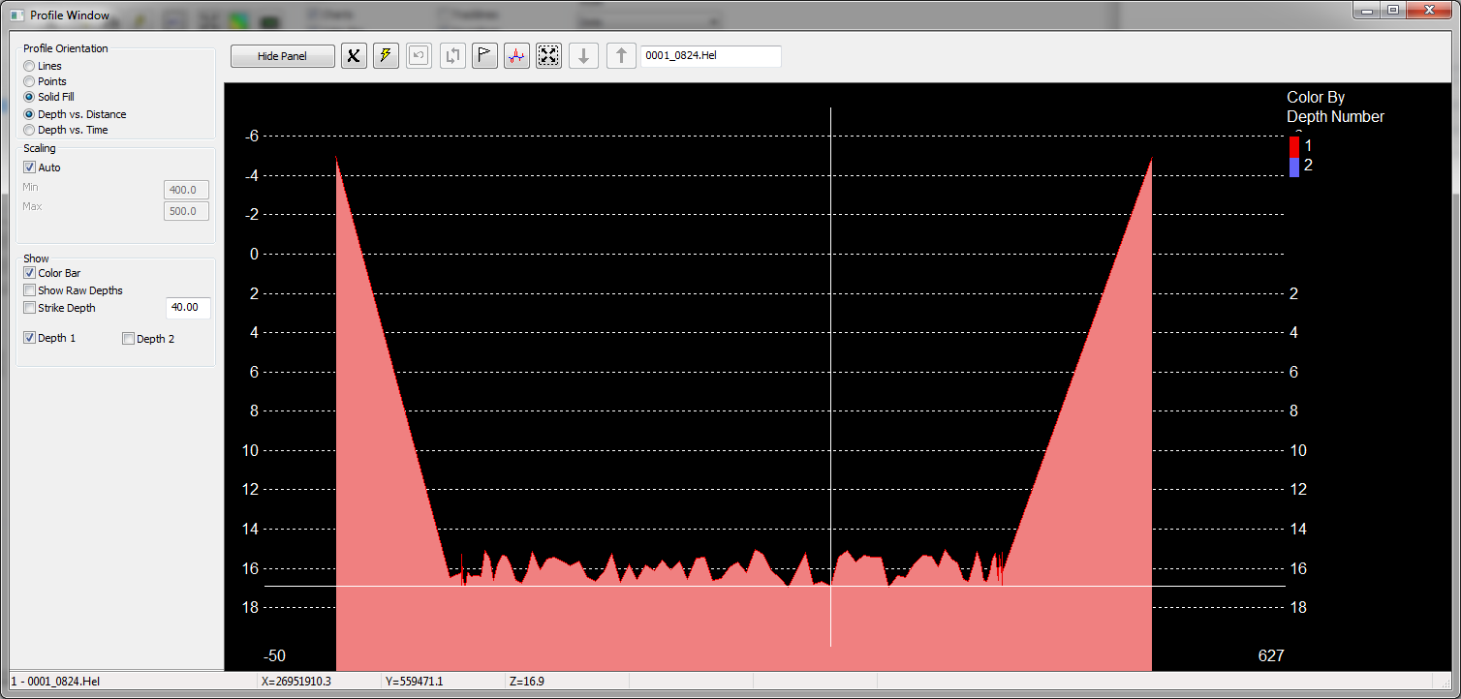
Water’s Edge Targets in Processing
Water’s edge targets will process as a zero depth sounding at the position of the marked target.
It will draw a straight line from the last sounding to the water surface (depth=0)
Warning: Do not use this for volumes

Slide 36
Navigation Parameters

Slide 37
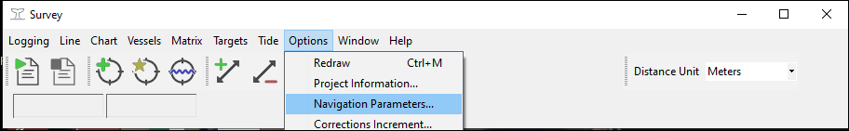

Navigation Parameters
The Navigation Parameters dialog in Survey provides options to
Automate planned line navigation
Customize data logging
Configure backups
Configure depth alarms
Set event markers

Slide 38




Navigation Parameters - Start Line Gates
A line gate specifies an area that, when entered, triggers a start or stop logging action.
Gate = 0 — Gate is disabled.
Gate > 0 — Go on-line when vessel breaks into circle with radius = gate.
Gate < 0 — Go on-line when vessel breaks inward semi-circle with radius = |gate|.
Offset — Moves the gate up or down the line.

Slide 39


Across Track Error Alarm
Across Track Error (XTE)
HYPACK Survey will generate an “XTE” alarm if the tracking point moves outside of the limit specified in Navigation Parameters.
The limit is relative to the active planned line.
Setting the limit to zero disables the alarm.
Moving the sliders on the LR Indicator also adjusts XTE.

Slide 40

Across Track Error Alarm
Across Track Error (XTE)
HYPACK Survey will generate an “XTE” alarm if the tracking point moves outside of the limit specified in Navigation Parameters.
The limit is relative to the active planned line.
Setting the limit to zero disables the alarm.
Moving the sliders on the LR Indicator also adjusts XTE.

Slide 41

Event Marks
Next event — The next event number to use.
Event interval — The time in seconds or the distance along line in grid units between events.
Event increment — The number added to the prior event number to generate the next number.
Manual — Make event marks at start/end of line and manually (CTRL-N).
Time — Make event marks at start/end of line and every n seconds.
Distance — Make event marks at start/end of line and every n grid units along the planned line.

Slide 42

Line Information
Next line — The name or number of the next line to be run.
Line increment — The number of lines to move down the line queue when selecting the next line.
  If = 1, sequence = 1, 2, 3, 4
  If = 3, sequence = 1, 4, 7, 10
  If = -2, sequence = 9, 7, 5, 3
While logging — Select the most appropriate segment of the active line only while logging.
Always — Always auto-select active leg.
Never — Survey never changes line segment. User must use CTRL-B & CTRL-F.

Slide 43

Other Options
LOG Backup Time — Prevents large contiguous file sizes and protects data loss on long lines. Performs an immediate end line & start line.
MTX Backup Time — Moved to MATRIX – OPTIONS dialog..
Depth Alarms — Generates an alarm if the depth reported by the echosounder is less than the minimum value or greater than the maximum value. Set to 0 to disable an alarm.

Slide 44

Other Options
Reset Events — If enabled, events will begin at 1 on startup. Otherwise, Survey will remember the last used event number.
Even Intervals — Event time will be adjusted to the specified event time interval.
Connect Events — The Survey map will connect event marks with line segments.
Events on Segment Switch – Survey will generate an event at every waypoint of a multisegmented line.
Geodetic Heading — Survey will convert the input heading from geodetic to grid heading by applying the grid convergence and then use the grid heading for all computations on the grid.

Slide 45


Naming Schemes
HYPACK provides several naming convention options for data files.
Method | 2D Lines | 3D Lines | No Lines
Standard | 002_1607.RAW | 10P00.RAW | 000_1607.RAW
Long (Vessel Name is NANCY) | 2003NA0061607_2.RAW | 2003NA0061607_2.RAW | 2003NA0061607_0.RAW
CHS | 2003NA0061607.RAW | 2003NA0061607.RAW | 2003NA0061607.RAW
Julian (Julian day is 006) | 002_1607.006 | 10P00.006 | 000_1607.006
Other | 002_1607.ADB | 10P00.ADB | 000_1607.ADB

Slide 46
Matrix Files

Slide 47


Matrices in HYPACK Survey
A HYPACK matrix (MTX) is a gridded rectangular area for recording depth information and other data during acquisition.
A matrix is used to:
Track coverage
Calculate cell statistics for multibeam bathymetry
Display a real-time surface as data is logged.

Slide 48



Matrix Configuration Options
 | SURVEY | DREDGEPACK | HYSWEEP
MTX File |  |  | 
Auto MTX single beam |  |  | 
Auto MTX multibeam |  |  | 
User-defined MTX files will work with all HYPACK products, but their bounds need to be pre-defined.
HYPACK Survey can auto-generate a set of matrices, This option is available for multibeam, topographic LiDAR, and single beam data.
You cannot change method mid-survey.
Singlebeam Auto Matrix now available in HYPACK 2022!

Slide 49


Selecting the Active Device
HYPACK Survey
Check the “Use for matrix update” option on your echosounder in your hardware configuration.
DREDGEPACK
Check the “Use for matrix update” option on the driver that provides the depth of the digging tool.
HYSWEEP
Depth data is passed to HYPACK Survey automatically.
HYPACK Hardware

Slide 50
Programs That Can Use MTX Files
Program | Usage | Comments
Matrix Editor | Creates blank MTX files. | Make sure you designate usage in HYPACK or HYSWEEP!
MAPPER | Can fill MTX files with depths. | Does not ‘infill’ blank matrix cells.
TIN Model | Can fill MTX files with depths. | Can ‘infill’ blank cells on the interior of the model.
HYPACK Survey | Can update MTX files with depths. | Minimum, Maximum or Latest value. Corrected or Uncorrected depth.
HYSWEEP | Updates MTX with depths to show coverage. | Tracks minimum and maximum depth values in each cell. Tracks 100% or 200% for each cell.
DREDGEPACK | Updates MTX with depth of cutting tool. | Minimum depth for ‘depth-based’ projects. Maximum depth for ‘elevation-based’ projects.
XYZ to MTX | Automatically creates a filled MTX file. | TIN Model for Dummies.

Slide 51





Configuring Matrix Options in HYPACK Survey

Slide 52


Map Window: Matrix Display Options
Each Map Window can display the matrix information differently according to the appearance settings dialog.
Cell Depth
Cell Hit Count
Transparency
Z Scaling
Sun illumination

Slide 53
Extended Information

Slide 54



Comments and Alarms
Alarm area
The comment window allows the operator to store text notes in the project log. Comments can be referred to during the editing process.
Alarm conditions are reported on the bottom of the main window. An alarm sound will repeat until the ESC key is pressed. The alarm will be displayed until the condition is rectified.

Slide 55



GPS Quality Windows
Survey provides a set of GPS graphs that enable the operator to monitor the quality of the GPS solution.
Graph the
Error ellipse (requires PTNL,QA or NMEA GST string)
Satellite count and constellation (requires NMEA GSV string)
HDOP and status code
Time sync error
Undulation

Slide 56



Device Time Series Windows
Survey provides a set of graphs that display a time series of standard data types of interest to the operator. Graph the values reported to Survey from device drivers, including:
  Heave
  Pitch
  Roll
  Tide
  Depth

Slide 57


Display Schemes
Survey can be configured with different display schemes which alter how the program looks.
You can create different color combinations to suit changing lighting and weather conditions or the personal tastes of different helmsmen.
Use the built-in defaults or customize your own with Schemebuilder.

Slide 58




Tracking Points
Survey can have multiple tracking points on each mobile.
The XYZ of each tracking point is displayed on the map. The user can select the “Main” tracking point to be used at any time from the Tracking Points window.
Survey can also log statistics on each tracking point to get the average position and standard deviation during rig moves.

Slide 59




Anchor Handling
The Anchor Manager window is accessed from the Vessels window.
From this window, you can drop and raise anchors and transfer them to other mobiles (support vessels).
You can also place floats on anchor wires or radius circles about dropped anchors.
On an anchor or marker to drop or raise it.
Click and drag an anchor to set a marker.
Markers are planned anchor positions before deployment.

Slide 60


Multiple Position Sensors Per Mobile
HYPACK Survey allows you to assign multiple positioning sensors to a mobile.
The Boat Multi Position window is used to select one or more sensors to determine the final vessel position. If multiple sensors are selected, an average position is calculated.
The green dots show the three GPS positions. The red dot denotes their average.

Slide 61



Remote Viewing
Observe & interact with HYPACK Survey using remote view tools
  View vessel position
  Manually control logging
Use any web enabled device
  smartphones, tablets, computers
Controlled access and secured views

Slide 62


Line Direction Modes
Origin
Terminus
1
2
3
4
Picks the next line based on which line has the closest waypoint.
Closest Point

Slide 63

Line Direction Modes
Origin
Terminus
1
2
3
4
Next line will always start at the line’s origin point.
Origin Point

Slide 64

Line Direction Modes
Origin
Terminus
1
2
3
4
Next line will always start at the line’s terminus point.
Terminus Point

Slide 65

Line Direction Modes
Origin
Terminus
1
2
3
4
Next line will start in the opposite direction of the current line.
Alternate Points

Slide 66
Vessel Settings

Slide 67

Vessels and Their Functions
A vessel (also called a mobile) is any independently mobile object.
This usually means some sort of boat, but in HYPACK it may be a lot of other things too—a towfish, an ROV, or a digging tool on a dredge.
Here are two vessels—a boat and towfish. In HYPACK terms, these are both considered mobiles.

Slide 68


Vessel Configuration
Access the vessel setup dialog from the main menu.
A vessel can be displayed in many different ways. Each area map can have its own vessel configuration.

Slide 69

Vessel Symbols and Boat Shapes
Symbol — Draw a simple shape at the mobile position on the area map.
Display shape — Draw a HYPACK boat shape file, AutoCAD DXF, or bitmap file at the mobile position. Boat shapes can be created using the Boat Shape Editor tool.
Adjust scale, color, and transparency of the symbol or boat shape.

Slide 70



Ghost Shapes
A ghost shape is a copy of the active boat shape positioned at a fixed location.
These are useful aids for positioning large vessels like during rig moves or for construction applications.
Example ghost shape.

Slide 71

Vector-based Boat Shapes
HYPACK Survey can draw a vessel as a 2D vector shape by loading a shape file (SHP) created with the Boat Shape Editor or importing an AutoCAD DXF file.
Important: The XY origin of the vector graphic must match HYPACK’s boat reference origin or the shape will not be positioned correctly.
When using DXF, it is recommended to make the background transparent and set the fill color to white.

Slide 72

Other Display Options
Vessel track — Draws the last n seconds of track line data behind the mobile.
CMG vector — Draws a vector to the estimated mobile position at n seconds in the future.
Range circle & offsets — Draws informational indicators on the vessel shape for these items.
These buttons open dialogs to manage anchor positioning features and cross sectional displays. See other presentations for more information.

Slide 73

Dynamic Draft Correction
Static draft is entered in hardware configuration, but dynamic draft should be accounted for during data collection.
If not measured by a sensor or modeled using a draft table, the user can manually set the dynamic draft correction in the vessel window.
The value entered is superseded by any draft device configured in HYPACK Hardware.

Slide 74


Dead Reckoning
Dead reckoning calculates a position based on the current speed, heading, and elapsed time from the last position.
Gate distance — A calculated position must be within this distance from the last accepted position, otherwise it is rejected. After n consecutive rejections, the dead reckoned position will be accepted anyway.

Slide 75
Heave Drift Alarm
Motion caused by turning, acceleration and deceleration can result in heave drift, a condition where the motion reference unit temporarily mismeasures heave.
If the average heave value over thirty seconds exceeds zero by the specified threshold amount, a suspected heave drift condition is reported with an alarm.

Slide 76
Thank You !
Contact Us:
Sales@HYPACK.com
Help@HYPACK.com
(860) 635 - 1500
Links to more information:
HYPACK on Youtube.com ( Historical Sessions ) HYPACK Live Chat
HYPACK on Youtube.com ( Newer Sessions ) HYPACK Ustream
HYPACK SUPPORT Site HYPACK Website

