Slide 1
SBES – Preparation

Slide 2
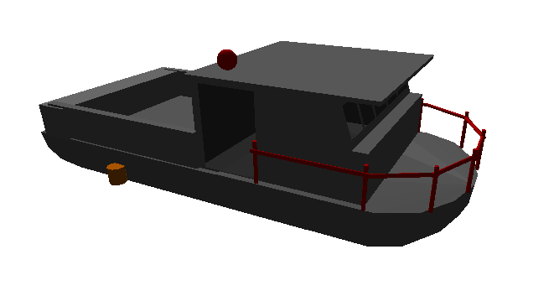
Physical Offsets
Frequently the GPS and the Sonar are not located at the same horizontal position
GPS
Sonar
A reference point needs to be selected and all offsets measured to that point.

Slide 3
HYPACK HARDWARE

Slide 4
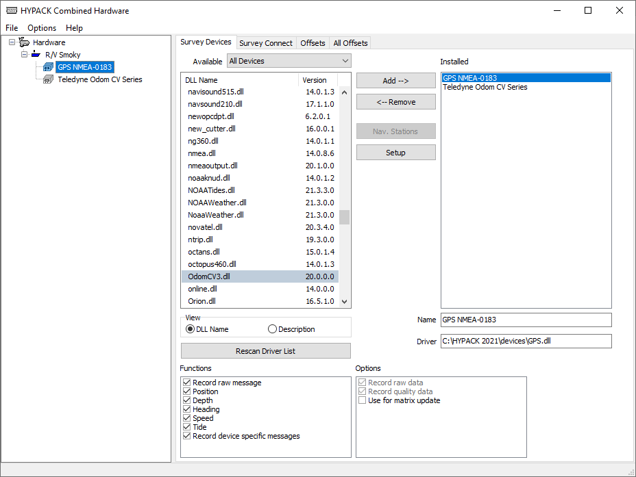
HYPACK® Hardware
HYPACK HARDWARE, HYSWEEP HARDWARE & SIDE SCAN HARDWARE are all configured from this program.

Slide 5
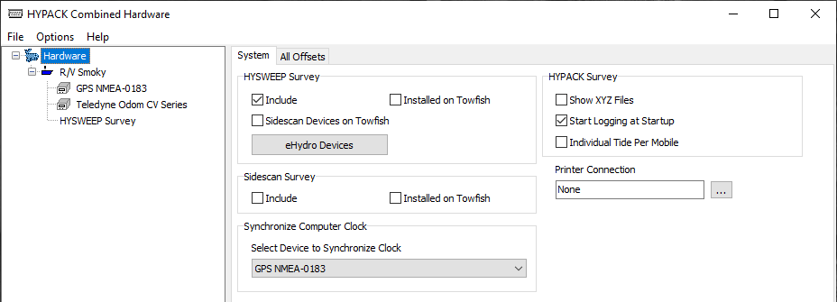
HYPACK Configuration Page
Right-click on ‘Hardware’ to add another mobile.
For multibeam, check “Include”. This creates a ‘HYSWEEP Survey’ listing. Then click on the listing to add you multibeam, MRU and gyro systems.
If you have a multibeam device, check the “HYSWEEP Survey - Include” box. If you have a Sidescan, check the “Sidescan Survey - Include” box. If you have both, check the “HYSWEEP Survey - Include” and configure both of them under Multibeam.

Slide 6
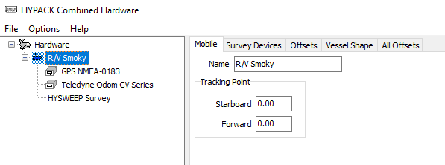
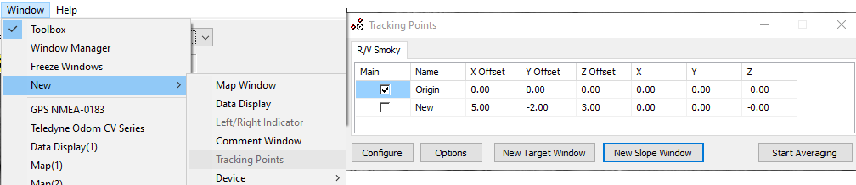
Vessel Page: Mobile Tab
You can name each vessel.
Specify the Tracking Point for each mobile. This is the point used to determine the distance off-line, distance to-go, etc.
Specifying tracking points in Survey gives you more flexibility!

Slide 7
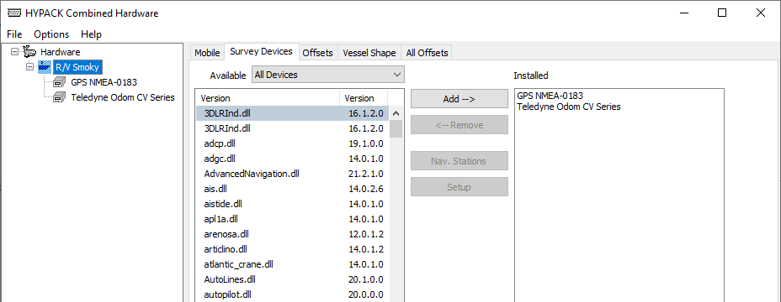
Vessel Page: Survey Devices Tab
This is where you go to specify the devices used on each mobile.

Slide 8
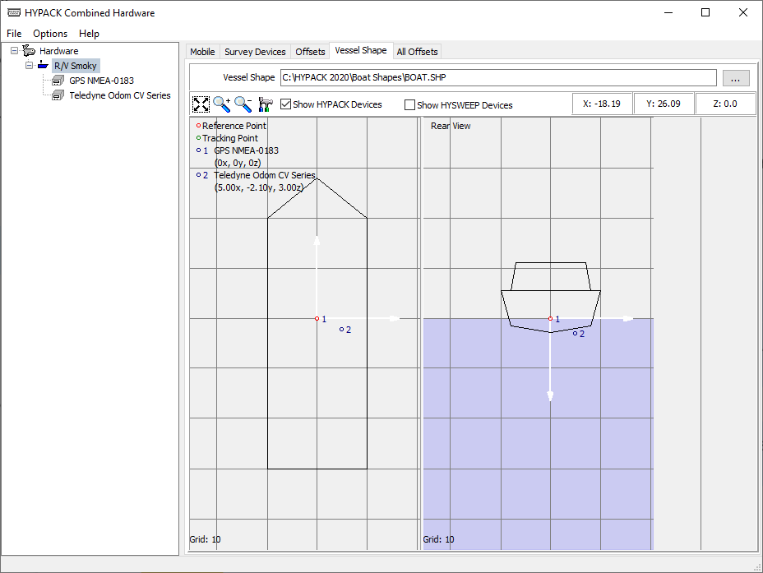
Vessel Page: Vessel Shape Tab
You can visually inspect the location of your sensors and pick your default 2-D boat shape for HYPACK SURVEY.

Slide 9
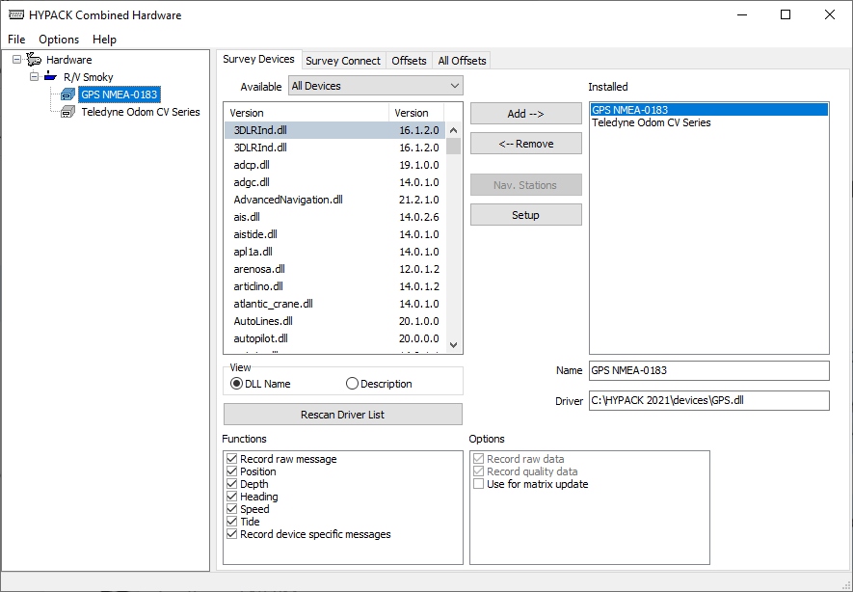
Devices: Survey Devices Tab
Click on a vessel to add devices.
Click on an installed device to access the functions, options and setup for each device.

Slide 10
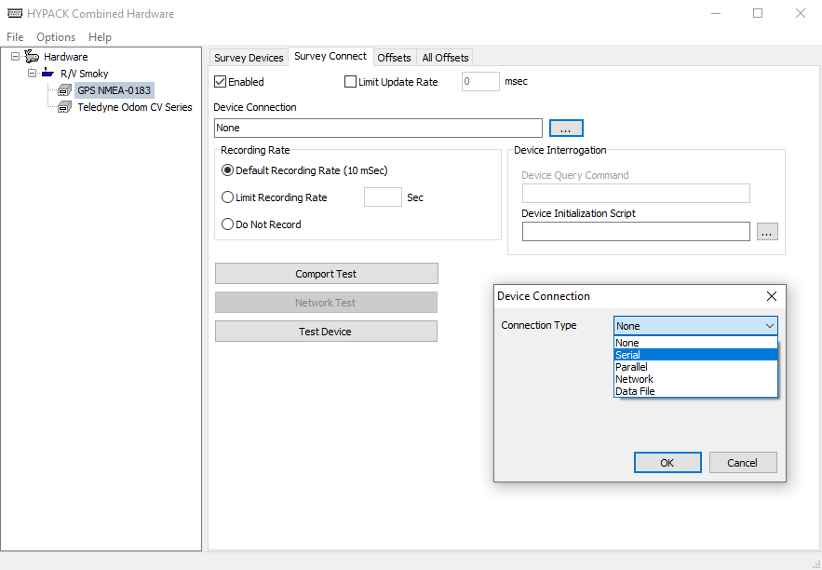
Devices: Connect Tab
Click to get the Device Connection
window.
You can examine the serial port
stream from here.
You can test the device from here.

Slide 11
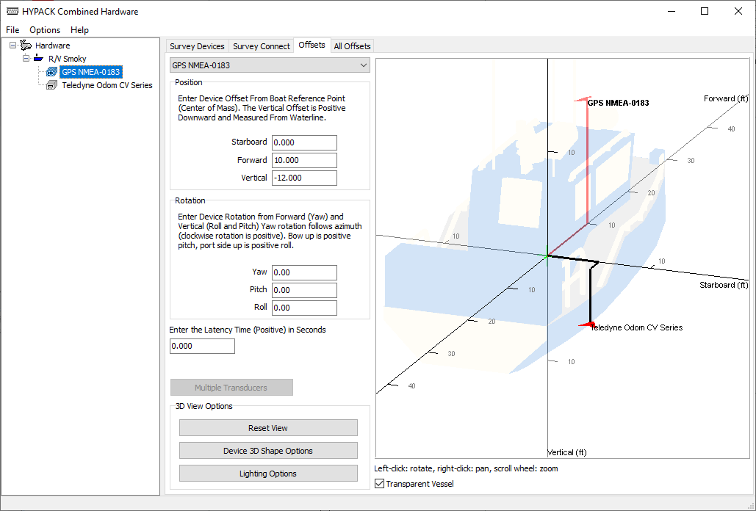
Devices: Device Offsets Tab
Specify the position for each device, relative to your boat origin. Remember, Z is positive downwards!
You can now visually inspect the location of your sensors in 3D.
Pan, tilt and zoom in/out. User can load 3od shape files.

Slide 12
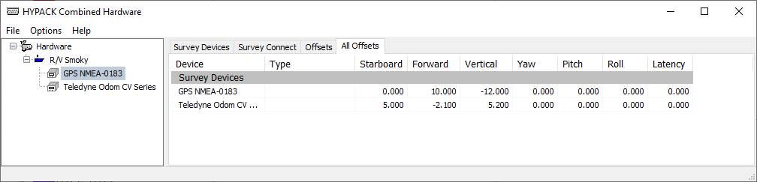
Devices: All Offsets
See all your offsets in one page.

Slide 13
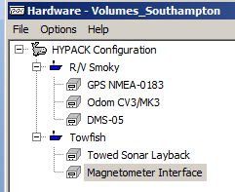
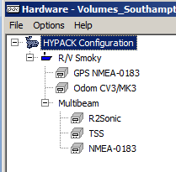
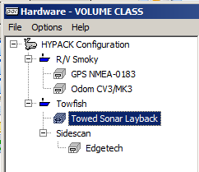
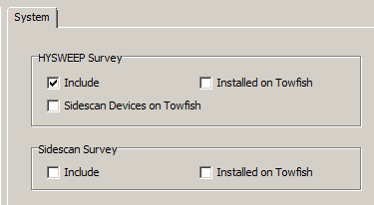
Example Hardware Configurations
Survey vessel with magnetometer installed on towfish with manual layback.
Survey vessel with R2Sonic multibeam installed on the vessel.
Survey vessel with Edgetech sidescan installed on a towfish.
The multibeam and/or sidescan are placed on the main vessel or the towfish mobile depending on the setting in the HYPACK Configuration tab.

Slide 14
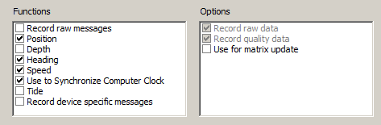
Device Functions and Options
Optional functionality can be selected for certain devices:
  Record raw messages
  Record device specific messages:
    GPS: Records time synch differences
    Echo Sounders: Records acoustic ping for each ping.
  Use of Matrix Update

Slide 15
Single Beam Echo Sounder Placement:
Y
GPS
X
CO-LOCATE GPS ANTENNA WITH SINGLE BEAM TRANSDUCER
Transducer

Slide 16
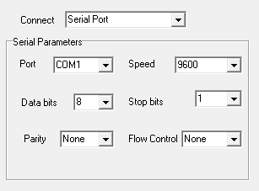
Serial Port Stuff
RS 232: Short Distance (<30m)
RS 422: Longer Distance (>100m)
  You can connect an RS422 device to an RS-232 port.
    TX- to RX and SG to SG
When configuring a COM port, you must define:
  COMn Port number
  Baud Rate How many bits per second (more or less)
  Data Bits How many bits in one ‘word’
  Stop Bits Bit’s tacked on to the end of each word
  Parity Used to detect transmission errors
  Flow control is generally not needed and not desired.

Slide 17
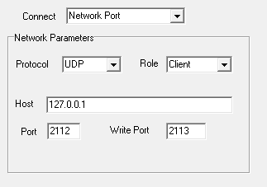
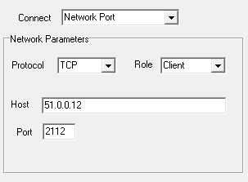
Network Connections
UDP requires an IP address and separate read/write port numbers
It may be necessary to reset the IP Address for your computer to an address similar to your network device.

Slide 18
GPS Configuration

Slide 19
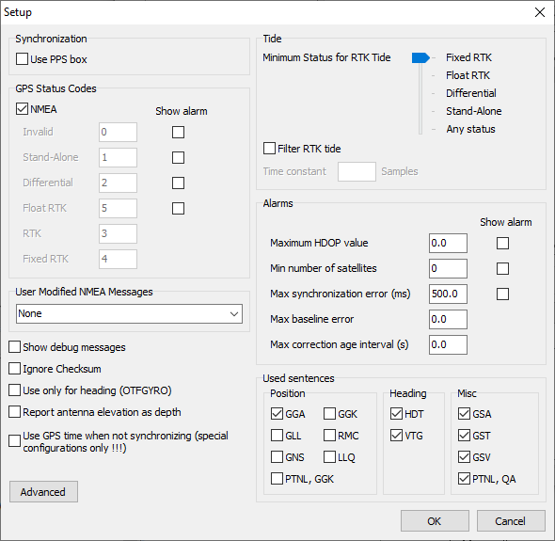
GPS: Setup Window
Synchronization:
Are you using a 1PPS box?
GPS Status Codes:
Standard – NMEA 3.0 (Most GPS units made after 2005)
Uncheck NMEA box to manually set the Code values.
Option to Show Alarm if GPS Status is lost.

Slide 20
GPS: Setup Window
RTK Tide:
Minimum status:
      Compute for all and correct in post-processing.
  Filter RTK Tide:
      Recommended on dredges.
      Not recommended on survey vessels.
  Alarms:
Maximum HDOP Value: recommended: 4.0
Minimum number of Satellites: recommended: 5
Maximum synch error (ms): recommended: 100
Maximum baseline error:
Used when computing bearing between two GPS.
recommended: DGPS: 2m | RTK: 0.5m
Maximum correction age interval(s):
      Time between corrections from the RTK base station

Slide 21
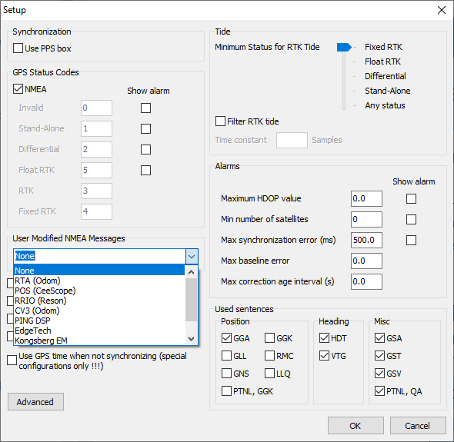
GPS: Setup Window
User Modified NMEA Messages:
    RTA (Odom): Used when Odom’s RTA unit is provided time-tagged info.
    POS (CeeScope): Used when position data is delivered by Ceescope.
    RRIO (Reson)
    CV3 (Odom)
    Ping DSP
    Edgetech
    Kongsberg EM
Used sentences:
Only selected desired messages

Slide 22
GPS: Setup Window
Show debug messages
Ignore Checksum
Use only for heading (OTFGYRO)
Report antenna elevation as depth
Use GPS time when not synchronizing (special configurations only !!!)

Slide 23
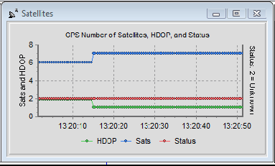
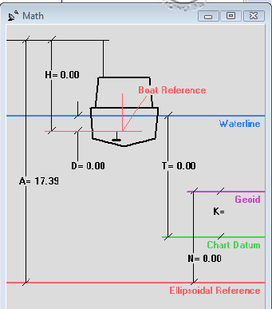
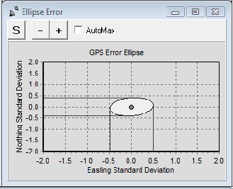
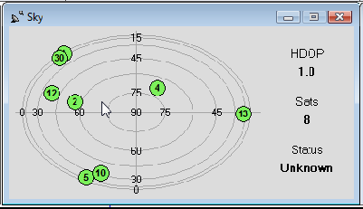
GPS Windows in Survey
HDOP (Green), # of Sats (Blue), Status: (Red)
Error Ellipse
(Requires $GPGST sentence)
Sky Plot (Requires $GPGSV sentence)
RTK Math Window

Slide 24
Echosounder Setup

Slide 25
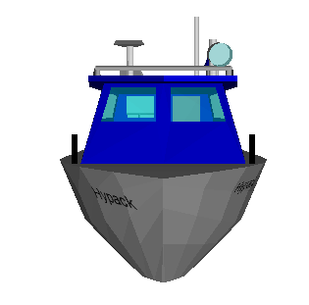
Echosounder: Vertical Offset
Correct for the Static Draft (depth of transducer below the static waterline) either in the echosounder (bar check) or in HARDWARE (Vertical Offset). DO NOT USE IN BOTH PLACES!
R/V DBT
R/V DBS
1 m
1 m
6 m
6 m
Sounder outputs 6.0m to computer
Sounder outputs 7.0m to computer
Outputting Depth Below Surface (DBS):
Vertical Offset is set to 0.0

Slide 26
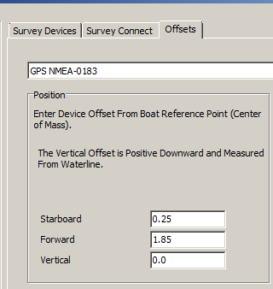
Echosounder Configuration: Offsets
Offsets:
Enter the offsets of the echosounder transducer, relative to the boat origin.
Vertical Offset:
If your echosounder outputs the Depth Below Surface, then enter a Vertical Offset = 0.0
If your echosounder outputs the Depth Below Transducer, then enter Vertical Offset = Static Draft.
Z = positive downward!
Latency:
For almost all single beam sounders, enter Latency = 0.00.
Enter the combined latency between the GPS and Echosounder determined in the SINGLE BEAM LATENCY program as the latency for the GPS device.

Slide 27
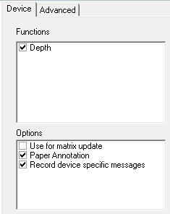
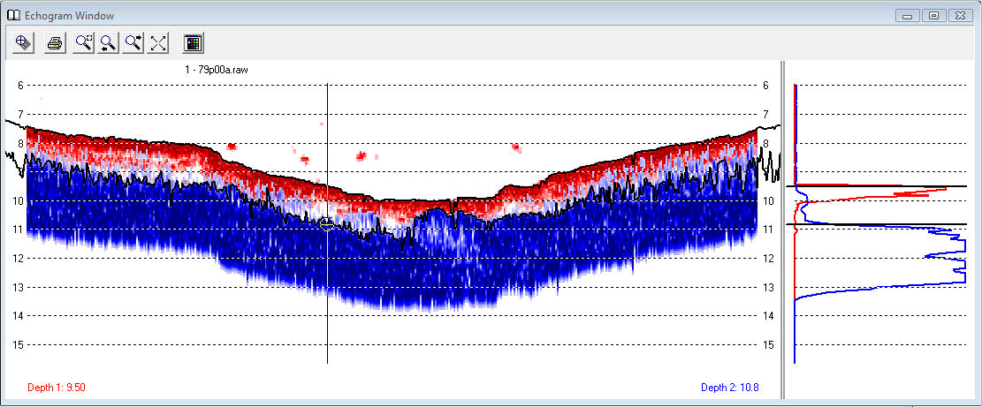
Echo Sounder Configuration
Functions:
Available functions may differ, depending on the echo sounder. As a minimum, you want to select ‘Depth’.
Options:
‘Use for matrix update’: Paints a matrix with the color-coded depth data.
‘Paper Annotation’: Enables the output of annotation to the echo sounder at event marks.
‘Record device specific messages’: Enables the storage of acoustic data for certain sounders.

Slide 28
MRU use in HYPACK

Slide 29
MRU Decision Tree
Is it being used along with a multibeam sonar?
Yes!
Configure it in HYSWEEP® HARDWARE.
I have an MRU.
No
Through the echo sounder device driver.
How is the MRU integrated?
Do you also want to use the HPR values in HYPACK® SURVEY?
You are done!
Through its own device driver
No
Make sure the ‘Heave’ function for the echosounder is enabled in HYPACK® HARDWARE
Add the device driver for the MRU in HYPACK® HARDWARE.
Yes!
Add the HYSWEEP.DLL in HYPACK® HARDWARE
You are done!
You are done!
You are done!

Slide 30

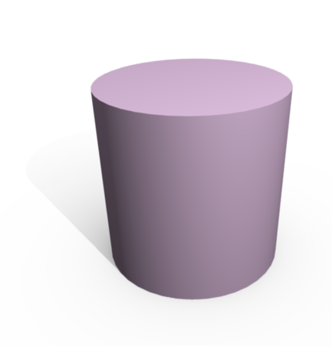

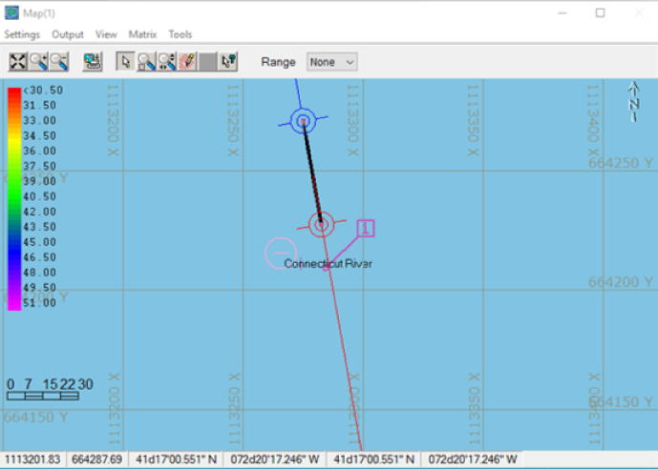
Connecting your MRU
If you echosounder can output uncorrected depths and MRU data, then we have no objection!
HPR Data
Echosounder
MRU
Echosounder
MRU
HPR Data
Heave-corrected soundings
Raw
Soundings
You can do it this way …..
We prefer you do it this way.
This is recommended only if your echo sounder can output the raw depth and heave measurement as separate entities.
Select the specific device driver for your MRU and configure it!

Slide 31
Where to put the MRU?
GPS
GPS
MRU
XDucer
MRU
XDucer
Try to mount your MRU at the center of mass of your vessel. If you can’t do this, mount it as close as possible to the center and carefully measure the offsets.

Slide 32
HYPACK Timing

Slide 33
HYPACK® Timing Basics
The internal clock on your computer is a poor time device.
HYPACK SURVEY and DREDGEPACK® use a proprietary clock model called VERITIME.
When you start SURVEY or DREDGEPACK®
  VERITIME is initially set to the Windows clock time.
  VERITIME and Windows clock times slowly drift apart.
In ‘Normal’ mode, all devices receive their time tags from the VERITIME clock model.
  All devices are time tagged off the same time standard.

Slide 34
Time Tagging
Device drivers monitor a serial/network port. They have the highest priority!
When the 1st character of a message arrives, the program gets a time tag from the VERITIME routine.
To adjust for the delay in transmission from the time of measurement to the time of transmission, a ‘Latency’ correction is entered in the Offsets in HYPACK HARDWARE and is subtracted from the VERITIME time tag.
Latency Time of Device
TIME
TIME OF MEASUREMENT
TIME OF RECEIPT OF 1ST CHARACTER
Time of Receipt of 1st Char: 08:32:15.000
Latency Time for Device: 0.200
Time of Measurement: 08:32:14.800

Slide 35
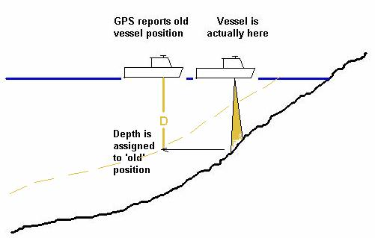
Theory of Latency
There is a delay in time from when your GPS computes a position until it is transmitted out the Serial port or Ethernet connection.
If you don’t correct for this Latency, your depths will not be in the correct position.
  In most cases, they will be backwards along the track line.
A 0.5 second Latency error at 8 knots = 6.75’ or 2+ meters Position shift

Slide 36
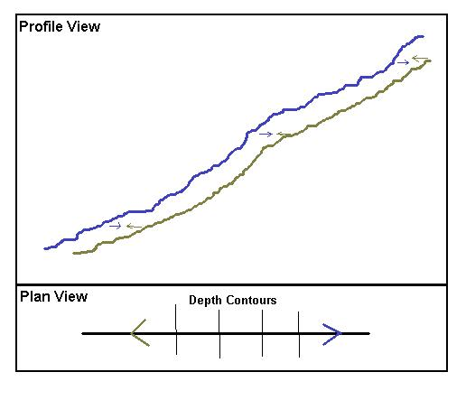
Test Survey Lines
For Singlebeam, Run reciprocal survey lines up/down a slope or over a known feature.
  It’s best if your planned lines are perpendicular to the bottom slope!
If the Latency correction is perfect, the profiles will overlay each other.
  If there is an error, the profiles will be early or late.
  The LATENCY TEST program varies the time tags to determine the best ‘fit’ Latency time.

Slide 37
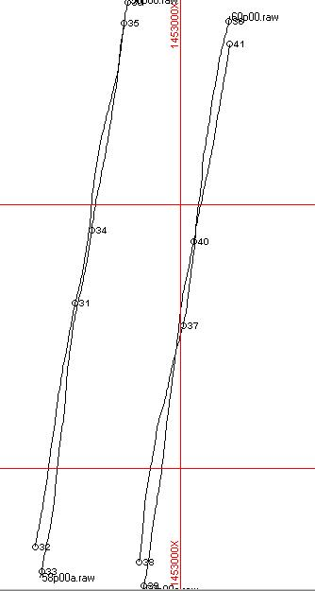
The Keys to a Good Test
Run perpendicular to the bottom slope.
  Running non-perpendicular to the slope will generate errors unless the reciprocal track-lines are ‘dead on’.
Run the test at slack tide.
  The test does not factor Tide, Draft, Heave, or Pitch corrections.
Keep as close to the planned line as you can.
Watch the GPS constellation.
  No big changes in HDOP during the test.
  You might consider setting your GPS Elevation mask to +20°, so when a new satellite arrives, it won’t jump your position too much. (Set it back after the test!)
Jumps in position due to poor GPS positioning can result in false latency results.
  Run the LATENCY TEST three times, each time with a separate pair of lines and use the average latency time.
  Results are more easily repeated with RTK GPS than with DGPS.

Slide 38
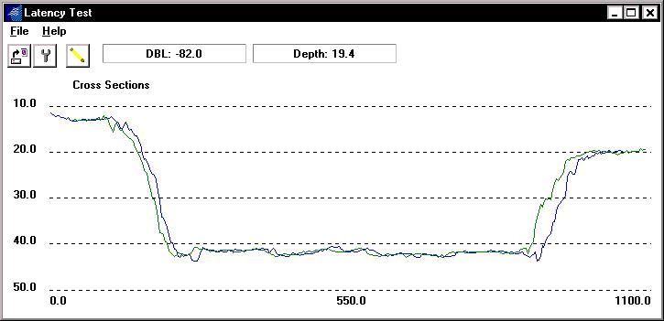
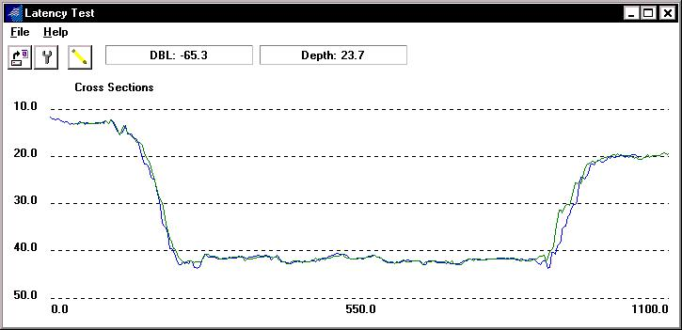
Before & After Profiles
Before
After

Slide 39

Setting the Latency in HARDWARE
LATENCY TEST computes a combined value between the GPS and the Echosounder.
In the HARDWARE program for your GPS device:
  Take the current Latency time for the GPS (1.000 in example).
  Subtract the result from the average of 3 LATENCY TESTS.
    (1.00 – 0.75 = 0.25 for this example).
  Set the Latency time of your GPS to 0.25 (for this example).
  Make sure the Latency time of your echosounder is set to 0.00
Now, go back to SURVEY, collect 3 more sets of test lines and check the results.

Slide 40
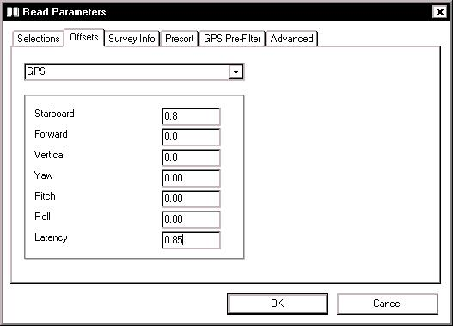
Correcting Latency - SINGLE BEAM EDITOR (32 bit)
Correcting Existing RAW Data Files:
  You can update the Latency value used during data collection by changing the value in the SINGLE BEAM EDITOR.
  Enter the correct Latency value as determined in the LATENCY TEST program.

Slide 41
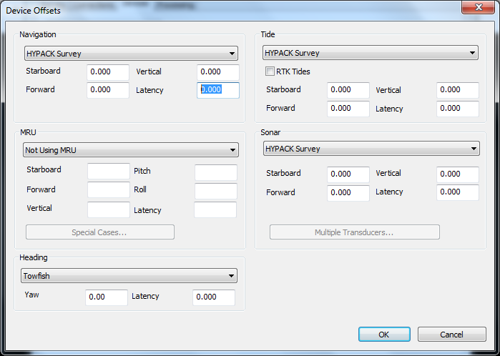
Correcting Latency - SBMAX 64
In the SBMAX64 editor, enter the latency in the Navigation field on the device offset page

Slide 42
Clock Synchronization

Slide 43
Who Should Synchronize?
Synchronize if you have a multi-beam that outputs datagrams with UTC time stamps.
Synchronize if you plan to use post-processed heave.
Synchronize if you plan to use post-processed GPS positions.
Synchronize if you are using LiDAR data

Slide 44
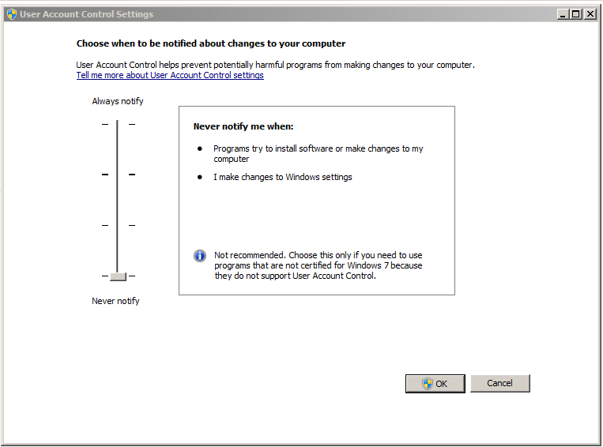
Preparing your Computer to Synch the Clock
The Synch Clock function requires that the computer be exposed to changes from other programs.
The User Account Controls Notification should be disabled to allow the software to update the computer time.
If this is not disabled, the Veritime Clock will still function, however the computer time will not be changed.

Slide 45
How Clock Synchronization Works
GPS
UTC time from the GPS is received using 1Hz ZDA message and optional PPS signal.
The time in the Data Display is the local time representation of VERITIME
Veritime Clock
Using the GPS Time the clock monitored and updated every second. The current time is pushed to WINDOWS to update the computer time.
WINDOWS
Time
The device timing uses the VERITIME time for record time. If the time push to WINDOWS fails the device time is still in synch with the GPS time.

Slide 46
Clock Synchronization: How it works
When the ZDA sentence arrives: (1 Hz only!)
  HYPACK SURVEY compares the UTC time from the GPS (corrected with the time zone offset) with the time from the VERITIME clock model (HYPACK SURVEY).
  It can speed up the VERITIME clock model, or slow it down so that it matches UTC.
  You should wait one or two minutes after starting HYPACK SURVEY before starting to survey to allow the VERITIME clock model to synch to UTC. SURVEY will show a “No Synch” error until it locks on.
When the GGA sentence arrives (any rate):
  HYPACK SURVEY uses the time tag in the GGA sentence (corrected for local time zone offset) as the position time tag.
When a message arrives from your echosounder, MRU or other non-GPS device:
  HYPACK SURVEY gets a time tag from the VERITIME clock model, which has been ‘synched’ to UTC less the local time zone offset.

Slide 47
Clock Synchronization
  These times are adjusted to local time zone, along with any latency offset entered by the user and used as the time tag for the position.
Device Message | Veritime Action | Time Tag
‘ZDA’ from GPS | VERITIME Clock Model Adjusted | Difference recorded in RAW record
‘GGA’ or ‘GGK’ from GPS | Nothing | From GGA/GGK sentence
Echosounder, gyro and other devices | Nothing | From VERITIME model

Slide 48
Clock Synchronization – 1PPS Box
GPS
Computer
RS-232 Out (GGA, VTG, ZDA)
Without 1 PPS Box
12VDC
1 PPS Out
Computer
1PPS Box
RS-232 Out (GGA, VTG, ZDA)
With 1PPS Info on CTS Line
GPS
RS-232 Out (GGA, VTG, ZDA)
With 1 PPS Box
Without a 1PPS Box: Time of ZDA sentence is based on the arrival of first character of ZDA transmission.
With a 1PPS Box: Time of ZDA sentence is based on arrival of 1PPS pulse.

Slide 49
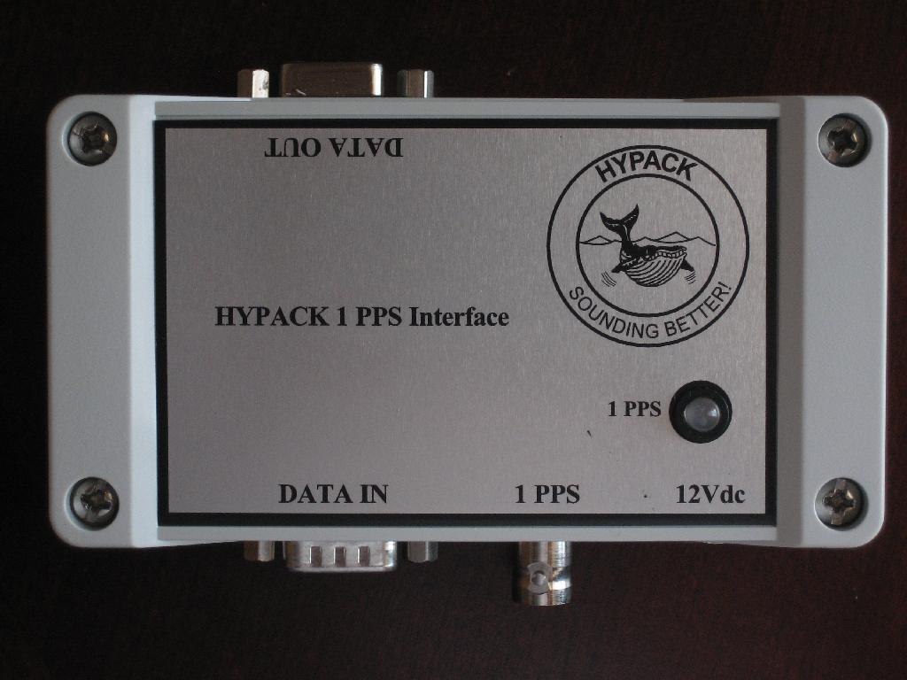
The 1 PPS Box
RS232 Out (to computer)
1 PPS Receipt Strobe
Alternates RED/GREEN every 1 second when operating correctly
The use of the PPS box is to allow the computer time to detect the PPS signal.
The PPS box converts a short pulse into a stable, detectable signal.
12VDC In
RS232 In Requires ZDA at 1 Hz May also carry 1PPS pulse on Pin 8 or 9
1 PPS In
(from GPS) BNC Connector

Slide 50
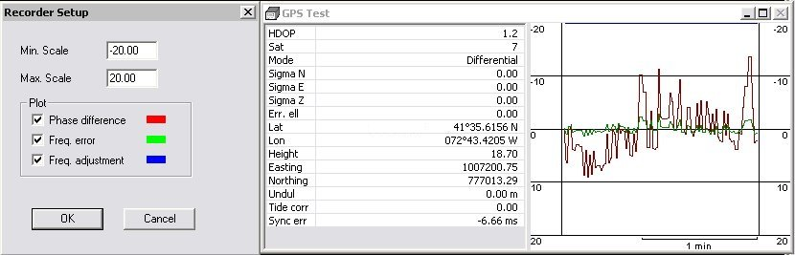
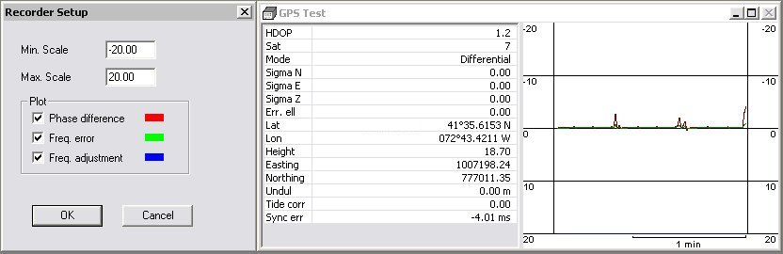
Time Synchronization Tests
Make sure you monitor the difference between the VERITIME and GPS clocks!
The difference should be small (<20mSec) and should work its way towards 0.0 after a spike.
If it gets large and stays large, something is wrong, Stop SURVEY.
ZDA Only
ZDA and 1 PPS Box

Slide 51
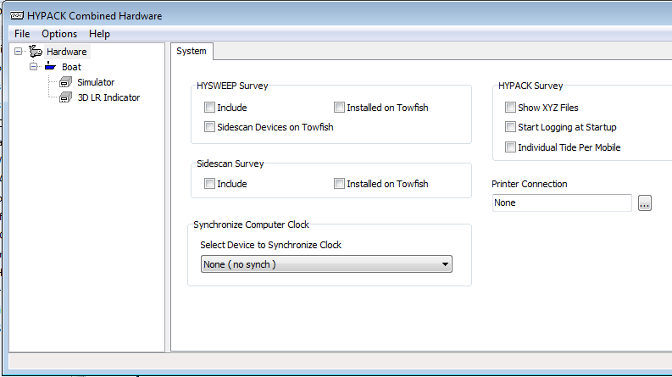
Synch the Computer Clock
Select ONE GPS device to use to synchronize the computer clock to UTC in the HYPACK Configuration page.

Slide 52

1PPS Configuration
GPS – Setup
Specify if you are using a 1PPS box.

Slide 53
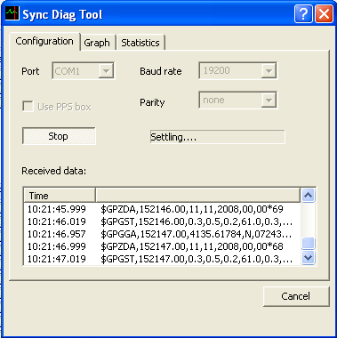
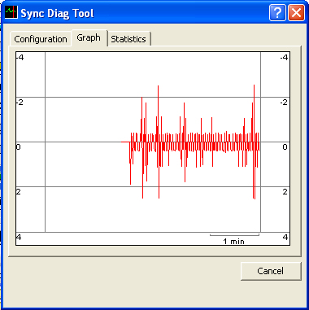
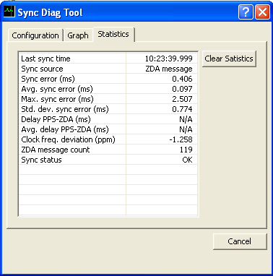
ZDA – 1PPS Testing: Utilities
Test the consistency of your ZDA message for synchronization.
Located under ‘Utilities – Calibration’ menu item.
Graph shows ‘Sync Error’ in mSecs. Sync Error equals the difference between VERITIME and the time of arrival of the ZDA message

Slide 54
Planned Line Editor

Slide 55

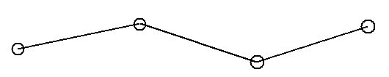
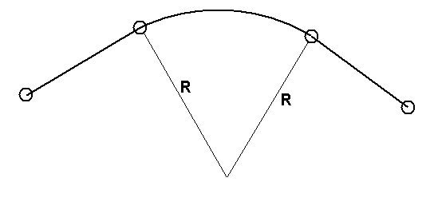
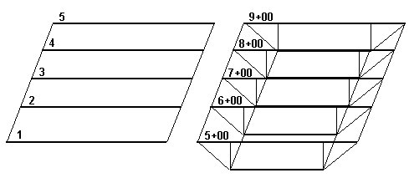
Planned Lines Basics
A planned line needs a minimum of two waypoints.
A planned line can have over 100 segments.
Internal segments can be made as arcs by entering the radius for the arc.
Lines can be:
  2D: Only X-Y at waypoints
  3D: X-Y at waypoints and design depth at Distance Along Line
You can survey without Planned Lines. Many multibeam surveys do not use them and rely on a MTX file(s) to ensure 100% coverage.

Slide 56
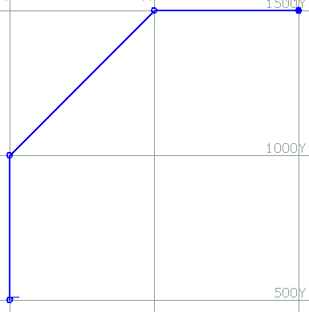

Line Editor: Arc Segments
Enter inside (or outside) radius for a segment.
Curved lines CANNOT be used when computing volume quantities.
If the arc is created on the wrong side, add a “-” to the radius to flip it to the other side!

Slide 57



Offsets: Centerline
Smart Corners, Centerline Offsets.
Create your centerline, Select Offsets: Centerline, Generate perpendicular lines.

Slide 58

Offsets: Parallel Lines
Enter your initial line.
Select Offsets: Parallel
Generate your parallel lines.
You can now stagger the offsets:
  50m, 100m, 50m, 100m, etc.
For Parallel Offsets, lines are renumbered North to South and West to East.

