Slide 1
SBES - Processing Data

Slide 2
Objectives of this session
1
2
Single Beam Editing
3
Single Beam Workflow
Water Level Corrections
4
5
6
Draft Corrections
Motion Reference Units
Sound Velocity
Notes:
Stressed Water Supply
Issue
Maintain the health of traditional water sources and execute a water source diversification strategy
Solution
Xylem’s leading-edge technologies monitor, pump and treat water from all sources and enable water reuse
Aging Infrastructure
Issue
Utilities have to effectively assess and identify high-risk areas for repair/replacement before problems occur
Solution
Xylem’s intelligent pipeline and critical infrastructure services perform condition assessment, identify defective assets, provide bypass services and replacement technologies, reduce or eliminate combined sewer overflows and leaks/non-revenue water
Stormwater & Flooding
Issue
Significant increase in severe weather patterns is causing flooding and related damages to communities
Solution
Xylem’s flood management solutions include sensors for early warnings, dewatering for disaster response, communications for recovery and submersible pumping for resilient infrastructure
Regulatory Compliance
Issue
Utilities must successfully comply with a growing body of compliance regulations
Solution
Xylem’s analytics and sensors evaluate a broad range of water quality parameters, and our technologies treat water and wastewater to meet regulatory standards
Non-Revenue Water
Issue
Utilities have an important opportunity to reduce persistent and costly water losses from leaks and faulty meter readings
Solution
Xylem’s broad portfolio of solutions monitors for, and identifies, water leaks, as well as faulty meters. Our communications network enables point-to-multipoint communications throughout the system
Operating Strategy Reducing Costs
Issue
Utilities want to lower operating and energy costs, and leverage new revenue opportunities
Solution
Xylem offers industry-leading pumping and treatment solutions for energy efficiency, and software-enabled solutions to optimize operations and identify revenue opportunities

Slide 3
Single Beam Editing Flow
Single Beam Editing Flow
Raw Data
SURVEY
Editing
Final Products
SINGLE BEAM EDITOR
*.TID
*.VEL
CROSS SECTIONS & VOLUMES
Edited Data
Edited Data
3DTV
Sounding Selection
EXPORT TO CAD
SORT
CROSS SORT
SB SELECTION
HYPLOT
Sorted Data
Sorted Data
TIN MODEL

Slide 4
Single Beam Editor (SBMAX)
Raw Data
Based on the time of the depth measurement, SBMAX interpolates:
  Position
  Tide
  Draft
  Sound Velocity
  Heave-Pitch-Roll
Eliminate or Smooth Positions.
Eliminate or Smooth Depths.
Save each depth with associated position and corrections.
Optionally:
SBMAX
*.TID
*.VEL
Edited
‘All’ Format
CROSS SECTIONS & VOLUMES
Sounding Selection Programs
FINAL PRODUCT PROGRAMS
You can process your data in SBMAX with predicted tides (or no tides). When you get your final tides, you can load the processed data back into SBMAX and insert the final tides.

Slide 5
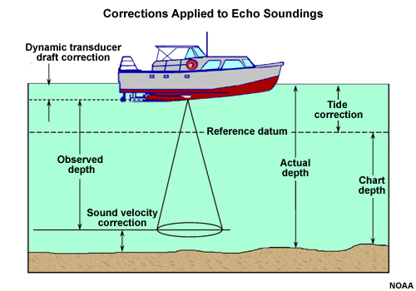
Corrections to Soundings
Static / Dynamic Draft
Motion Reference Units
Sound Velocity
Tide \ Water Level

Slide 6
Single Beam Editing – 64 Bit

Slide 7
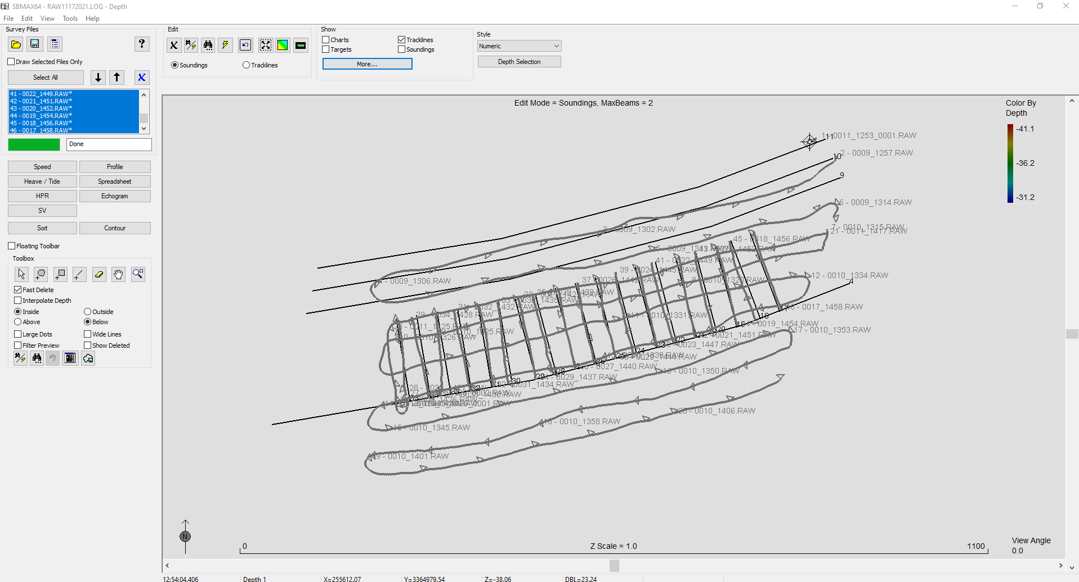
Single Beam Editor (SBMAX-64)
Easy user interface for Editing and Testing.
Tide and SV Corrections.
Added in HYPACK 2022, Contour and Sort

Slide 8
SBMAX64 Highlights
Uses HYSWEEP HS2x format for saved data.
What you can do now (that you couldn’t before):
  Recalculate RTK Tides from edited data.
  Properly adjust device offsets of edited files.
  All raw data available for every sounding.
  (Still allows export to HYACK ALL2 Format)
More Sonar Options Without a HYSWEEP Key
  Multiple Transducer Systems.
  Sontek M9 ADCP/Multibeam.
Change Read Parameters any time during Editing
  Don’t need to reload to fix a mistake.
Common User Interface With MBMAX64 Multibeam Editor
  No need to learn two edit programs.
  Modernizes single beam editing.
  Edit all lines at once in the Survey Window.

Slide 9
Data Flow
Data Flow
Reads:
  Raw Data Files
  HS2x Edited Single Beam Files
  ALL2 Format Data Files
  Old ALL Format Data Files
Applies (optionally):
  Tide Correction Files
  SV Correction Files
Saves:
  HS2x Format Files (Default)
  ALL2 Format Data Files (Export)
  XYZ Format
Raw Data
Files
Optionally:
*.TID
SBMAX64
*.VEL
HS2x / ALL
Format Files
Sounding Selection Programs
Read a single file, selected files from a *.LOG, or the entire *.LOG file.
Notes:
9

Slide 10
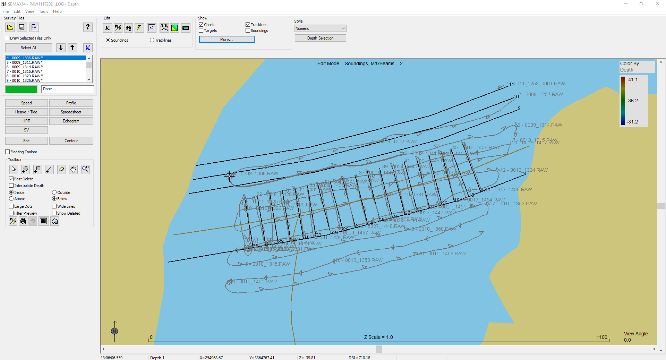
SBMAX64 Layout
SBMAX64 Layout
Top Panel: Mostly Applies to the Survey Window and Data.
Left Panel: Applies to All Windows and Data
Survey Window: Tracklines or Soundings.
Status Bar: Point Data and Measurement Between Points.
Notes:
10

Slide 11
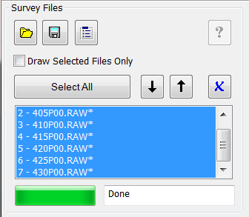
Left Panel, Survey Files
Left Panel, Survey Files
Useful Option:
Draw Select or All Survey Files
Buttons:
Load Survey
Save Survey
Edit Read Parameters
More Buttons:
  Select All Files
  Next File Down
  Previous File Up
  Remove File From Survey
File List Is Used For:
  Display
    Time Series Windows.
    Profile Window.
  Filtering.
  Adjustments.
File List and Selected Files
  File Number and Name
  Asterisk at Modified Files.
Notes:
11

Slide 12
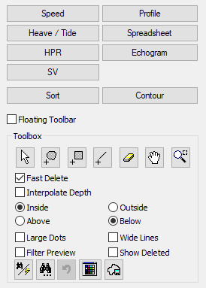
Left Panel, Editing
Left Panel, Editing
View windows for data, time series, sounding and imagery
Select for very useful Floating Toolbar
Editing Tools: Mouse Pointer Shows Selected Tool
Measure
Lasso Select
Block Select
Line Select
Eraser
Tilt / Rotate
Zoom Window
Buttons:
  Search and Filter
  Find Next
  Very Useful Undo
  Color Settings
Notes:
12

Slide 13
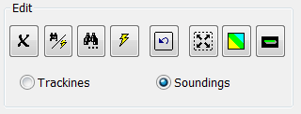
Top Panel, Editing
Top Panel, Editing
Buttons:
Delete Point or Selection
Search and Filter Options
Find Next
Filter
Undelete Selections
Zoom Extents
Map View
Profile View
Edit Mode
Tracklines: Click this to display and edit positions. SBMAX64 always starts in Trackline mode
Soundings: Click this to display and edit soundings.
Notes:
13

Slide 14
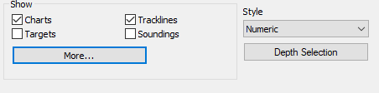
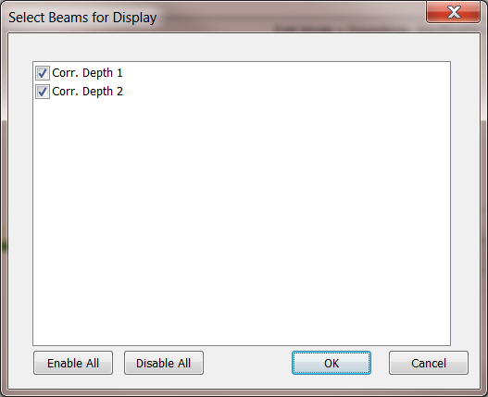
Top Panel, Display
Style: Soundings may be drawn as Dots or as Numeric Depth.
Show:
Charts: Shows charts enabled in the HYPACK Shell.
Color Bar: Shows a color legend appropriate for the data displayed.
Flags: Obsolete
Targets: Shows targets from the HYPACK database.
Tracklines: Shows survey track lines.
Soundings: Shows sounding points.
Planned Lines: Shows planned survey lines.
Events: Shows event numbers.
Notes:
14

Slide 15
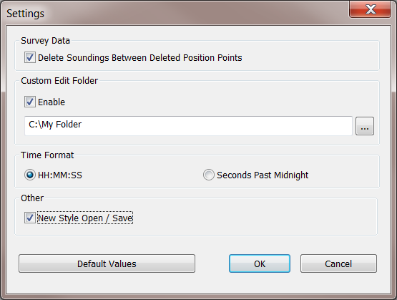
Getting Started – Editor Settings
Getting Started – Editor Settings
Edit Menu, Settings:
Delete Soundings Between Deleted Position Points: Yes or no.
Custom Edit Folder: Override HYPACK default.
Time Format: Select a display format. Seconds past midnight is useful for correlating points in the data files.
New Style Open / Save: Program sometimes gets stuck in memory using the new style. Use the old style to prevent that.
Notes:
15

Slide 16

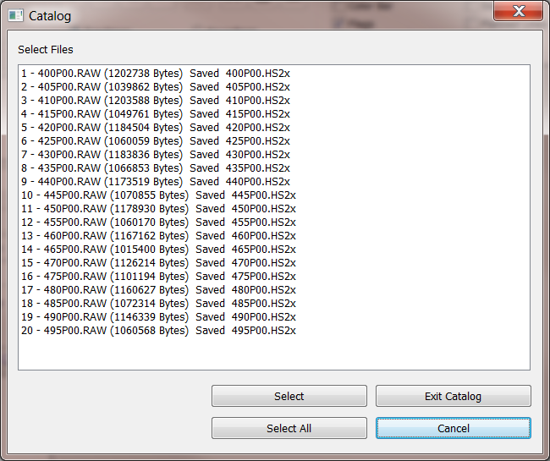
Loading Files
Loading Files
Use File pulldown Menu, Load Survey or the Folder Button.
Select Data File(s) or HYPACK Catalog
Catalog: Select One or More Survey Files From HYPACK *.LOG.
Notes:
16

Slide 17

Read Parameters
Read Parameters
Everything Required to Process the Data
Tabs:
  Survey: Applies to all loaded files.
  Corrections: Tide, Sound Velocity and Dynamic Draft.
  Devices: Device Selections and Offsets.
  Processing: Heave and Sonar Settings.
In SBMAX64: Any of the Read Parameters can be updated After Files are Loaded!
Notes:
17

Slide 18
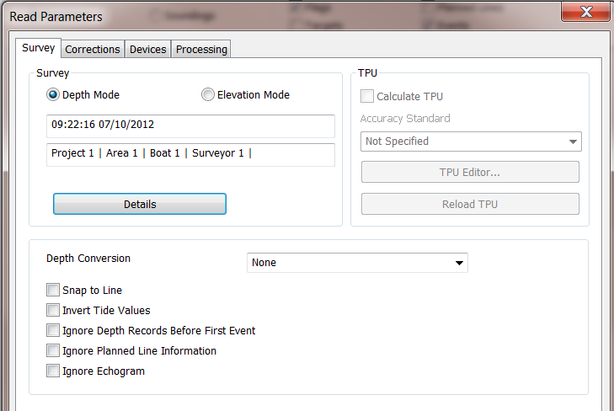
Survey Tab
Survey Tab
Summary of Survey Info
Depth or Elevation: Select Your Work Mode.
Details: Click to see additional survey information.
TPU: (Future) Calculate Total Propagated Uncertainty of each Sounding.
Depth Conversion, etc.: To be used as needed.
Notes:
18

Slide 19
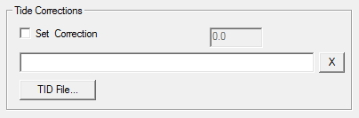
Corrections Tab, Tides
Corrections Tab, Tides
Corrections are Applied to Selected Survey File(s)
Set Correction: To Use This, Check the Box and Enter a Correction Value for the Entire File. Set to 0.0 to replace embedded tide data in the file(s)
TID File: Select a TID File.
X: Remove TID File.
Priority – SBMAX64 Will Never Double Correct for Tide:
Set Correction.
TID File.
Tide Data From Survey File.
Notes:
19

Slide 20
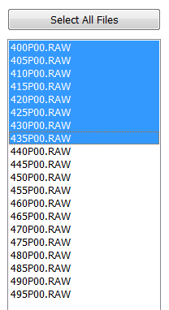
More on Tide Corrections
More on Tide Corrections
Corrections are applied to selected files.
Using a Tide Correction File:
  Make a Tide Correction file (*.TID) in the MANUAL TIDES program.
  Select your TID file.
RTK Tides:
  No entry is needed in Corrections tab.
  Set up RTK Tide parameters in the Processing tab.
Manual tides entered during SURVEY:
  No entry is needed in Corrections tab.
  Specify ‘Manual Entry in Survey’ as Tide Device in devices tab.
Telemetry Tides:
  No entry is needed in Corrections tab.
  Specify telemetry tide device as Tide Device in Devices tab.
Notes:
20

Slide 21
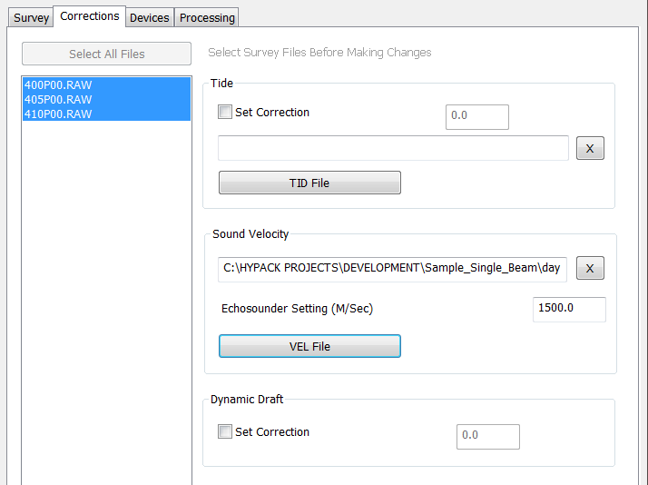
Corrections Tab, Sound Velocity
Corrections Tab, Sound Velocity
Sound Velocity Corrections
Calibrated sounder with a bar check:
  No correction file is needed.
Using a velocity probe:
  Create a Sound Velocity Correction file (*.VEL) in the SOUND VELOCITY program.
  Select File Here.
Using fixed corrections at different depths:
  Not supported in SBMAX64.
Notes:
21

Slide 22

Corrections Tab, Draft
Corrections Tab, Draft
Corrections are Applied to Selected Survey File(s)
Set Correction: To Use This, Check the Box and Enter a Squat and Settlement Correction Value for the Entire File.
Priority:
  Set Correction.
  Draft Data From Survey File.
Notes:
22

Slide 23
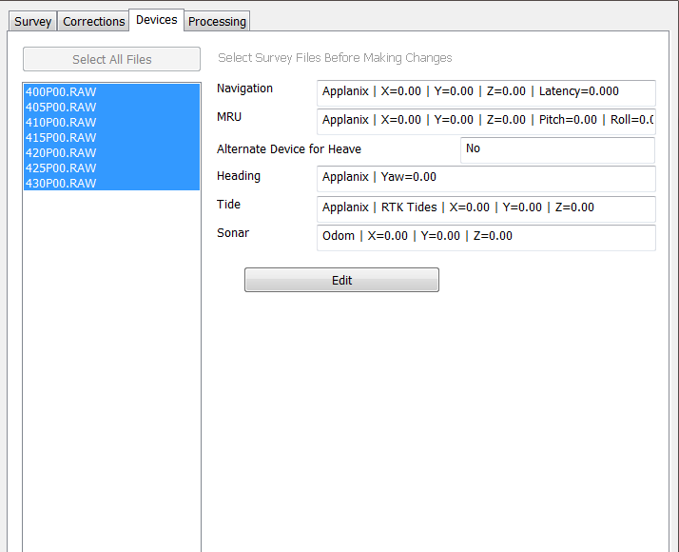
Device Tab
Device Tab
One Page Summary of Device Selections and Offsets.
Use Edit Button to Make Changes.
Settings are Applied to Selected Survey File(s)
Notes:
23

Slide 24
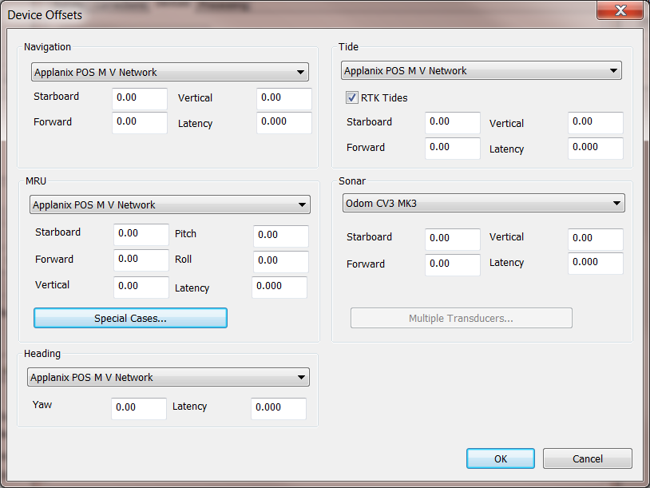
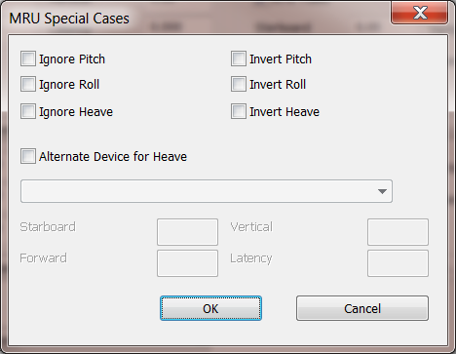
Devices and Offsets
Devices and Offsets
Use Drop Down Lists to Select Devices.
Enter Relevant Offsets.
If using RTK Tides, enable setting
Settings are Applied to Selected Survey File(s)
MRU adjustments (if needed)
Notes:
24

Slide 25
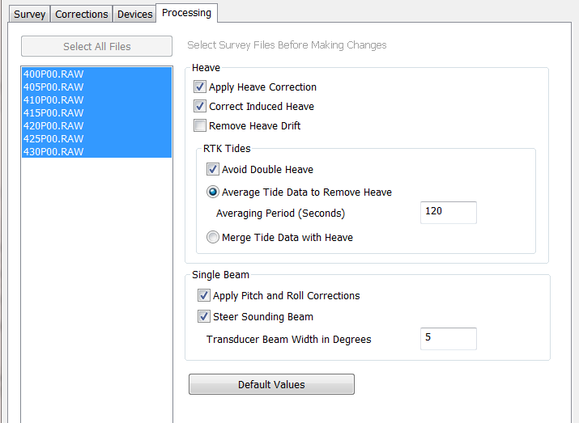
Processing Tab, Heave
Processing Tab, Heave
Apply Heave Correction: Use Heave Correction From MRU.
Correct Induced Heave: Required When MRU is Not Mounted at Boat Reference.
Remove Heave Drift: Apply Averaging to “Fix” Heave Drift.
Avoid Double Heave: When RTK Tide and MRU Both Measure Heave.
Average to Remove Heave: Use Averaging to Remove Heave From RTK Tide.
Merge Tides With Heave: Use Heave to Fill Gaps Between RTK Tide Points.
Notes:
25

Slide 26
Processing Tab, Single Beam
Processing Tab, Single Beam
Apply Pitch and Roll Corrections: Use Corrections from the MRU to calculate transducer draft change.
Steer Sounding Beam: Use pitch and roll corrections to steer the beam. Otherwise depth is considered directly below the transducer. More in the next slide.
Transducer Beam Width in Degrees: From manufacturers specs.
Notes:
26

Slide 27
Single Beam Steering
Single Beam Steering
The position of the sounding is based upon the center of your transducer beam.
‘Steer Sounding Beam’ computes a new location for the center of your transducer beam, based on the pitch and roll values, and the beam width of your transducer.
D’ = COS(pitch) * COS(roll) * D
D’
D
X’,Y’
X,Y
Notes:
27

Slide 28
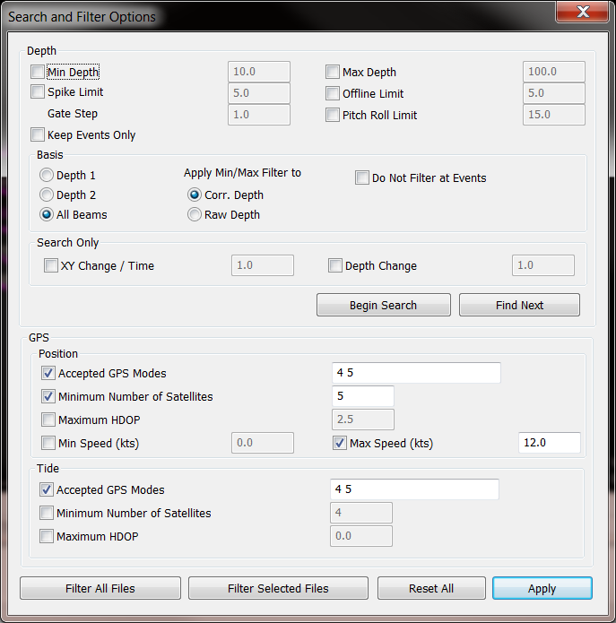
Presort, GPS Pre-Filter tabs are gone…
Presort, GPS Pre-Filter tabs are gone…
Presort:
Not presently available in SBMAX64. Use SBMAX (32 bit) or other HYPACK tools to thin your data.
GPS Pre-Filter:
Now available at any time during an edit session. See Search and Filter Sections below.
Notes:
28

Slide 29
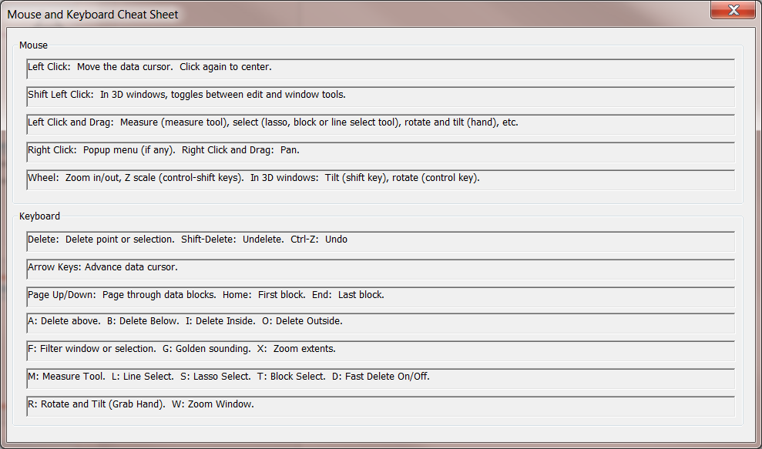
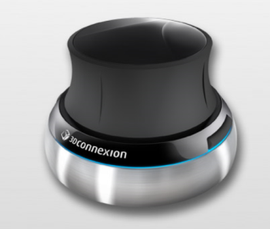
Mouse and Keyboard Cheat Sheet
Mouse and Keyboard Cheat Sheet
“Space Navigator” 3D Mouse
Edit Menu, Mouse and Keyboard Cheat Sheet: Extremely useful short cuts to speed the edit process. Valid for all the graphical edit windows.
Notes:
29

Slide 30
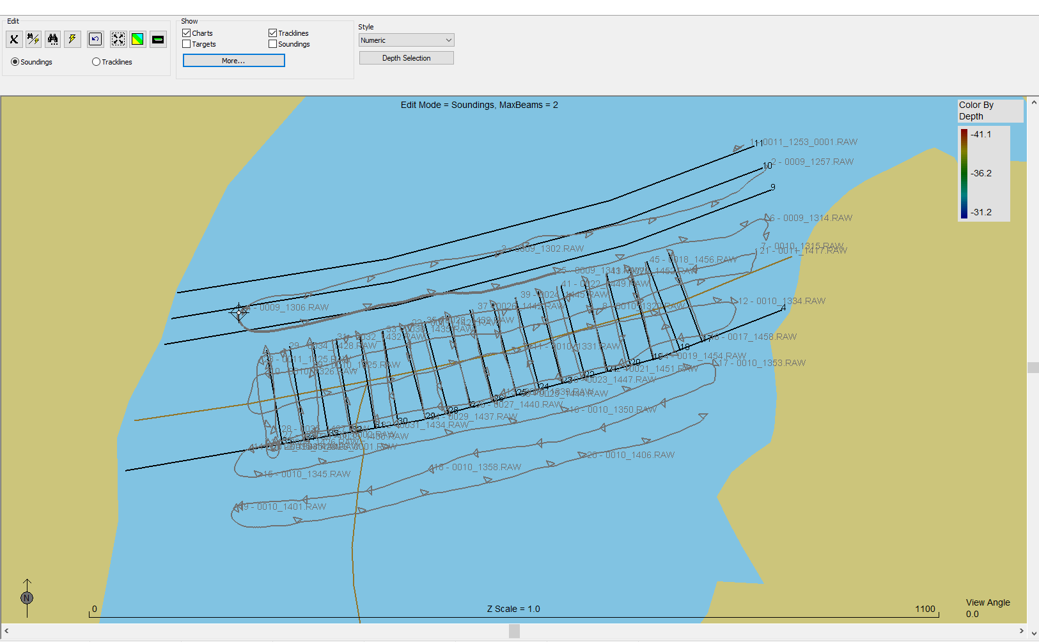
Background Files in Survey Window
Background Files in Survey Window
Users can display all background files in the main window.
Check the box at the top of the map.
Hit ‘F9’ to get to the View Options window.
Notes:
30

Slide 31
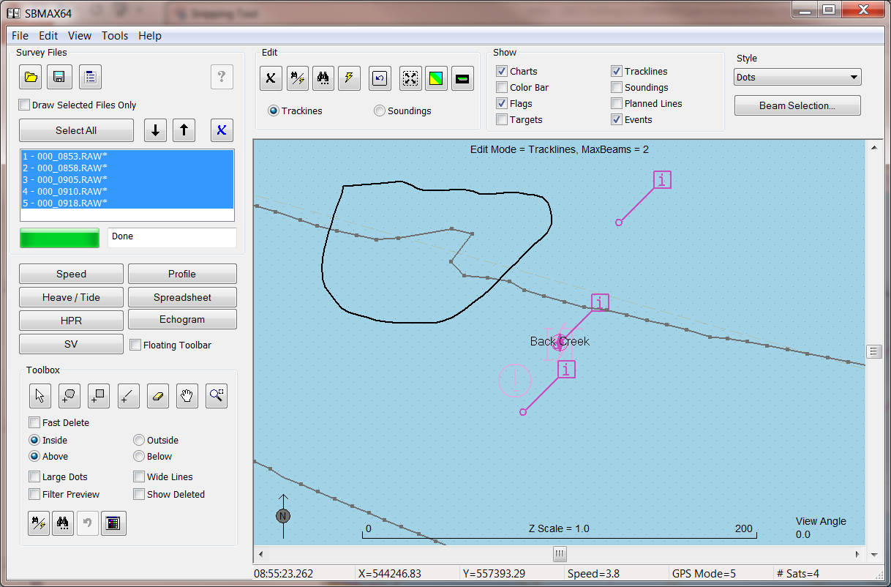
Editing Positions Manually
Editing Positions Manually
(1) Select “Lasso” Tool, Inside
(2) Lasso the position spike
(3) Delete key or click the delete button
Notes:
31

Slide 32
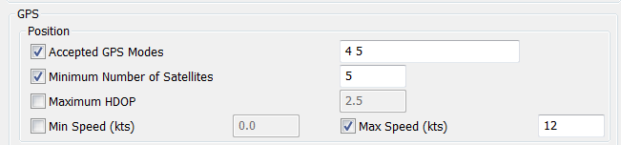
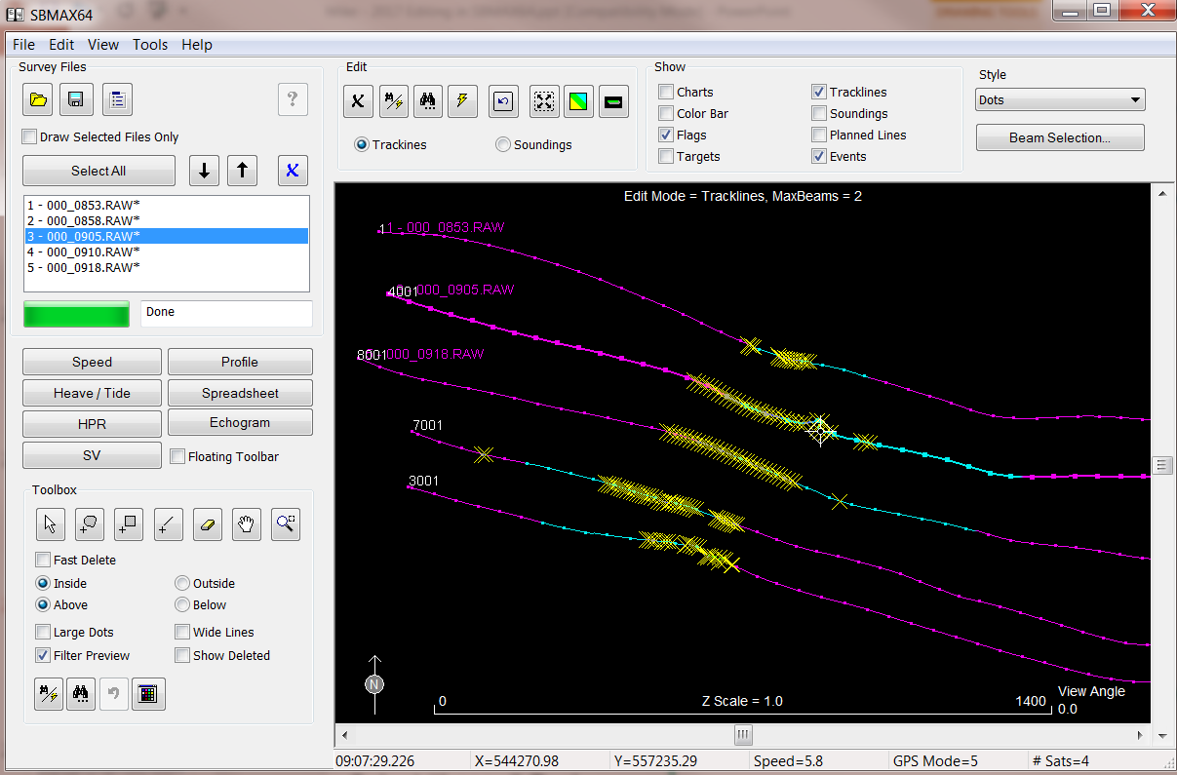
Filtering Positions
Filtering Positions
Edit Menu, Search and Filter Options to set GPS filters
Apply Filters with the Lightning Bolt.
Filter Preview: Enable (show) or disable (hide) here.
Notes:
32

Slide 33


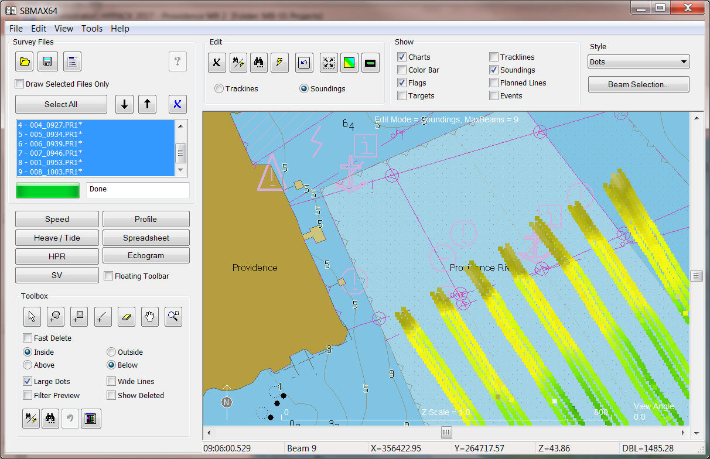


Viewing Soundings in the Survey Window
Viewing Soundings in the Survey Window
Select Soundings
Useful for Viewing:
Zoom Extents: Zoom out to full survey.
Map View: Top Down.
Profile View: Side On.
Beam Selection: Which beams to display.
Also:
Grab Hand or Shift Left Click: Enter 3D Tilt / Rotate Mode. Shift Click again exits mode.
Mouse Wheel: Zoom in/out.
Right Click and Drag: Pan.
Control Shift Mouse Wheel: Vertical Exaggeration.
Sounding Colors:
Use Button, Right click menu, Edit menu.
Color by Depth, Beam, Survey Line … Many options.
Notes:
33

Slide 34
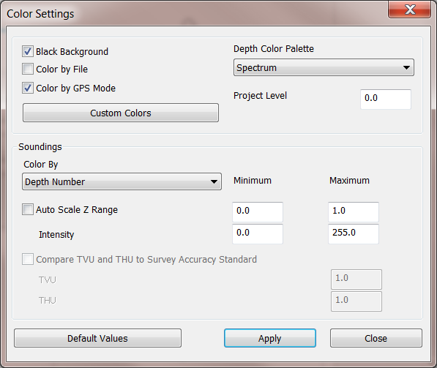
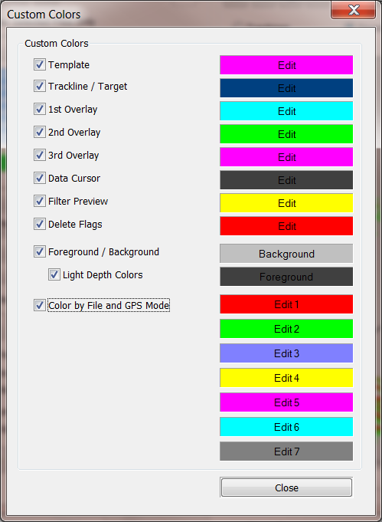
Color Settings
Color Settings
Complete control of system colors. Most of the options explain themselves.
Color by File and GPS Mode: Cycles through 7 colors by default. Color selection can be changed in Custom Colors.
Notes:
34

Slide 35
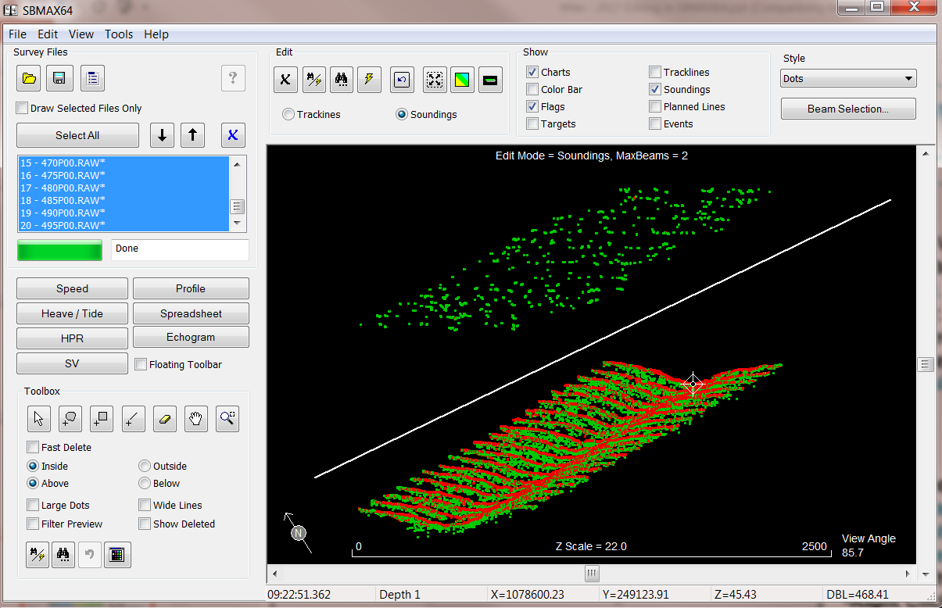

Edit Soundings in the Survey Window
Edit Soundings in the Survey Window
Use the Mouse:
Rotate, Tilt, Pan and Exaggerate to get to a useful view
Select a Tool:
Lasso Selection
Block Selection
Line Selection
Eraser
Clean the Data:
Possible to edit an entire survey with a click.
Surface noise completely separated from the soundings in SBMAX64. Line select / delete cleans it with one click.
Notes:
35

Slide 36
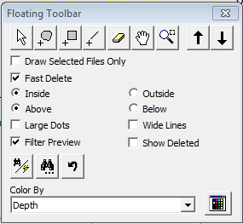
The Floating Toolbar
Block Select
Line Tool
Eraser Tool
Lasso Tool
File select tools
Measure Tool
Zoom Window
Tilt and Rotate

Slide 37
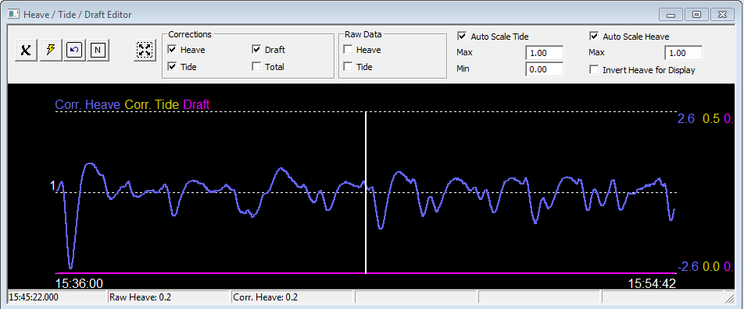
RTK Tides: Tide and Draft Window
RTK Tides: Tide and Draft Window
Use Heave/Tide Editor. View Menu or Left Panel.
Filter Button: Same Selection Rules as Position Filtering.
Color by GPS Mode If It Is Helpful.
Notes:
37

Slide 38
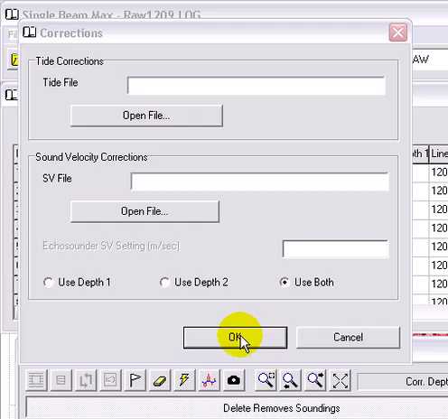
RTK Tides: Tide and Draft Window
RTK Tides: Tide and Draft Window
Notes:
38

Slide 39
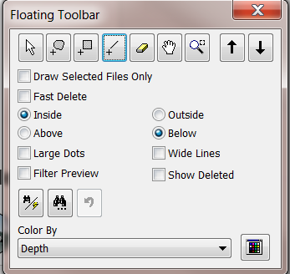

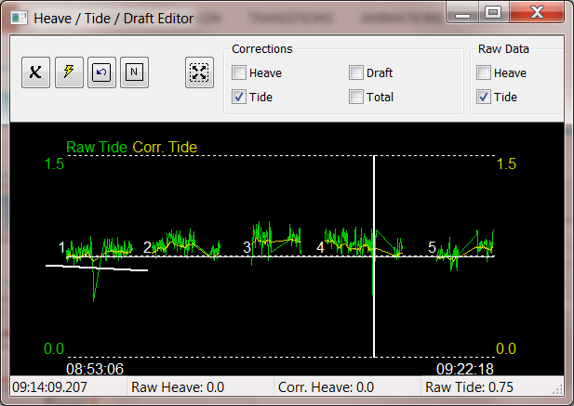
Editing Tide Manually
Editing Tide Manually
2. Drag a line to isolate the tide spike
(3) Delete key or click the delete button
Select “Line” Tool, Delete Below
Fast Delete: Removes data as soon as the mouse button is released. No need for Delete button or Key. Use “Undo” for mistakes.
Notes:
39

Slide 40
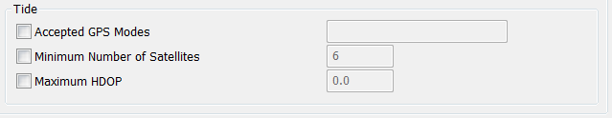
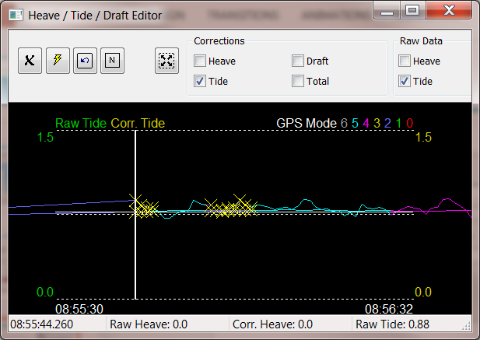
Filtering RTK Tide
Filtering RTK Tide
Edit Menu, Search and Filter Options for RTK Tide Filter Settings
Apply Filters with Lightning Bolt
Filter Preview: Yellow X’s show points outside filter limits.
Notes:
40

Slide 41
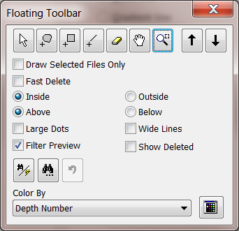
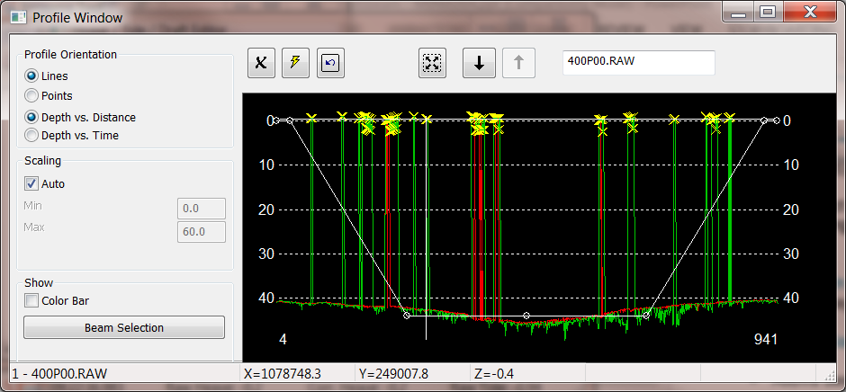

Edit / Filter in the Profile Window
Edit / Filter in the Profile Window
Corrected Depths, One Line at a Time
Edit: All the toolbar options are available for Profile Editing.
Filter: Apply depth filters with preview.
Trackline Editing: Not available in SBMAX64. Edit track lines in the Survey Window.
Use this to undelete soundings. (1) “Show Deleted” in toolbar, (2) select soundings in Profile, (3) undelete button.
Notes:
41

Slide 42
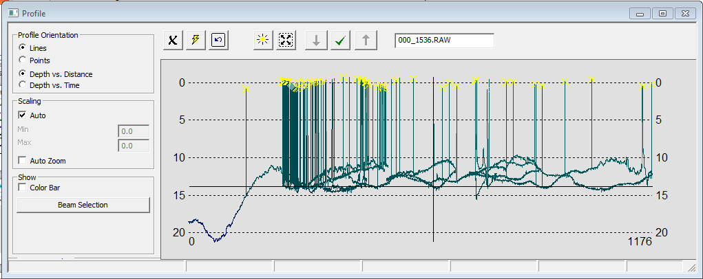
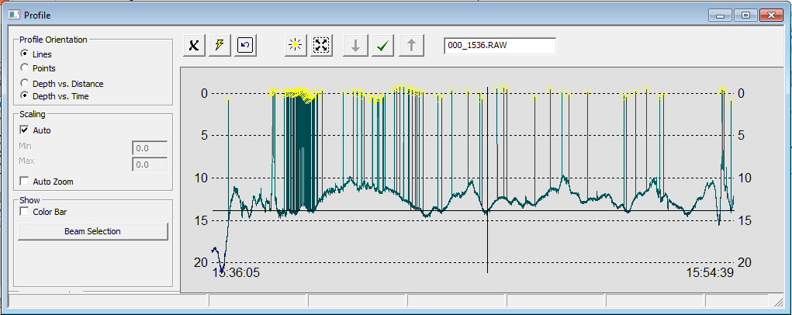
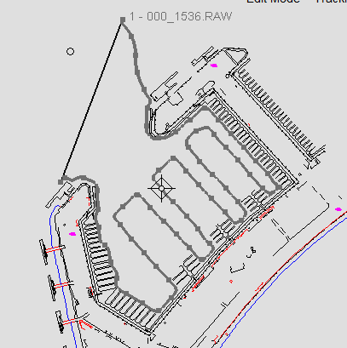
PROFILE WINDOW – Depth vs Distance or Time
When the vessel is driven not along the planned line, Depth vs Time is preferred.

Slide 43
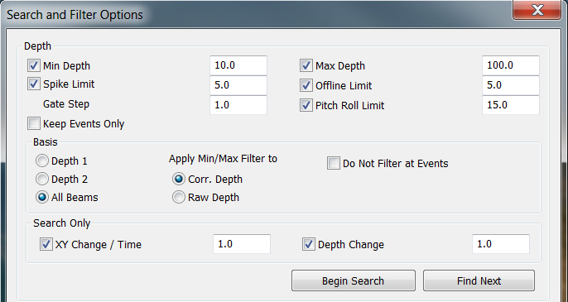

Depth Filters
Depth Filters
Spike Limit: Uses a gating method to detect outliers. Spike Limit is the depth gate, Gate Step controls how fast the gate expands.
Offline Limit: Removes soundings beyond the set limit from planned line.
Basis Depth 1/2/All: Controls which beams filters are applied to.
Notes:
43

Slide 44
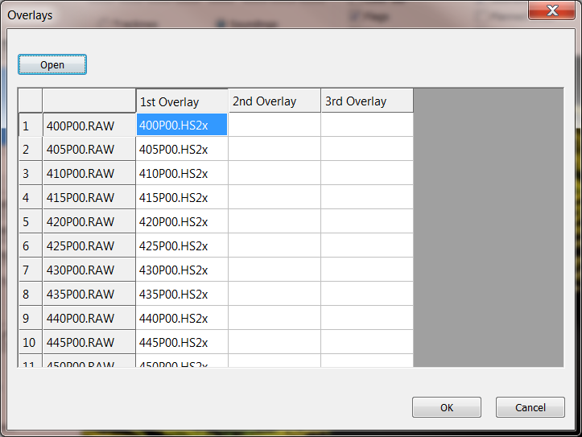
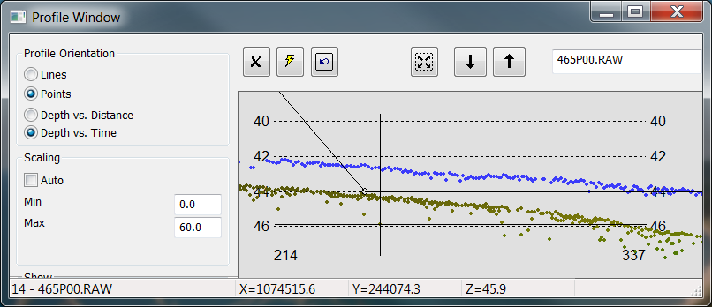
Overlays
Overlays
Overlay Surveys (File Menu)
Click in 1st, 2nd or 3rd column.
Open *.LOG file from a previous survey.
Differences can be seen in the Profile Window.
Set overlay color in Custom Colors
Notes:
44

Slide 45
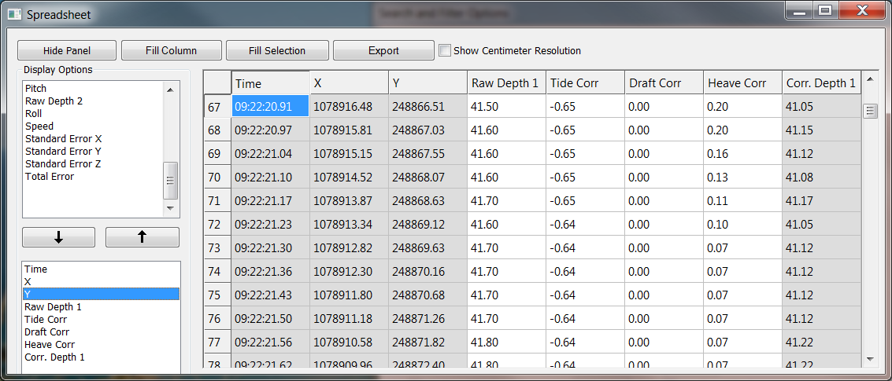
Spread Sheet
Spread Sheet
Select Columns: Use up and down arrows (or double click in list) to add or remove data from the spread sheet.
Editing Cells: Cells that may be changed are shown in white. Cells shown in gray can not be changed.
Fill Column: Fills data from the current row to the end.
Fill Selection: Fills the selected range of cells.
Export: Click to export the spreadsheet to file.
Notes:
45

Slide 46
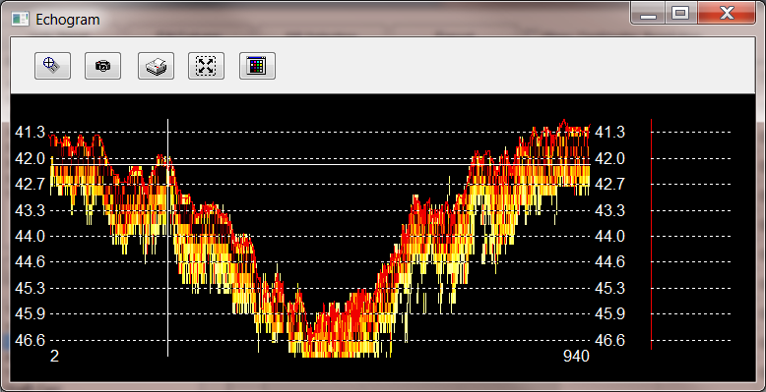
Echogram
Echogram
Shows the Analog Signal recorded by some echosounders.
Odom MK3 and CV3, Kongsberg EA400, Knudsen.
Still a work in progress in SBMAX64.
Notes:
46

Slide 47
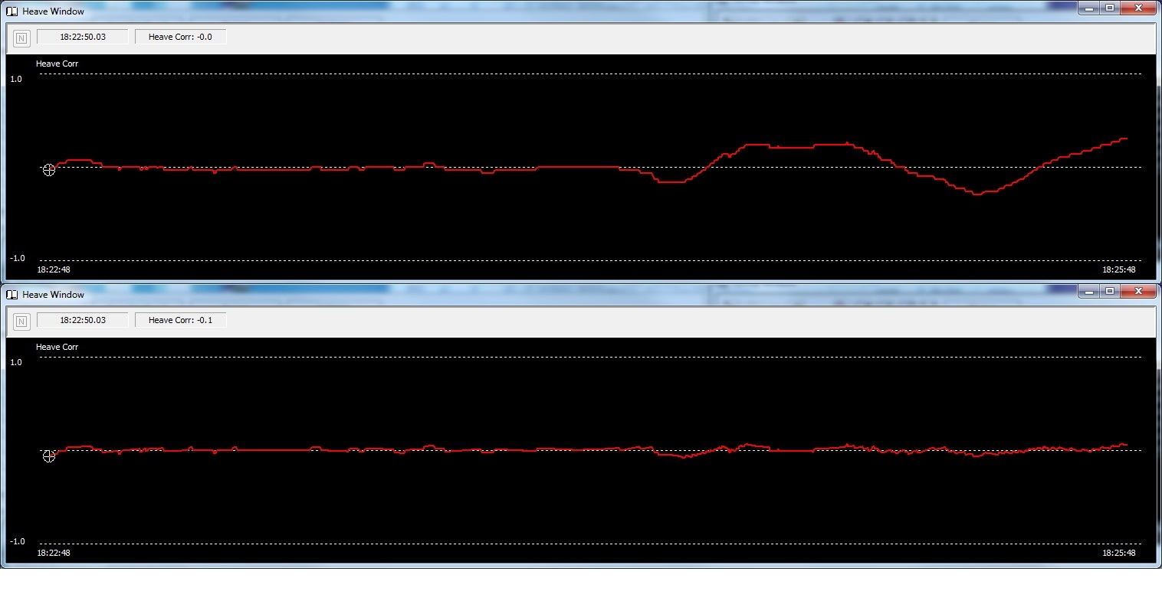
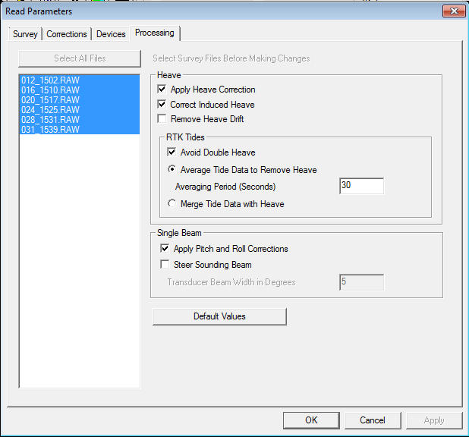
Correction of Heave Drift
Correction of Heave Drift
Heave Drift NOT Removed
Heave Drift Removed
Heave values can drift ‘off-center’ due to rapid accelerations or changes of direction.
Notes:
47

Slide 48
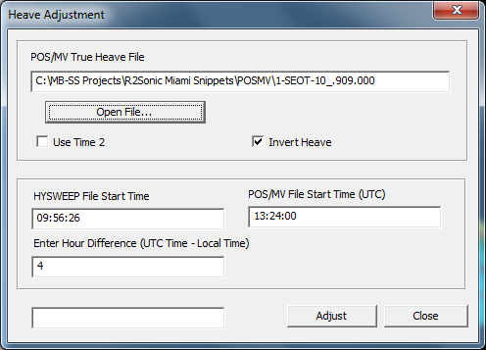
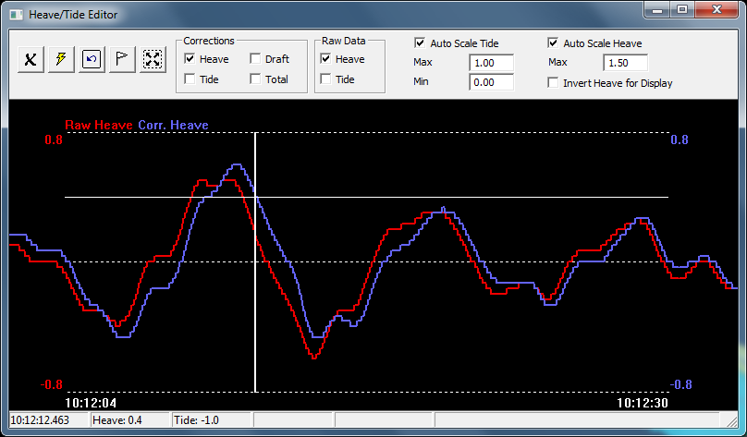
POS/MV True Heave Adjustments
POS/MV True Heave Adjustments
Use Heave Adjustments, POS/MV True Heave.
Open One or More True Heave Files.
Enter Offset, Local to UTC Time.
Use Adjust Button to Replace Heave.
True Heave vs. Raw Heave
True Heave in Blue.
Raw Heave in Red.
True Heave is Correct.
What Does That Say About Raw Heave? It is not always right
Notes:
48

Slide 49


POSPac Adjustments
POSPac Adjustments
Make Sure Geodetic Parameters are Right.
Open a POSPac File: *.OUT.
Select Data To Replace
  Positions.
  RTK Tides.
  Heading.
  Pitch and Roll.
POSPac Does Not Replace Heave.
Verify Device Offsets = IMU or Sensor 1 location.
Click Adjust to Replace Data.
Use Tools Menu, POSPac Adjustments.
Navigation and Tide Devices are Replaced With “POSPAC”.
Notes:
49

Slide 50

SBET Editor
SBET Editor
Use Tools Menu, SBET File Editor
Clean and Save SBET files
True Heave Fills Gaps Between Interpolations
Notes:
50

Slide 51


Post-Processed GPS Correction
Post-Processed GPS Correction
Allows the user to apply enhanced Post-Processed positions and RTK tide data from an ASCII file.
Notes:
51

Slide 52

Saving Files
Saving Files
HS2x – HYSWEEP Edit 64 bit: Default save format. Saves all raw data for adjustment or replacement in re-editing.
XYZ: Soundings may be saved to XYZ as well.
Export: Save to HYPACK ALL2 format for compatibility with older programs.
One File Per Survey Line: Option for XYZ.
Append to File Names: Option for HS2x and XYZ. Helps create unique file names when surveys are saved for differing purpose.
Notes:
52

Slide 53

Export Options (ALL2 Format)
Export Options (ALL2 Format)
Files are saved to project’s Edit folder or Custom folder from Settings.
Original data files are not modified in any way.
File Extension Options:
  *.EDT (Default)
  User Defined
    Useful for separating Pre VS. Post Survey data
    Can now have unlimited length extensions.
Notes:
53

Slide 54
Water Level Corrections

Slide 55
Water Level Corrections
    HYPACK adds all of the corrections to the measured depth.
    Your tide correction will always be a NEGATIVE value if the water level is above the chart datum.
    Raw Depth
    Tide Correction
    Draft Correction
    SV Correction
    + Heave Correction
    ----------------------------------
    Final Depth
Water Level
Tide Correction
Chart Datum
Measured Depth
Chart Sounding
The Bottom

Slide 56
Tide Corrections
Method | Program
Telemetry Tide Gauge | SURVEY with telemetry tide driver
Manual Entry During SURVEY | SURVEY
RTK TIDES | SURVEY using GPS.DLL, POSMV.DLL, or F180.DLL
Manual Entry During Post- Processing | MANUAL TIDES
Prediction from High & Low Water Times and Heights | MANUAL TIDES
Harmonic Predictions | HARMONIC TIDES
Interpolating Between Stations | Tide Adjustments routine in SBMAX
Tidal Zoning | TIDAL ZONING

Slide 57

Telemetry Tide Devices
Uses a device driver:
  Tidalite
  Gentide (Generic Tide Driver)
  Valeport
  Hazen
  eTrac
Update rates:
  Some based on ‘query’
  Some based on equipment
Generates ‘TID’ record in RAW data file at every update.
If you want to use multiple gauges in real time, you’ll have to have a custom driver created that knows how to interpolate between the gauges.

Slide 58

Manual Entry During SURVEY
Writes a TID record:
  Any time you change the Tide Correction.
  At the start of line.
SBMAX interpolates between manually entered records.

Slide 59

RTK Tides
Computes the Tide correction based on vertical movements of the GPS antenna.
RTK TIDES has its own presentation.

Slide 60
Manual Entry in Post-Processing
Enter times and corrections into the MANUAL TIDES program.
Generate corrections based on:
  Linear
  B-Spline
  High/Low Water Times and Heights
MANUAL TIDES can create tide correction files for a single day or for multiple days.
Input of dates (multi-day) allows for US or International format.
Table data is stored in a *.TDX file.
Tide corrections are stored in a *.TID file.

Slide 61

Importing Tides from NOAA (USA Only)
NOAA provides tide observations for most major ports in the USA.
Users can download this information to an ASCII TXT file and then import the data into the MANUAL TIDES program.

Slide 62

Harmonic Predictions
Uses Port Factors and Day Factors from British Admiralty Publication NP 203.
Computes a predicted tide, based on harmonic constituents.
Saves result to a *.TID file.
Do not use French constituents, as they are not ‘combined’.

Slide 63
Tide Adjustments
Centerline Method:
  Interpolates a tide correction based on the position of the sounding along a centerline and the distance from gauges referenced to the centerline. Two or more gauges.
3 Point Method:
  Interpolates a tide correction based on the position of the sounding and a triangular tide surface created between three tide stations. Three gauges.
TIDE STATIONS

Slide 64


Tidal Zoning
Generates Tide corrections at the boat location based on Magnitude and Time difference models from primary tide location.
Magnitude and Time Difference models are created in TIN MODEL and stored in the \HYPACK 20xx\TideModel folder.
Check the HYPACK Help files for detailed information about the setup and application of the TIDAL ZONING program.

Slide 65


New Integrated Sort Routine
This Sort routine allows basic sorting of the data
No need to save and reload files

Slide 66

Generate DXF Contours inside SBMAX64
The SBMAX program now has the ability to generate the contours
The TIN MODEL export dialog allows users to test the contour and make adjustments before saving the DXF

Slide 67
DRAFT Corrections

Slide 68
Static Draft
  Bar Check
    Determine your Static Draft correction with a bar check, not a physical measurement.
  HYPACK HARDWARE Setup: Two Methods…
    Echosounder outputs Depth Below Transducer (DBT):
      Enter the Static Draft as your vertical offset.
      Vertical positive downward!
    Echosounder outputs Depth Below Surface (DBS):
      Enter ‘0.0’ as the vertical offset for your echosounder.
Static Draft
Depth below surface
Depth below transducer

Slide 69
Dynamic Draft
Dynamic Draft is composed of two components:
  Settlement: Downward movement of vessel during forward movement caused by a pressure wave created in front of the vessel.
  Squat: A rotation of the vessel caused by the application of power.
You can correct for it:
  Real time:
    DRAFTTABLE.DLL
  Post Processing:
    Manual Dynamic Draft Entry
    Tools – Draft Correction Table in SBMAX and MBMAX
Static Draft
Transducer
Squat
Settlement

Slide 70
Determining Changes in Dynamic Draft:
RPM | Speed | Vertical Change
0 | 0 kts | 0.00m
500 | 2.5 kts | -0.25m
1000 | 4.5 kts | -0.30m
2500 | 7.0 kts | -0.10m
Use a level instrument to determine height changes in the transducer at different RPM/speeds.
Run the test at slack tide to avoid the influence of currents.

Slide 71

Correcting for Dynamic Draft in SURVEY
Options:
  Use a pressure transducer or bubbler system.
  Manually enter draft as the vessel RPM changes.
  Use the DRAFTTABLE.DLL
  ***When using RTK this is not required. RTK antenna height compensates for dynamic draft.
DRAFTTABLE.DLL:
  Use to determine Dynamic Draft versus Speed.
  Allows for single correction or dual (shallow water & deep water) corrections.
Draft Table Driver

Slide 72
Motion Reference Units

Slide 73
Motion Reference Units (MRUs)
Heave Vertical Reference
A heave sensor (or MRU) outputs its height above or below it’s current vertical reference.
The vertical reference slowly changes based on the range of motion of the sensor.

Slide 74

Do I Need a Heave Sensor?
Can you just apply a moving average through the data to eliminate heave? No. There will always be a difference

Slide 75
Connecting your MRU
HPR Data
HPR Data
MRU
Echosounder
MRU
MRU
Echosounder
Echosounder
Raw soundings
& HPR Data
Raw soundings
HPR Data
Heave-corrected soundings
Computer
Computer
Computer
This is OK!
This is not good…..
This is OK!
Adding the MRU as a separate device allows you to examine the raw heave-pitch-roll data.
If we just have heave-adjusted soundings (and not separate heave values), then you cannot tell if heave drift or bad heave occurred during the survey line.

Slide 76


Correction of Heave Drift
Heave Drift NOT Removed
Heave Drift Removed
Heave values can drift ‘off-center’ due to rapid accelerations or changes of direction.

Slide 77


Correcting with Post-Processed Heave
Applanix POS M/V and other IMUs can internally log raw data that can be post-processed into more accurate heave data (= True Heave or iHeave).
SBMAX (and MBMAX) can read these files and apply the new heave values.
You MUST synchronize the HYPACK SURVEY clock and the IMU clock in order for this to work!
Pay close attention to this!

Slide 78

Correcting Single Beam Data with POSPac
The Applanix POS M/V allows users to log raw data and reprocess it to get enhanced Position, Heave, and Tide data.
By reading the POSPac *.OUT file, SBMAX can :
  Update Positions
  Update Heave Data
  Recalculate RTK TIDES
    This allows you to re-do your RTK TIDES, should someone have entered bad info during data collection
Corrections are made as the data files are read into SBMAX.
Post-Processed GPS in other formats can sometimes be used in the ‘Post-Processed GPS Correction’ routine. Comma-separated data is required.

Slide 79

Correcting Single Beam Data with POSPac
Name of *.OUT File (POSPac)
Recalculates RTK Tide Values
Display of Time Stamps of 1st Records
Time Difference (in hours) between HYPACK *.RAW file and POSPAC *.OUT file.
YOU HAVE TO BE CAREFUL WITH THIS ENTRY!
You MUST synchronize the HYPACK SURVEY clock and the POS/MV clock in order for this to work!

Slide 80


The Bar Check
1
Lower a bar or plate 5’ or 2m beneath the surface.
  Adjust the ‘zero’ or ‘draft’ or ‘tide’ on your echo sounder until you read that value.
Lower the bar to your deepest Project depth to be measured.
  Adjust the sound velocity speed until you read that value.
Repeat steps 1 and 2 until you don’t have to make any adjustments.
  Your echo sounder will now output soundings that have sound velocity speed corrections factored into the output depth.
2

Slide 81
Sound Velocity and Single Beam Data

Slide 82
Sound Velocity Corrections
Method | Usage | Program
Calibrating your echosounder with a bar check. | Single Beam | None.
Correcting with a Sound Velocity Speed profile. | Multibeam and Single Beam | SOUND VELOCITY
Correcting for sound velocity based on measured errors at each depth. | Single Beam | SOUNDING ADJUSTMENT Separate program or built into SBMAX

Slide 83
Problems with Bar Checks
Wave action: (Nothing like trying to calibrate your sounder to a tenth of a foot while standing in a 2’ sea.)
Currents: The bar moves from beneath the transducer when you lower it, limiting your ability to see it.
Performing the bar check outside your survey area: It’s more convenient to do the bar check in the harbor.
Surveying with a single bar check in an area where the sound velocity profile changes (fresh versus salt water boundaries).
Set aside time for your crews to practice and perform bar checks!

Slide 84

Using Data from a Velocity Probe
  Use the SOUND VELOCITY program to enter the velocity information.
  Direct import from:
  SonTek CastAway
  Valeport SWiFT
  AML Base X2
  Load the resulting *.VEL file into the SINGLE BEAM EDITOR.

Slide 85

Why Sound Velocity Matters….
The green bars indicate the 0.3 foot change in depth based upon changes in Sound Velocity

Slide 86


SOUNDING ADJUSTMENTS Routine
Lower a bar to specific depths beneath the static water line.
Note what the echo-sounder reports.
SOUNDING ADJUSTMENT reads edited data files and inserts the appropriate ‘Correction’ based on the measured depth.
This same routine is now available in the SINGLE BEAM EDITOR (SBMAX)
SOUNDING ADJUSTMENT is available as a separate program, or as an integrated routine in SBMAX.

Slide 87

SOUNDING ADJUSTMENTS
Process the data in the SINGLE BEAM EDITOR.
Enter your Depth and Error information into the SOUNDING ADJUSTMENTS program.
Take the resulting edited ‘ALL’ format data files and process them through SOUNDING ADJUSTMENTS.

