Slide 1
Volume Computation

Slide 2
Objectives of this session
1
Basic Terminology
Understanding the terms used in volume computation and how they relate to different methods
2
Gaps and Incomplete Coverage
How do gaps in data affect the result of volume computation quantities
3
Contour vs Non-Contour Volumes
What is a Contour Volume and when should it be used?
4
5
Understanding Infill
The amount of material that has been gained between pre/post dredge surveys is called Infill, how do I quantify that
TIN Model Volumes
Understand the fundamental difference in CSV vs TIN MODEL for volume computation.
Several options exist within TIN MODEL that are not available in CSV
Notes:
Stressed Water Supply
Issue
Maintain the health of traditional water sources and execute a water source diversification strategy
Solution
Xylem’s leading-edge technologies monitor, pump and treat water from all sources and enable water reuse
Aging Infrastructure
Issue
Utilities have to effectively assess and identify high-risk areas for repair/replacement before problems occur
Solution
Xylem’s intelligent pipeline and critical infrastructure services perform condition assessment, identify defective assets, provide bypass services and replacement technologies, reduce or eliminate combined sewer overflows and leaks/non-revenue water
Stormwater & Flooding
Issue
Significant increase in severe weather patterns is causing flooding and related damages to communities
Solution
Xylem’s flood management solutions include sensors for early warnings, dewatering for disaster response, communications for recovery and submersible pumping for resilient infrastructure
Regulatory Compliance
Issue
Utilities must successfully comply with a growing body of compliance regulations
Solution
Xylem’s analytics and sensors evaluate a broad range of water quality parameters, and our technologies treat water and wastewater to meet regulatory standards
Non-Revenue Water
Issue
Utilities have an important opportunity to reduce persistent and costly water losses from leaks and faulty meter readings
Solution
Xylem’s broad portfolio of solutions monitors for, and identifies, water leaks, as well as faulty meters. Our communications network enables point-to-multipoint communications throughout the system
Operating Strategy Reducing Costs
Issue
Utilities want to lower operating and energy costs, and leverage new revenue opportunities
Solution
Xylem offers industry-leading pumping and treatment solutions for energy efficiency, and software-enabled solutions to optimize operations and identify revenue opportunities

Slide 3
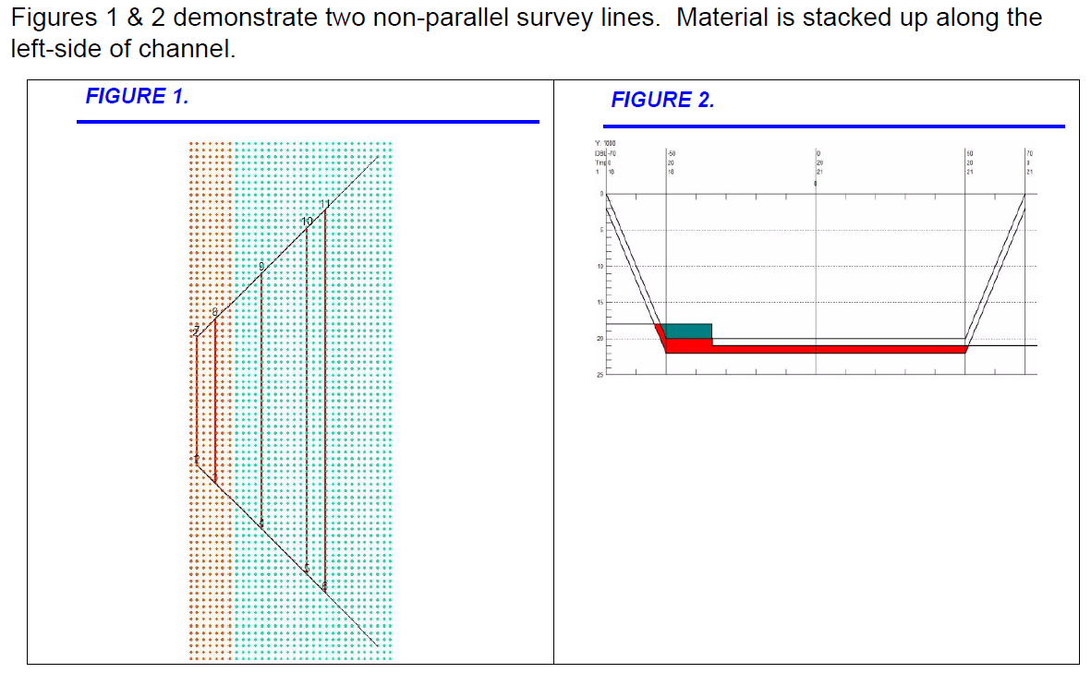
Variations in Volume Results
Computing the volumes in the four different methods result in the following total material above design:
TIN Standard 3181
HYPACK 3180
Philadelphia 3692
Method Average End Area 1 4454
Why did this happen? What’s the deal?
TIN MODEL utilizes all of the survey data by creating a series of triangles between sounding data that calculates the volume values individually within these connecting triangles for all the data points on each line. This coverage is so complete it sometimes creates a solid fill and in our opinion, gives the most accurate representation of your channel bottom.
This means that the TIN computes the volume for what the channel bottom is literally doing, reflecting total channel material, and does not miscalculate volume amounts by missing them in its computations.

Slide 4
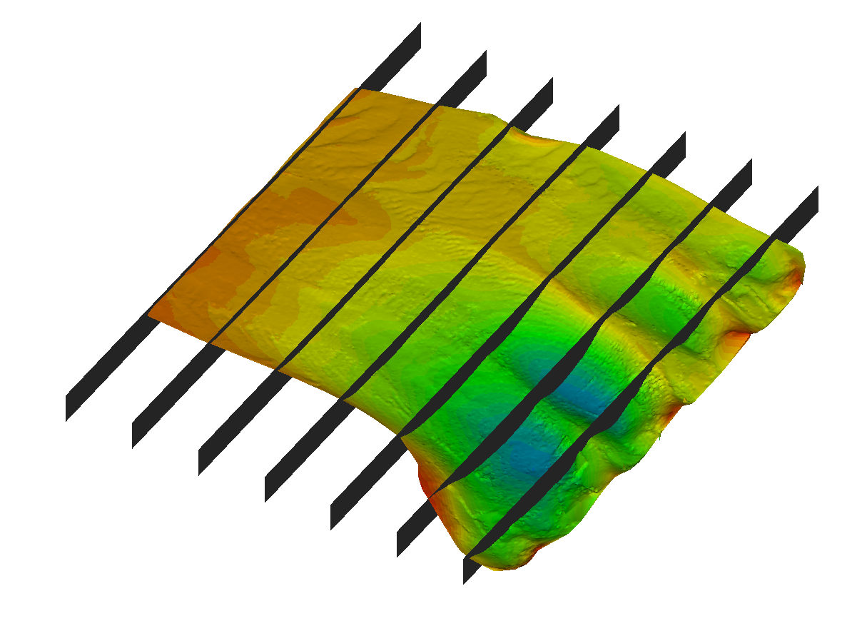
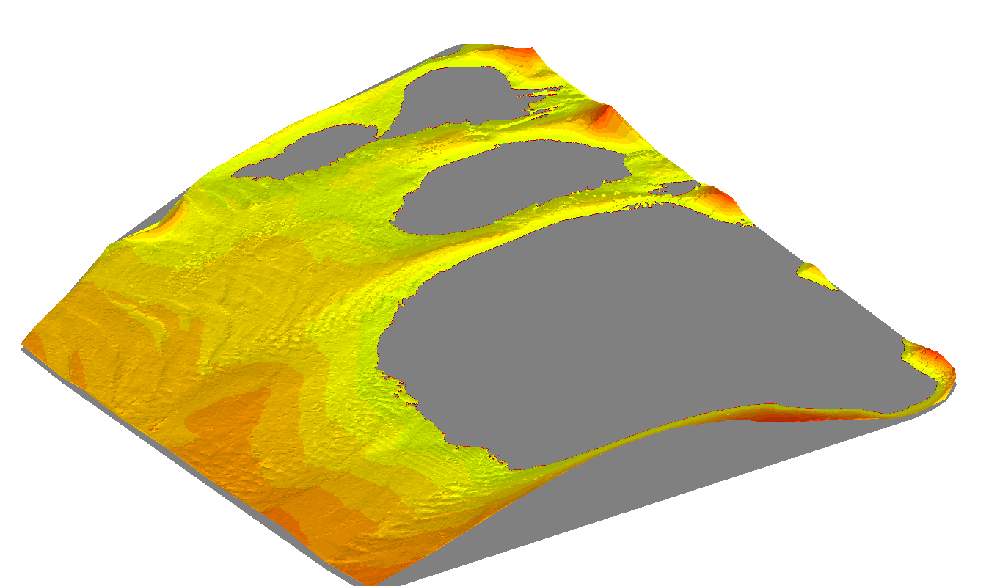
The Difference in CSV and TIN Model Volumes
Cross Sections and Volumes (CSV) uses several slices of data and interpolates the rest
TIN Model uses every sounding to create a surface and compare that with another surface or a level cut through the surface

Slide 5
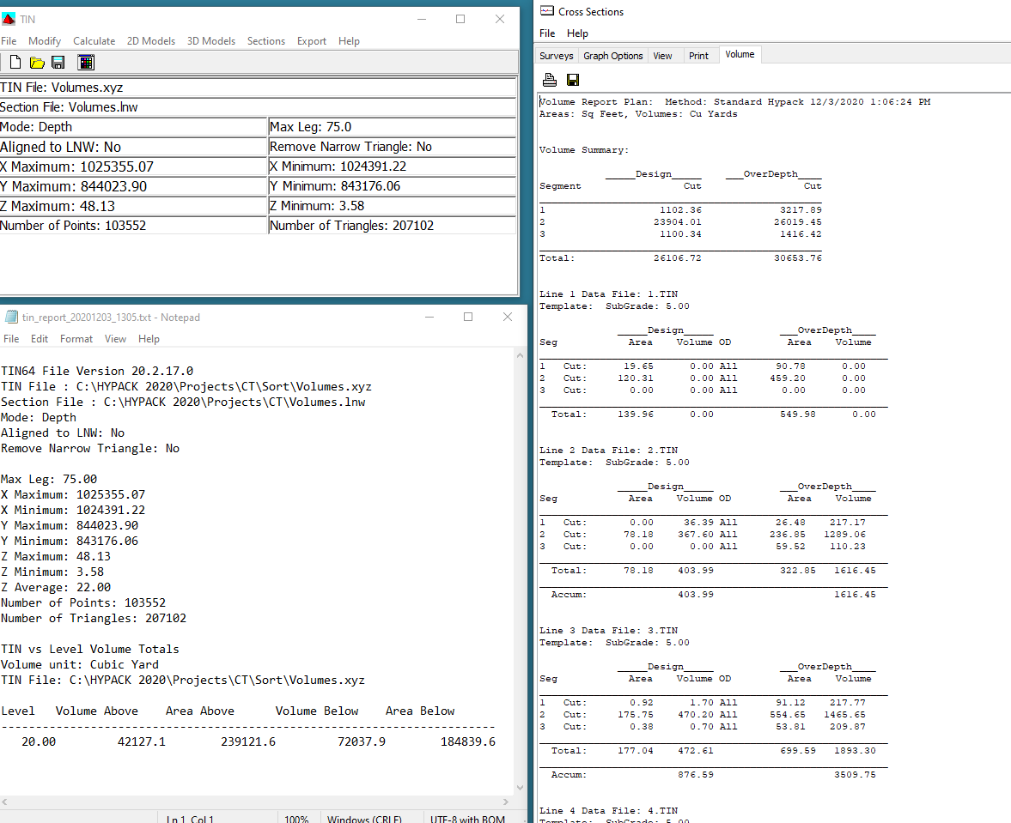
The Difference in CSV and TIN Model Volumes
In the example the volume above the 20 feet is 42,127 from TIN Model and 26,106.72 from CSV
The difference is that TIN Model in this case is calculating from the level without side slopes of all material and the CSV is interpreting across sections that are sloping due to scouring.

Slide 6
Basic Terminology

Slide 7
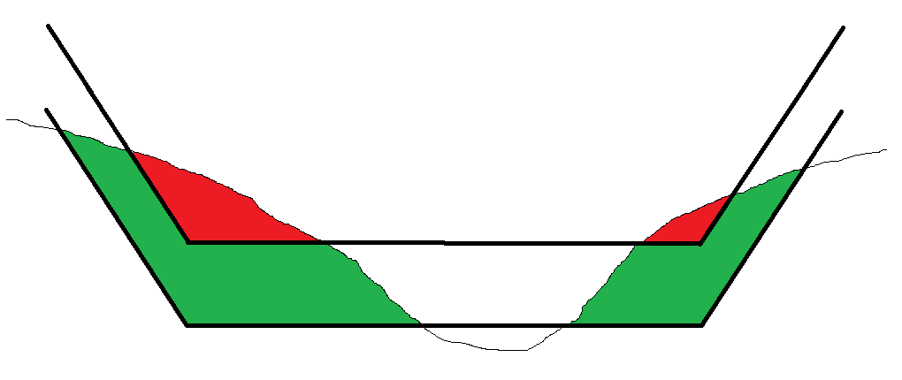
BASIC TERMINOLOGY
Channel Design Template
Channel Centerline
(not always in center of channel)
V
H
Side Slope Pitch expressed as ratio of H:V (e.g. 3:1)
Allowable Overdepth Template
Left Side Slope Left of Center Right of Center Right Side Slope
Material Above Design (Material Above Grade…)
Allowable Overdepth Material

Slide 8
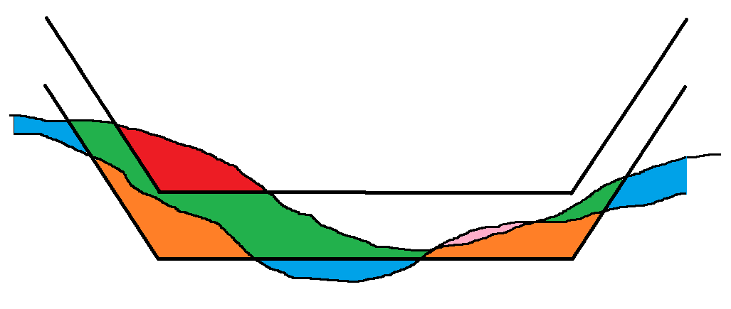
BASIC TERMINOLOGY
Overdredged material can be computed just beneath the allowable overdepth template, or to the extents of the survey data.
There can also be penalties based on overdredging!
Material Removed Above Design (Grade)
Material Removed in Allowable Overdepth
Overdredged Material
Remaining Material
Infill
Infill can occur above design, in the allowable overdepth, or beneath the allowable overdepth.
Is it natural or a result of the dredging operation?
Some contracts have penalties for
infill material!

Slide 9
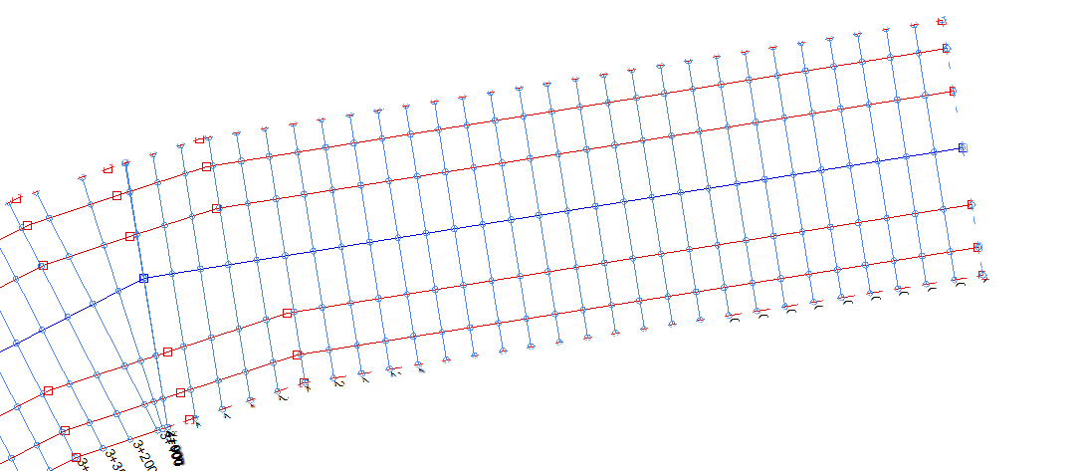
Chainage and Offset
Channel Origin
‘Chainage’ is the distance along the centerline.
Usually expressed in engineering notation (3240’ = 3+240 or 32+40).
Channel origins don’t always start at ‘0’.
‘Offset’ is normally positive to the right (looking towards increasing chainage).
Offset
Chainage

Slide 10
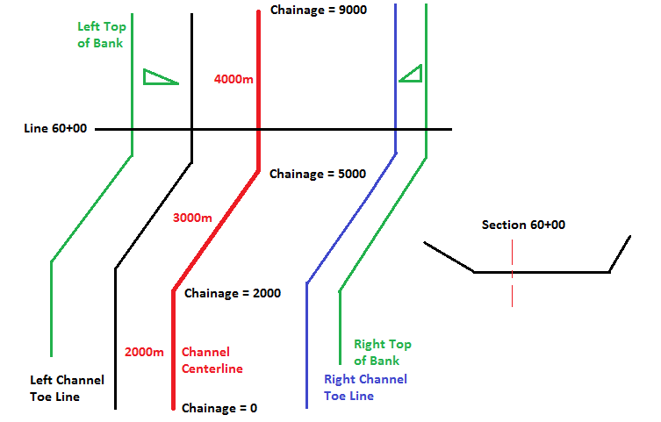
Volumes by Sections
CROSS SECTIONS AND VOLUMES (CSV)
The “centerline” is not always in the center of the channel.
The left side slope and right-side slope do not have to be equal.
The channel design depth, the channel overdepth, the left side slope, right side slope and channel width can all change as we progress along the channel.

Slide 11
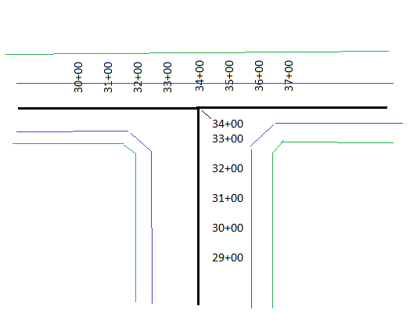
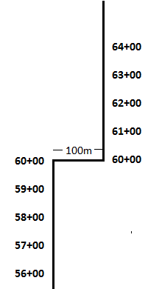
Weird Chainage Examples
Use a Border file to sub-divide volumes around complex corners!
The channel suddenly shifts sideways, and the chainage is unchanged!

Slide 12
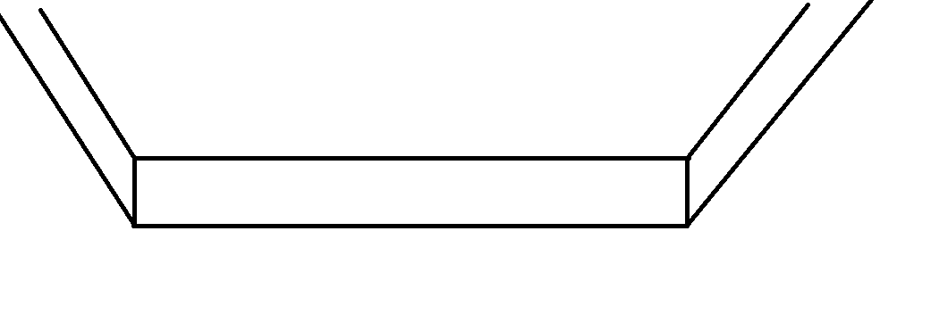
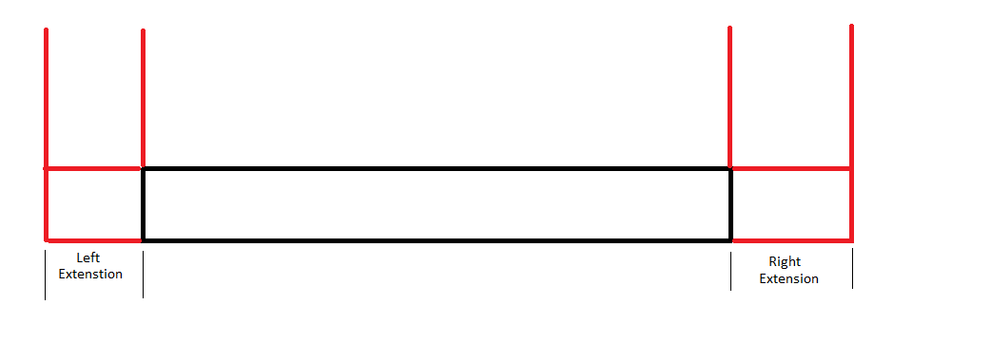
Box Cut Templates
The Philadelphia Methods in CSV (CROSS SECTIONS AND VOLUMES) and TIN MODEL can switch between a standard template (with side slopes) and a ‘Box Cut’ template.
  The ‘toe points’ of the section are fixed
  A separate Left and Right Extension can be applied outward from the toes

Slide 13
Gaps and Incomplete Coverage

Slide 14
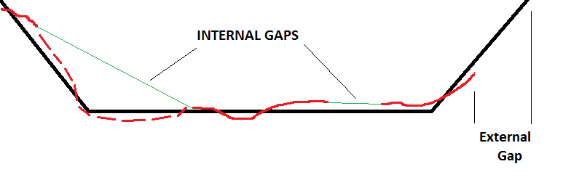
Gaps in Survey Data
INTERNAL GAPS: CSV will ‘interpolate’ depth values across internal gaps. It’s best that you check your data to see where they occur and how they will affect you.
Take extra caution with gaps that span the toe lines.
EXTERNAL GAPS: CSV does not ‘extrapolate’ trends to create data. The area computation stops where your data stops.
Danger!

Slide 15
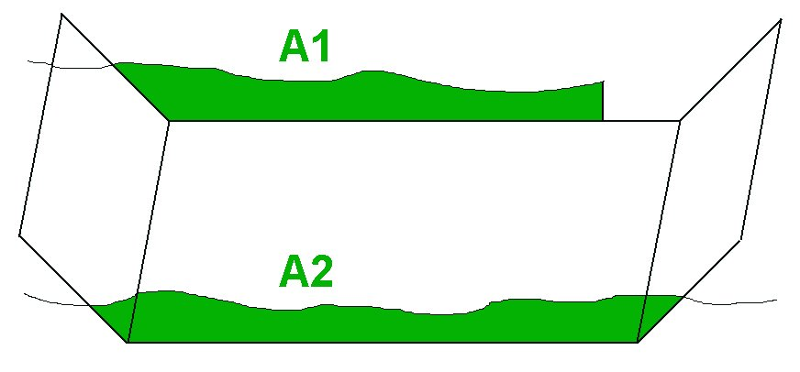
Incomplete Survey Data: Exterior Gaps
CSV does not create data or extrapolate trends on external gaps.
In the figure above: V = L * (A1 + A2) / 2.
The resulting volume would be less than the actual amount.

Slide 16
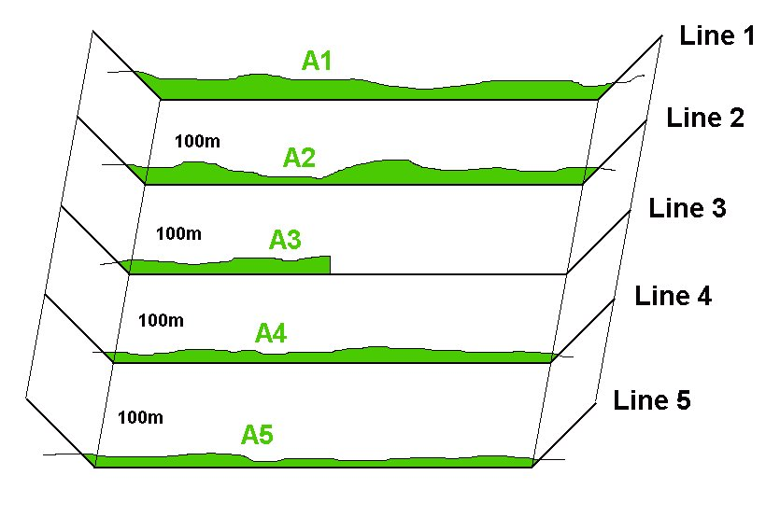
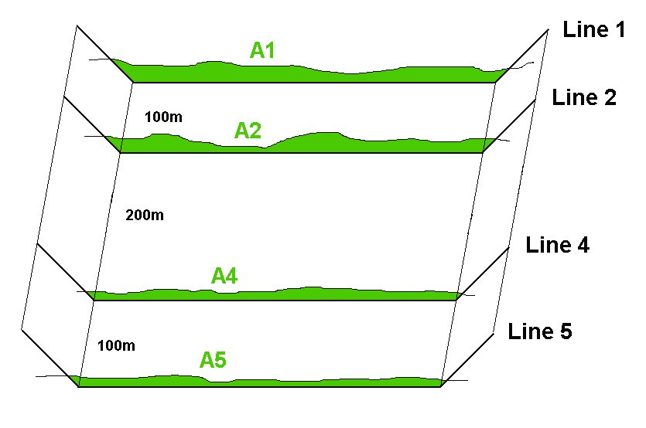
Incomplete Survey Data: Exterior Gaps
Line 3 has incomplete survey data.
CSV doesn’t care
  V23 = 100*(A2+A3)/2
  V34 = 100*(A3+A4)/2
  Since A3 is less than it should be, the volume quantity will also be less.
It might be more accurate to leave Line 3 out of the computation.
  V₂₄ = 200 * (A₂+A₄) / 2
  Better overall result if the sectional profiles are similar.

Slide 17
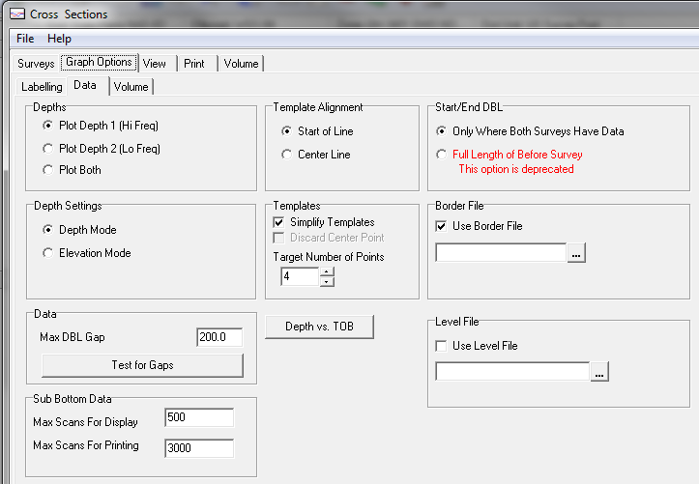

Checking for Gaps in Data
Probably your best course of action is to check your files for any external data gaps and then decide on how to proceed.
Graph Options – Data tab

Slide 18
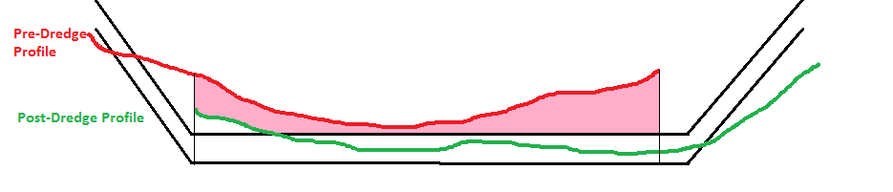
External Gap Handling in PostDredge
This is the ‘default’ setting and better than the other. However, it is not perfect.
Areas where I have coverage in both surveys : Computed
Areas where I only have coverage in the Before Survey : Ignored
Areas where I only have coverage in the After Survey : Ignored
Notes:
This is NOT a good option.
Areas where I have full coverage in both Before and After: Volume computation is OK.
Areas where I have coverage in just the Before survey: I get full credit for removing the material.
Areas where I only have coverage in the After survey: Ignored.

Slide 19
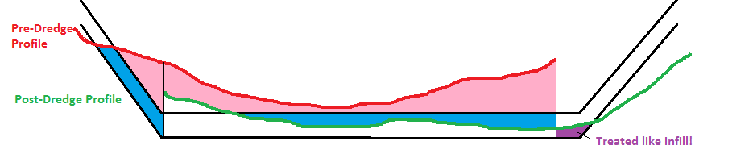
How about we calculate the material separately for each profile and then take the difference?
Not a good idea.
Areas where I have coverage in both surveys: Computed
Areas where I only have coverage in the Before Survey: Treated as removed
Areas where I only have coverage in the After Survey: Treated as infill

Slide 20
Contour vs Non-Contour Volumes

Slide 21
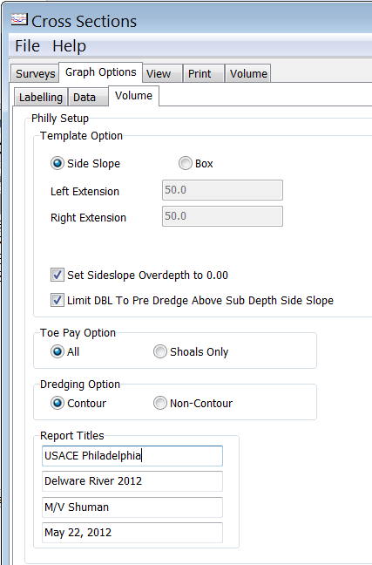
Contour vs. Non-Contour
Philadelphia Methods
Contour: Includes overdepth material only where the bottom is shallower than the channel design.
  Referred to as ‘Smart’ option in Standard HYPACK Method and ‘V2P’ in AEA Methods.
Non-Contour: Includes all overdepth material.
  Referred to as ‘All’ option in Standard HYPACK Method and would be ‘V2P + V2NP’ in AEA Methods.

Slide 22
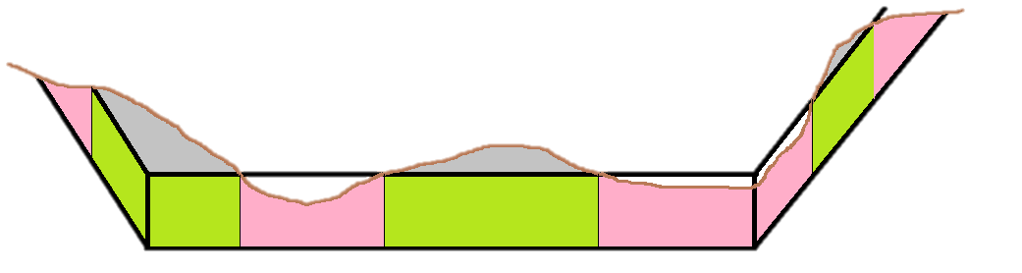
Classification of Allowable Overdepth
Some volume reports sub-divide the Allowable Over-depth material into two groups.
    Material where the bottom is above the Channel Design Template.
    Material where the bottom is beneath the Channel Design Template.
Non-Contour / Normal: Everything in over depth is paid
Contour / Smart : Only the green material is paid

Slide 23
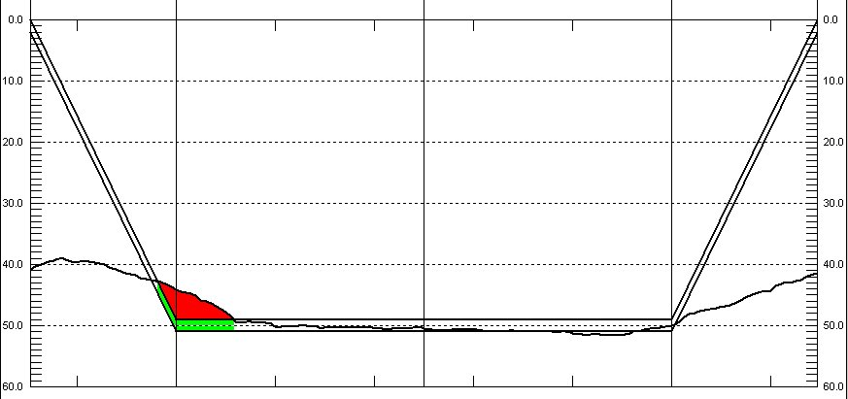
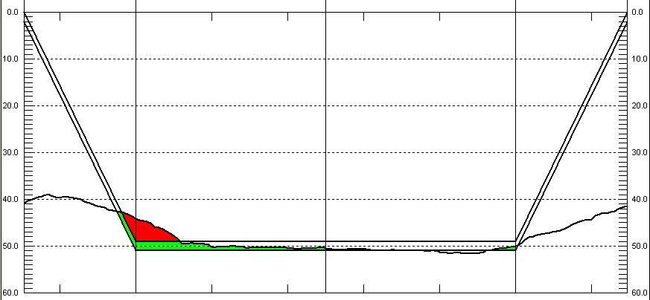
Contour Overdepth Material for Post-Dredge Survey
Overdepth
8,170 cyd
CONTOUR OVERDEPTH
It can make a BIG difference!
Note the ‘green’ material that is included to the right after the bottom drops below the design template….
NON-CONTOUR OVERDEPTH
Overdepth
27,035 cyd

Slide 24
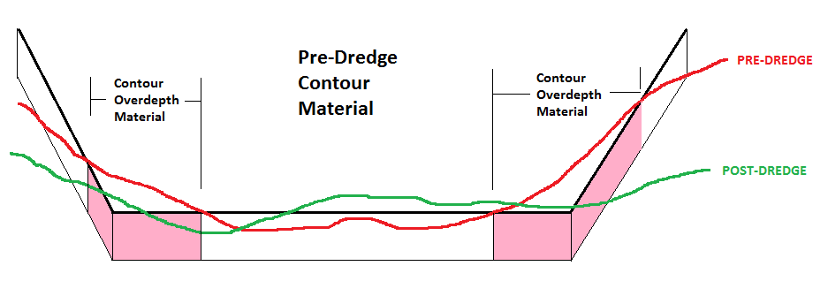
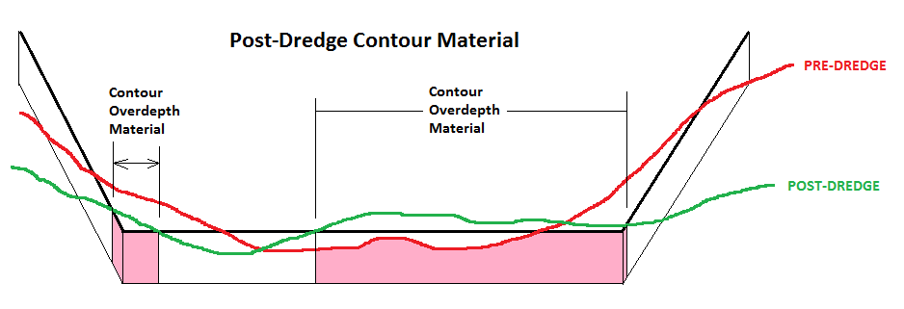

Contour Overdepth in Post-Dredge
You could compute the Contour Overdepth material base on the Pre-Dredge profile.
Then you could compute the Contour Overdepth material based on the Post-Dredge profile.
Then you could take the difference between the two.
But, you’d be wrong!

Slide 25
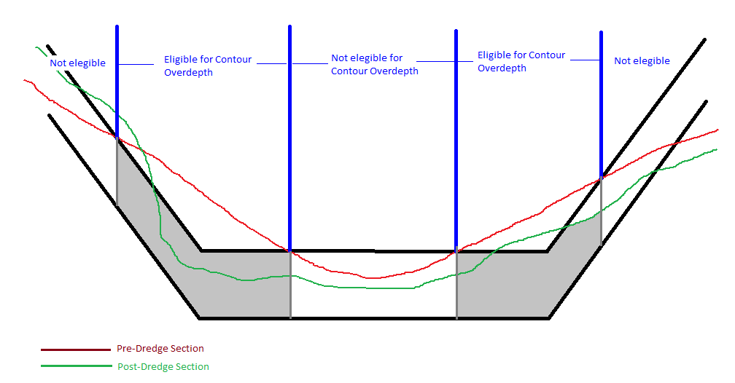

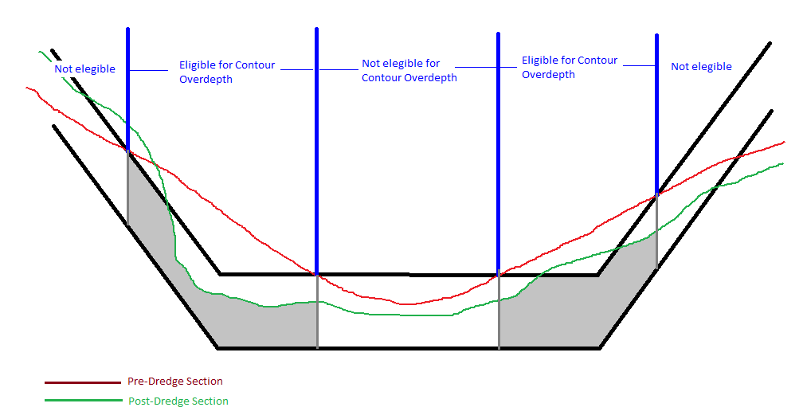
Contour Overdepth Material for Post-Dredge Survey
When computing the Contour Overdepth for the Post-Dredge section, you must use the limits established by the Pre-Dredge section.

Slide 26
TOE PAY OPTION
Philadelphia Method
Shoals Only: Includes overdepth material in extension area only if the depth at the toe line is shallower than the design depth.
All: Includes all overdepth material in the extension area.
This only is computed for the “Box” option.
We don’t know anybody who uses this option. Philadelphia COE doesn’t even use it anymore. We recommend you set it to ‘All’. (default)

Slide 27
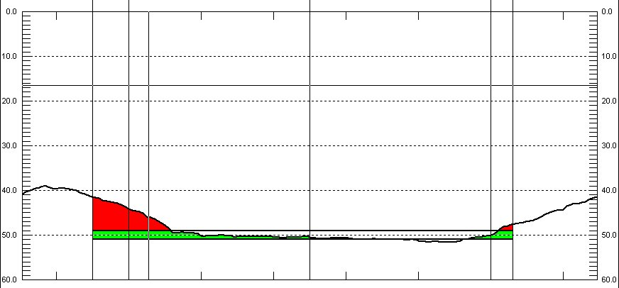
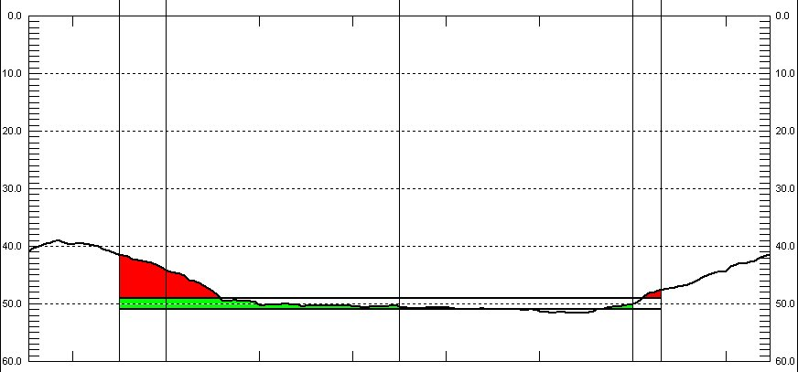
ALL vs Shoals Only
All: Includes all overdepth material in the extension area.
Shoals Only: Includes overdepth material in extension area only if the depth at the toe line is shoaler than the design depth.
All
Shoals Only

Slide 28
Understanding Infill

Slide 29
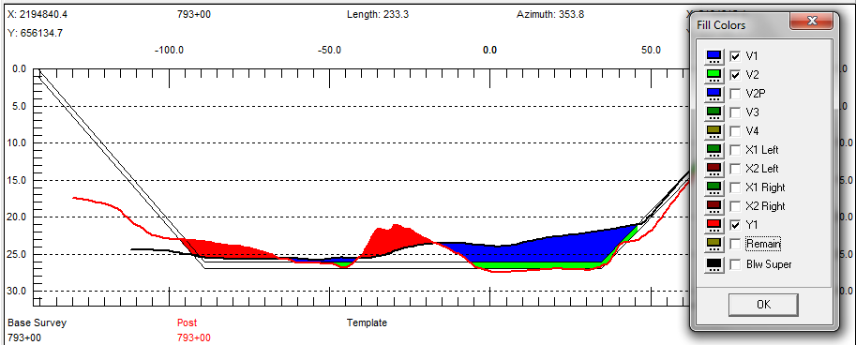
A Few Words About Infill
Maybe somebody moved stuff from A to B!
Maybe the infill is just due to natural sedimentation!
On what basis do you want to pay them (or get paid)!
B
A

Slide 30
Infill in Reports
Philadelphia Post Dredge Report
Dredging Quantities Summary
===========================
Materials Gross Material Infill Net Material
Total Removed To Project Depth ...... 5836.8 651.1 5185.7
Total Pay Removed In Overdepth ...... 2040.1 86.0 1954.0
Total Pay Removed ................... 7876.9 737.2 7139.7
Total Removed ....................... 9545.9 1764.5 7781.4
Total Remaining Above Project Depth . 1981.9 1981.9
Total Overdredged Material .......... 1669.0 1027.3 641.7
Total Infill Material ............... 1764.5
The Philadelphia Post Dredge report (above) has:
A ‘Gross Material’ column that just includes the amounts removed, without any Infill adjustment.
An ‘Infill’ column that shows the computed Infill for each quantity.
A ‘Net Material’ column that is ‘Gross Material’ minus ‘Infill’.
If the infill is due to natural sedimentation, then use the Gross Material column. If the Infill is due to the dredging process, then use the Net Material column.

Slide 31
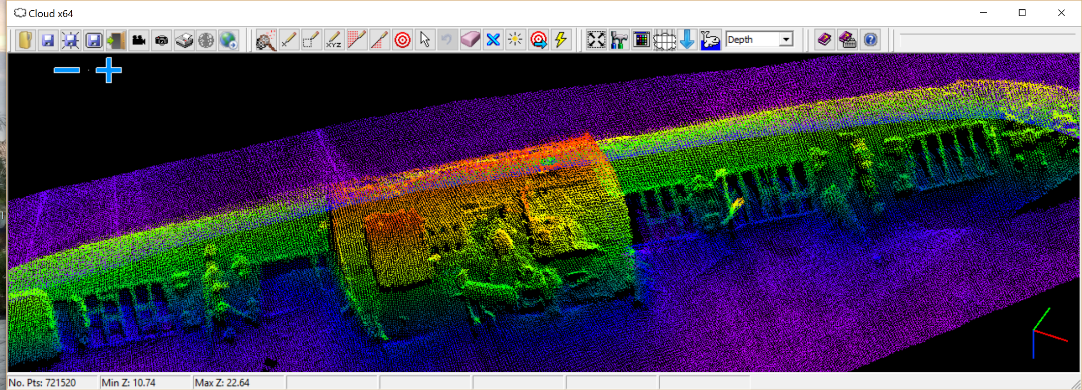
TIN MODEL VOLUMES

Slide 32
TIN MODEL Volumes
TIN = Triangulated Irregular Network.
Volumes by TIN MODEL
  Triangles are created between exact X-Y-Z data points
  There is no ‘gridding’ going on in TIN MODEL
  The exact volume of each triangle above/below the design surface is computed

Slide 33
TIN TO LEVEL
(Reservoir Calculation)

Slide 34
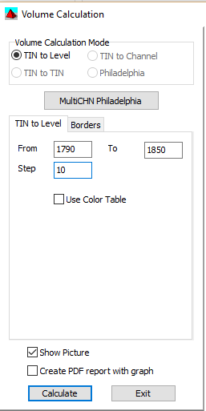
TIN to Level Settings
Select “TIN to Level”
Set the Minimum (From) and Maximum (To) Z-values, along with the Step (Increment).
Show Picture gives visual feedback. It slows things down a lot with TIN to Level.
Create PDF report with graph is a new option in HYPACK 2016.
Results are saved to a TXT file in the Project folder.
  Every time you start TIN MODEL, a new TXT file is created.
Input File | SSS.XYZ
TIN Max Side | 200
Z-Mode | Elevation
Volumes: | TIN to LEVEL
Levels: | 1790 to 1850 by 10

Slide 35
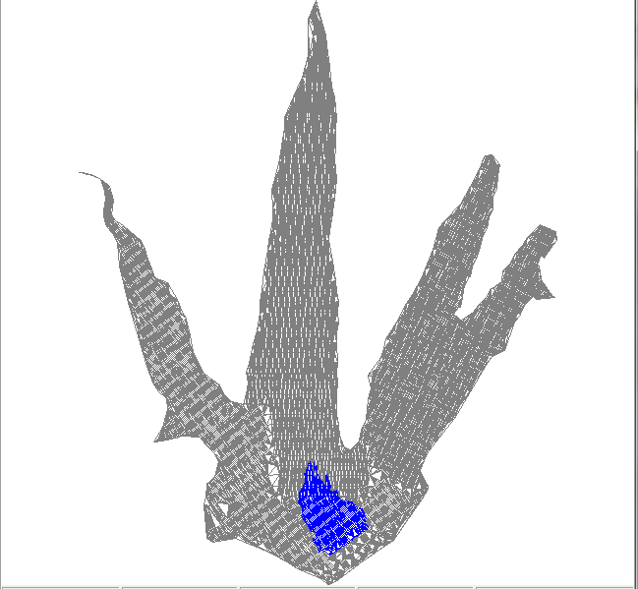
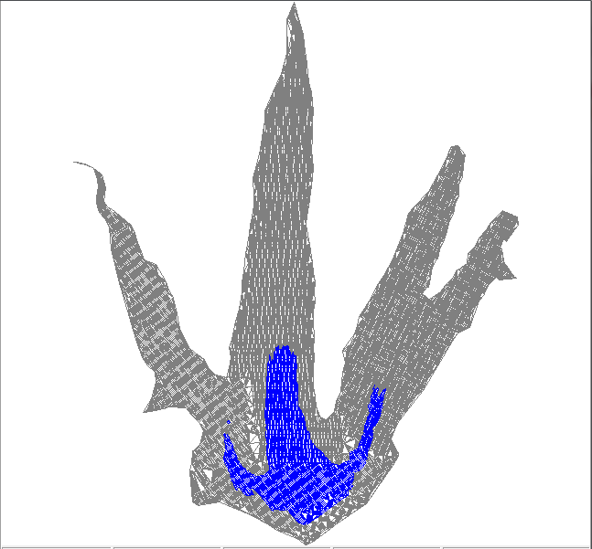
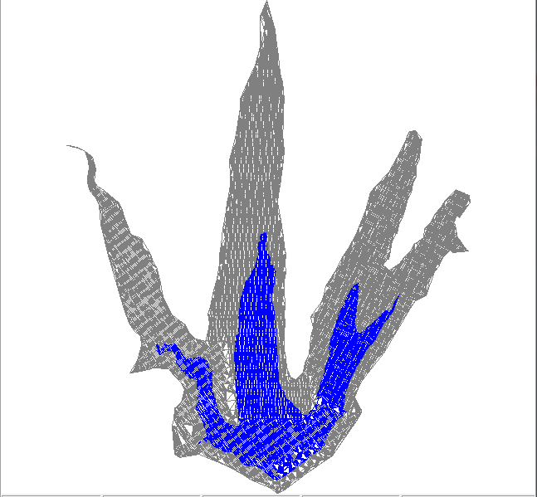
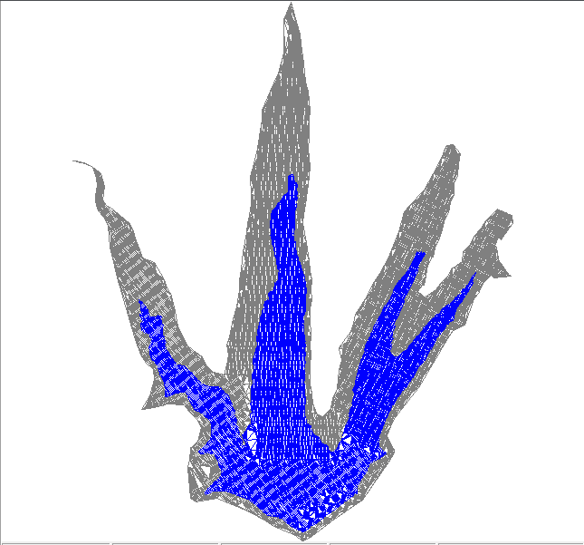
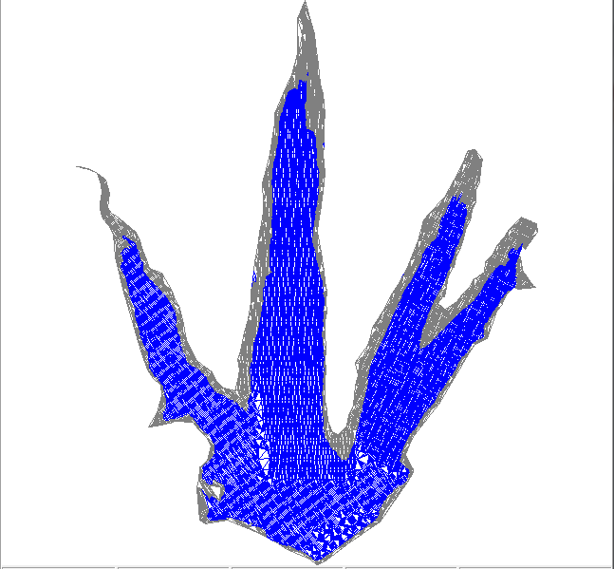
TIN TO LEVEL
Computes the volume of water and the surface area of the ‘pool’ as the water level varies between used defined limits.
W.L. = 1800’ MSL
W.L. = 1810’ MSL
W.L. = 1820’ MSL
W.L. = 1830’ MSL
W.L. = 1840’ MSL
Volume unit: Cubic Yard
TIN vs Level Volume Totals
TIN File: C:\HYPACK 2010\Projects\VOLUME CLASS\Sort\SSS.xyz
Level Volume Above Area Above Volume Below Area Below
------------------------------------------------------------------------
1790.0 1862942.2 1294355.2 0.0 0.0
1800.0 1388139.1 1243780.9 4587.7 50574.4
1810.0 948598.2 1111184.9 44437.7 183170.3
1820.0 569947.4 934024.9 145177.7 360330.4
1830.0 258080.3 729400.7 312701.4 564954.6
1840.0 53980.9 352777.3 587992.8 941578.0
Your results may differ, depending on how you edited the edge of the reservoir….
Water Level
Volume of Pool
Surface Area of Pool

Slide 36
TIN TO LEVEL - VERTICAL DIRECTION in elevation mode
Your ‘Volume Above ‘is actually your ‘Volume Below’, and vice versa.
Not good……
Depth Data in Depth Mode
Depth Data in Elevation Mode
Volume unit: Cubic Yard
TIN vs Level Volume Totals
TIN File: C:\HYPACK 2010\Projects\VOLUME CLASS\Sort\TTT.XYZ
Level Volume Above Area Above Volume Below Area Below
------------------------------------------------------------------------
50.0 67928.3 171105.4 2721078.6 1468396.2
60.0 141839.6 226405.7 2187767.0 1413095.9
70.0 236790.1 288352.6 1675494.7 1351149.0
80.0 356760.0 360494.4 1188241.7 1279007.2
90.0 506226.9 458859.8 730485.8 1180641.8
100.0 722789.6 767772.3 339825.7 871729.3
110.0 1111091.1 1349108.5 120904.5 290393.1
120.0 1645057.6 1488999.8 47648.1 150501.8
130.0 2208077.7 1567501.0 3445.4 72000.6
Volume unit: Cubic Yard
TIN vs Level Volume Totals
TIN File: C:\HYPACK 2010\Projects\VOLUME CLASS\Sort\TTT.XYZ
Level Volume Above Area Above Volume Below Area Below
------------------------------------------------------------------------
50.0 2721078.6 1468396.2 67928.3 171105.4
60.0 2187767.0 1413095.9 141839.6 226405.7
70.0 1675494.7 1351149.0 236790.1 288352.6
80.0 1188241.7 1279007.2 356760.0 360494.4
90.0 730485.8 1180641.8 506226.9 458859.8
100.0 339825.7 871729.3 722789.6 767772.3
110.0 120904.5 290393.1 1111091.1 1349108.5
120.0 47648.1 150501.8 1645057.6 1488999.8
130.0 3445.4 72000.6 2208077.7 1567501.0

Slide 37
TIN TO TIN DIFFERENCE

Slide 38
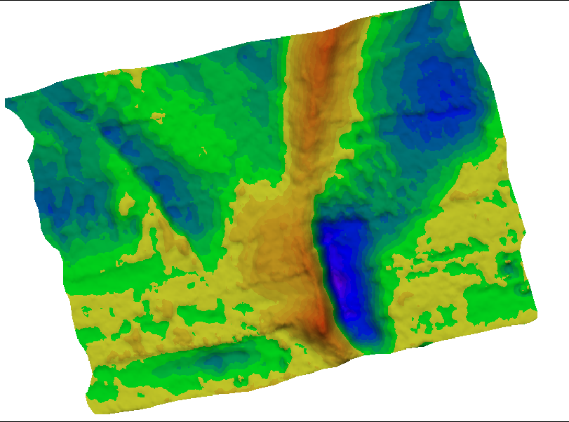
TIN TO TIN DIFFERENCE
Light Green to Blue: Gained Material
Yellow to Orange: Lost Material
Used to determine the difference between two surfaces.
  Where have I lost material?
  Where have I gained material?
  Has there been a net gain or loss between the two surveys?

Slide 39
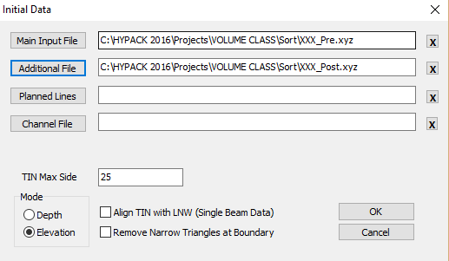
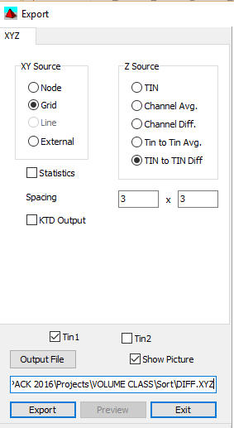
Step 1: Make a Difference File
Earlier survey goes in the “Input File” slot.
Later survey goes in the “Additional File” slot.
Node: Creates an X,Y, Difference point at each node in each data set.
Grid: Creates an X,Y, Difference point at a user defined interval.

Slide 40
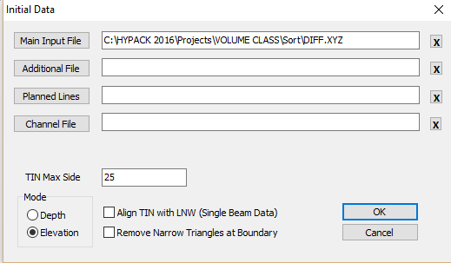
Step 2: Load the Difference File into TIN MODEL
Difference File
Set Mode to Elevation
Note: Let’s say your earlier survey showed a depth of 25’ at a point and the later survey shows a depth of 23’ at the same point. The ‘Difference’ file will have a z-value of +2.0’, as you accumulated 2’ of material at that point since the 1st survey.
Since accumulations are positive differences, you need to tell the TIN MODEL that you are in Elevation Mode when loading a Difference file.

Slide 41
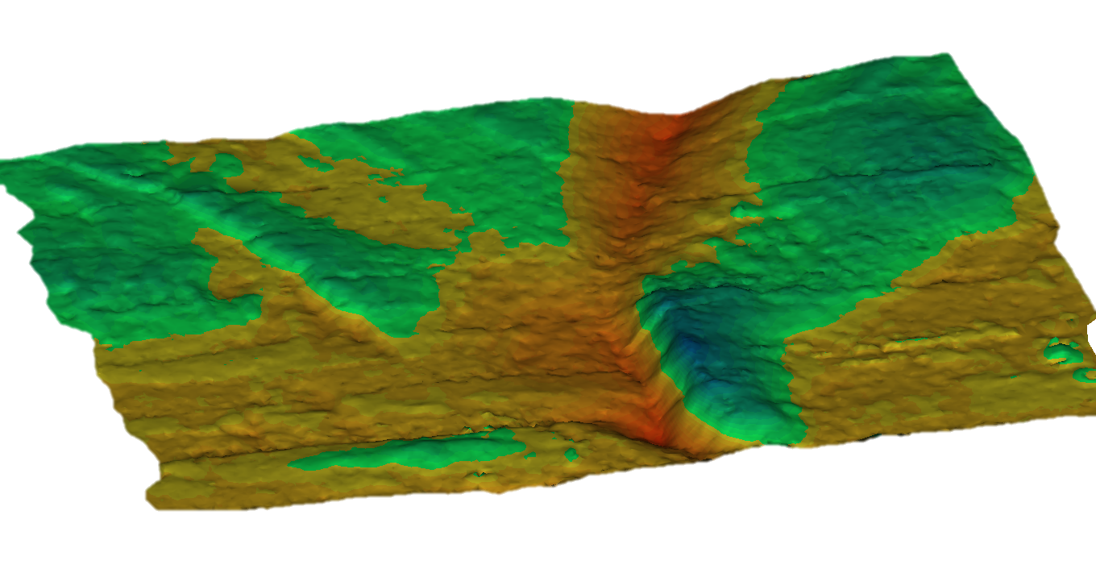
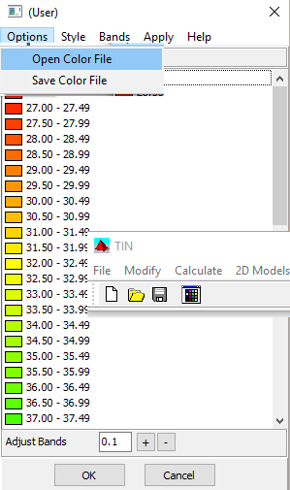
Step 3: View 3D Color Model
We set the color ranges so that -15 to 0.0 are shades of red/yellow and 0.0 to +15 are shades of green/blue.
Click the color icon.
Options – Open Color File
  Select DIFF.HCF

Slide 42
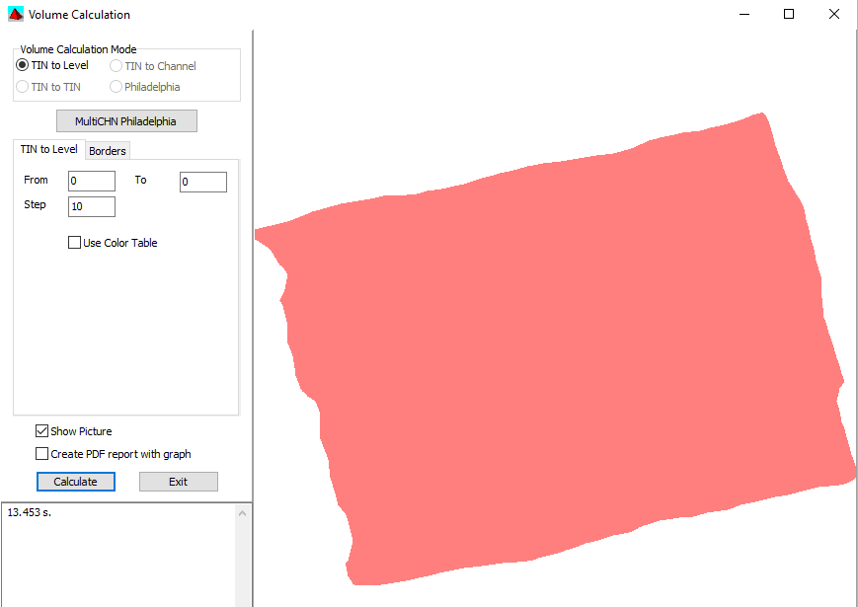
Step 4: Net Accumulation or Loss?
Volumes | TIN to Level
Levels: | 0 to 0
Step | 1 (Doesn’t matter)
Compute the volumes for the Difference File above/below the 0.0 level.
TIN to LEVEL: Set both “To” and “From” levels to “0”.
Volume Above = 14,892 cyd
Volume Below = 5,958 cyd
Net Gain = 8,934 cyd
Volume Above represents regions where we have gained material.
Volume Below represents areas where we have lost material.

Slide 43
Stock Pile Volumes

Slide 44
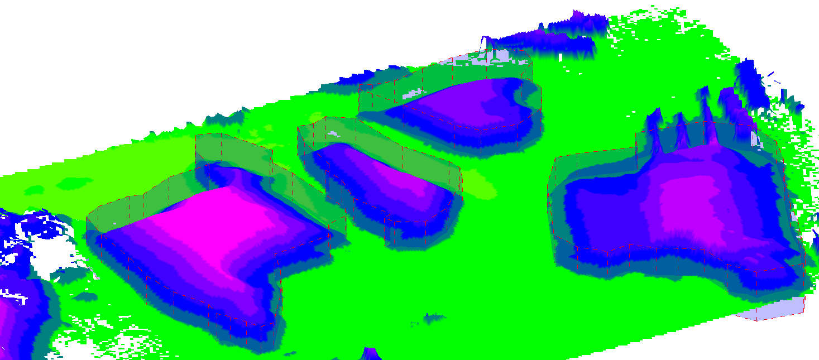
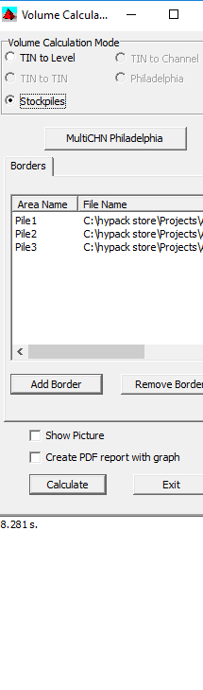
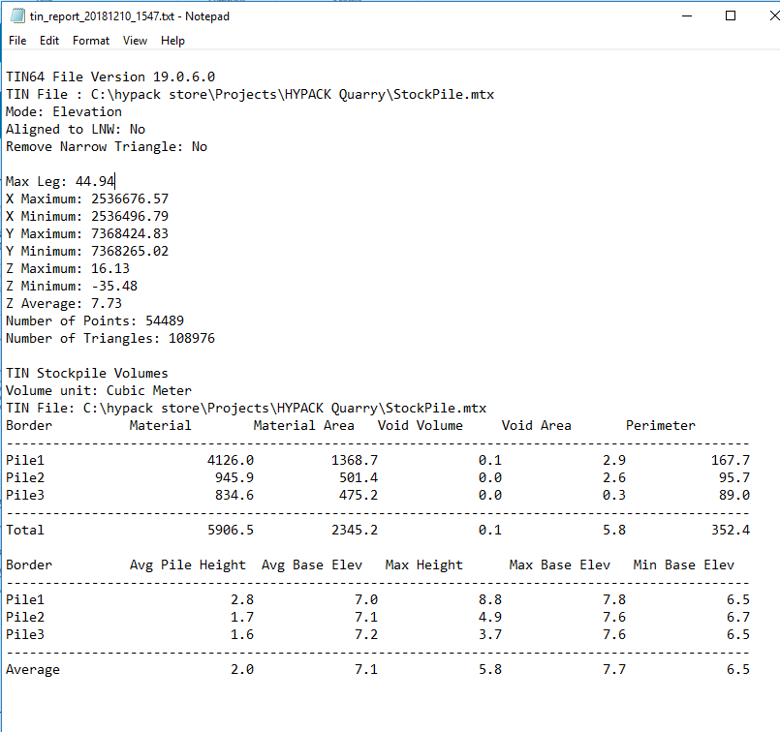
Stock Pile Volumes
To begin the stockpile volume, a border file is required for each pile to be computed
Each pile is computed separately: Volume, Void, Perimeter and Area are computed for each border

