Slide 1
Volumes

Slide 2
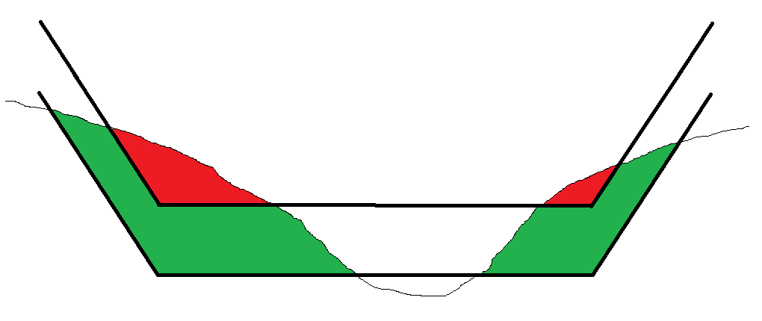
BASIC TERMINOLOGY
Channel Design Template
Channel Centerline
(not always in center of channel)
V
H
Side Slope Pitch expressed as ratio of H:V (e.g. 3:1)
Allowable Overdepth Template
Left Side Slope Left of Center Right of Center Right Side Slope
Material Above Design (Material Above Grade…)
Allowable Overdepth Material

Slide 3
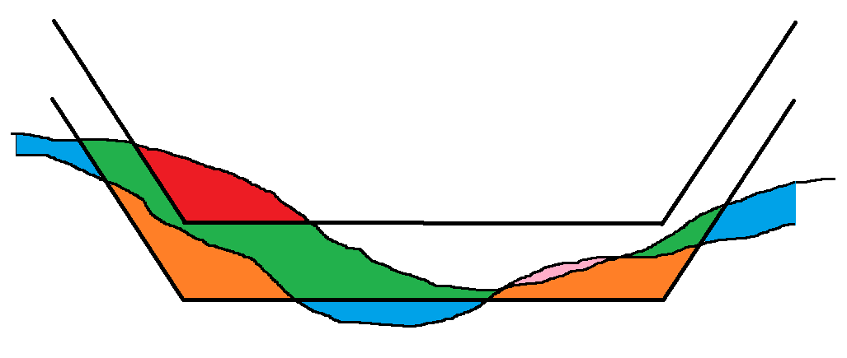
BASIC TERMINOLOGY
Overdredged material can be computed just beneath the allowable overdepth template, or to the extents of the survey data.
There can also be penalties based on overdredging!
Infill can occur above design, in the allowable overdepth, or beneath the allowable overdepth.
Is it natural or a result of the dredging operation?
Some contracts have penalties for
infill material!
Material Removed Above Design (Grade)
Material Removed in Allowable Overdepth
Overdredged Material
Remaining Material
Infill

Slide 4
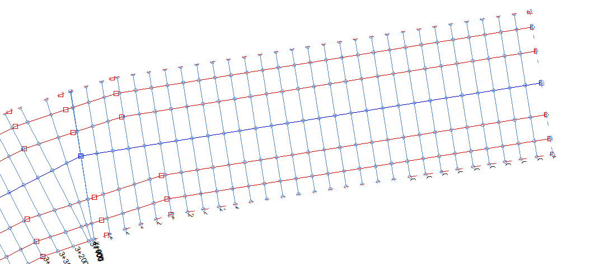
Chainage and Offset
‘Chainage’ is the distance along the centerline.
Usually expressed in engineering notation.
(3240’ = 3+240 or 32+40)
Channel origins don’t always start at ‘0’.
‘Offset’ is normally positive to the right (looking towards increasing chainage).
Channel Origin
Offset
Chainage

Slide 5
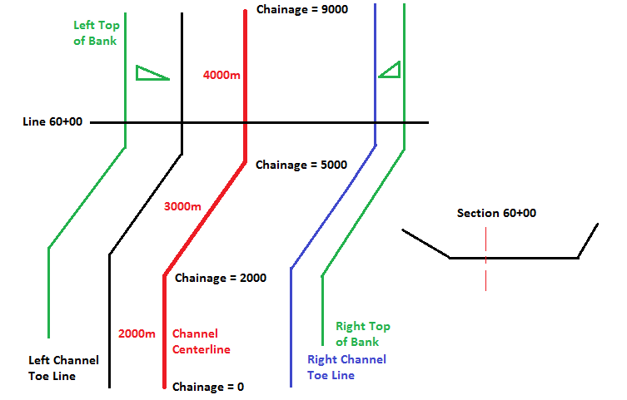
Volumes by Sections
CROSS SECTIONS AND VOLUMES Program (CSV)
The “centerline” is not always in the center of the channel.
The left side slope and right-side slope do not have to be equal.
The channel design depth, the channel overdepth, the left side slope, right side slope and channel width can all change as we progress along the channel.

Slide 6
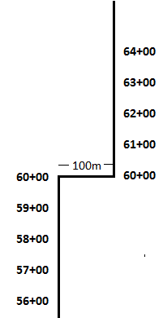
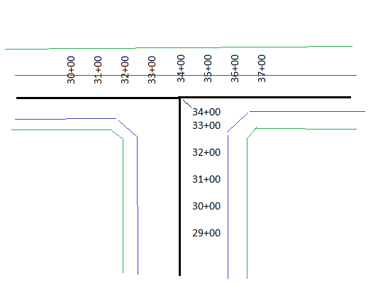
Weird Chainage Examples
Use a Border file to sub-divide volumes around complex corners!
The channel suddenly shifts sideways, and the chainage is unchanged!

Slide 7
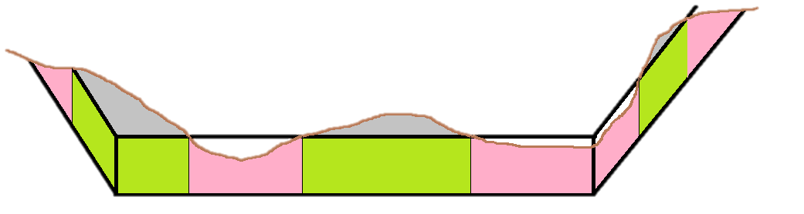
Classification of Allowable Overdepth
Some volume reports sub-divide the Allowable Overdepth material into two groups.
    Material where the bottom is above the Channel Design Template.
    Material where the bottom is beneath the Channel Design Template.
Non-Contour / Normal: Everything in overdepth is paid
Contour / Smart : Only the green material is paid

Slide 8
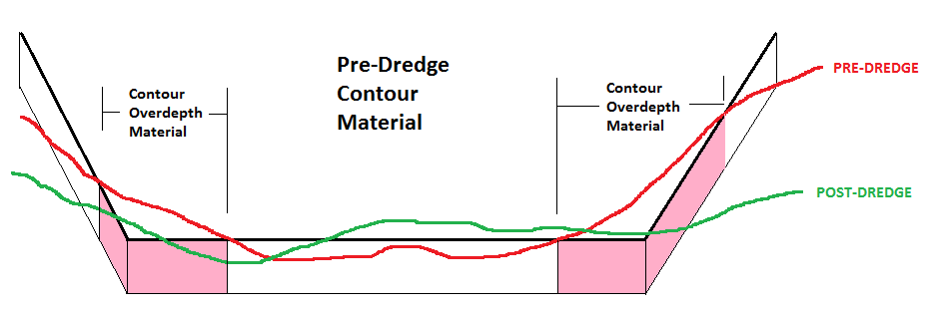
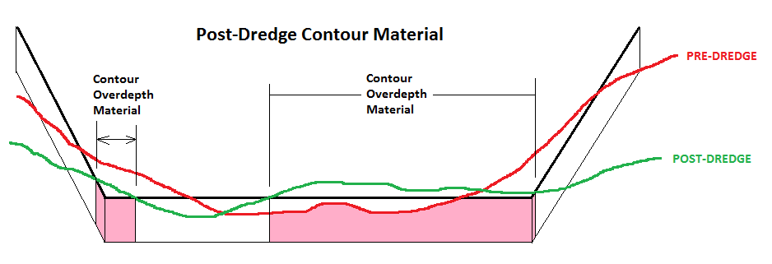
Contour Overdepth in PostDredge
You could compute the Contour Overdepth material based on the Pre-Dredge profile.
Then you could compute the Contour Overdepth material based on the Post-Dredge profile.
Then you could take the difference between the two.
But, you’d be wrong.

Slide 9
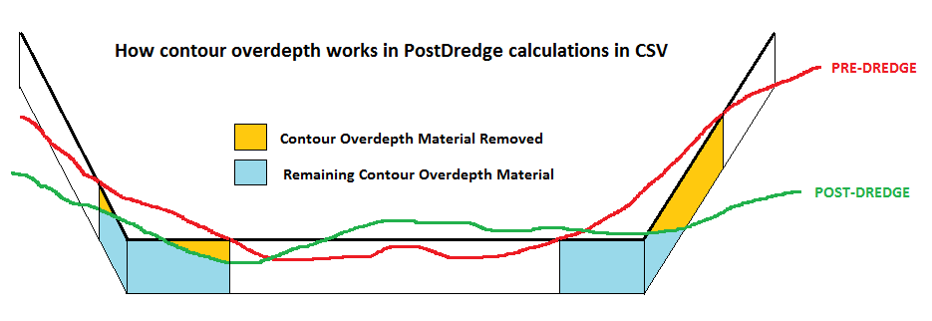
Contour Overdepth in PostDredge Calculations
Limits are set where material can be considered to be contour overdepth, based on the Pre-Dredge profile. The Post-Dredge computation is restricted to these limits.
Volumes tab:
Overdepth material removed outside these limits can be included or ignored!
Infill that occurs outside this area can be included or ignored.

Slide 10
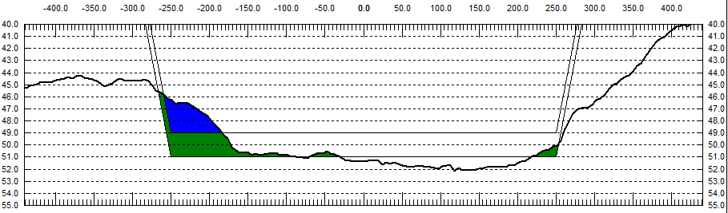
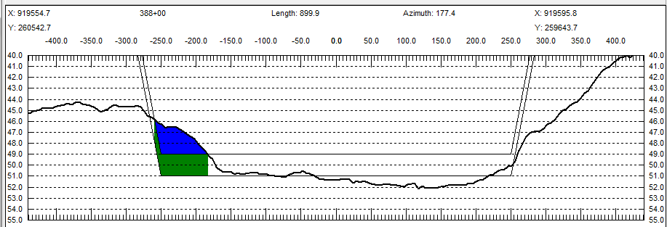
Differences in Allowable Overdepth
Non-Contour Overdepth
Overdepth
27,035 cyd
It can make a BIG difference!
Contour Overdepth
Overdepth
8,170 cyd

Slide 11
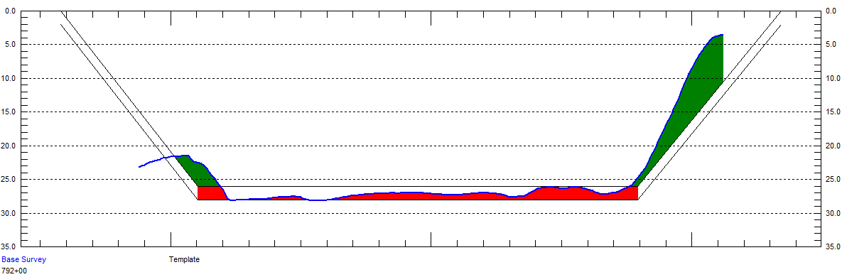
No Overdepth on Side Slopes
Some methods allow you to ignore the Overdepth material on the Side Slopes.
  This is typically an option that can be turned on and off.

Slide 12
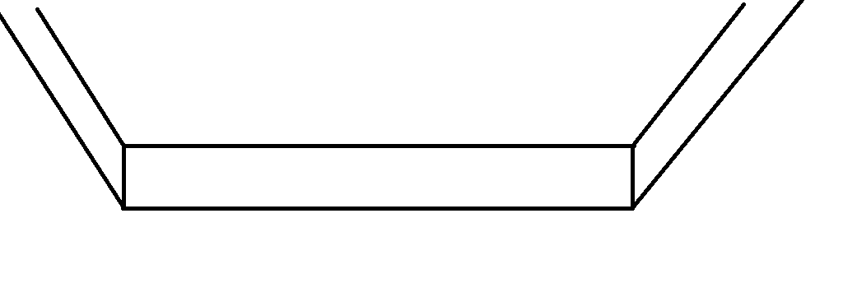
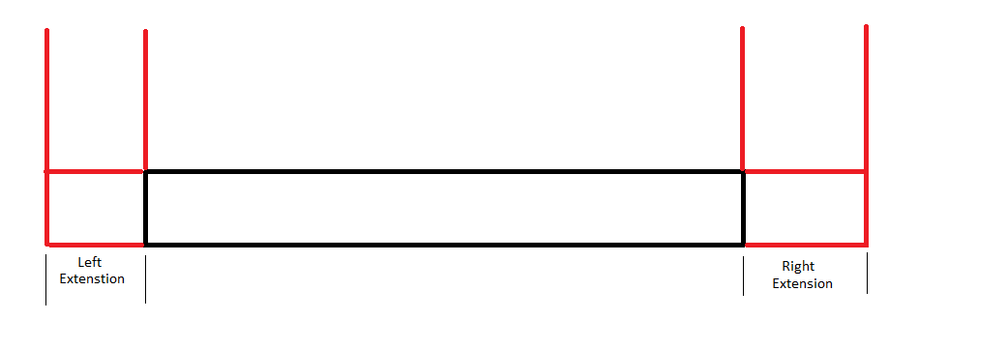
Box Cut Templates
The Philadelphia Methods in CSV (CROSS SECTIONS AND VOLUMES) and TIN MODEL can switch between a standard template (with side slopes) and a ‘Box Cut’ template.
  The ‘toe points’ of the section are fixed
  A separate Left and Right Extension can be applied outward from the toes
Left
Extension

Slide 13
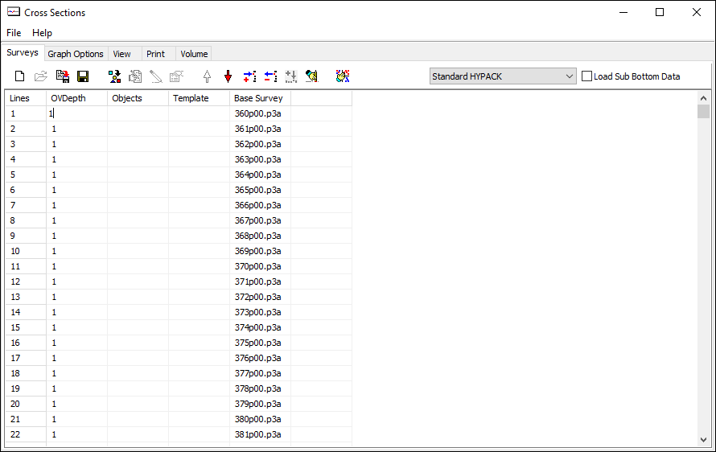
CROSS SECTIONS AND VOLUMES
Quick Tour
Surveys Tab: Select your method, enter the files, specify the offset to the overdredge template.

Slide 14
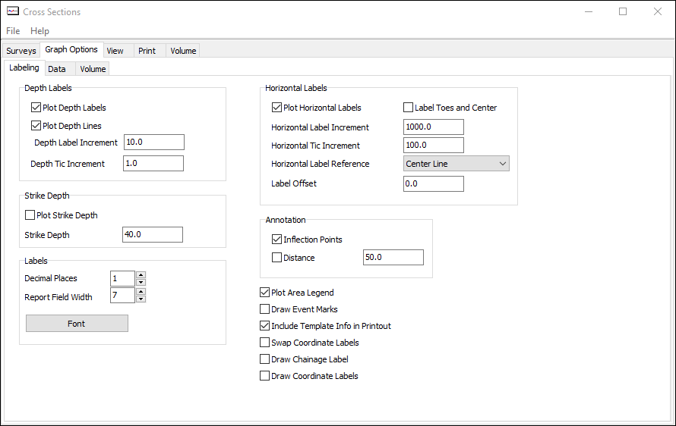
CROSS SECTIONS AND VOLUMES
Quick Tour
Graph Options Tab: Sub-tabs to set labeling options, data handling and settings for different volume methods.

Slide 15
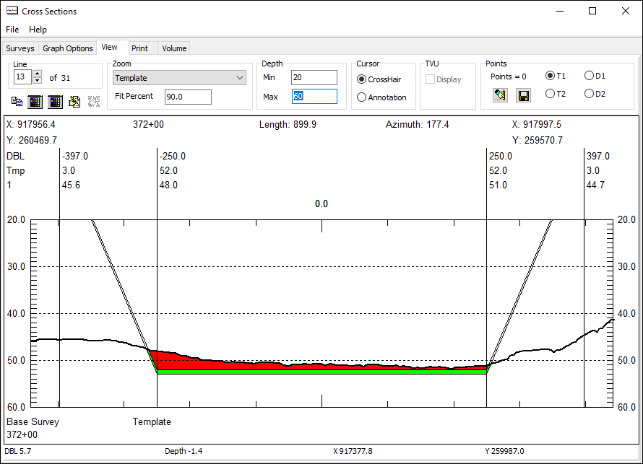
CROSS SECTIONS AND VOLUMES
Quick Tour
View Tab: Graphical and optional text info about each section.

Slide 16
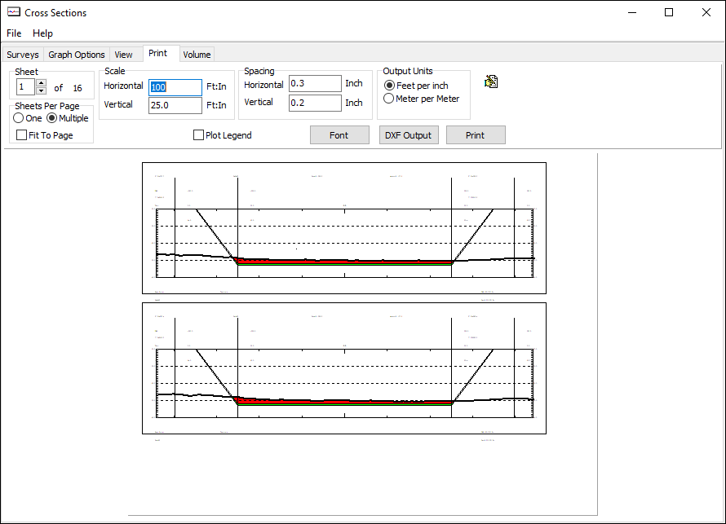
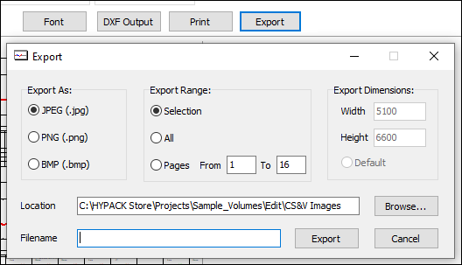
CROSS SECTIONS AND VOLUMES
Quick Tour
Print Tab:
Configuration for export to printer/plotter.
Export DXF and Image files.

Slide 17
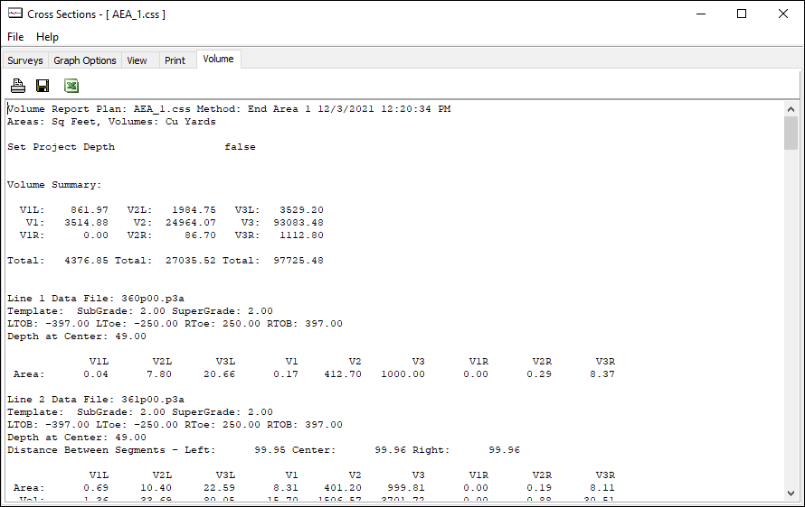
CROSS SECTIONS AND VOLUMES
Quick Tour
Volume Tab:
Text report. Different for each method.
Saves to TXT and XLS formats.

Slide 18
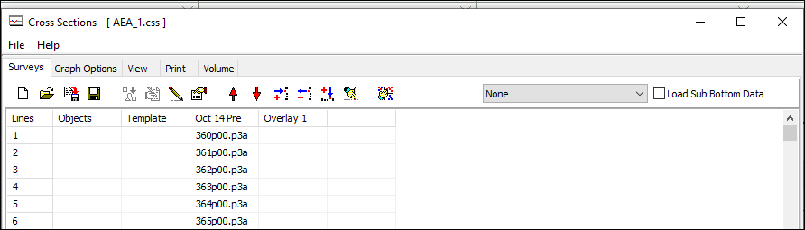
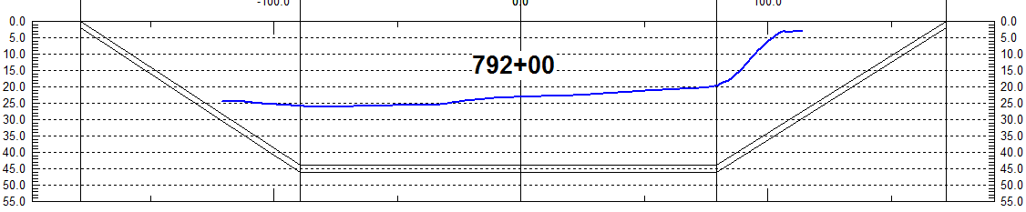
Sectional View with No Volumes
Set Method = ‘None’’
Cross sections and templates are displayed, but no volumes are computed.

Slide 19
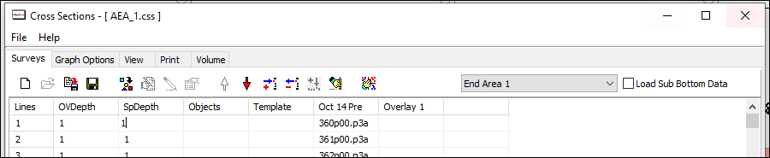
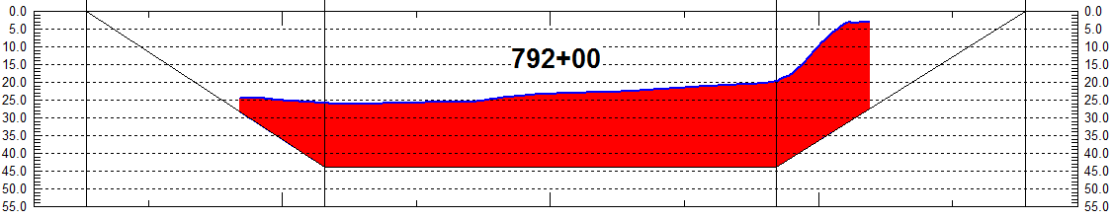
Single Survey Volume Computations
Volume quantities are now computed, using the info in the Surveys and Graph Option tabs.

Slide 20
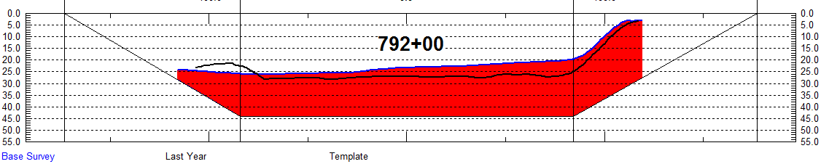
Single Survey Volume with Overlays
Sort Files Button: Important!
Just keep adding older surveys to the columns to the right. Volume comps will be done only using the Base Survey column.

Slide 21
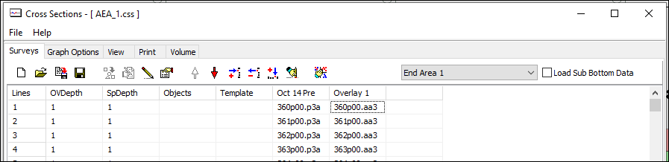
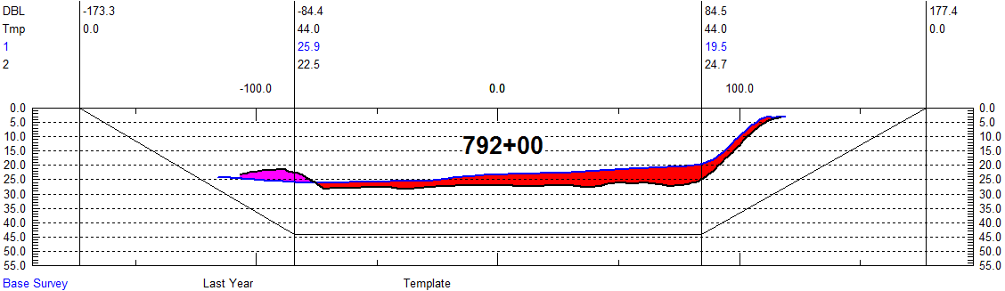
PreDredge vs. PostDredge
Always ‘Sort’ the file list to make sure the lines are the same.
Select a method with a ‘3’ or the word ‘PostDredge’.

Slide 22
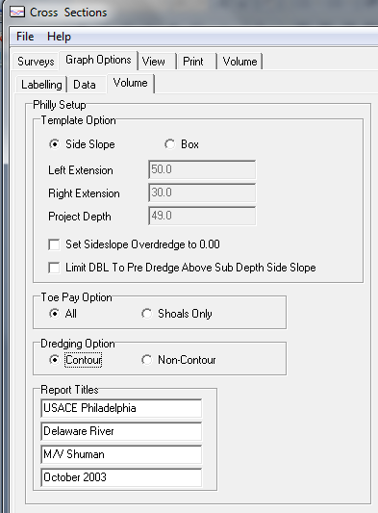
Contour vs. Non-Contour
Non-Contour Results
Total Material To Project Depth: 7,172 CY
Total Allowable Overdepth: 4,154
Total Pay Place 11,327
Contour Results
Total Material To Project Depth: 7,172 CY
Total Allowable Overdepth: 3,721
Total Pay Place 10,894

Slide 23
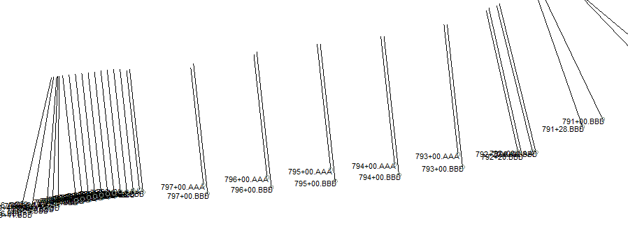
Mismatched Pre-Dredge and Post-Dredge Lines
What do you do if your Pre-Dredge and Post-Dredge planned lines don’t match?
The best option is to take one data set into the TIN MODEL along with your final planned line file (LNW) and create new Edited ALL format data with the correct templates!

Slide 24
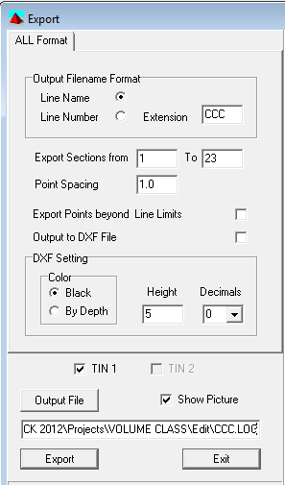
How to Fix This
Use the TIN MODEL to create a surface model of your data.
Use the Planned Line file (*.LNW) from your good data set and cut sections for each profile using TIN MODEL’s Export – All Format function.
Run CSV using the LOG file created in TIN MODEL.

Slide 25
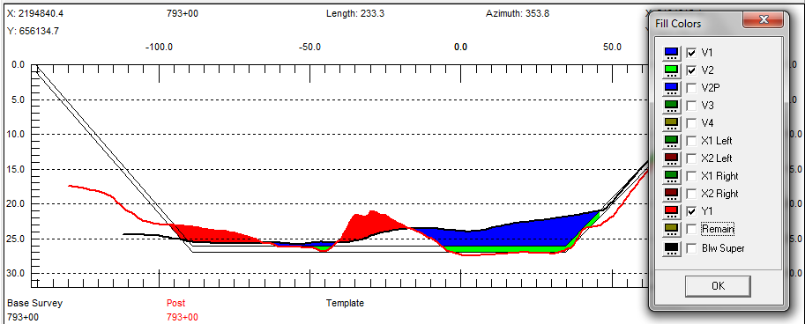
Looking at the Profile View
Pre-Dredge
(Black Line)
Post-Dredge
(Red Line)
Material Removed Above Design
Material Removed in Allowable OD
Material Added (Infill)
You can change the line colors and label names from the SURVEYS tab.

Slide 26
Understanding Infill

Slide 27
A Few Words About Infill
Maybe somebody moved stuff from A to B!
Maybe the infill is just due to natural sedimentation!
On what basis do you want to pay them (or get paid)!
B
A

Slide 28
Infill in Reports
Philadelphia Post Dredge Report
Dredging Quantities Summary
===========================
Materials Gross Material Infill Net Material
Total Removed To Project Depth ...... 5836.8 651.1 5185.7
Total Pay Removed In Overdepth ...... 2040.1 86.0 1954.0
Total Pay Removed ................... 7876.9 737.2 7139.7
Total Removed ....................... 9545.9 1764.5 7781.4
Total Remaining Above Project Depth . 1981.9 1981.9
Total Overdredged Material .......... 1669.0 1027.3 641.7
Total Infill Material ............... 1764.5
The Philadelphia Post Dredge report (above) has:
A ‘Gross Material’ column that just includes the amounts removed, without any Infill adjustment.
An ‘Infill’ column that shows the computed Infill for each quantity.
A ‘Net Material’ column that is ‘Gross Material’ minus ‘Infill’.
If the infill is due to natural sedimentation, then use the Gross Material column. If the Infill is due to the dredging process, then use the Net Material column.

Slide 29
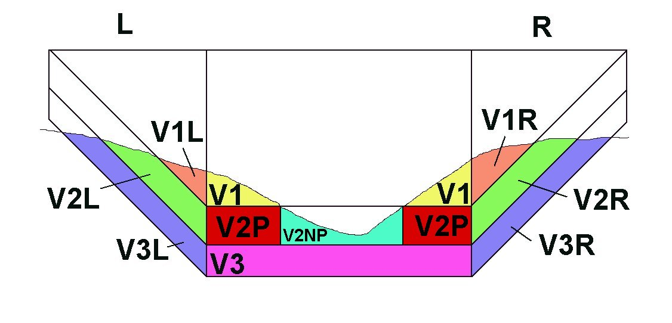
AEA3 Method: Reported Materials
AEA 3 compares a Pre-Dredge and a Post-Dredge survey
Surveys must have been conducted using the same planned line file.

Slide 30
Infill in Reports
AEA3 Method Report
Accum V1L V2L V3L V1 V2P V2NP V3 X2L X2R V1R V2R V3R
____________________________________________________________________________________________________________________
Y1 0.0 0.0 0.0 369.0 0.0 0.0 0.0 0.0 0.0 46.3 18.5 0.0
____________________________________________________________________________________________________________________
Pre 37.0 46.3 0.0 3703.7 1851.9 0.0 0.0 0.0 0.0 37.0 46.3 0.0
Post 9.3 27.8 0.0 2590.7 1851.9 0.0 0.0 0.0 0.0 83.3 64.8 0.0
_____________________________________________________________________________________________________________________
Delta 27.8 18.5 0.0 1113.0 0.0 0.0 0.0 0.0 0.0 -46.3 -18.5 0.0
TotPay 27.8 18.5 0.0 1481.9 0.0 0.0 0.0 0.0 0.0 0.0 0.0 0.0
AEA3 report (above) has:
A ‘Y1’ row that reports the Infill for each category.
A ‘Pre’ row that reports the material available from the PreDredge.
A ‘Post’ row that reports the material available from the PostDredge.
A ‘Delta’ row that is the Post minus Pre material.
A ‘TotPay’ that adds the infill material to the ‘Delta’ results.
If the infill is due to natural sedimentation, then use the TotPay row.
If the Infill is due to the dredging process, then use the Delta row.

Slide 31
Infill in Reports
Jacksonville Post-Dredge Method Report
Station To Station Depth Depth Slope Slope
792+00 799+56 26.0 27.0 0/0 0/0
Dredging Quantities Summary
===========================
Total Removed To Design Depth ........ 5194.6 CY
Total Removed In Overdepth ........... 2220.4
Total Allowable Box Cut .............. 1.0
Total Pay Volume Including Box Cut ... 7416.0
Total Remaining Above Design Depth.... 1979.1
Total Remaining In Overdepth ......... 1926.3
The Jacksonville Post Dredge report automatically applies the infill values. The report summarizes the ‘Net Material’ (Gross minus Infill).
We’ll prove that in a little bit……

Slide 32
Gaps and Incomplete Coverage

Slide 33
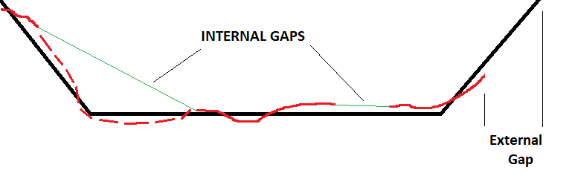
Gaps in Survey Data
INTERNAL GAPS: CSV will ‘interpolate’ depth values across internal gaps. It’s best that you check your data to see where they occur and how they will affect you.
Take extra caution with gaps that span the toe lines.
EXTERNAL GAPS: CSV does not ‘extrapolate’ trends to create data. The area computation stops where your data stops.
Danger!

Slide 34
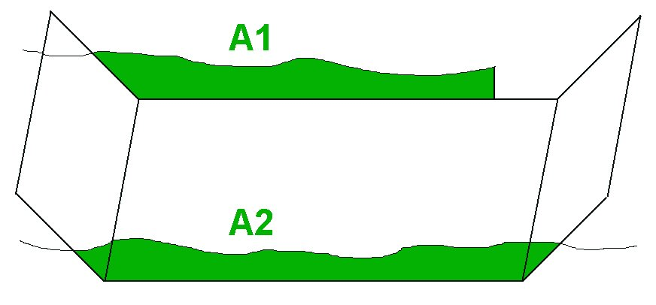
Incomplete Survey Data: Exterior Gaps
CS&V does not create data or extrapolate trends on external gaps.
In the figure above: V = L * (A1 + A2) / 2.
The resulting volume would be less than the actual amount.

Slide 35
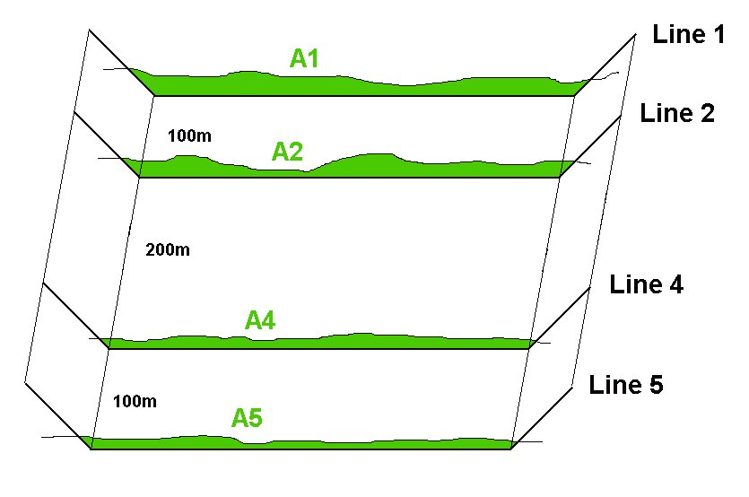
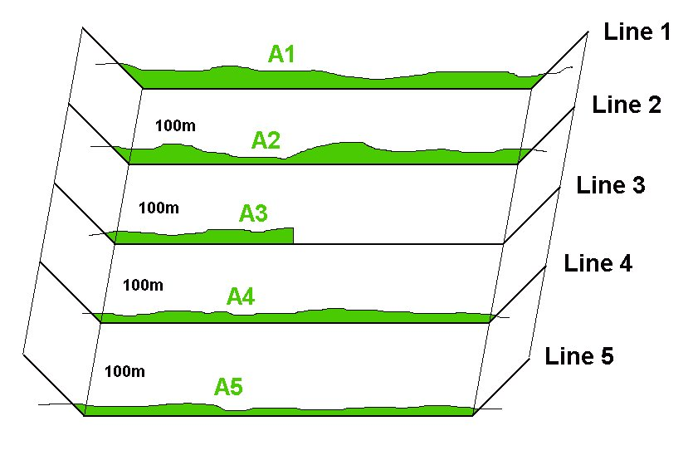
Incomplete Survey Data: Exterior Gaps
Line 3 has incomplete survey data.
CS&V doesn’t care.
  V₂₃ = 100*(A₂+A₃)/2
  V₃₄ = 100*(A₃+A₄)/2
  Since A3 is less than it should be, the volume quantity will also be less.
It might be more accurate to leave Line 3 out of the computation.
  V₂₄ = 200 * (A₂+A₄) / 2
  Better overall result if the sectional profiles are similar.

Slide 36
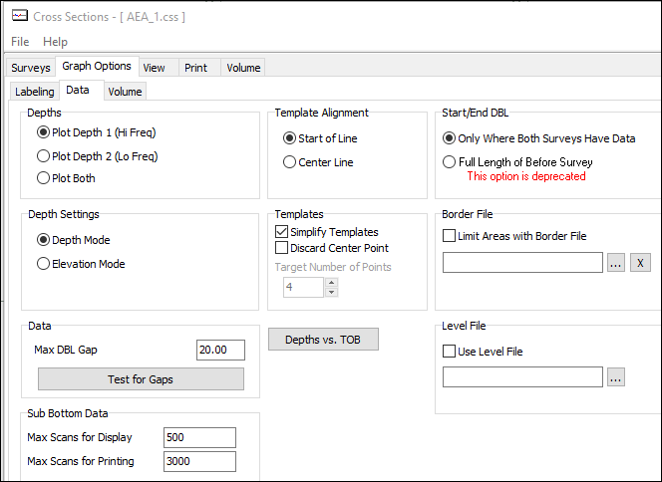

Checking for Gaps in Data
Probably your best course of action is to check your files for any external data gaps and then decide on how to proceed.
Graph Options – Data tab

Slide 37
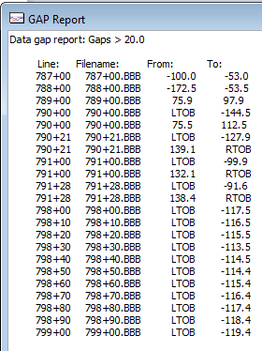
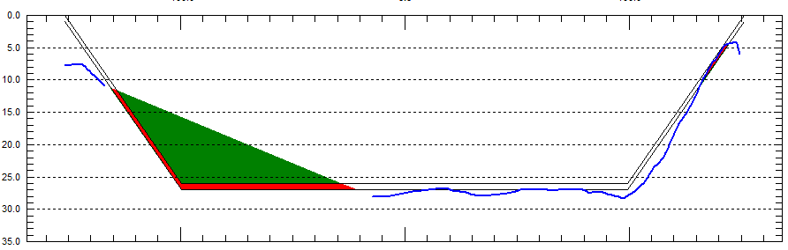
Example: Checking for Gaps
788+00: Take a look at this gap!
CSV will interpolate across the gap! Sometimes this is not a good thing!

Slide 38
External Gap Handling in PostDredge
What happens when your PreDredge and PostDredge profiles don’t cover the entire area?

Slide 39
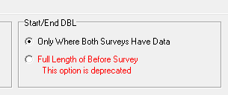
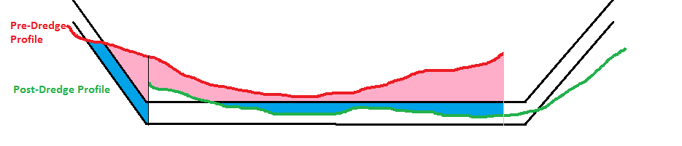
‘Full Length of Before Survey’
This is NOT a good option.
Areas where I have full coverage in both Before and After: Volume computation is OK.
Areas where I have coverage in just the Before survey: I get full credit for removing the material.
Areas where I only have coverage in the After survey: Ignored.

Slide 40
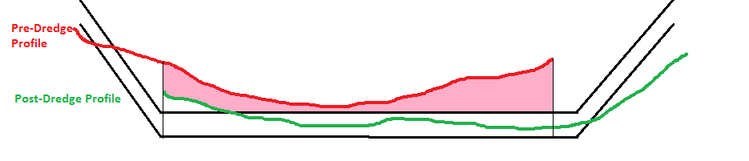
‘Only Where Both Surveys Have Data’
This is the ‘default’ setting and definitely better than the other. However, it is not perfect.
Areas where I have coverage in both surveys : Computed
Areas where I only have coverage in the Before Survey : Ignored
Areas where I only have coverage in the After Survey : Ignored

Slide 41
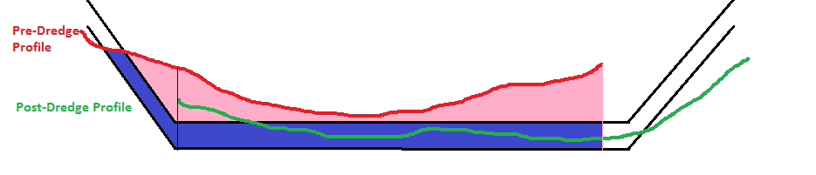
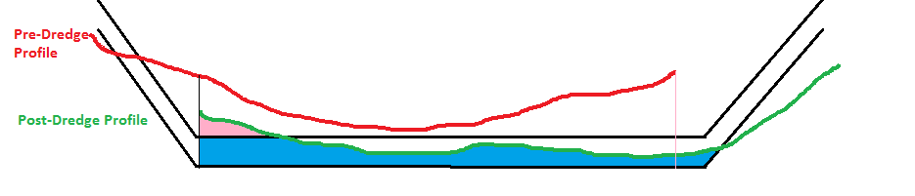
How about we calculate the material separately for each profile and then take the difference?
Take this….
Pre-Dredge Results
Subtract this…
Post-Dredge Results

Slide 42
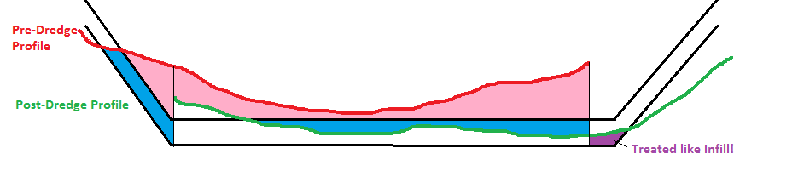
Pre-Dredge vs Post-Dredge
How about we calculate the material separately for each profile and then take the difference?
Not a good idea.
Areas where I have coverage in both surveys: Computed
Areas where I only have coverage in the Before Survey: Treated as removed
Areas where I only have coverage in the After Survey: Treated as infill

Slide 43
CROSS SECTION DESIGN TEMPLATES

Slide 44
Templates
4
1
9
1
2
3
7
8
4
5
6
2
3
Simple Template (4 or 5 points)
Complex Template
CHANNEL DESIGN and ADVANCED CHANNEL DESIGN can create Planned Lines that have both Simple and Complex Templates
Some methods in CS&V can only handle a Simple Template.

Slide 45
Non-Standard Templates
Non-Standard Template
Non-Standard Template
1
1
7
2
3
4
5
6
2
3
CSV will search for the deepest flat segments and declare it the center channel.
  Segment 2-3 in the top left.
  Segments 4-5-6 in the top right.
If the volume method requires a centerline point, the routine will use an existing one, or create one if it does not find one.
All material to the left of the left toe point is included in the left slope.
All material to the right of the right toe point is included in the right slope.
The following methods have been modified to handle non-standard templates:
  AEA1, AEA2, AEA3
  Savannah
  Philadelphia PreDredge, PostDredge
  GLDD1
  AEA No Segments
  Norfolk

Slide 46
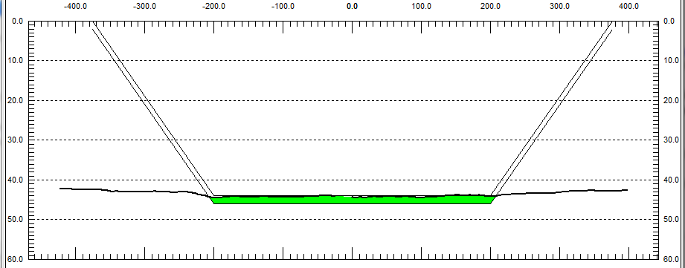
Design Templates
Templates can also be made in CS&V, using the template editor in the Survey tab.
Template files are stored with a TPL extension.
If multiple lines use the same template, use the Fill Column tool.
1
5
2
3
4

Slide 47
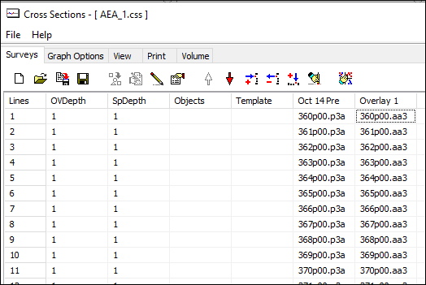
Example: Templates
If there is no entry in the ‘Template’ column, CSV will use the template info that it finds in the header of the data files.

Slide 48
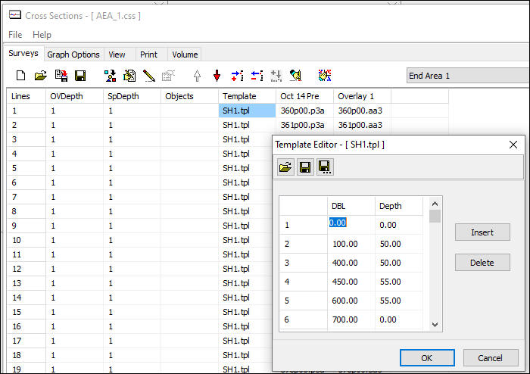
Manual Templates Example
Click in the Template Editor grid.
Click the Template Editor Icon.
Enter the Distance-Depth pairs.
Save the file.
Fill the Template column.

Slide 49
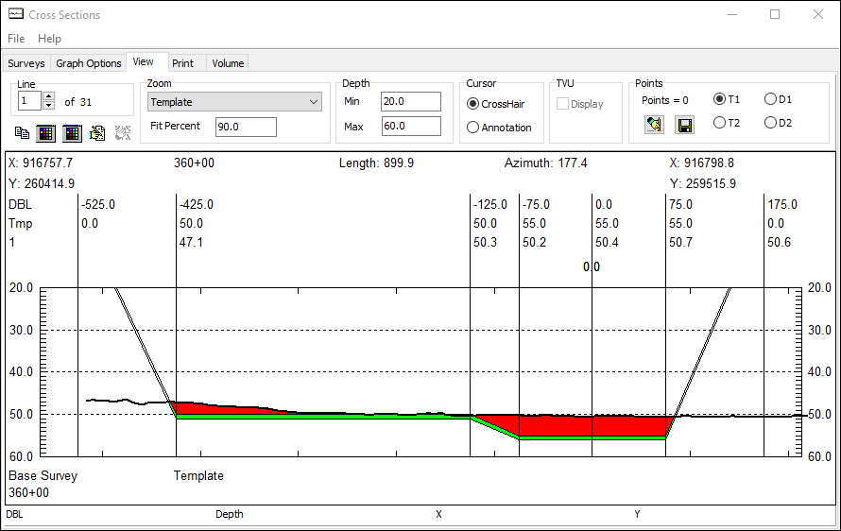
The Result…..

Slide 50
Handling Complex Templates
Simple Template with Centerline Point: This is what the methods used to require. They work with this template without any alterations.
Simple Template with no Centerline Point: The methods are going to create a Centerline Point midway between the toe points.
The AEA, Philadelphia, Savannah and Norfolk methods can now handle complex templates.

Slide 51
More Complex Templates
No Side Slope: CSV searches for the deepest ‘flat’ region and decides that is the center channel. It sub-divides the center channel into left-right. In this case the left-side slope materials would all be 0.0 and the right side slope materials would be normal.
Center Channel
No Side Slopes: CSV searches for the deepest ‘flat’ region and decides that is the center channel. It sub-divides the center channel into left-right. In this case the left-side slope and right side slope materials would all be 0.0.
Center Channel
Left Side Slope
Complex Templates: CSV searches for the deepest ‘flat’ region and decides that is the center channel. It sub-divides the center channel into left-right. Everything to the left of the Left Toe is reported as Left Slope material. Everything to the right of the Right Toe is reported as Right Slope Material.
Center Channel

Slide 52
Template Points Required
Methods that need to have the same number of template points in each profile.
Method | Template Points | Method | Template Points
AEA1 | Complex | GLDD1 | 4
AEA2 | Complex | GLDD3 | 4
AEA3 | Complex | Kingfisher | Up to 20
Standard HYPACK | Up to 20 | AEA No Segments | Up to 20
Savannah | Complex | Beach Pre | Up to 20
Philadelphia Pre | Complex | Beach Post | Up to 20
Philadelphia Post | Complex | Zone Listing Pre | Not Applicable
Jacksonville Pre | Up to 20 | Zone Listing Post | Not Applicable
Jacksonville Post | Up to 20 | End Area No Templates. | Not Applicable
Norfolk | Complex

Slide 53


Different Number of Template Points
Example 1
Distance Depth
-300.0 0.0
-200.0 50.0
0.0 50.0
200.0 50.0
300.0 0.0
Example 2
Distance Depth
-300.0 0.0
-200.0 50.0
200.0 50.0
300.0 0.0
It doesn’t work!

Slide 54

Try “AEA No Segments”
AEA No Segments is designed to work with different numbers of segments. You have to create them from the Start of Line, as some segments may not have centerline points.

Slide 55

AEA No Segments Report
There is no sub-division between segments.
The report contains the total amount of material above the template and in the allowable overdepth template.
V1 = Above Design
V2 = Allowable Overdepth.
Accum Vol = The total sum of material from the first section to the current section.

Slide 56

Using a new LNW File as the Template Source
You can use an LNW file created in CHANNEL DESIGN as a Template source
CSV will match the template by the names of the planned line used to collect the data
  This means the centerline waypoints in your channels must be the same
CSV will align each template so that the centerline point or the Start Line waypoint are matched between the two profiles
Be Careful with this one!

Slide 57


Volumes with NO Template!
AEA No Templates
Computes the amount of material in SURVEY 1 that is above SURVEY 2. (Cut)
Computes the amount of material in SURVEY 1 that is beneath SURVEY 2 (Fill).
Takes the difference to get the net material.
No template is involved.

Slide 58
Templates Summary
1. | Make your lines in CHANNEL DESIGN or ADVANCED CHANNEL DESIGN (ACD) and use the existing template info. | Plus: Easy, no hassle. Minus: Have to be able to design channel in CD and ACD.
2. | Make user-defined templates in CSV | Plus: It will get you a result. Minuses: Not easy, limits available methods, restrictions on number of template points.
3. | Make a new LNW file in CHANNEL DESIGN and use its templates in CSV | Plus: Quick way for a deeper channel or new side slopes. Minuses: Centerline and chainage must be identical to original channel.
4. | Generate sections in TIN MODEL using the same LNW file. | Plus: Allows you to compute volumes on data that was collected with different planned lines. Allows you to compute volumes (by sections) with multibeam data. Minuses: You are computing volumes with mathematically generated depths. You didn’t really collect those depths.
5. | Compute volumes without templates. | Plus: Good if you just want to know how much was removed or added. Minus: No side slopes, no sub-division of quantities.

Slide 59
Side Slope Credits

Slide 60

Side Slope Credits
AEA3
    X1 Material can be credited to fall into the X2 void.
    X1 and X2 are listed in the report.
Jacksonville PostDredge
  A can fall into B
  A can fall into C
  A can fall into B + C
  A, B, C values and ‘credit’ are listed at the bottom of the report.

Slide 61

AEA3 View
X1
X2

Slide 62


AEA3 Report
X2Left shows a void beneath the Allowable Overdepth template of 8 ft²
X1Left shows 9 ft² of Allowable Overdepth material available in the left side slope
Summary shows 33.4cy of available material and a void of 29.6cy (void is reported as negative). You could apply a credit of 29.6cy to the Allowable Overdepth material.

Slide 63


Jacksonville Post-Dredge
Credits: Graph Options – Volume Tab
Sets the distance inward (and outward) from each toe that “C” material will be computed and the distance outward from each toe that “B” material will be computed.

Slide 64




JAX POST Credit Calculation
‘A’ material can ‘fall’ into the voids of ‘B’, ‘C’, or ‘B+C’

Slide 65


Jacksonville Post Dredge
Box Cut Distance = 20
20
20
Material and voids located within 20’ or 20m of the toe line would be included in the computation.

Slide 66


Jacksonville Post Dredge
Box Cut Distance = 5
5
5
Material and voids located within 5’ or 5m of the toe line would be included in the computation.

Slide 67


JAX POST Credit Options
Only the first Void (outward) is included. The upper voids are ignored, even though the Box Cut Distance = 20.
Ignored
Included

Slide 68


JAX POST Credit Options
Included
All voids outwards are included, up to the distance of the Box Cut distance.
Included

Slide 69
Jacksonville Post-Dredge Credits
Test Example Results
Credit = MIN(A, B)
Left Slope Right Slope Total
Station A B C Credit A B C Credit Credit
792+20 22.9 0.0 0.0 0.0 139.3 0.0 0.0 0.0 0.0
793+00 74.0 0.0 0.0 0.0 302.0 0.0 0.0 0.0 0.0
794+00 49.0 0.0 0.0 0.0 41.0 0.0 0.0 0.0 0.0
795+00 31.6 0.0 0.0 0.0 30.8 0.0 0.0 0.0 0.0
796+00 18.7 0.0 0.0 0.0 40.6 0.0 0.0 0.0 0.0
797+00 9.2 0.0 0.0 0.0 27.8 0.0 0.0 0.0 0.0
798+00 1.9 0.0 0.0 0.0 50.1 0.0 0.0 0.0 0.0
798+10 0.2 0.0 0.0 0.0 6.5 0.0 0.0 0.0 0.0
798+20 0.0 0.0 0.0 0.0 6.2 0.0 0.0 0.0 0.0
798+30 0.1 0.0 0.0 0.0 8.0 0.0 0.0 0.0 0.0
798+40 1.1 0.0 0.0 0.0 8.2 0.0 0.0 0.0 0.0
798+50 2.4 0.0 0.0 0.0 4.2 0.0 0.0 0.0 0.0
798+60 7.0 0.0 0.0 0.0 1.1 0.0 0.0 0.0 0.0
798+70 11.6 0.0 0.0 0.0 0.5 0.0 0.0 0.0 0.0
798+80 10.2 0.0 0.0 0.0 0.1 0.0 0.0 0.0 0.0
798+90 4.3 0.0 0.0 0.0 0.1 0.0 0.0 0.0 0.0
799+00 2.0 0.0 0.0 0.0 0.4 0.0 0.0 0.0 0.0
799+17 17.6 0.8 0.0 0.8 0.7 0.0 0.0 0.0 0.8
799+24 8.4 0.2 0.0 0.2 0.1 0.0 0.0 0.0 0.2
799+28 10.1 0.0 0.0 0.0 0.0 1.4 0.0 0.0 0.0
799+41 18.0 0.0 0.0 0.0 0.0 3.6 0.0 0.0 0.0
799+56 18.3 0.0 0.0 0.0 0.0 0.0 0.0 0.0 0.0
-------- -------- -------- -------- -------- -------- -------- -------- --------
Total 1.0 0.0 1.0
Congratulations! You went through all of this for 1cy credit!

Slide 70

Jacksonville Post-Dredge Credits
This is one of only two sections where the After Dredge profile passes beneath the Allowable Overdepth template (left toe).

Slide 71
Limiting Volumes With a Border File

Slide 72

Limiting Volume Computations with a Border File
CSV can read a border file (*.BRD) and only compute area (and thus volume) inside the border.

Slide 73
Limiting Volume Computations with a Border File
Careful here!
In CSV, the border areas between 360-361 and 374-375 will not be calculated.

Slide 74


Using a BRD File Example
If ‘Limit Areas with Border File’ is checked ‘On’, then volumes are restricted to the area inside the BRD file.
If Unchecked, the BRD limits are displayed, but volumes are not restricted.

Slide 75



Using a BRD File
Without the border file
With the border file

Slide 76
Beach Volumes

Slide 77

Beach Volumes
Beach PreDredge: Computes available material from a single survey
Beach PostDredge: Computes:
    Material added up to the design template
    Material added above the design template
    Voids beneath design template where material can still be added

Slide 78

Beach Volumes
Step 1: Elevation Mode
Everybody doing beach work seems to be in Elevation Mode.
Go into your Graph Options – Data tab and set it to ‘Elevation Mode’.

Slide 79


Beach Volumes
Step 2: Set your Maximum and Minimum Template Spacing
Maximum Design Template:
  Creates a template above your design template.
Minimum Design Template:
  Creates a template beneath your design template.
Don’t want them?
Then set them to ‘0.0’

Slide 80


Beach Volumes Example
Each line has its own template.
Rather than enter in a TPL file for each line (11 times in this case), we can use a LOG file.
Use NOTEPAD to create a LOG file named
“III Templates.LOG”
Try loading it into the Template column!

Slide 81

Beach PreDredge Result
You are going to have to set the Min/Max display values to reflect your elevation mode.
The graph view is colored about the Design template.
The survey profile is the black line at the bottom. The blue area is the material you need to add to bring the beach up to the Design template.

Slide 82
Beach PreDredge Volume Report
Beach Volume Report: Pre Dredge Report
Elk Haven Municipal Beach Project
HYPACK Dredging Company
June 15, 2010
Not for Navigation
Volumes: Cubic Yards
Compensating Slopes: Not Used
Design Template
Total Material Required: 141190.2
Station File Distance Area Avg. Volume Accum. Design
Between Units^2 Area Units^3 Volume Volume
Lines Units^2 Units^3 Per Dist.
10+00 10p00.III 582.6
11+00 11p00.III 100.0 434.8 508.7 12258.6 12258.6 20.0
12+00 12p00.III 100.0 408.1 421.4 12169.6 24428.3 19.8
13+00 13p00.III 100.0 655.0 531.5 12750.3 37178.6 20.6
14+00 14p00.III 100.0 703.8 679.4 13921.6 51100.2 22.4
15+00 15p00.III 100.0 709.5 706.7 15920.5 67020.8 25.6
The volume report shows the area, volume and accumulated volume for each line. It repeats for the Design Template, the Maximum Template and the Minimum Template.
The Design Volume Per Distance divides the Volume for the line by the distance of data coverage of the line.

Slide 83

Beach Post Dredge
Example: Pre vs. Post
Change the method to the ‘Beach Post Dredge’.
Add the JJJ.LOG file to the column to the right of the PreDredge files.

Slide 84

Beach Post Dredge
Profile View

Slide 85

Beach Post Dredge Report
Area, Volume and Accumulated Volume for each section.
% Filled = Volume Added / (Volume Added + Remaining Void)
Overfilled = Material added in excess of each template.

Slide 86


Beach Volumes
Compensating Slopes
Material located uphill (on a sloping segment) can be credited to fall into a downhill void on that segment.
List the segments you want to apply the Compensating Slopes in the first column. Separate segments by commas.

Slide 87
Zone Edge Lists

Slide 88

Why ZONE EDGE LISTS?
The ORANGE region is our old center channel (25’). We’re going to be paying $6/cy for maintenance dredging.
The RED area is where the 25’ channel has been widened for the US Navy. We’re going to charge them $8/cy for this material.
$6
$10
Before ZONE EDGE LISTS method was created, we didn’t have any means of allocating volumes for this project!
The BLUE areas are a 1:4 side slope. It goes from 25’ to 0’ on the left and 20’ to 0’ on the right. It doesn’t extend the entire channel on the right. We’re paying $8/cy for the material on the left and $10/cy for the material on the right.
$8
$15
The GREEN area runs up a 1:2 slope only on the right-hand side from 25’ to 20’. It’s harder material, so we’re paying $15/cy.
$8

Slide 89
The Process
LINE EDITOR or CHANNEL DESIGN or IMPORT FROM DXF
Create your planned line file (*.LNW). Don’t worry about templates created in CHANNEL DESIGN. We will be ignoring them!
ADVANCED CHANNEL DESIGN
Create your 3-D Advanced Channel Design File (*.CHN)
Define and mark your zones.
Import your LNW file.
Export your Zone Edge List file
CROSS SECTIONS AND VOLUMES
Select the Zone Edge List PreDredge or PostDredge method.
Enter the Zone Edge List file as your template file (every row).
That’s it!

Slide 90

ADVANCED CHANNEL DESIGN (ACD)
Our Nodes
Check out the ‘Nodes’ tab in ACD.
  It just has nodes for the center channel points, all at 25’.
  We’re going to teach you an easy way to create the side slopes.

Slide 91

ACD Making Faces Manually
Enter the nodes for each ‘face’.
a k i c
c i e
k l j i
l b d j
i j f e
j d f
g e f h
Rules for making faces:
Connect the nodes counter-clockwise (running the bases)
No concave faces.
No non-planar faces.

Slide 92

ACD: Face Tools
Remove Unused Nodes
Fix Face Orientation
Check Faces
Make Horizontal Plane to Right of Node List
Make Horizontal Plane to Left of Node List
Make Vertical Wall
Make a right side slope from the Node List
Make a left side slope from the Node List

Slide 93


ADVANCED CHANNEL DESIGN (ACD)
Create a side slope area the easy way!
Use the Right-Side Slope tool to create a 2:1 side slope.
Use the nodes:
  b d f h
Terminate the side slope at a depth of 20’

Slide 94


ADVANCED CHANNEL DESIGN (ACD)
Add to your existing side slope.
Use the Right-Side Slope tool.
Create a 4:1 side slope that rises up to the 0.0 level.
Use nodes _2 _3 _4

Slide 95


ADVANCED CHANNEL DESIGN (ACD)
Make your final side slope.
Use the Left Side Slope tool.
Make a 4:1 side slope that rises to Depth = 0.0
Use nodes a c e g

Slide 96

Our Channel in 3D

Slide 97

ADVANCED CHANNEL DESIGN (ACD)
Create your Reporting Zones and Assign the Polygons
Using the ‘arrow’ tool, click on each zone name and assign polygons to that zone.
From the ‘Zones’ Tab.
Add six zones:
  Federal Channel
  Left Slope
  Right Slope
  Navy East
  Navy West
  Ridge Cut

Slide 98

ADVANCED CHANNEL DESIGN (ACD)
Insert your Planned Lines and Export your *.ZEL File
If you plan to do volumes in CROSS SECTIONS AND VOLUMES:
Click the ‘Profiles’ tab and import your LNW file.
Click on the ‘Zones’ tab and ‘Export ZEL’ (Zone Edge List). Save as OOO.ZEL
The Zone Edge List file will take the place of your templates in CROSS SECTIONS AND VOLUMES.

Slide 99


Some CHN/ZEL “Do’s and ‘Don’t”
Don’t have a Planned Line share the same ‘edge’ as your *.CHN file. It may not find all of the necessary intersections.
Fix: Extend your channel design so that the entire planned line intersects with ALL of the reporting zone areas. CSV will only compute volumes up to the planned line limits.

Slide 100

Some CHN/ZEL “Do’s and ‘Don’t”
Don’t have a planned line start inside a reporting zone.
Don’t have a planned line start exactly on a polygon border. The intersection may not be found!

Slide 101

Zone Edge List Method in CSV
Load *.zel files under the Template section

Slide 102

Zone Edge List Method in CSV - View

Slide 103

Zone Edge List Report
Summary: By each Zone
Design
Overdepth (All)
Overdepth (Contour)

Slide 104
OVERDREDGED MATERIAL

Slide 105

OVERDREDGED MATERIAL
Material removed beneath the Allowable Overdepth template
Pre-Dredge Profile
The Philadelphia PostDredge method is the only method that computes OVERDREDGED Material.
Post-Dredge Profile
Overdredged Material

Slide 106


OVERDREDGE EXAMPLE
This setting is going to be important! “Limit DBL to Pre-Dredge Above Sub Depth Side Slope”

Slide 107

OVERDREDGE EXAMPLE
Philadelphia Post Dredge
This seems pretty straight-forward.
Two lines, 100’ spacing, with a block of material removed beneath the Allowable Overdepth template that is 20’ wide by 1’ deep.
Overdredged Material= (100’ x 20’ x 1’)/27 = 74.1cy
….Nope…..

Slide 108



LIMIT DBL - Unchecked
With the ‘DBL Limit….’ unchecked, CSV includes any and all Overdredged material out to the limits of the survey.

Slide 109



LIMIT DBL - Checked
Left DBL Limit
Right DBL Limit
With the ‘DBL Limit….’ checked, CSV includes any and all Overdredged material out to where the PreDredge profile crosses the Allowable Overdepth template.

Slide 110

OVERDREDGED MATERIAL
DREDGESTATS Program

Slide 111

OVERDREDGED MATERIAL
DREDGESTATS Program
DREDGESTATS
  Classifies depths into three categories:
    Above Require Grade
    In Paid Overdepth
    Beneath Paid Overdepth
  It only looks at depths in the center channel area, ignoring side slope areas.

Slide 112
Volume Computation Methods

Slide 113
AEA3 Post Dredge Example
Math Results:
Net Material Above Design: 1,092.6 cy
Net Material Allow. Overdepth: 0.0 cy
Volume Summary:
DV1L: 27.8 DV2L: 18.5
DV1: 1113.0 DV2P: 0.0
DV1R: -46.3 DV2NP: 0.0
DV2R: -18.5
____________________________________
Total: 1094.4 0.0
CSV AEA3 Result:
Net Material Above Design: 1,094.4 cy
Net Material Allow. Overdepth: 0.0 cy
The small difference is due to my inability to make a vertical wall at the 9’ to 7’ transition in the Post Dredge profile. To see the actual ‘Infill’, ‘Gross’ and ‘Net’ values, we need to go to the bottom of the report…….

Slide 114
Post Dredge Example
AEA3: The Bottom of the Report
Accum V1L V2L V3L V1 V2P V2NP V3 X2L X2R V1R V2R V3R
___________________________________________________________________________________
Y1 0.0 0.0 0.0 369.0 0.0 0.0 0.0 0.0 0.0 46.3 18.5 0.0
__________________________________________________________________________
Pre 37.0 46.3 0.0 3703.7 1851.9 0.0 0.0 0.0 0.0 37.0 46.3 0.0
Post 9.3 27.8 0.0 2590.7 1851.9 0.0 0.0 0.0 0.0 83.3 64.8 0.0
__________________________________________________________________________
Delta 27.8 18.5 0.0 1113.0 0.0 0.0 0.0 0.0 0.0 -46.3 -18.5 0.0
TotPay 27.8 18.5 0.0 1481.9 0.0 0.0 0.0 0.0 0.0 0.0 0.0 0.0
The last ‘group’ shows the Accumulated Volumes for each category.
  ‘Delta’ represents the material, net of infill (Gross – Infill)
  ‘TotPay’ represents the Gross Material.
To compare it against the Philadelphia PostDredge summary:
  Total Removed to Project Depth = V1L + V1 + V1R
  Delta = 27.8 + 1113.0 + (-46.3) = 1094.5
  TotPay = 27.8 + 1481.9 + 0 = 1509.7
  Total Pay Removed in Overdepth = V2L + V2 + V2R = 0 = 0
  Total Pay Removed = V1L + V1 + V1R + V2L + V2 + V2R

Slide 115
Post Dredge Example Philadelphia PostDredge
Math Results:
Net Material Above Design: 1,092.6 cy
Net Material Allow. Overdepth: 0.0 cy
Materials Gross Material Infill Net Material
Total Removed To Project Depth ...... 1509.7 415.3 1094.4
Total Pay Removed In Overdepth ...... 18.5 18.5 0.0
Total Pay Removed ................... 1528.2 433.8 1094.4
Total Removed ....................... 1667.1 554.2 1113.0
Total Remaining Above Project Depth . 2683.3 2683.3
Total Overdredged Material .......... 138.9 120.4 18.5
Total Infill Material ............... 554.2
The Philadelphia Report summary breaks down the materials into ‘easy-to-understand’ groupings.

Slide 116
Post Dredge Example Jacksonville PostDredge
Math Results:
Net Material Above Design: 1,092.6 cy
Net Material Allow. Overdepth: 0.0 cy
Dredging Quantities Summary
===========================
Total Removed To Design Depth ........ 1094.4 CY
Total Removed In Overdepth ........... -0.0
Total Allowable Box Cut .............. 0.0
Total Pay Volume Including Box Cut ... 1094.4
Total Remaining Above Design Depth.... 2683.3
Total Remaining In Overdepth ......... 1944.4
The Jacksonville PostDredge report provides ‘Net’ values. There is no option on how to apply the Infill. Infill is always deducted from the Gross Volume in the report.

Slide 117

Philadelphia Settings
Set Sideslope Overdepth to 0.00: This setting affects the computation of ‘Allowable Overdepth Material’. If checked, it ignores any overdepth material on the side slope regions.
Limit DBL to PreDredge Above Sub Depth Side Slope: This is an important one that’s going to take another page to explain……

Slide 118


Limit DBL to Pre Dredge Above Sub Depth Side Slope:
Right side limit
This option stops the volume computation where the PreDredge survey passes through the Allowable Overdepth template. If you had not checked this box, the area shown in the bracket would be included in the INFILL and OVERDREDGE calculations.

Slide 119

How these options change your results
The Two options allows for four possible results!
  Set Side Slope Overdepth to 0.00
  Limit DBL to PreDredge…..
SideSlope On, Limit Off
------------ Overdepth = 1.0 ft --------
Left Left Right Right Volume
Slope Channel Channel Slope (CY)
---- ---- ---- ---- ----
0.0 0.0 0.0 0.0
Ovdrg 7.5 0.0 0.0 -6.5
Infill 0.0 0.0 19.9 9.0
SideSlope Off, Limit On
------------ Overdepth = 1.0 ft --------
Left Left Right Right Volume
Slope Channel Channel Slope (CY)
---- ---- ---- ---- ----
1.0 0.0 0.0 -0.5
Ovdrg 0.5 0.0 0.0 0.0
Infill 0.0 0.0 19.9 3.0
Both Off:
------------ Overdepth = 1.0 ft --------
Left Left Right Right Volume
Slope Channel Channel Slope (CY)
---- ---- ---- ---- ----
1.0 0.0 0.0 -1.0
Ovdrg 7.5 0.0 0.0 -6.5
Infill 0.0 0.0 19.9 10.0
Both On:
------------ Overdepth = 1.0 ft --------
Left Left Right Right Volume
Slope Channel Channel Slope (CY)
---- ---- ---- ---- ----
0.0 0.0 0.0 0.0
Ovdrg 0.5 0.0 0.0 0.0
Infill 0.0 0.0 19.9 2.5

Slide 120
Contour vs. Non-Contour
Philadelphia Methods
Contour: Includes overdepth material only where the bottom is shoaler than the channel design.
    Referred to as ‘Smart’ option in Standard HYPACK Method and ‘V2P’ in AEA Methods.
Non-Contour: Includes all overdepth material.
    Referred to as ‘All’ option in Standard HYPACK Method and would be ‘V2P + V2NP’ in AEA Methods.

Slide 121


CONTOUR vs. NON-CONTOUR
CONTOUR OVERDEPTH
Note the ‘green’ material that is included to the right after the bottom drops below the design template….
NON-CONTOUR OVERDEPTH

Slide 122
PHILADELPHIA METHOD
Toe Pay Option
Shoals Only: Includes overdepth material in extension area only if the depth at the toe line is shoaler than the design depth.
All: Includes all overdepth material in the extension area.
We don’t know anybody who uses this option. Philadelphia COE doesn’t even use it anymore. We recommend you set it to ‘All’. (default)

Slide 123


PHILADELPHIA METHOD
All:
Includes all overdepth material in the extension area.
Shoals Only: Includes overdepth material in extension area only if the depth at the toe line is shoaler than the design depth.
All
Shoals Only

Slide 124

OVERDEPTH – Gross Removed
Yellow= Overdepth Removed
This equals Gross Total Pay Removed in Overdepth
Blue= Infill
1
2
3
4
5
6
Dredging Quantities Summary
===========================
Materials Gross Material Infill Net Material
Total Removed To Project Depth ...... 2892.0 313.5 2578.5
Total Pay Removed In Overdepth ...... 8933.8 2648.7 6285.1
Total Pay Removed ................... 11825.8 2962.2 8863.6
Total Removed ....................... 26582.0 7497.4 19084.7
Total Remaining Above Project Depth . 548.7 548.7
Total Overdredged Material .......... 14756.2 4535.2 10221.0
Total Infill Material ............... 7497.4
The light green area is also inclusive of Total Pay Removed in Overdepth

Slide 125
How about a real project?
Both Off:
Materials Gross Material Infill Net Material
Total Removed To Project Depth ...... 5836.8 651.1 5185.7
Total Pay Removed In Overdepth ...... 2307.4 86.0 2221.4
Total Pay Removed ................... 8144.2 737.2 7407.1
Total Removed ....................... 9813.2 1764.6 8048.7
Total Remaining Above Project Depth . 1981.9 1981.9
Total Overdredged Material .......... 1669.0 1027.4 641.6
Total Infill Material ............... 1764.6
Both On:
Materials Gross Material Infill Net Material
Total Removed To Project Depth ...... 5836.8 588.9 5247.9
Total Pay Removed In Overdepth ...... 1657.7 16.5 1641.3
Total Pay Removed ................... 7494.5 605.3 6889.2
Total Removed ....................... 8920.6 606.4 8314.2
Total Remaining Above Project Depth . 1919.6 1919.6
Total Overdredged Material .......... 1426.1 1.1 1425.0
Total Infill Material ............... 606.4
SideSlope = On, DBL Limit = Off
Materials Gross Material Infill Net Material
Total Removed To Project Depth ...... 5836.8 651.1 5185.7
Total Pay Removed In Overdepth ...... 1657.7 16.5 1641.3
Total Pay Removed ................... 7494.5 667.6 6826.9
Total Removed ....................... 9163.5 1695.0 7468.5
Total Remaining Above Project Depth . 1981.9 1981.9
Total Overdredged Material .......... 1669.0 1027.4 641.6
Total Infill Material ............... 1695.0
SideSlope = Off, DBL Limit = On
Materials Gross Material Infill Net Material
Total Removed To Project Depth ...... 5836.8 588.9 5247.9
Total Pay Removed In Overdepth ...... 2307.4 26.4 2281.0
Total Pay Removed ................... 8144.2 615.3 7529.0
Total Removed ....................... 9570.3 616.3 8954.0
Total Remaining Above Project Depth . 1919.6 1919.6
Total Overdredged Material .......... 1426.1 1.1 1425.0
Total Infill Material ............... 616.3
Various Results for Total Pay Removed:
Non-contour Net Results
Both off: 7,404cy
Both on: 6,889
Slope On, DBL Off: 6,282
Slope Off, DBL On: 7,529
So, the odds of two people getting the same result are pretty small, unless they agree on all parameter settings.

Slide 126
Thank You !
Contact Us:
Sales@HYPACK.com
Help@HYPACK.com
(860) 635 - 1500
Links to more information:
HYPACK on Youtube.com ( Historical Sessions ) HYPACK Live Chat
HYPACK on Youtube.com ( Newer Sessions ) HYPACK Ustream
HYPACK SUPPORT Site HYPACK Website

